Slide 1
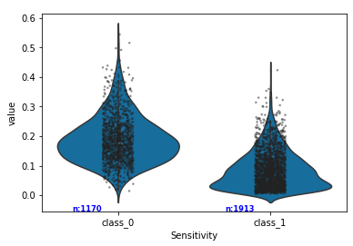
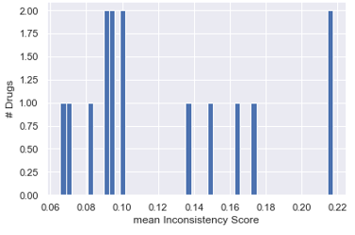
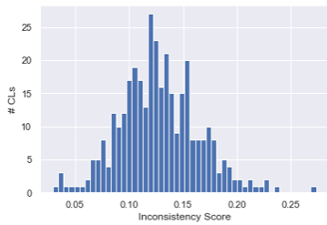
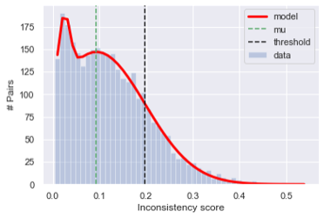
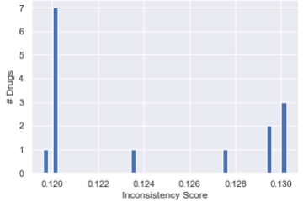
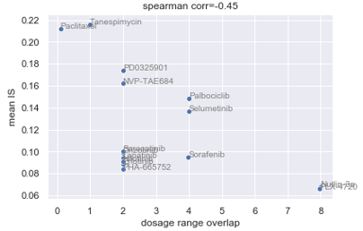
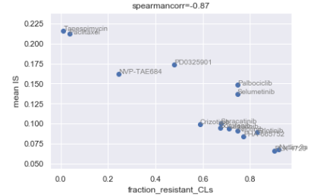
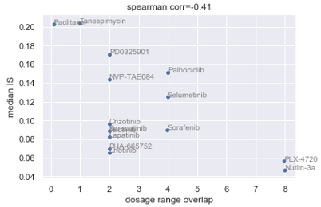
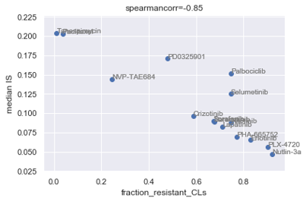
Arbitrary threshold on Approximated Area ?
1: resistant
0: sensitive
1st way: chose th=1 std from mean of 2nd mode
2nd way: Don’t use th based method to show the trend
1st mode corresponds o resistant pairs
Drug level analysis
Factors causing inconsistency in drugs?
Factor 2
Inconsistency score=Area approximated from HDI estimated from baysian sigmoid fitted curves (adjusted by the dosage range)
Factor 1

Slide 2
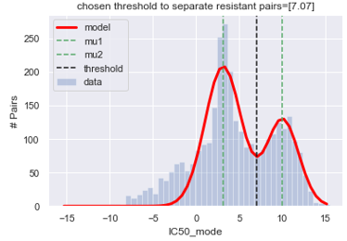
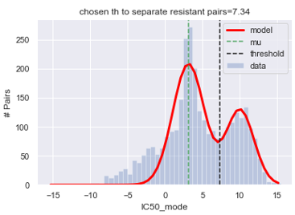
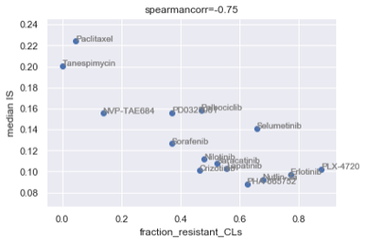
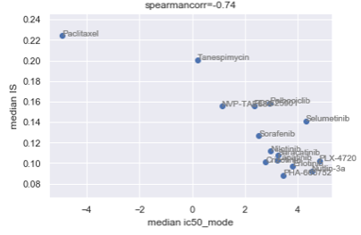
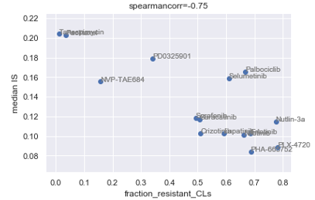
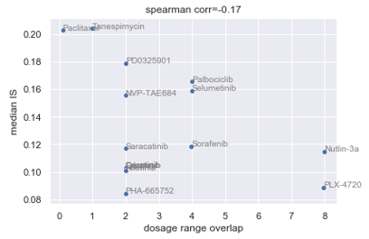
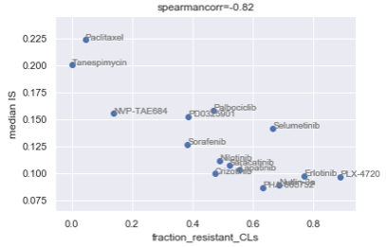
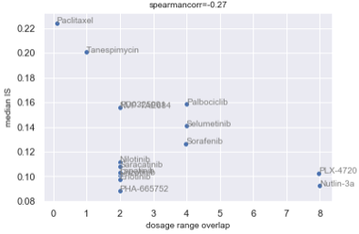
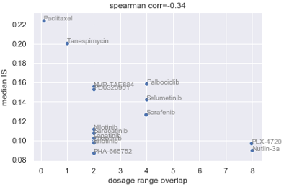
Perform analysis only of DW pairs so that low IS pairs (lot of near 0 AAA) do not make the results biased
* ic50 mode >max dosage => resistant (has some pairs which work on high dosage)
* Th ic50_mode (chosen ic50_mode as the median of xbw 2mus value at which y/#Pais is min between the 2means of the modes at 2 stddev from mean of 1sr mode which corresponds to resistant pairs )
* Th IS (if u do that resistant or low IS class has some highly consistent working pairs)
*Removed bias from too high area pairs by taking median instead of mean *Remove bias from CLs which haven’t been tested for all drugs (these CLs might make a drug appear bad or good since other have not even been tested for these)
*Removed bias from resistant CLs by taking only sensitive CLs
Ic50>max dosage

Slide 3
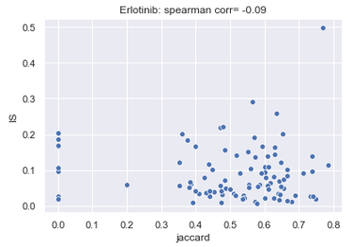
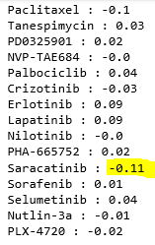
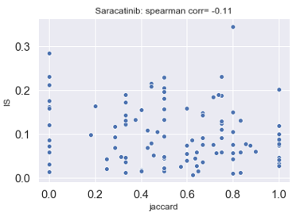
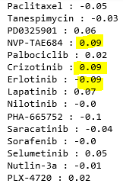
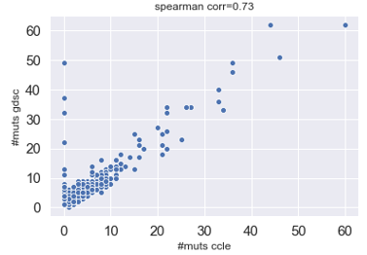
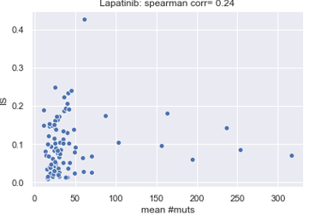
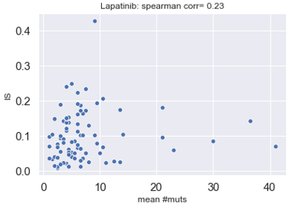
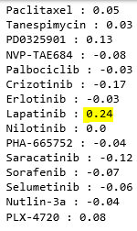
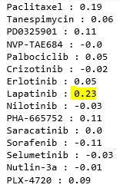
Cell line level analysis (Mutation)
Cancer genes: Drug wise spearman corr
Checked if
discordant mutation profiles cause inconsistency
High number of mutations cause inconsistency
Used
1601 common genes =>34 discordant CLs
299 cancer genes from [1] (154 common cancer genes out of 1638 CCLE and 19100 GDSC genes )=>40 discordant CLs
345 common CLs
All comm genes: Drug wise spearman corr
Improved corr=0.86
All comm genes: Drug wise spearman corr
Drug wise spearman corr (Conc CLs)
[1] Comprehensive Characterization of Cancer Driver Genes and Mutations

Slide 4
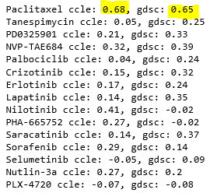

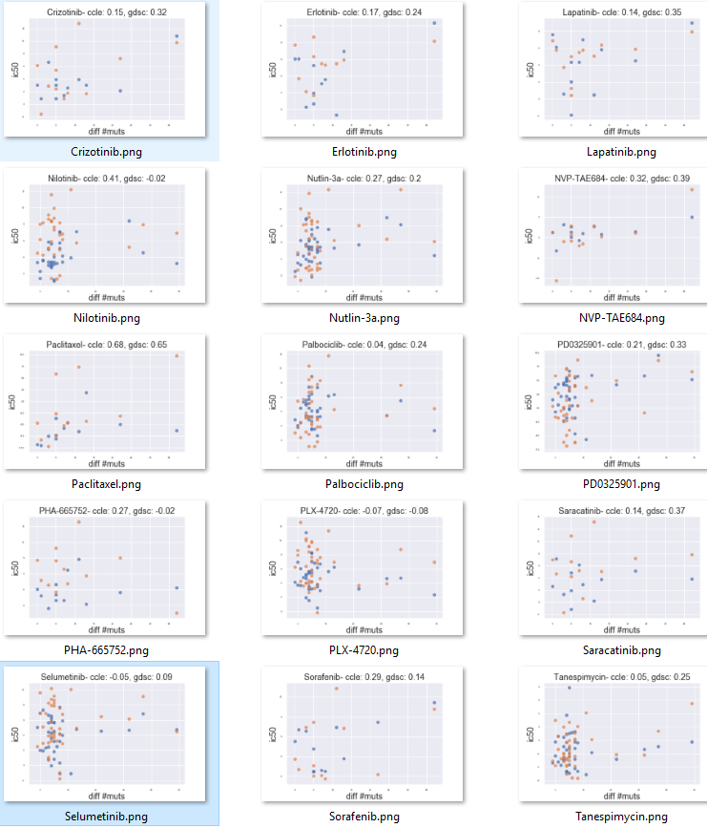
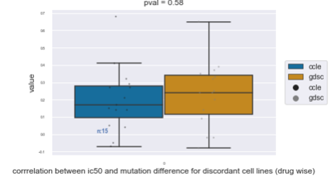
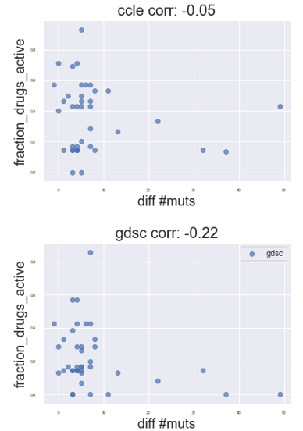
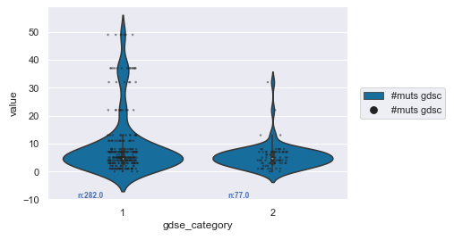
Observation
High #mutations GDSC=> High diff => CLs tend to be more
Ic50 of gdsc better correlates with diff in mutation for discordant CLs
1: resistant
0: sensitive
40 discordant CLs

Slide 7
Do we show distributution of consiostency scores for dr and CLs from previous (th based) analysis or not?=> u may use AAA score distr

