Slide 1
CaDRReS2
An attempt to improve drug-response prediction
-Aanchal Mongia
July 11, 2019

Slide 2
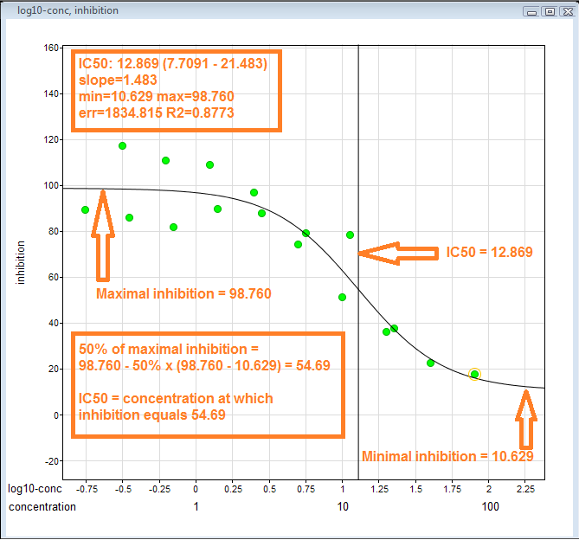
BACKGROUND
IC50: maximal concentration of drug which causes 50% inhibition of cancer cells
A drug response prediction model learns from the dose responses (IC50) available for the existing cell lines and predicts the drug response for a new cell line exploiting the GE patterns.

Slide 3
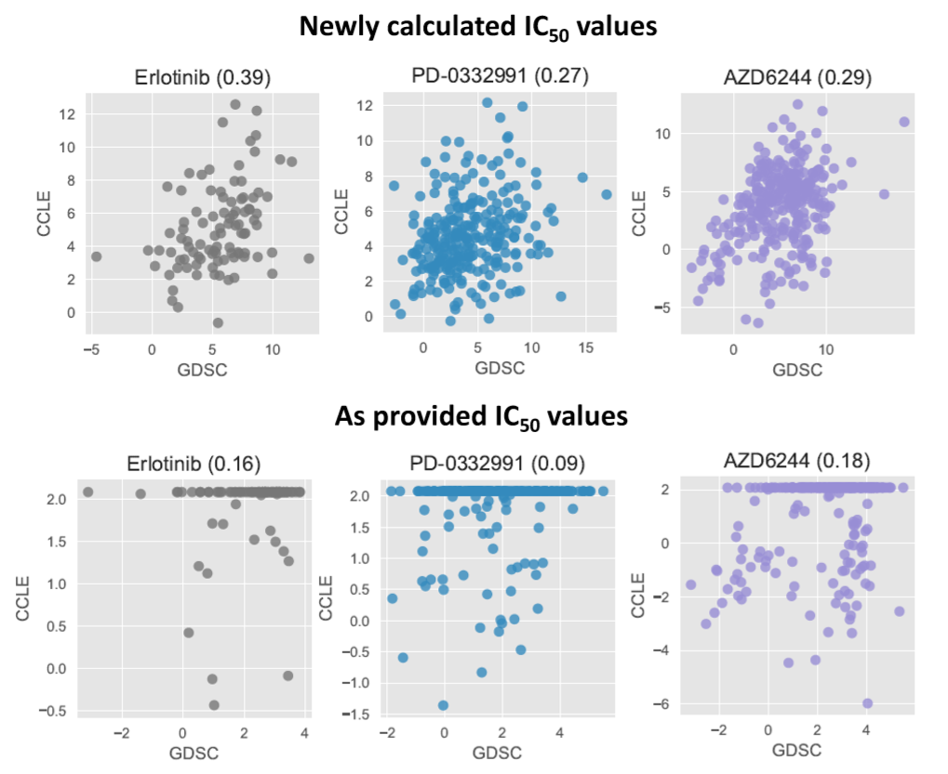
MOTIVATION
Inconsistent drug sensitivity information (IC50) across the datasets [Different labs (CCLE and GDSE) report different IC50 values for the same cell-line drug pair; median spearman correlation 0.35 ]
IC50 alone is not sufficient for a robust prediction (other measures which can be used: A_{max}, hill coefficient, AA)
For better biological interpretation and findings (drug discovery/repositioning)

Slide 4
TARGETS
Handling data inconsistency: To find a reasonable way to merge the dose response information from 2 different experiments (CCLE and GDSE)
Outlier detection and filtering (done)
Analysing the difference in response behaviour and correct them (in progress)
Merge the datasets for a more reliable database
Quantification of Drug response: Find an alternative metric to capture the drug response behaviour / quantify the Dose-response curve

Slide 5
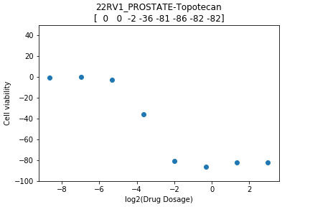
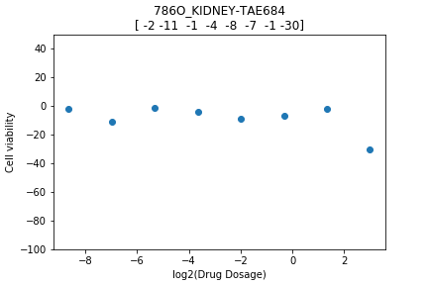
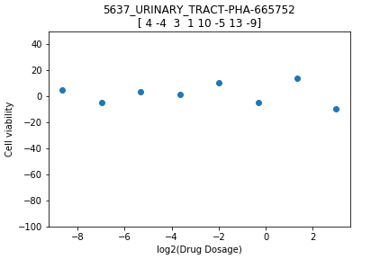
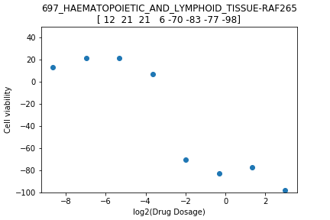
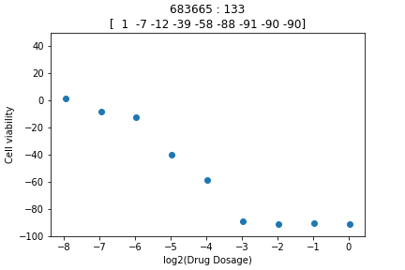
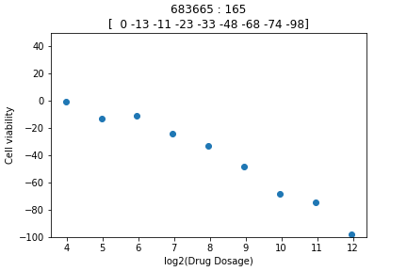
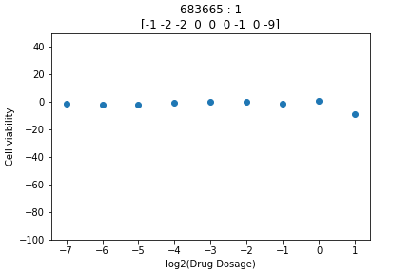
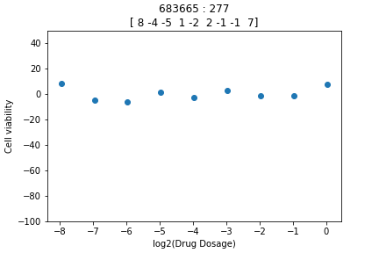
Drug working for a cell line
Drug not working for a cell line

Slide 6
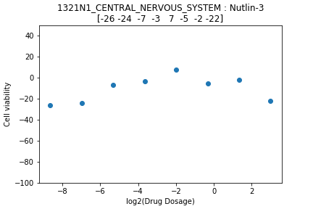
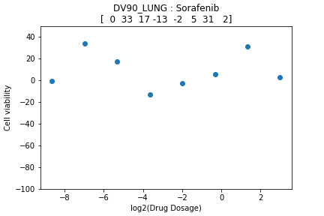
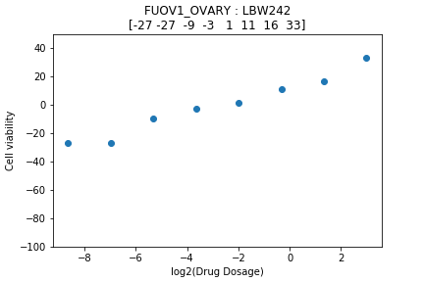
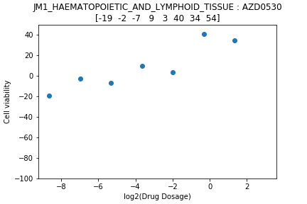
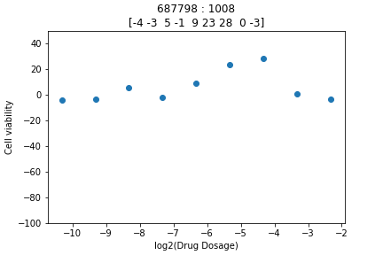
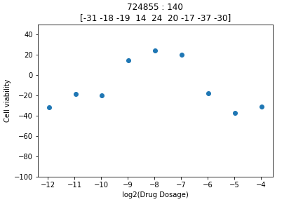
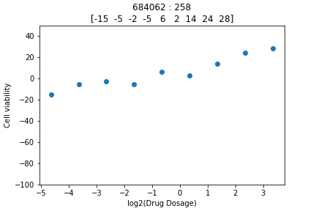
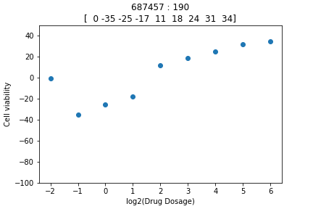
Outlier Type 1 (HUMP SHAPED) No.(%) of hump shaped pairs CCLE: 84/11670 (0.72%) No.(%) of hump shaped pairs GDSE: 760/224510 (0.339%)
Outlier Type 2 (RISING SHAPED) No.(%) of rising shaped pairs CCLE: 149/11670 (1.277%) No.(%) of rising shaped pairs GDSE: 2029/224510 (0.904%)

Slide 7
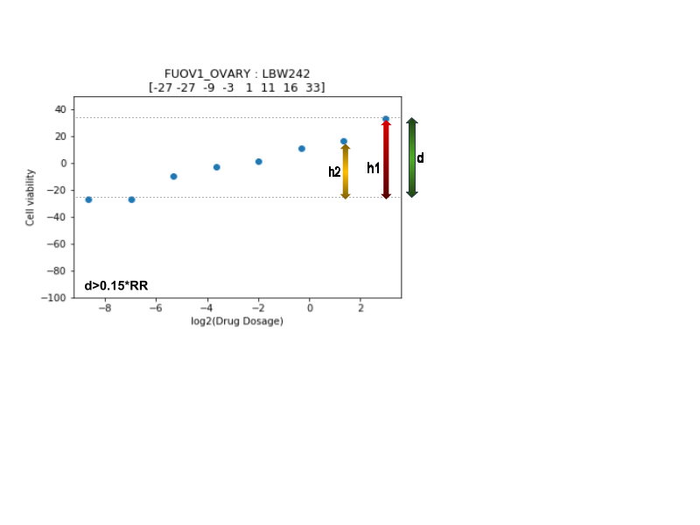
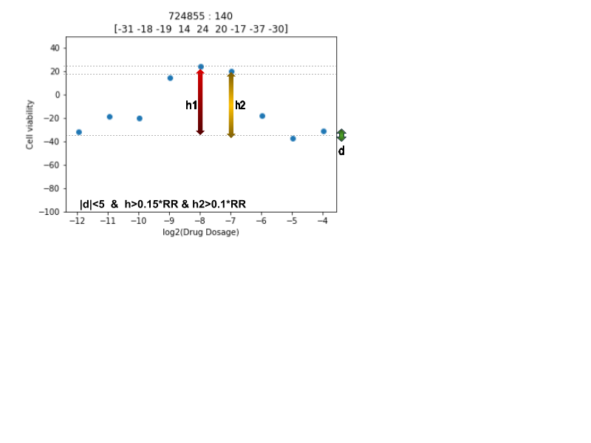
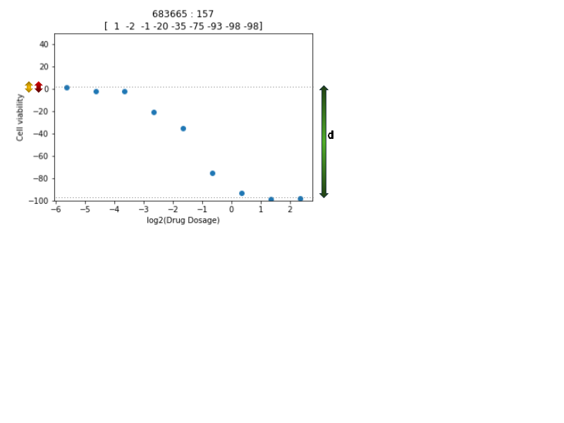
Method used to fetch outlier shapes
RR: response range (200)

Slide 8
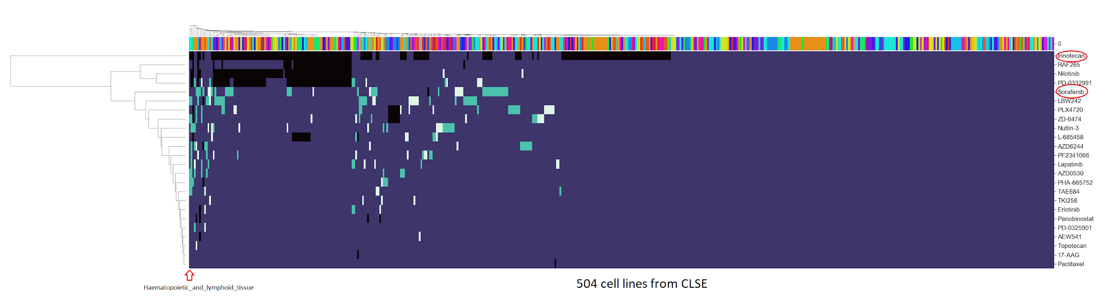
Category matrix
0: Drug not tested against cell line
1: Non-outlier curve
3: Rising-shaped curve
Hump-shaped curve
Maximum abnormal/bad curves are from the Cell lines derived from Haematopoietic_and_lymphoid_tissue.
Irinotican drug has not been tested for a lot of cell lines
Drug with maximum number of outliers: Sorafenib

Slide 9
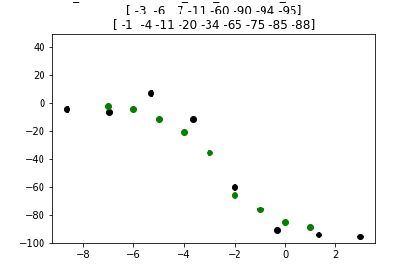
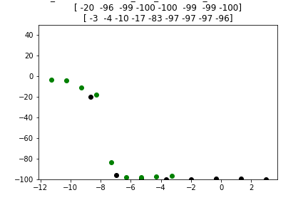
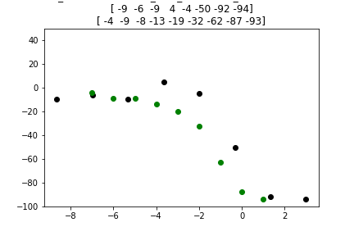
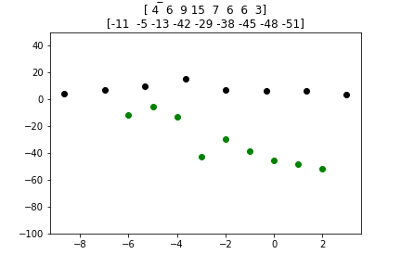
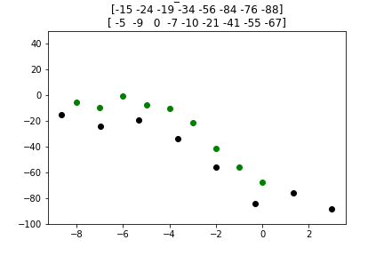
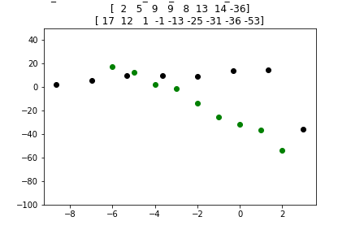
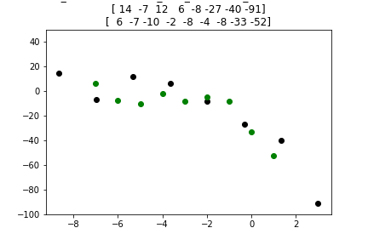
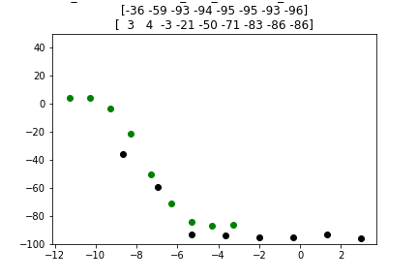
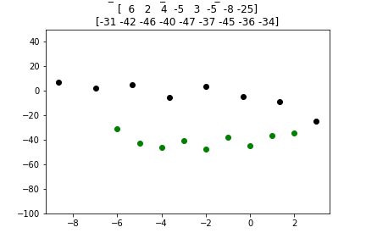
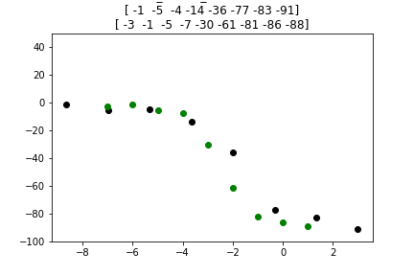
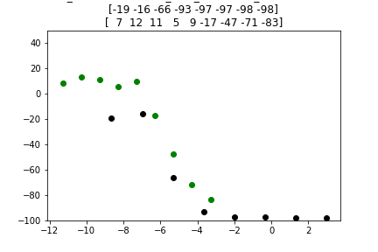
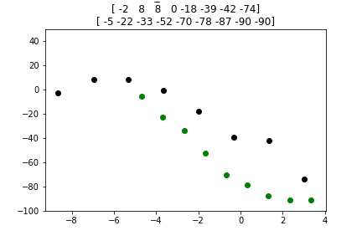
Common pairs between CCLE and GDSE
No of cell lines-drugs-common pairs: 357-15-3004
Type 1: Contradictory
Type 2A: Concordant
Type 2B: concordant
Type 3: Shift

Slide 10
Future plan
Quantify the difference between the drug response from both datasets for the common pairs
Separate based on area, DTW, etc between the curves Eg: (area<th1 and dtw<th2) => concordant
Analyse where this difference/shift is coming from and correct that to merge the datasets
Propose a new metric for measuring the drug response which captures the drug behaviour at its best.

Slide 11
Thank You

