Slide 1
CaDRReS2
An attempt to improve drug-response prediction
Progress
-Aanchal Mongia
August 1, 2019

Slide 2

Queries from last presentation..
Correlation b/w IC50 , AUC and adjusted AUC from CCLE and GDSC in [1] (which proposed to adjust for different drug dosage across datasets)
Are thresholds used to detect outliers
Justified?
consistent and robust across the datasets?
Is the hump or rising response the true behaviour of a drug? Or just an outlier response?
How many/what percentage of drugs/cell-lines exhibit outlier response (from CCLE heatmap)?
[1] Pozdeyev, Nikita, et al. "Integrating heterogeneous drug sensitivity data from cancer pharmacogenomic studies." Oncotarget 7.32 (2016): 51619.

Slide 3
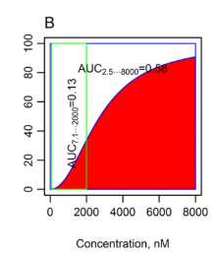
Correlation b/w IC50 , AUC and adjusted AUC from CCLE and GDSC in [1] ?
Correlation (Pearson) b/w adjusted AUC=0.69 Correlation b/w IC50=0.6 (but the correlation is for all drugs not individual drugs, not for all IC50 values)
LIMITATIONS
No dosage overlap/small overlap => AUC very less
Full overlap/maximal overlap but different auc => still inconsistent results
Information loss (when large drug dosages tested)

Slide 4
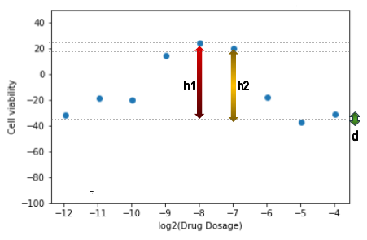
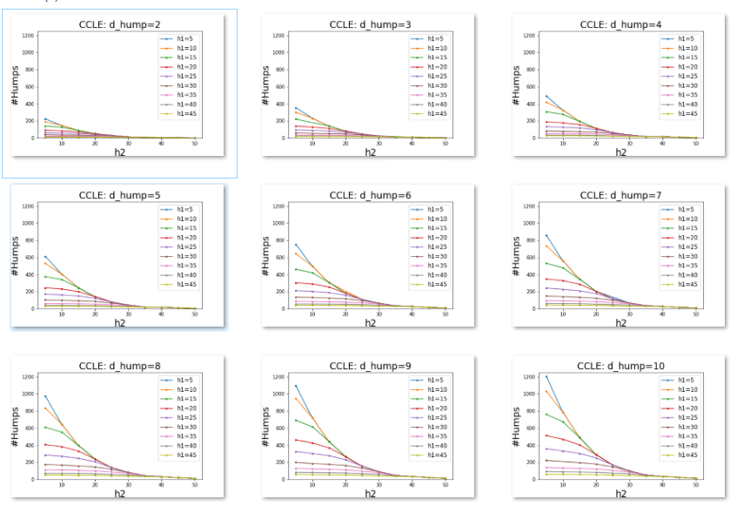
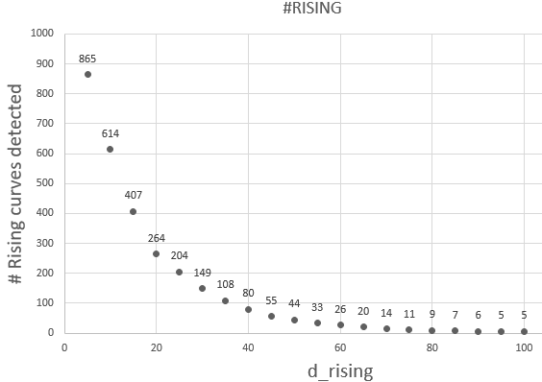
2. Are thresholds used to detect outliers (a)Justified? (b)consistent and robust across datasets?
MODEL PARAMETERS: h1, h2, d (used in both hump and rising detection)
Variation of no of rising curves detected with d_rising
Variation of no of humps detected with h2
d_rising chosen: 30
h2 chosen: 20

Slide 5
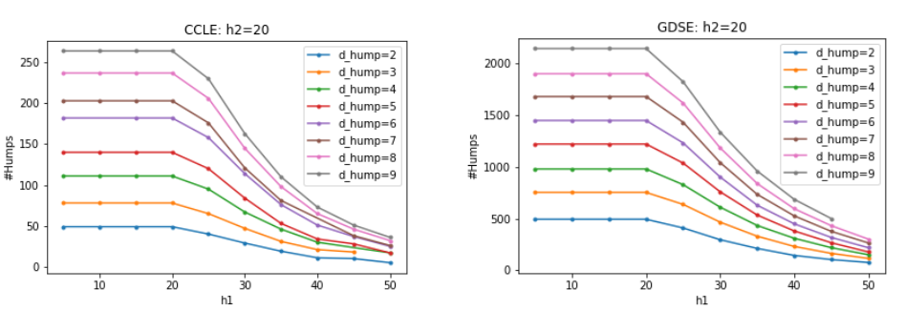
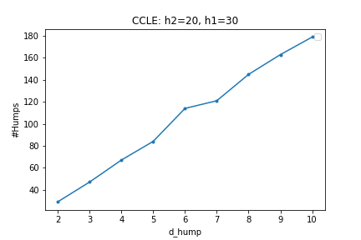
Variation of humps detected with h1
Variation of humps detected with d_hump
d_hump chosen: 5
h1 chosen: 30
Similar trends observed for GDSC (Appendix), hence thresholds chosen are consistent and robust
Data point where curve starts to stabilize=> probably separate class of response in data (similar to elbow method)

Slide 6
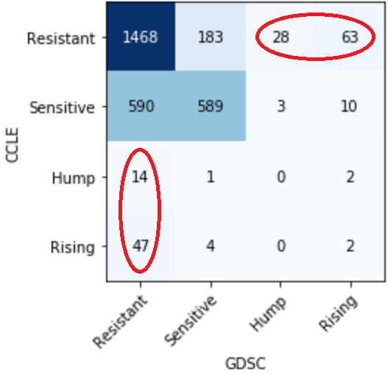
3. Is the hump or rising response the true behaviour of a drug? Or just an outlier response?
Hump or rising response is NOT the true behaviour of a drug
#H-H pairs: 0 #R-R pairs: 2
“Hump” and “rising” may in fact be “DNW”/”resistant” cases
% “Hump” in CCLE but “resistant” in GDSC: 82.35 % % “Rising” in CCLE but “resistant” in GDSC: 88.67 % % “Hump” in GDSC but “resistant” in CCLE: 90.32 % % “Rising” in GDSC but “resistant” in CCLE: 81.81%
2 pairs having hump shaped response in CCLE and Rising shaped response in GDSC

Slide 7
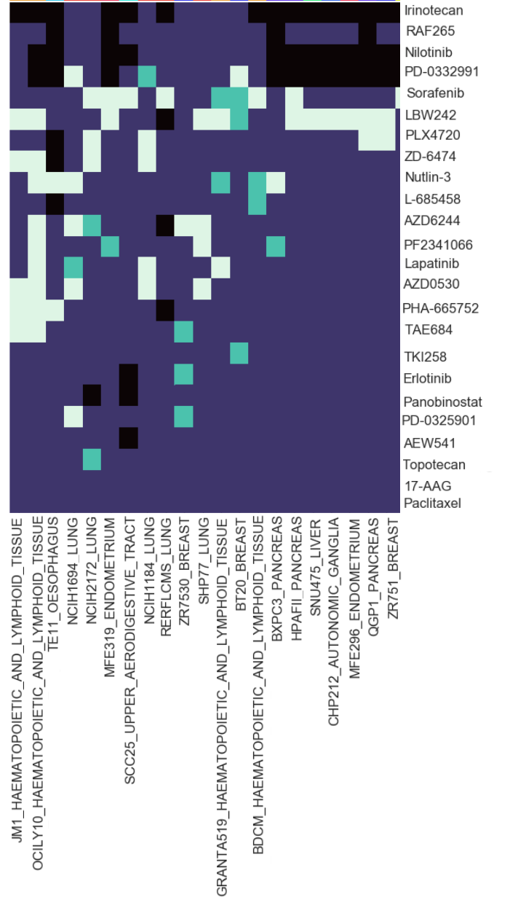
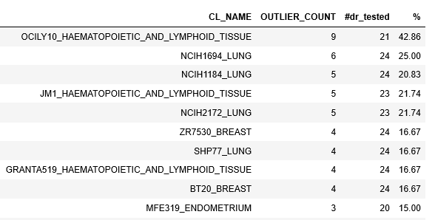
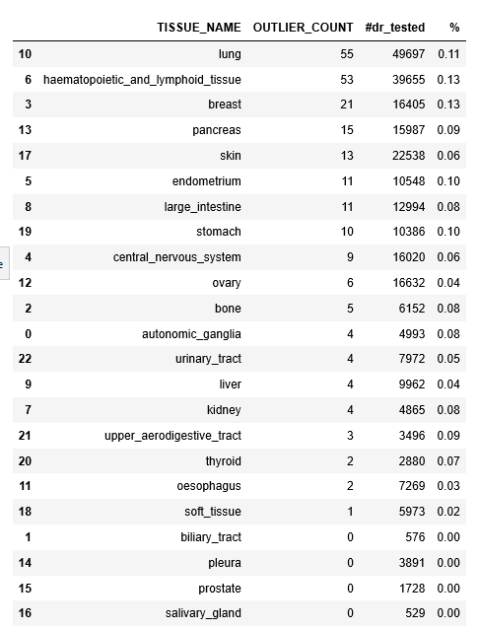
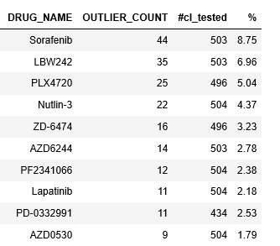
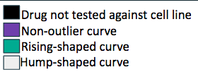
4. How many drugs/cell-lines exhibit outlier response ?
Maximum abnormal/bad curves are from: OCILY10_HAEMAOOIETIC_AND_LYMPHOID_ TISSUE (42%)
And not from Cell lines derived from Haematopoietic_and_lymphoid_tissue!
Drug with maximum number of outliers: Sorafenib (8%)

Slide 8
Common Pair separation/classification
5 classes:
Concordant (751 samples, 25%)
Concordant_differentRange (787 samples, 26.19%)
Concordant_lessConfidence (219 samples, 7.3%)
Shifted (308 samples, 10.25%)
Contradictory (939 samples, 31.25%)
The two datasets agree on the behaviour of drug for nearly 42% of common pairs (class 1,3,4).
For classes 1,2,3 => re-fit curve
For class 4 => Analyse the difference and correct
For class 5 => Analyse the difference and correct/remove

Slide 9
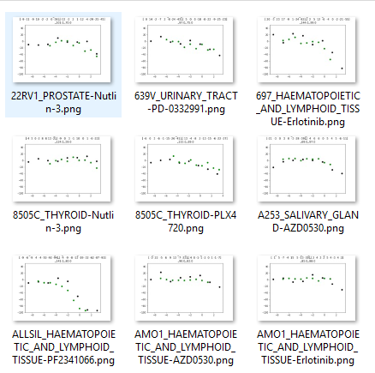
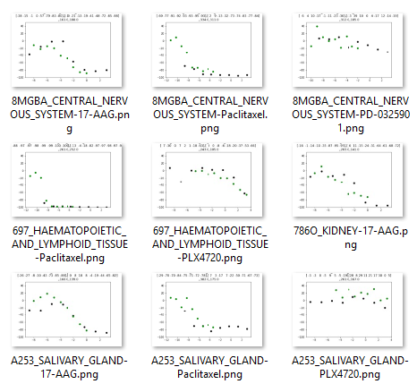
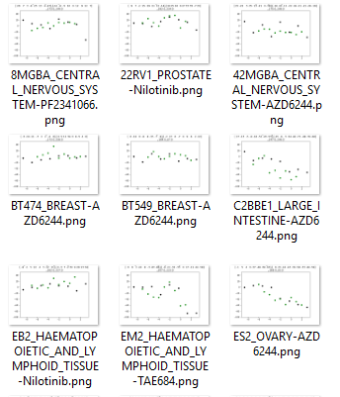
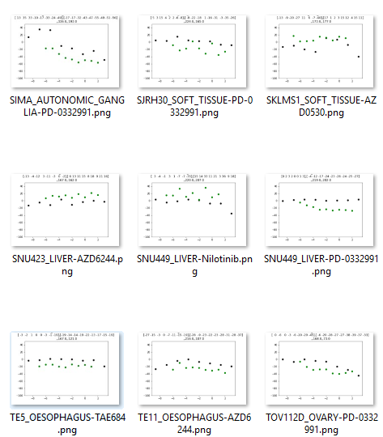
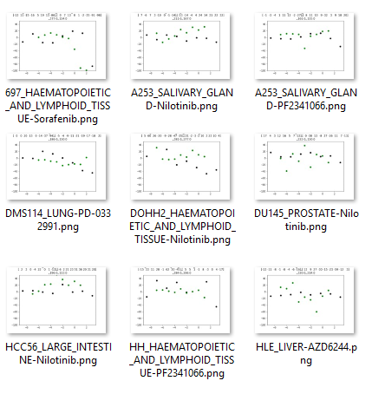
Concordant
Concordant_differentRange
Concordant_lessConfidence
Shifted
Contradictory

Slide 10
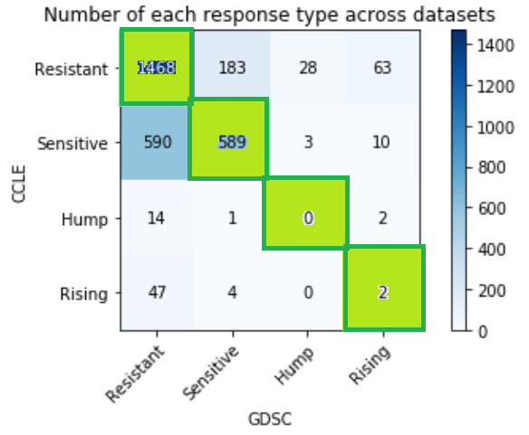
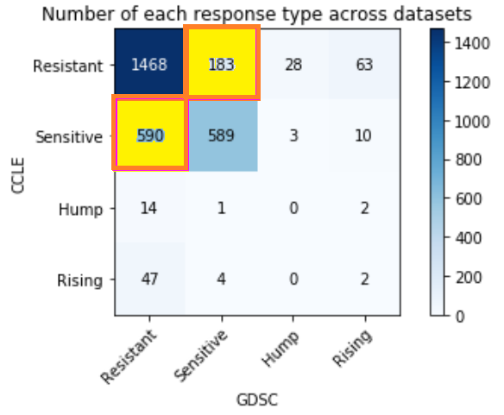
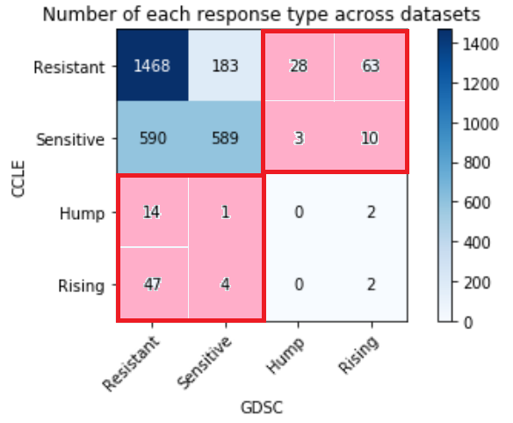
Method
area<150 and dtw<150
Concordant
Concordant_ diffRange
if
|CV¹_{CCLE}-CV¹_{GDSC}|>=3 or |CV*_{CCLE}-CV*_{GDSC}|>=3
(#elements>1 in CV_{CCLE} -CV_{GDSC})>=7 or(#elements>1 in CV_{CCLE} -CV_{GDSC})>=7
shifted
area<250 and dtw<150
Concordant_ lessConfidence
otherwise
contradictory
elseif
area<200 and dtw<150 and (|CV¹_{CCLE}-CV¹_{GDSC}|>=3 or |CV*_{CCLE}-CV*_{GDSC}|>=3 )
dtw<150 and (#elements>1 in CV_{CCLE} -CV_{GDSC})>=6 or (#elements>1 in CV_{CCLE} -CV_{GDSC})>=6)
otherwise
else
CV_{CCLE},CV_{GDSC}: cell viability from CCLE, GDSC
DD¹_{CCLE}: initial drug dosage in CCLE DD¹_{GDSC:}: initial drug dosage in GDSC
DD*_{CCLE}: last drug dosage in CCLE
DD*_{GDSC}: last drug dosage in GDSC
otherwise

Slide 11
Analysing the difference in response (in progress)
Possible sources of inconsistency [2] :
Cell counting
Edge effects and non-uniform cell growth
Different dose range (class “Concordant_differentRange”)=> take union and re-fit
Time=> ?
Cell density
[2] Niepel, Mario, et al. "A Multi-center Study on the Reproducibility of Drug-Response Assays in Mammalian Cell Lines." Cell systems (2019).

Slide 12
Future plan
1) Handling data inconsistency: To find a reasonable way to merge the dose response information from 2 different experiments (CCLE and GDSE)
Outlier detection and filtering (done)
Common Pair separation/classification (in progress)
Analysing the difference (shift, outlier behaviour) in response behaviour (in progress)
Correct them
Merge the datasets for a more reliable database
2) Quantification of Drug response: Find an alternative metric to capture the drug response behaviour / quantify the Dose-response curve in the best way possible

Slide 13
Thank You

Slide 14
Appendix
-Aanchal Mongia
August 1, 2019

Slide 15
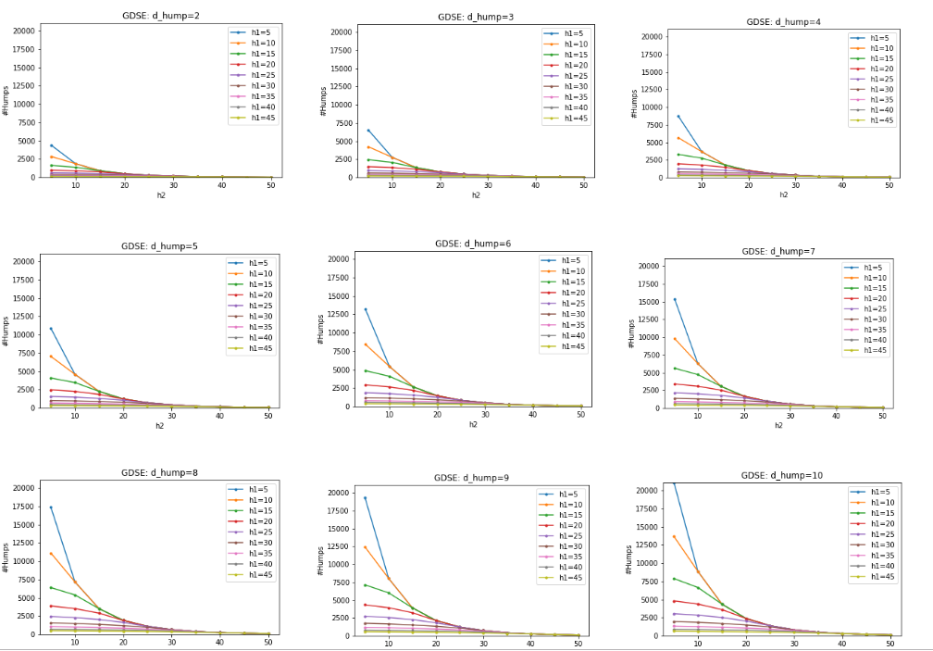
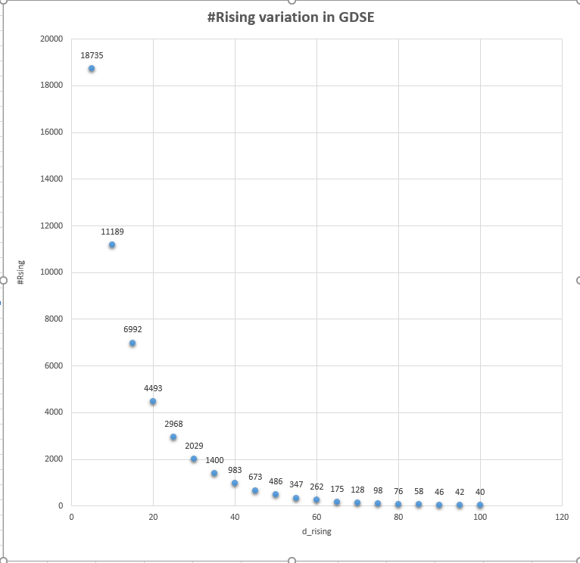
2. Are thresholds used to detect outliers (a)Justified? (b)consistent and robust across the datasets?
GDSC dataset trends
Variation of no of humps detected with h2
Variation of no of rising curves detected with d_rising
d_rising chosen: 30
h2 chosen: 20

Slide 16
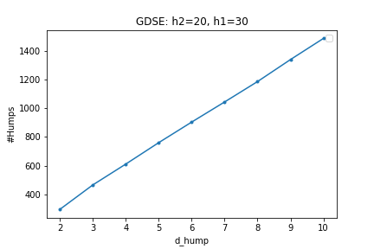
Variation of humps detected with h1
Variation of humps detected with d_hump
h1 chosen (for both datasets): 30
d_hump chosen (for both datasets): 5

Slide 17
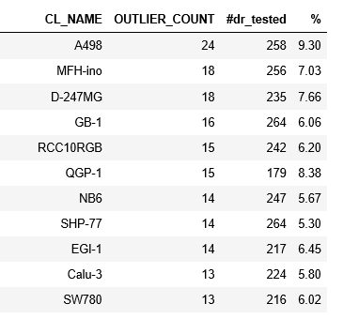
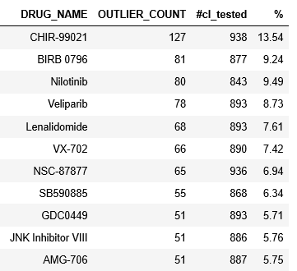
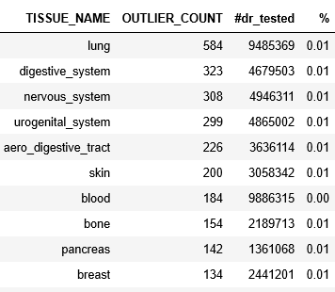
GDSE: outliers per drug, cell-line, tissue

Slide 18
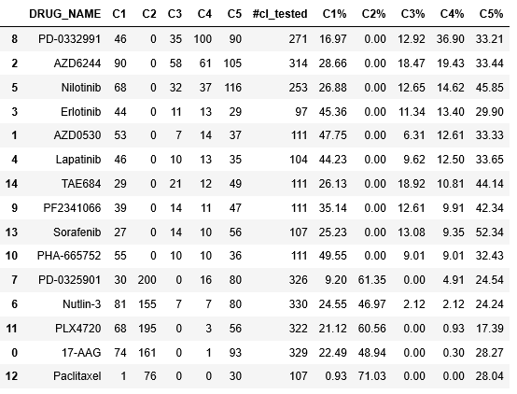
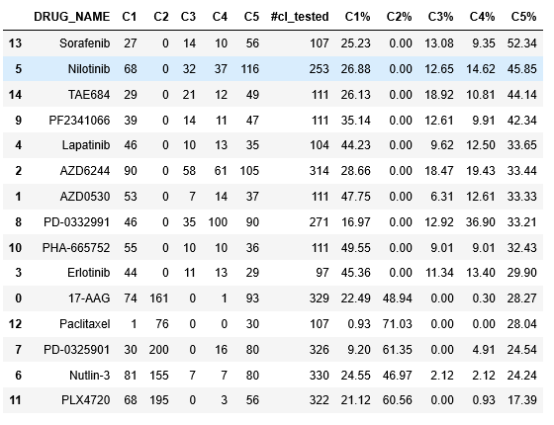
Sorted by C4%
Sorted by C5%

Slide 19
