Slide 1
CaDRReS2
An attempt to improve drug-response prediction
Work progress
-Aanchal Mongia
September 19, 2019

Slide 2
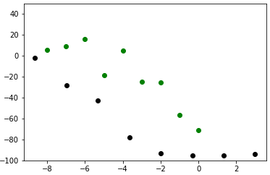
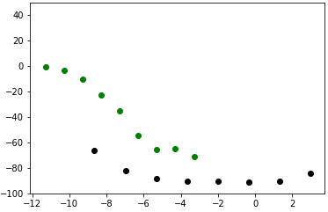
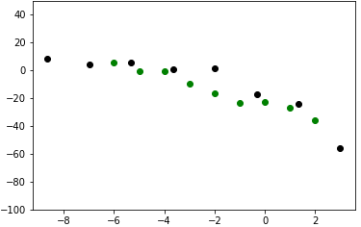
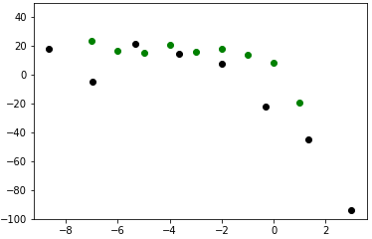
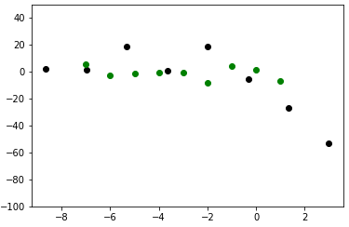
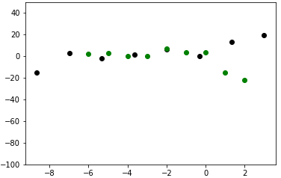
Quick recap
Why not previous method?
1.Not threshold free
2. Not adjusted for different drug dosage
3. Doesn’t consider outlier shape as resistant case
Aim: To handle inconsistency in drug sensitivity information (IC50) across the datasets
Strategy: Targeting the drug response of common pairs from both datasets (CCLE and GDSE)
~3000 common cell line-drug pairs
Analyse where this difference/shift is coming from and correct that/remove unexplainable responses to merge the datasets
Work/Findings so far:
Both datasets have ~2% of outlier response (rising/hump shaped curve) which are actually resistant/DNW cases.
Common pairs separation: Repeated with another method
classified “Conc_diffrange”
classified “shifted”
classified “contradictory”

Slide 3
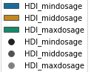
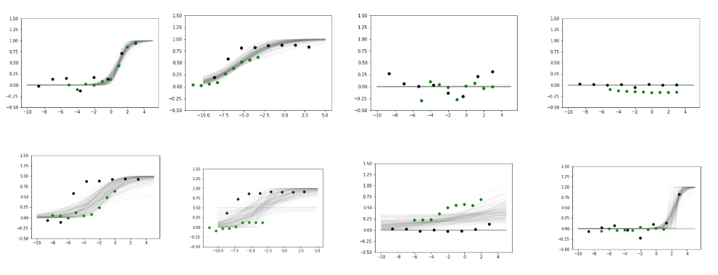
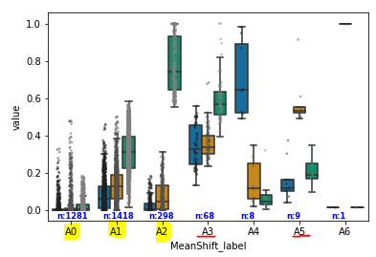
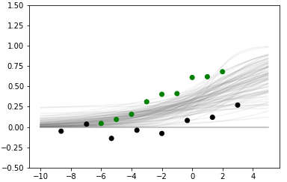
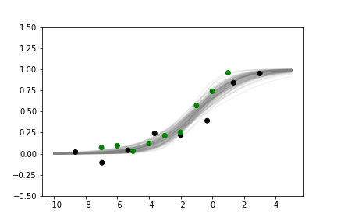
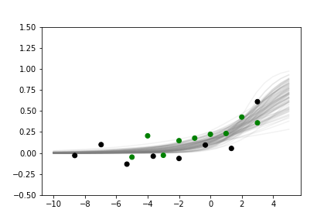
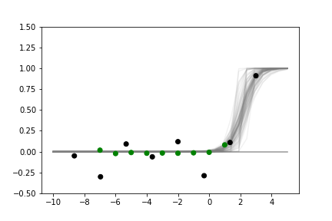
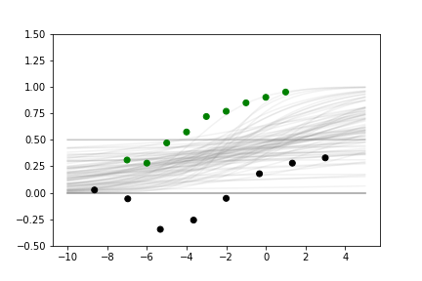
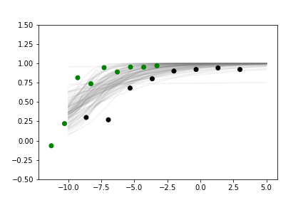
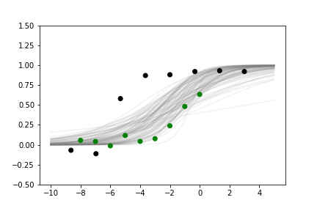
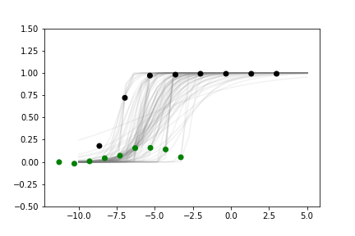
Current Method
Curve fitting
3. Separate/cluster the common cell line-drug pairs (used Mean shift clustering)
2. Extract features or shape descriptors that uniquely describe each dose response curve
HDI_{min,}
HDI_{mid,}
HDI_{max}
c
b
a
HDI_{x}: Interval of credible values in the distribution at dosage x

Slide 4
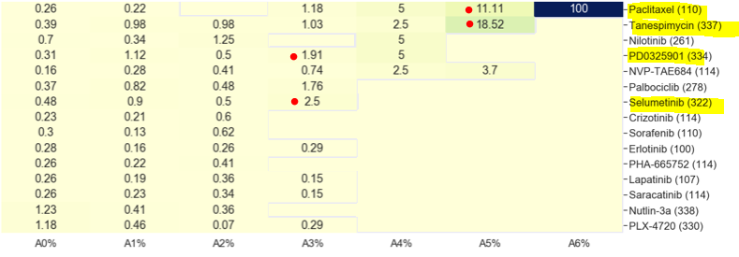
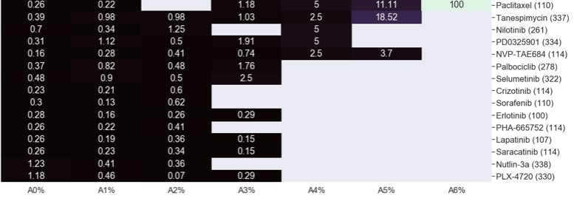
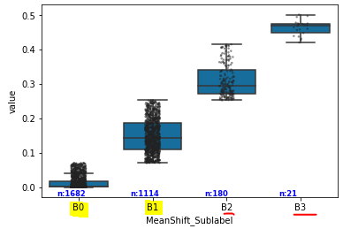
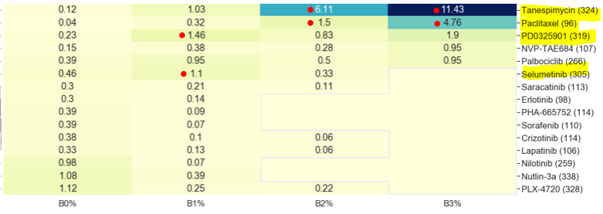
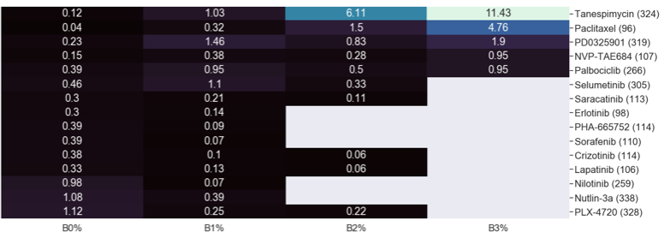
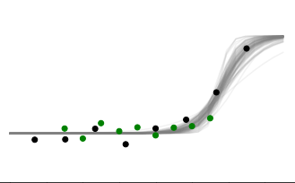
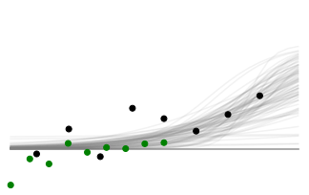
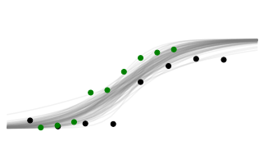
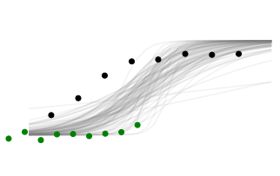
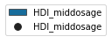
Sub-classification results:
Drug enrichment matrix
Level 1
Enrichment value = #pairs from drug i X 100 Total pairs in cluster j X . #unique drugs in cluster j
Level 2

Slide 5
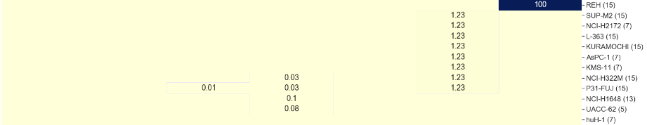
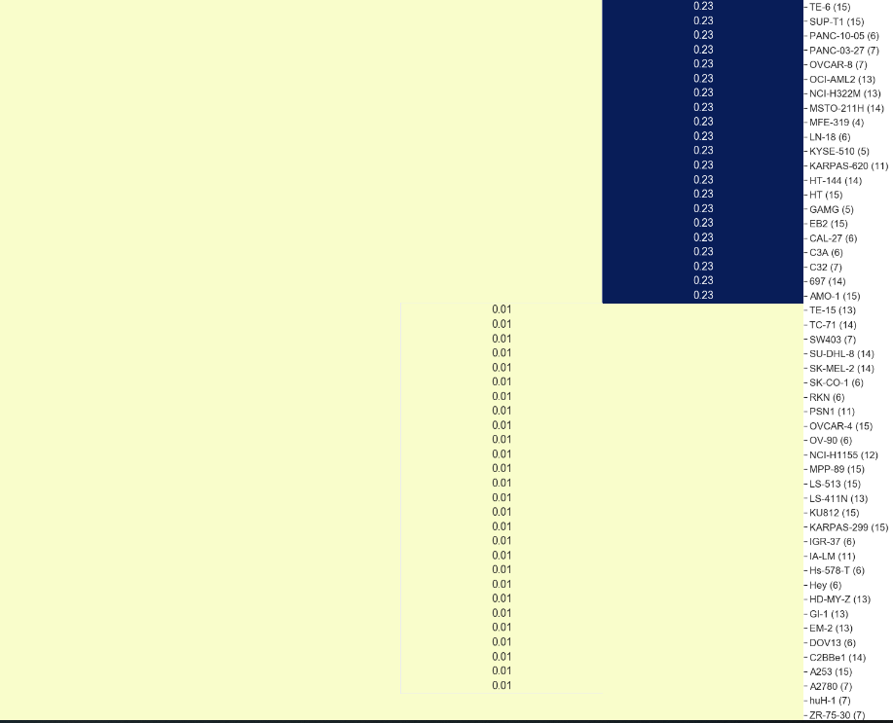
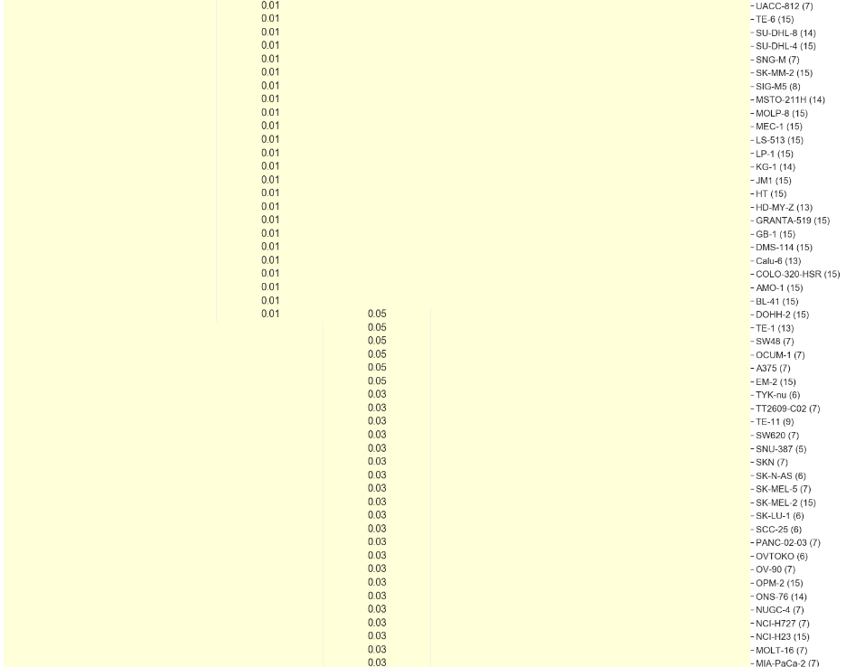
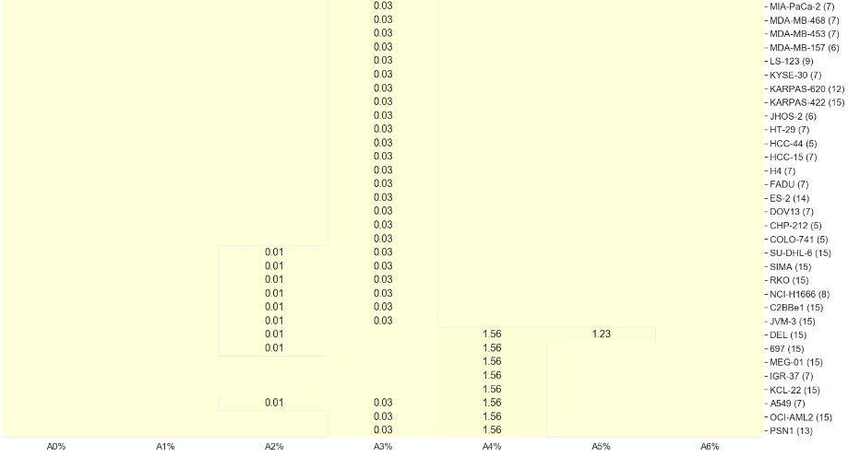
Level 1
Cell-line enrichment matrix
Level 2

Slide 6
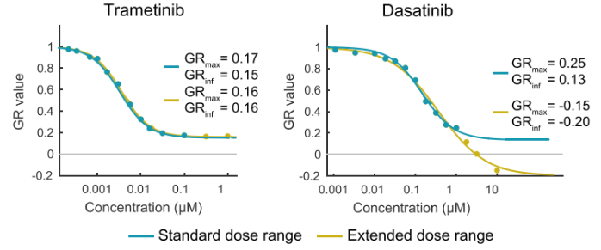
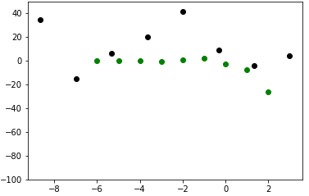
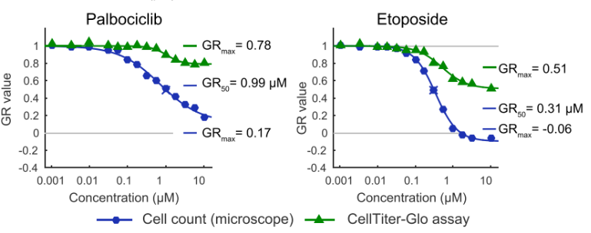
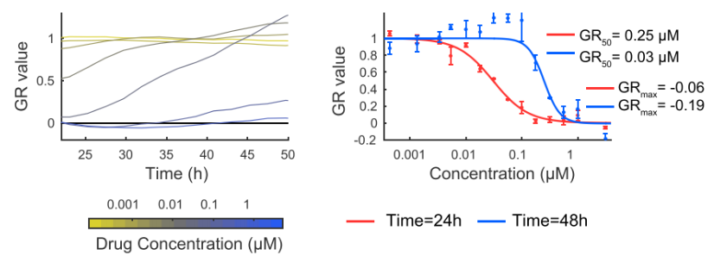
Possible explanations of the following types of inconsistencies
INCONSISTENCY | CAUSE
conc_diffRange | DIFFERENT DRUG DOSAGE TESTED
Outlier behaviour (Hump/Rising) | RESISTANT CELL-LINE / INACTIVE DRUG
Open-ended (discordant at high dosage) | DIFFERENT CELL COUNTING METHOD
Closed shape (discordant at medium dosage) | DIFFERENT TIME DURATIONS
✓
✓
?
?
Source: Niepel, Mario, et al. "A Multi-center Study on the Reproducibility of Drug-Response Assays in Mammalian Cell Lines." Cell systems (2019).

Slide 7
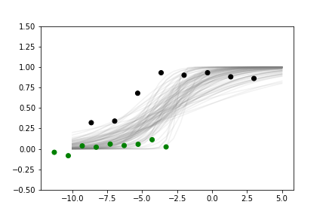
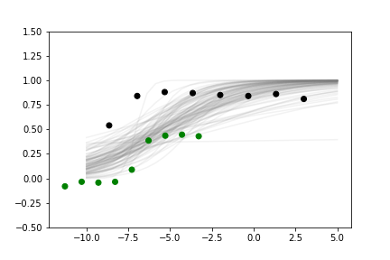
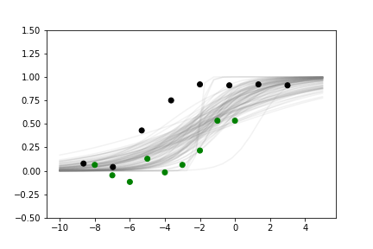
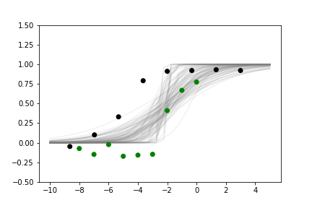
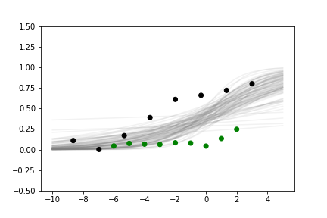
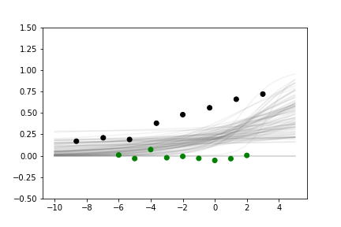
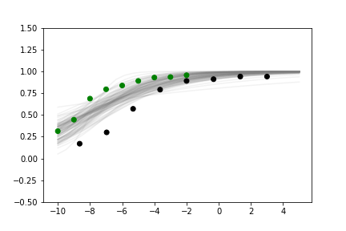
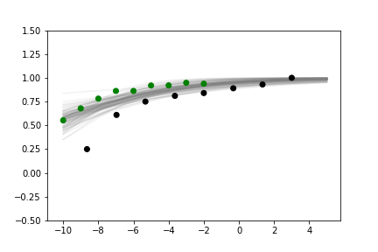
DRUG | PATTERN ENRICHED IN | Target | Pathway
Paclitaxel |  | Microtubule stabiliser | Mitosis
Tanespimycin |  | HSP90 heat-shock protein inhibitors | Protein stability and degradation
Selumetinib |  | MEK1, MEK2 | ERK MAPK signaling
PD-0325901 |  | MEK1, MEK2 | ERK MAPK signaling

Slide 8
Future plan
Handling data inconsistency: To find a reasonable way to merge the dose response information from 2 different experiments (CCLE and GDSE)
Outlier detection and filtering (done)
Common Pair separation/classification (done)
Analysing the difference (shift, outlier behaviour) in response behaviour (in progress)
Correct them
Merge the datasets for a more reliable database
https://docs.google.com/document/d/10JKDnRydsUQwhej4ii3_xxloQkwTwxtCeeZrdRgttTU/edit?usp=sharing

