Slide 1
CaDRReS2
An attempt to improve cancer drug-response prediction
Work progress
-Aanchal Mongia
October 3, 2019
Notes:
Motivation: Inconsistent IC50 values across the datasets
Aim: Merge datasets while handling inconsistency in drug response
Strategy: Targeting the drug response of common pairs
~3000 common pairs
Analyse where this difference is coming from
correct/remove inconsistent responses

Slide 2
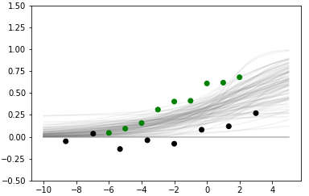
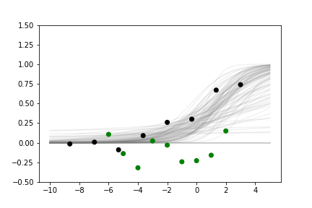
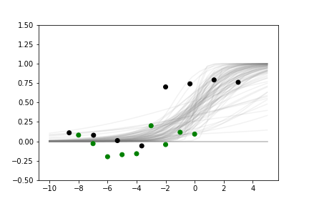
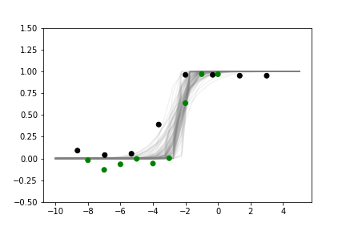
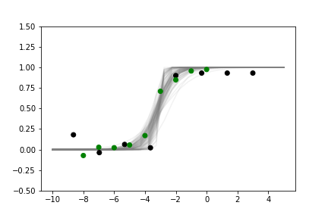
Curve separation strategy
Previous
Current
Curve fitting
Extract features: a. HDI_{min}, b. HDI_{mid}, c. HDI_{max}
Separation
Cluster using a,b,c (concordant:0,1,2 discordant: 3,4,5,6)
Separate out inconsistent pairs from concordant clusters using b
Curve fitting
Extract features: a. HDI_{min}, ab. HDI_{min-mid} ,b. HDI_{mid}, bc. HDI_{mid-max}, c. HDI_{max}, ABFC
Separation
Thresholding based on Area bw fitted curves (adjusted)
Cluster disconcordant groups using a,b,c,d,e
Some Misclassifications
Classified concordant
C32,Selumetinib
Calu-6,Tanespimycin
Classified discordant
a
ab
b
bc
c
OCI-AML2,Tanespimycin
OVCAR-8,Tanespimycin
Notes:
We had some closed (inconsistent) pairs in concordant set so we shifted to to a more direct way of having concordant set (area). Area works wonderfully well but we did not use it before bcz area would be high for conc_diffRange pairs, but now we corrected for this by taking area between the fitted curves(sampling 5 points from it, not 3 bcz if we use just 3 points the approximation might not be precise.eg. the lower pairs on left side would have high value) and not the actual points. This makes sure the conc_diffRange gives low area value
Thresholding based on Area bw fitted curves (adjusted)-> we divide area by max area as diff drugs have different dosaes, so diff maximum area, so common th wont work for all drugs. Eg: large width dosage would give high area even for concordant pair
Classified in concordant cluster (#1) in previous method bcz (HDI mid low but area large).. 1 more eg:A673,Tanespimycin
Classified in discordant cluster (#3) in previous method bcz (HDI mid high but area low)

Slide 3
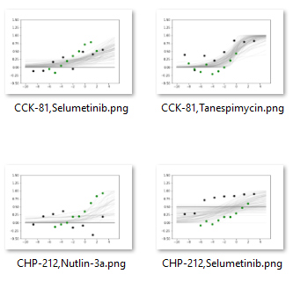
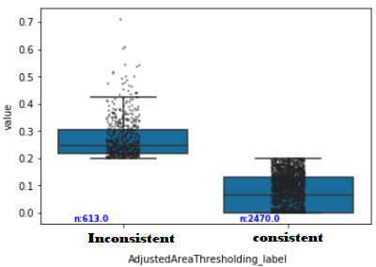
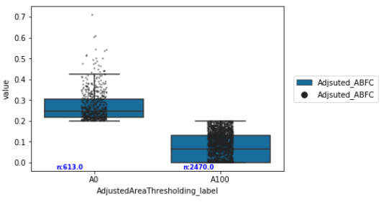
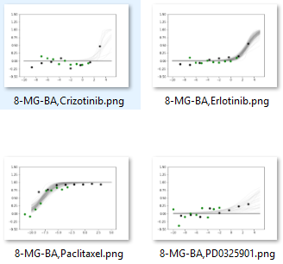
Level 1 results

Slide 4
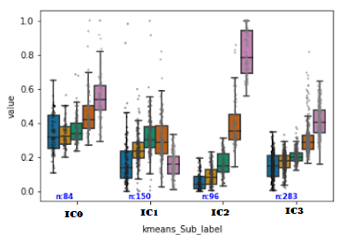
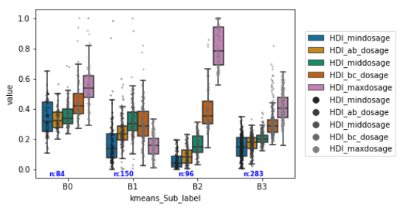
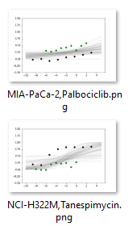
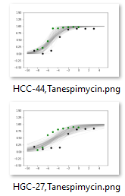
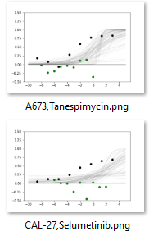
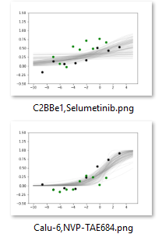
Level 2 results

Slide 5
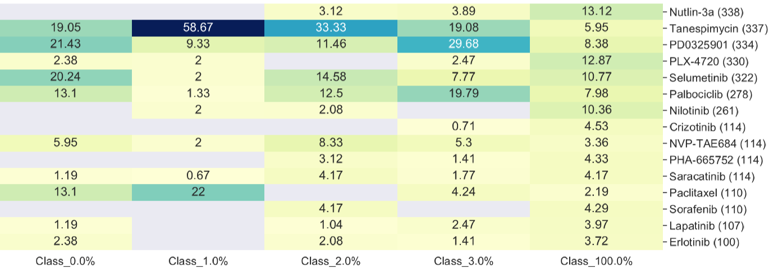
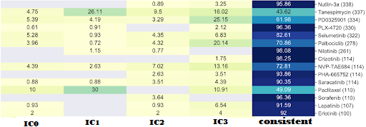
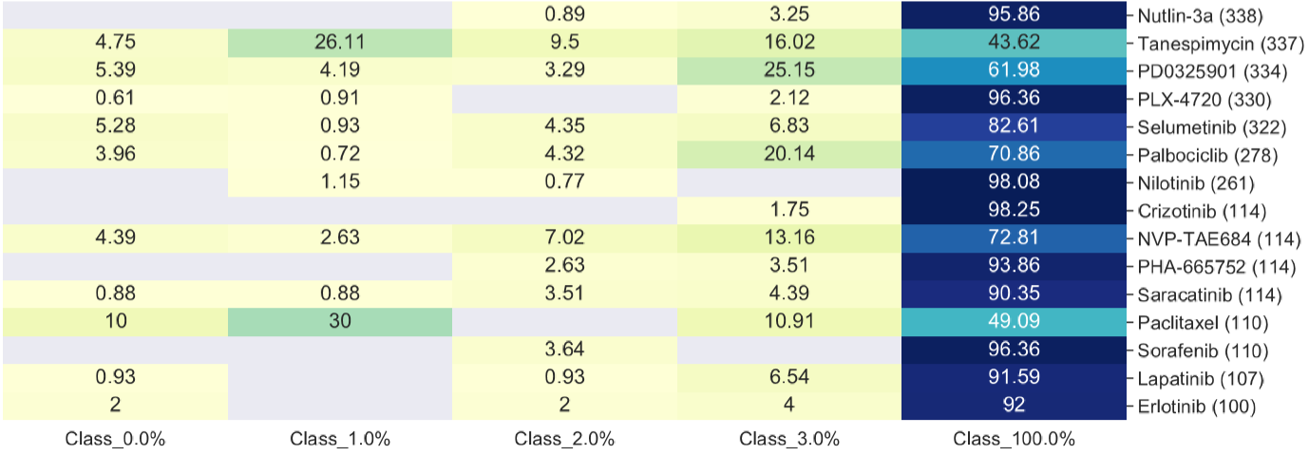
Percentage of drugs in each cluster
Percentage of clusters in each drug
Faulty drugs: Tanespimycin, Paclitaxel, PD0325901 (GROUP 1)
Partially Faulty drugs: palbociclib, NVP-TAE684, Selumetinib (GROUP 2)

Slide 6

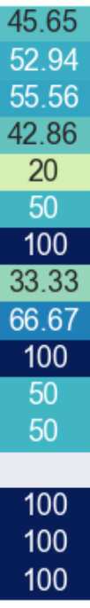
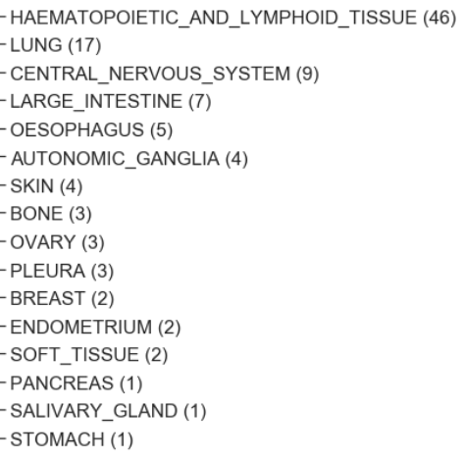

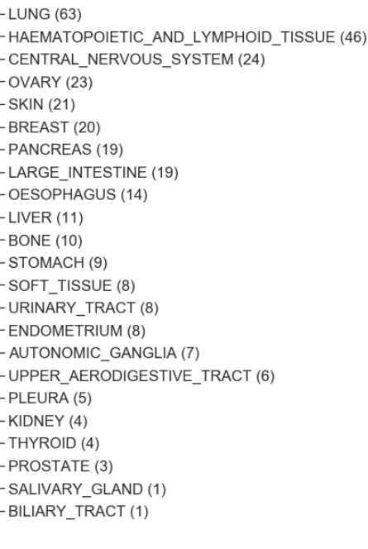

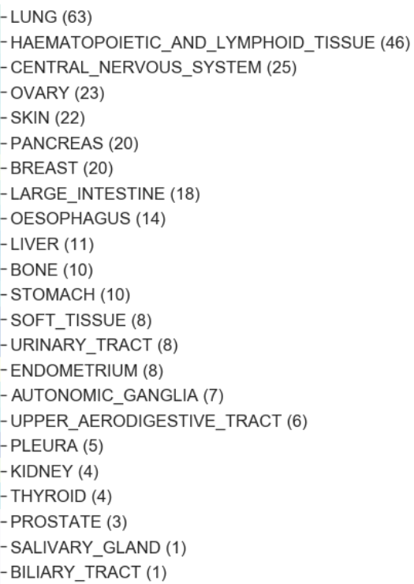
Any tissue enrichment within faulty drugs?
Tanespimycin
Paclitaxel
PD-0325901
inconsistent
inconsistent
Liver tissue+PD-0325901
Skin tissue+PD-0325901 (GROUP 1c)
inconsistent
Breast tissue+Tanespimycin (GROUP 1a)
Inconsistency
Inconsistency
Notes:
Why we see tissue enrichment?
-> if we can learn some rule to see which cell type/tissue gives rise to inconsistency within that drug

Slide 7
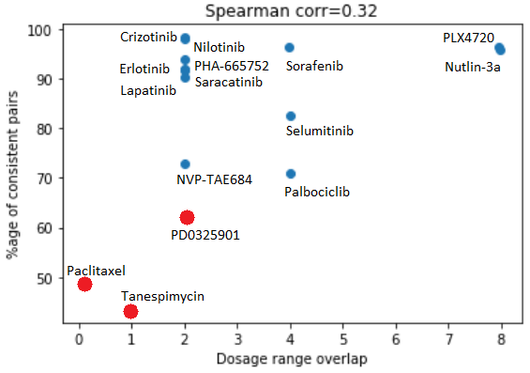
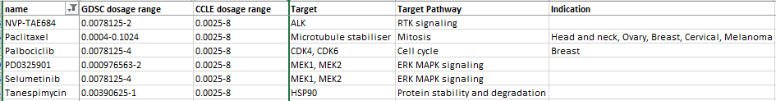
FILTER: All inconsistent pairs with Paclitaxel, Tanespimycin, PD-0325901, palbociclib, NVP-TAE684, Selumetinib.
FOR GENERALIZATION
Attach confidence scores ( low, med to GROUP 1, GROUP 2 and v.low to GROUP 1a,1c)
Identify faulty drugs not in the concordant set: Find out what is common in these faulty drugs which is causing this behaviour?
Dosage range? Target/Pathway? Time dependence?

