Slide 1
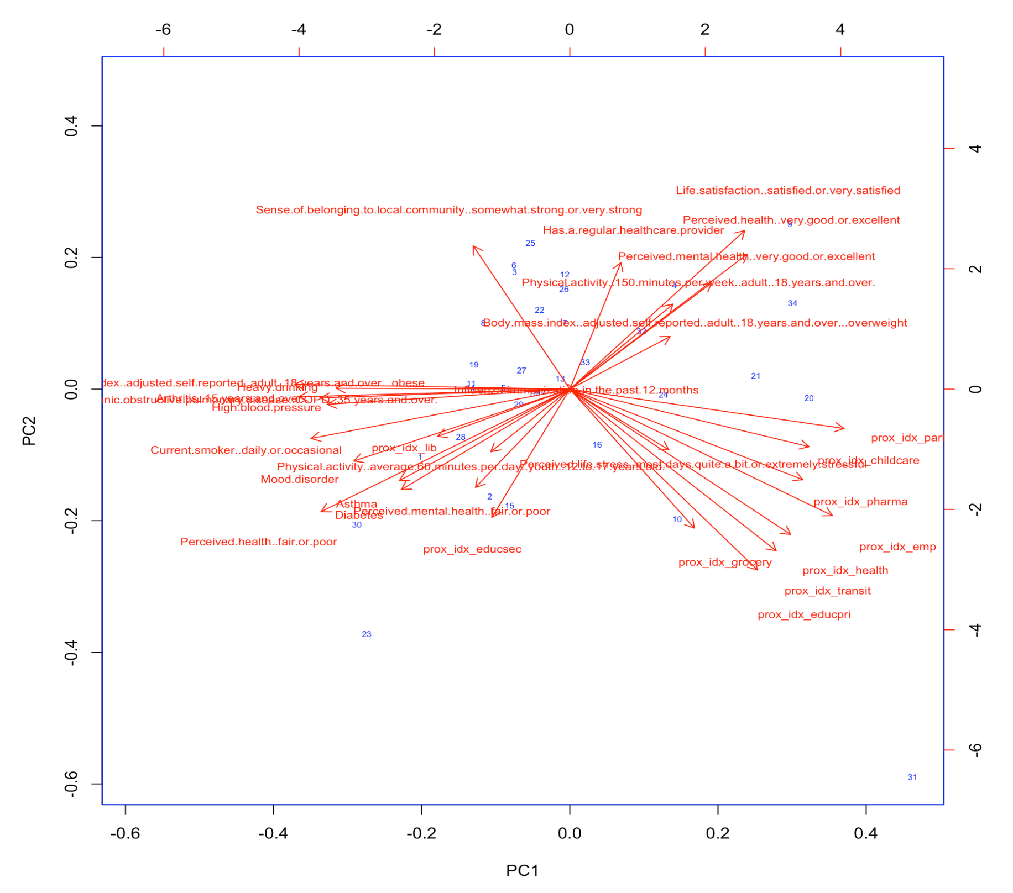
Good health
Halton Regional Health Unit
Poor health
Amenity richness
﻿﻿Porcupine Health Unit
﻿City of Toronto Health Unit

Slide 2
