Slide 1
CSCI 130 – Computing: Science/Applications

Slide 2
Logistics
Instructor(s):
Jeremy Iverson (jiverson002@csbsju.edu). PENGL 213, Ph: (320) 363-3083
Office hours:
John Miller (jmiller@csbsju.edu). PENGL 215, Ph: (320) 363-3155
Office hours:
Textbook:
Computer Concepts and Applications, Herzfeld & Miller et al.
Website:
https://csbsju.instructure.com/courses/10164
Labs:
PENGL 218, TR
M | 12:30 | pm | - | 1:30 | pm
R | 11:00 | am | - | 12:00 | pm
T | 9:10 | am | - | 10:05 | am
W | 10:20 | am | - | 11:15 | am
01A | 11:10 | am | - | 12:30 | pm
Notes:
Book is currently available on Canvas, hard copies are available on request.
Go through canvas page a little bit – things to point out:
Homepage links
TA office hour links
Book link
Links to grades, announcements, and discussions

Slide 3
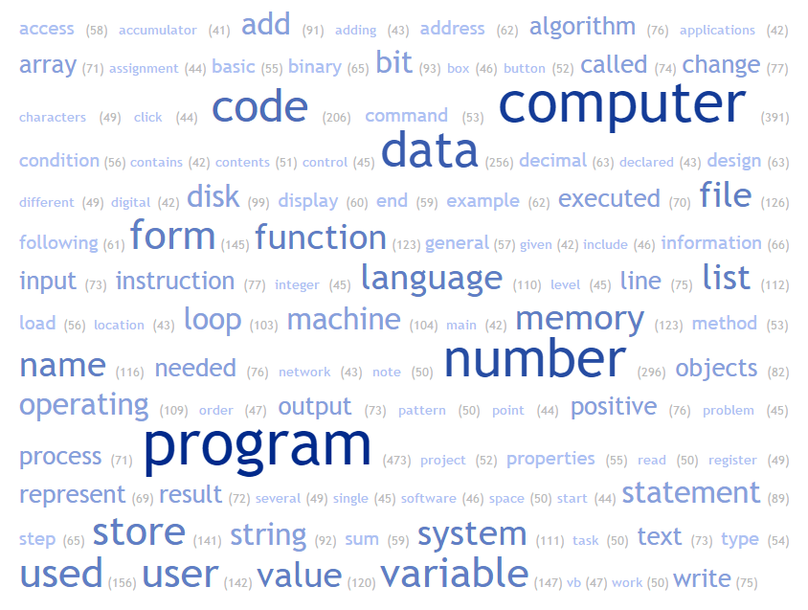
Course content
Notes:
So what is this course about?
A word cloud from the main chapters of the textbook. Ask students to point out words they recognize and may/may not understand. This is an opportunity for me to get a general sense of what topics are familiar to some of the students. If they have heard the words, in what context – what do the words mean to them.

Slide 4
Course content
Notes:
Spend more time on this. These are the words that I think they may have heard before.
Point out a few missing words:
Gaming
Graphics
Pokemon Go

Slide 5
Course content
Problem Solving
Algorithms
Programming
Hardware
Visual Basic
Computer organization
Tools
Details
Excel
Data rep.
Assembly
Notes:
Algorithms – how do we solve problems
Visual Basic – how do we tell a computer the steps to solve a problem
Tools – programs that are designed to solve specific types of problems
Hardware and details – help us improve the tools, programming, and algorithm for the specific technology that we have available to us
Data rep – for example, how does a computer represent pi (pi is infinite, computer is finite)

Slide 6
Syllabus
https://csbsju.instructure.com/courses/10164/assignments/syllabus

Slide 7
Teaching philosophy
Your job is to empower those you teach; when you do for them what they should be doing for themselves, you create dependency rather than empowerment.
It is easy to give in to the frustration that results from seeing amazing possibilities for the people you are teaching, and you want it more for them than they want it for themselves.
Don’t give in to that frustration!
- Based on passage from “Resisting Happiness” by Matthew Kelly
Notes:
Dependency – relying on the instructor, TA, or fellow student for original thought or deeper understanding (in context of computer science) instead of oneself

Slide 8
Expectations
Prepare for class (do the reading!)
Participate in class
Be respectful
Believe in yourself
Notes:
So let me summarize
Emphasize that material is new and challenging
Don’t be discouraged if comprehension is not apparent right away
Seek help (TAs and me)
Many of the topics can be re-formulated / re-stated

Slide 9
Questions
Syllabus
Course content
General computing
Notes:
Goal of this class is to increase your computer literacy and improve problem solving skills
Give meaning to the computer terminology floating around
Gigabytes
Quad-core CPU
Megapixels
Some problems we will look at:
What are MP3s and why are they useful
What is a database (facebook)

Slide 10
DKC³ 2012 WORD PROBLEMS
2) Cake
You must cut a birthday cake into exactly eight pieces, but you're only allowed to make three straight cuts, and you can't move pieces of the cake as you cut.
How can you do it?
3) Equator
An eccentric individual makes it his life's work to tie a rope around the earth's equator. He buys a lot of rope and makes the attempt. A rival of his, not to be outdone, decides he wants to tie a rope around the earth's equator that is elevated from the ground by one yard at all points along the rope. Assume the earth is perfectly spherical.
How much more rope does the rival need? Calculate the amount to the nearest hundredth of a yard.
4) 5-digit Number
What 5-digit number has the following property? If we put numeral 1 in front of the number, we get a number three times smaller than if we put the numeral 1 behind this number.
13) Weight of Bucket
A bucket filled with water weighs 25lbs. When one-half of the water is poured out, the bucket and remaining water weigh 13.5 lbs.
How much does the bucket weigh?
Notes:
2) A cake is not circle
3) You don’t need to know the diameter or circumference of the earth, use algebra
4 & 11) more algebra

