Slide 1
Demonstration

Slide 2
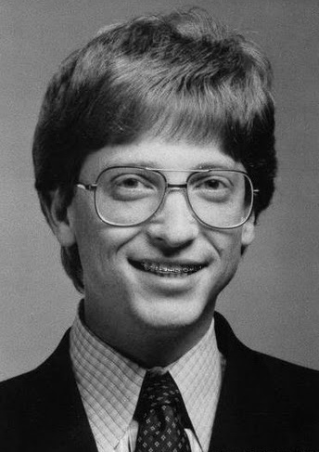
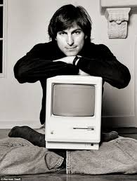

Slide 3
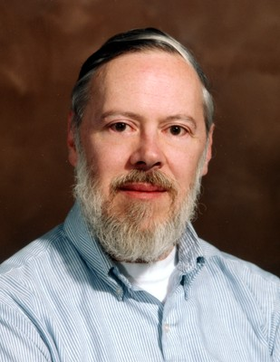
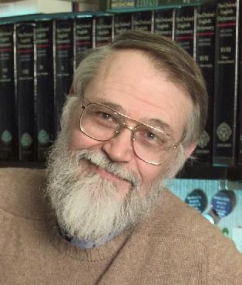
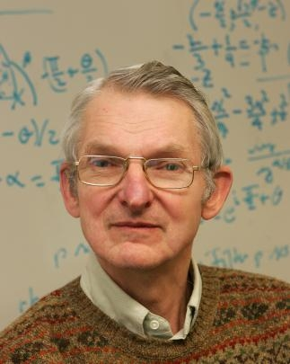
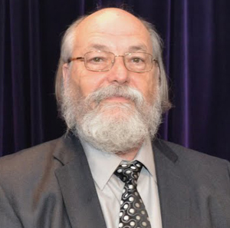
Notes:
Dennis Ritchie (passed away same week as Steve Jobs) Brian Kernighan
Ken Thompson Douglas Mcilroy
Joe Ossanna is missing from picture
Creators of the OS called Unix. Unix or Unics (Uniplexed Information and Computing Service) is a pun on Multics(Multiplexeed Information and Computer Services) and OS developed by MIT, Bell Labs, and GE
Kernighan is not credited as a ‘creator’, but in 1972 Unix was re-written in the C programming language created by Kernighan and Ritchie.

Slide 4
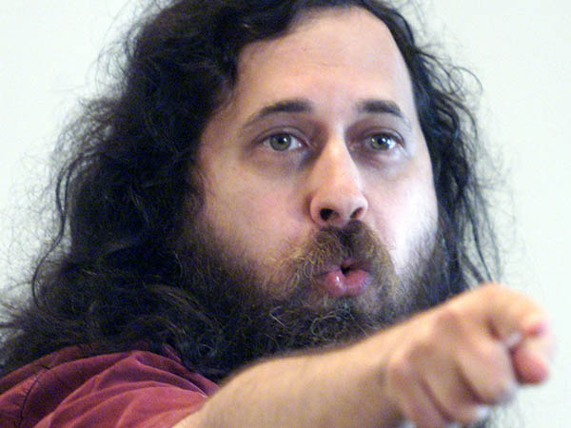
Notes:
Richard Stallman
Eccentric (very interesting to watch his talks)
Pioneered concepts of copy-left (preserves the right to use, modify, and distribute free software) via GNU General Public License (GPL), the most widely used free software license
Creator of GNU operating system and its associated utilities
1983 set out to create a unix-like OS made of completely free software, called the GNU project

Slide 5
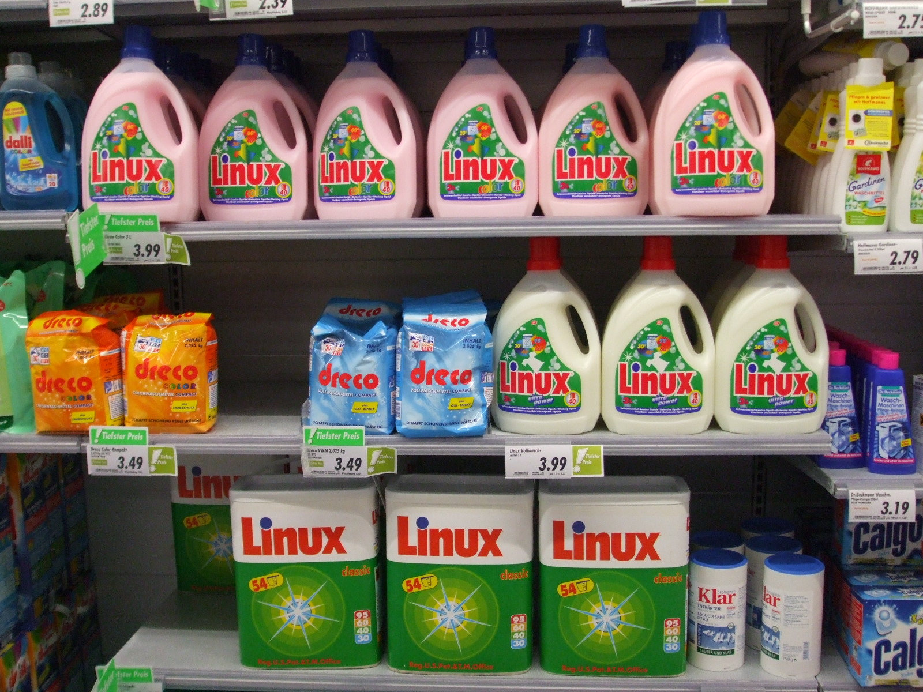

Slide 6

Notes:
Linus Torvalds
Finnish decent
Studying at University of Hellsinki when he purchased copy of Modern Operating Systems (he was frustrated by the licensing of the accompanying OS, so he decided to write his own)
Due to some legal issues, UNIX was not freely available at the time (sold by Bell Labs as a proprietary product)
GNU OS was not yet available although many of the utilities were
As a result, Linux, simply put, is a collection of functionalities to interact with software
The OS that we call Linux today is shorthand for GNU/Linux because a distribution comes packaged with the Linux kernel as well as the GNU utilities
In a given distribution ~10% of source loc are contributed by GNU utilities and ~10% are contributed by Linux kernel
Linux has largest installed base of any general-purpose operating system
Talk about Linux kernel, distributions, and where ‘RedHat’ fits in
Also talk about android and chrome OS (you can log in to your android phone via a terminal)

Slide 7
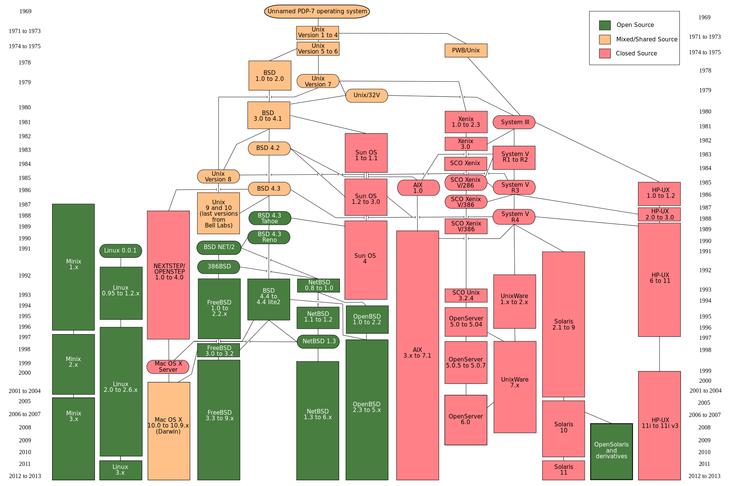
Notes:
Where is Window??
It is based on a completely separate kernel.

Slide 8
Java: built-in data types & objects, formatting

Slide 9
Objectives
Understand the meaning of the vocabulary variable and object in the context of Java
Get familiar with the formatting conventions for this class
Practice your algorithm design skills
Practice translating your algorithm into a Java program

Slide 10
Variables
Placeholders that may refer to either a primitive data type or an object
Put another way, an identifier (name) given to a particular piece/collection of data

Slide 11
Primitive data types
Provided by the Java language
Built-in data type | Sample
byte | -128…127
short | -32,768…32,767
int | -2,147,483,648…2,147,483,647
long | ??..??
float | single precision floating-point
double | double precision floating-point
char | character type
boolean | true, false
Notes:
long: -2^63…2^63-1

Slide 12
Objects
Entities in Java upon which actions can be performed
Examples thus far include: GLabel

Slide 13
Variable naming conventions
camelCase
Meaningful
No spaces

Slide 14
Formatting expectations
Identifiers MUST follow naming conventions
Curly brace placement
White space
Comments

Slide 15
Comments
Single line - // …
Multiples lines - /* … */
Javadoc - /** … */

Slide 16
Demonstration
Notes:
Go through Lab 01 in detail
Some notable things:
Use of ACM library
init() and run()
‘public class’ is not named so because we are in class ☺ this is a requirement of Java (we will talk about this later
For now, just know that class name must match the name of the source file it is included in
Comments – We will go through Javadoc, when we start writing our own methods
Variable scope
Two scopes defined in every Java file we will use
class-level scope – everything between the opening { for ‘public class’ and its closing }
method-level scope – everything between opening { for a method and its closing }

Slide 17
Practice
Copy the Java file “BucketWeightCalculator” from /usr/people/classes/CS160 directory to your CS160 directory
Solve the problem
Express the solution as an algorithm
Code algorithm in Java
Determine variables
Code in Java

