Slide 1
Java: inheritance

Slide 2
Objectives
Understand usefulness of inheritance in Java
Learn syntax of inheritance in Java

Slide 3
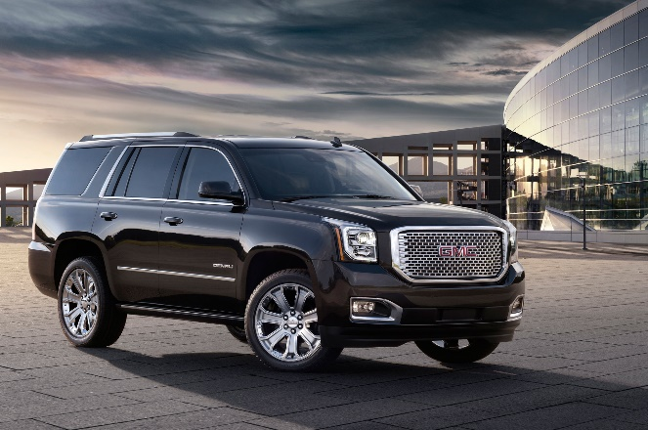
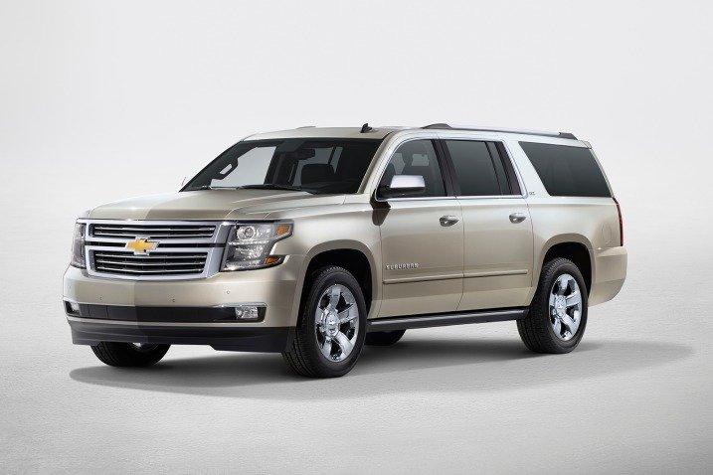
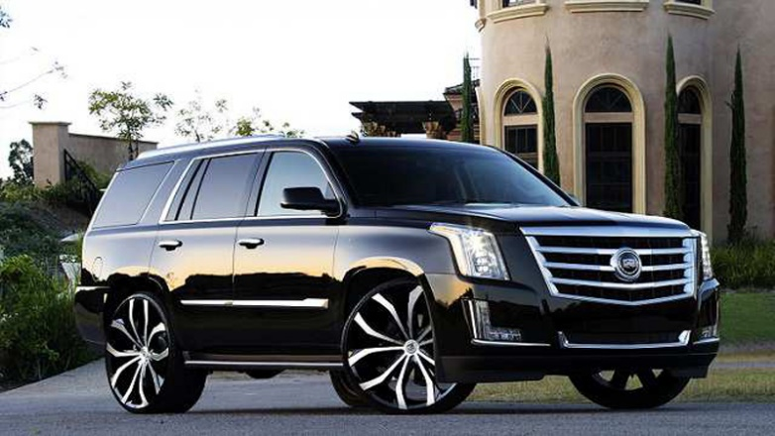
Real world example
Car
SUV
Truck

Slide 4
Inheritance
Describes a relationship between two Java classes
A more general class (superclass)
A more specialized class (subclass)
Can think of this relationship using the phrase is a
For example, a Yukon is a SUV
And, a Yukon SUV is a GMC

Slide 5
ACM program classes
We have created many subclasses of the different program classes provided by the ACM library
Why did we do this?
Reduce code duplication
Notes:
We don’t want to rewrite all of the code necessary to create a GraphicsProgram – a canvas along with all of its associated functionalities in Java – the authors of the ACM library have already done that. If we want to change the behavior of the default GraphicsProgram, i.e., add new elements, we will do that by creating a new class that is a GraphicsProgram, i.e., a specialization of a GraphicsProgram or a subclass

Slide 6
Substitution principle
You can always use a subclass object when a superclass object is expected
This is allowed because each instance of a subclass is an instance of the superclass
A Yukon SUV is a GMC
Is the converse true?

Slide 7
Inheritance syntax
public class SubclassName extends SuperclassName
{
…
}
public class Cannon2 extends GraphicsProgram
{
…
}

Slide 8
Practice
Explore the Java and ACM API documentation
Create the inheritance diagrams for Bullseye.java and BullseyePlacer.java
Notes:
What is at the top of the inheritance diagrams?
It turns out that java.lang.Object is the superclass of every class in Java, i.e., it is at the top of the inheritance diagram for every class

