Slide 1

Notes:
Start with binary activity

Slide 2
Traditional compilation
Notes:
hello_printer.c

Slide 3
What is Java?
Developed by Sun Microsystems
James Gosling, Mike Sheridan, and Patrick Naughton initiated the Java language project in June 1991
General-purpose and Object-oriented language
Widespread acceptance
Notes:
Java was originally designed for interactive television, but it was too advanced for the digital cable television industry at the time.
The language was initially called Oak after an oak tree that stood outside Gosling's office.
Later the project went by the name Green and was finally renamed Java, from Java coffee.
Gosling designed Java with a C/C++-style syntax that system and application programmers would find familiar
https://spectrum.ieee.org/computing/software/the-2017-top-programming-languages
Other types of languages: functional, imperative, procedural
LISP and Prolog are examples of a special purpose programming language designed to create artificial intelligence. used extensively in AI applications
Cobol is a commercial language

Slide 4
Why Java?
Simple[r]
no pointers
automatic garbage collection
rich pre-defined class library
Object oriented
all functions are associated with objects
potentially better code organization and reuse
Platform independent
Same application runs on all platforms
Java bytecode can run on any JVM, on any platform
…including mobile phones and other hand-held devices
Notes:
Also note safety – programmers can execute programs without fear. Features of the language ensure the program is terminated if it tries to do something unsafe.
Python's memory allocation and deallocation method is automatic. The user does not have to preallocate or deallocate memory by hand as one has to when using dynamic memory allocation in languages such as C or C++.
Visual Basic provides the automatic garbage collection system
The Python bytecode itself is not platform-dependent, assuming a full Python VM implementation

Slide 5
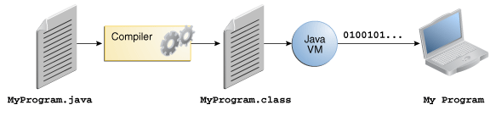
Java Virtual Machine (JVM)
Steps:
Write all source code in plain text files ending with the .java extension.
Compile those source files into .class files by the javac compiler.
A .class file contains bytecodes — the machine language of the Java Virtual Machine(Java VM).
Run the bytecode/.class file using JVM
Notes:
How does it achieve portability?
Both compiled and interpreted
Source code is compiled into Java bytecode
Which is then interpreted by the Java Virtual Machine (JVM)
Java bytecodes are translated on the fly to machine readable instructions in runtime (Java Virtual Machine)
Java bytecode is the instruction set of the Java virtual machine. Eachbytecode is composed by one, or in some cases two, bytes that represent the instruction (opcode), along with zero or more bytes for passing parameters.

Slide 6
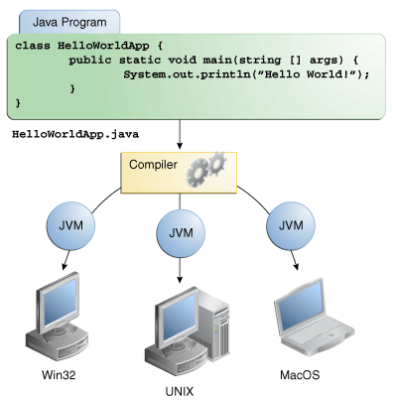
Java Virtual Machine (JVM)
Because the Java VM is available on many different operating systems, the same .class files are capable of running on any platform.
Notes:
What is the problem with just re-compiling?
time cc –o hell_printer hello_printer.c
Takes only fractions of second, why not just re-compile?

Slide 7
Writing first application
You need:
The Java SE Development Kit 7 (JDK 7)
A text editor:
Simple text editors:
Notepad, Notepad++ , gedit, …..
Integrated Development Environment (IDE):
Eclipse, Netbeans, DrJava , …..

Slide 8
QUESTION
What is the difference between JDK and JRE?
Java Download page has both!
http://www.oracle.com/technetwork/java/javase/downloads/jre7-downloads-1880261.html
ANSWER:
You need to answer the question: Do you want to run Java programs or do you want to develop Java programs?
JRE:
If you want to run Java programs, but not develop them, download the JRE.
JDK:
If you want to develop Java applications, download the Java Development Kit, or JDK.
The JDK includes the JRE, so you do not have to download both separately.

Slide 9
Installing Java JDK
On Windows:
http://docs.oracle.com/javase/7/docs/webnotes/install/windows/jdk-installation-windows.html
On Linux:
http://docs.oracle.com/javase/7/docs/webnotes/install/linux/linux-jdk.html
On Mac OS X:
http://docs.oracle.com/javase/7/docs/webnotes/install/mac/mac-jdk.html

Slide 10
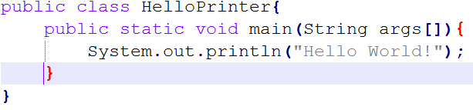
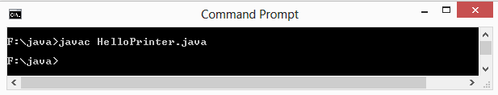
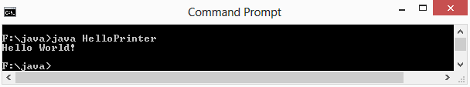
Your first Program: HelloPrinter.java
Choice 1: Using simple text editor
STEP1: Write and save your program in text editor as HelloPrinter.java
STEP2: Compile the source file into a .class file
STEP3: Run the program

Slide 11
Programming Question
Write HelloPrinter program using gedit editor
Save program as HelloPrinter.java
Open a terminal and navigate (cd) to the place you saved your file
Compile program (if no errors, verify .class file is generated)
Run program

Slide 12
Programming Question
Modify your program to write
H
e
l
l
o
W
o
r
l
d
!

Slide 13
Your first Program: HelloPrinter.java
Choice 2: Using IDE
Start the Java development environment (We use DrJava).
Open HelloPrinter.java
Modify it to write Hello <YOUR NAME HERE>!
Compile it and run it.

Slide 14
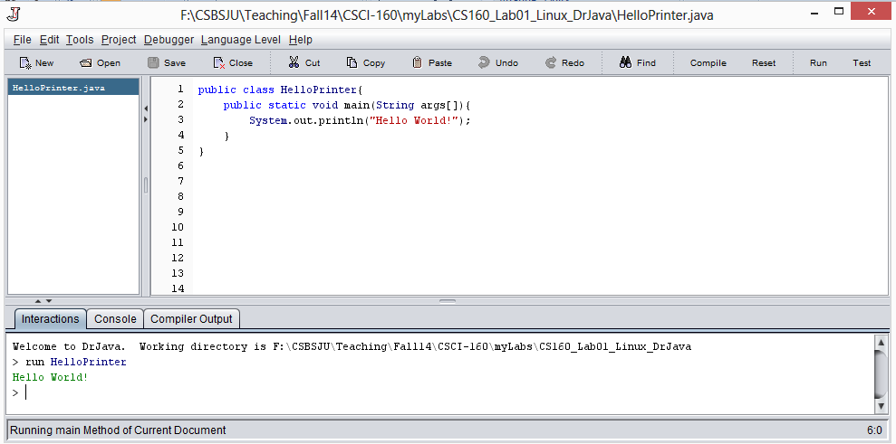
Becoming Familiar with Your Programming Environment
2. Compile
3. Run
1. Write and save program (File->save)

Slide 15
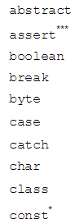

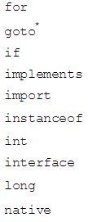
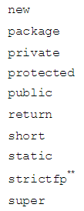
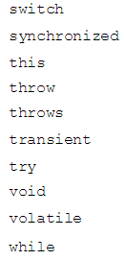
Reserved Words
Here is a list of keywords in the Java programming language. You cannot use any of the following as identifiers in your programs.

Slide 16
Java Conventions
A rule that we agree to follow, even though it’s not required by the language
Begin a class name with an uppercase letter:
Student
Employee
String
Names of variables and methods, never start with an uppercase letter.
age ← variable name
print() ← method name
Identifier names follow camel casing (For subsequent words in name, first word capitalizd)
totalSalary ← variable name
getName() ← method name
SalariedEmployee ← class name

Slide 17
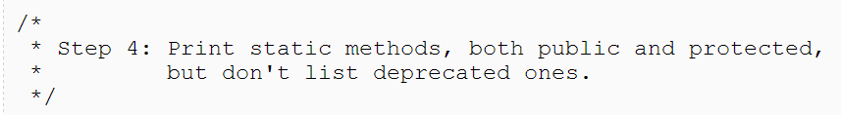
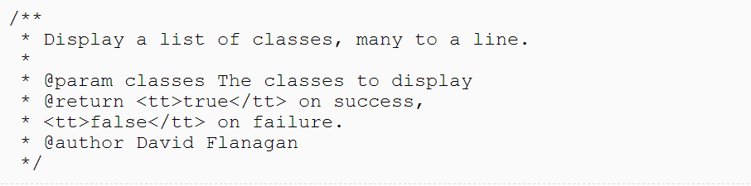
Comments
Java supports three types of comments:
single-line comment:
multiline comment
document comment

Slide 18
Practice
Add a comment to HelloPrinter.java explaining what it does.
Generate documentation for your program.

