Slide 1
Logical reasoning

Slide 2
Objectives
Get familiar with the vocabulary of logical reasoning
Practice.

Slide 3
Argument
A sequence of propositions, called
hypotheses, followed by a final proposition,
called the conclusion.
An argument is valid, whenever the
conclusion is true whenever the hypotheses
are all true, otherwise the argument is invlid.
Notes:
Domain is something that we can define.

Slide 4
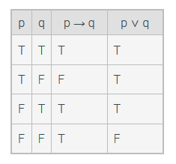
Using a truth table to establish validity
p → q p ∨ q ∴ q

Slide 5
Using a truth table to establish validity
p → q p ∨ q ∴ q
Notes:
Conclusion is true when hypotheses are all true, so argument is valid.

Slide 6
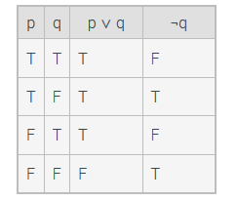
Using a truth table to establish validity
p ∨ q p _ ∴ ¬q

Slide 7
Using a truth table to establish validity
p ∨ q p _ ∴ ¬q
Notes:
Conclusion is not true when hypotheses are all true, so argument is invalid.

Slide 8
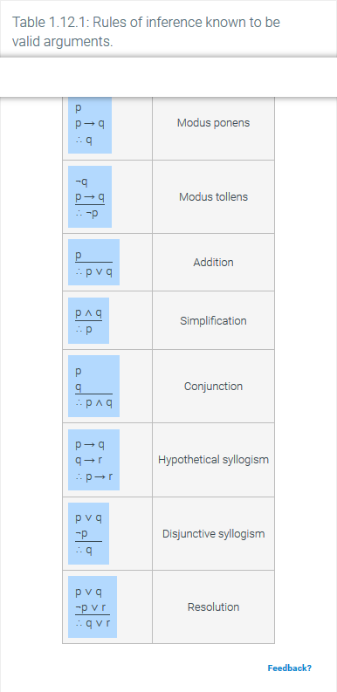
Using a rules of inference to establish validity
Notes:
Using truth tables to establish the validity of an argument can become tedious, especially if an argument uses a large number of variables. Fortunately, some arguments can be shown to be valid by applying rules that are themselves arguments that have already been shown to be valid. The laws of propositional logic can also be used in establishing the validity of an argument.

