Slide 1
Propositional logic

Slide 2
Objectives
Get familiar with the vocabulary of propositional logic
Practice the foundational concepts of propositional logic

Slide 3
Proposition
A statement, that is either true or false, but
not both
Truth value
A value indicting whether a proposition is
actually true or false
Notes:
Truth value is something that we assign to a proposition, either axiomatically (assumed to be true) or with further evidence.

Slide 4
Today is Thursday
Today is Friday
2 + 2 = 4
x + 7 = 11
Extraterrestrial life is real
Extraterrestrial life is awesome
Give some examples of statements that are not propositions.
Notes:
Yes
Yes
Yes
No
Yes
Yes

Slide 5
Compound proposition
Individual propositions connected with logical
operations.
Logical operation
Combines propositions using a particular
composition rule.

Slide 6
Conjunction (p ∧ q)
True if both p is true and q is true. False
otherwise.
Disjunction (p ∨ q)
True if either one of p or q is true, or if both
are true. False if neither p nor q is true.
Exclusive or (p ⊕ q)
True if p is true and q is false or q is true and
p is false. False otherwise.
Negation (¬p)
Reverses the truth value of p.

Slide 7
Inclusive or vs. exclusive or
For each of these sentences, determine whether an inclusive or, or an exclusive or, is intended. Explain your answer.
Coffee or tea comes with dinner.
A password must have at least three digits or be at least eight characters long.
The prerequisite for the course is a course in number theory or a course in cryptography.
You can pay using U.S. dollars or euros.
Notes:
Exclusive or: You get only one beverage with your meal.
Inclusive or: Long passwords can have any combination of symbols.
Inclusive or: A student with both courses is even more qualified.
Either interpretation possible; a traveler might with to pay with a mixture of the two currencies, or the store may not allow that.

Slide 8
Order of operations
¬ (not)
∧ (conjunction)
∨ (disjunction)
Parenthesis are useful to specify the order in which operations are to be performed:
¬q ∨ ¬p ∧ q, is different than
(¬q ∨ ¬p) ∧ q
For what truth values of p and q will these two compound propositions have different truth values?

Slide 9
Truth table
Shows the truth value of a compound
proposition for every possible combination of
truth values for the variables contained in the
compound proposition.
p | q | p ∧ q
T | T | T
T | F | F
F | T | F
F | F | F

Slide 10
Quick check
p | q | p ⊕ q
T | T
T | F
F | T
F | F

Slide 11
Quick check
p | q | p ⊕ q
T | T | F
T | F | T
F | T | T
F | F | F

Slide 12
Verify
Construct the truth tables for the two compound propositions from the order of operations example to verify your answer.
¬q ∨ ¬p ∧ q
(¬q ∨ ¬p) ∧ q

Slide 13
Conditional proposition
A compound proposition that uses a
conditional operation.
Conditional operation (p → q)
False if p is true and q is false. True otherwise.
Here p is called the hypothesis, and q is called
the conclusion.

Slide 14
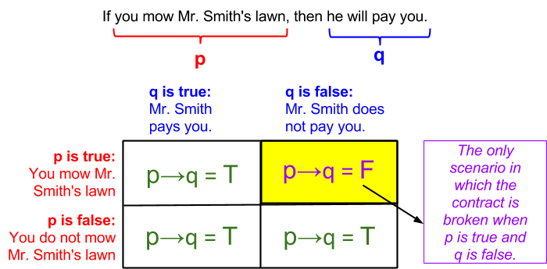
Figure 1.3.1: A conditional statement illustrated.
If you do not mow Mr. Smith’s lawn and he pays you, that is great, but it doesn’t make the statement false.

Slide 15
Only if
p is true “only if” q is true.

Slide 16
Converse
p → q is q → p
Contrapositive
p → q is ¬q → ¬p
Inverse
p → q is ¬p → ¬q
Notes:
Three conditional statements related to proposition p → q are so common that they have special names.

Slide 17
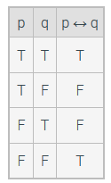
Biconditional (p ↔ q)
True when p and q have the same truth value and is false when p and q have different truth values.
Notes:
How does this relate to the truth table for XOR?

Slide 18
Logical equivalence
Tautology
A proposition that is always true, regardless
of the truth value of the individual
propositions that occur in it.
Contradiction
A compound proposition that is always false,
regardless of the truth value of the individual
propositions that occur in it.
Notes:
Tautology: p ∨ ¬p
Contradition: p ∧ ¬p
Exercise 1.4.1

Slide 19
