Slide 1
Propositional logic

Slide 2
Objectives
Get familiar with the vocabulary of propositional logic
Practice the foundational concepts of propositional logic

Slide 3
Proposition
A statement, that is either true or false, but
not both
Truth value
A value indicting whether a proposition is
actually true or false
Notes:
Truth value is something that we assign to a proposition, either axiomatically (assumed to be true) or with further evidence.

Slide 4
Today is Thursday
Today is Friday
2 + 2 = 4
x + 7 = 11
Extraterrestrial life is real
Extraterrestrial life is awesome
Give some examples of statements that are not propositions.
Notes:
Yes
Yes
Yes
No
Yes
Yes

Slide 5
Compound proposition
Individual propositions connected with logical
operations.
Logical operation
Combines propositions using a particular
composition rule.

Slide 6
Conjunction (p ∧ q)
True if both p is true and q is true. False
otherwise.
Disjunction (p ∨ q)
True if either one of p or q is true, or if both
are true. False if neither p nor q is true.
Exclusive or (p ⊕ q)
True if p is true and q is false or q is true and
p is false. False otherwise.
Negation (¬p)
Reverses the truth value of p.

Slide 7
Inclusive or vs. exclusive or
For each of these sentences, determine whether an inclusive or, or an exclusive or, is intended. Explain your answer.
Coffee or tea comes with dinner.
A password must have at least three digits or be at least eight characters long.
The prerequisite for the course is a course in number theory or a course in cryptography.
You can pay using U.S. dollars or euros.
Notes:
Exclusive or: You get only one beverage with your meal.
Inclusive or: Long passwords can have any combination of symbols.
Inclusive or: A student with both courses is even more qualified.
Either interpretation possible; a traveler might with to pay with a mixture of the two currencies, or the store may not allow that.

Slide 8
Order of operations
¬ (not)
∧ (conjunction)
∨ (disjunction)
Parenthesis are useful to specify the order in which operations are to be performed:
¬q ∨ ¬p ∧ q, is different than
(¬q ∨ ¬p) ∧ q
For what truth values of p and q will these two compound propositions have different truth values?

Slide 9
Truth table
Shows the truth value of a compound
proposition for every possible combination of
truth values for the variables contained in the
compound proposition.
p | q | p ∧ q
T | T | T
T | F | F
F | T | F
F | F | F

Slide 10
Quick check
p | q | p ⊕ q
T | T
T | F
F | T
F | F

Slide 11
Quick check
p | q | p ⊕ q
T | T | F
T | F | T
F | T | T
F | F | F

Slide 12
Verify
Construct the truth tables for the two compound propositions from the order of operations example to verify your answer.
¬q ∨ ¬p ∧ q
(¬q ∨ ¬p) ∧ q

Slide 13
Conditional proposition
A compound proposition that uses a
conditional operation.
Conditional operation (p → q)
False if p is true and q is false. True otherwise.
Here p is called the hypothesis, and q is called
the conclusion.

Slide 14
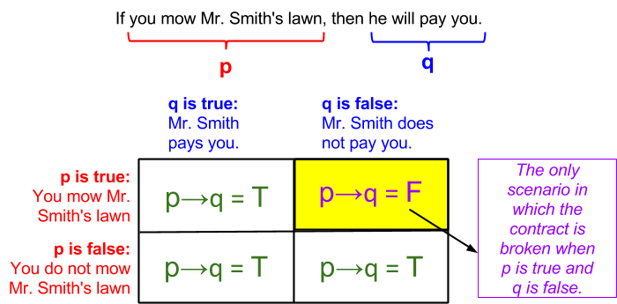
Figure 1.3.1: A conditional statement illustrated.
If you do not mow Mr. Smith’s lawn and he pays you, that is great, but it doesn’t make the statement false.

Slide 15
Only if
p is true “only if” q is true.

Slide 16
Converse
p → q is q → p
Contrapositive
p → q is ¬q → ¬p
Inverse
p → q is ¬p → ¬q
Notes:
Three conditional statements related to proposition p → q are so common that they have special names.

Slide 17
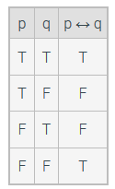
Biconditional (p ↔ q)
True when p and q have the same truth value and is false when p and q have different truth values.
Notes:
How does this relate to the truth table for XOR?

Slide 18
Logical equivalence
Tautology
A proposition that is always true, regardless
of the truth value of the individual
propositions that occur in it.
Contradiction
A compound proposition that is always false,
regardless of the truth value of the individual
propositions that occur in it.
Notes:
Tautology: p ∨ ¬p
Contradition: p ∧ ¬p
Exercise 1.4.1

Slide 19
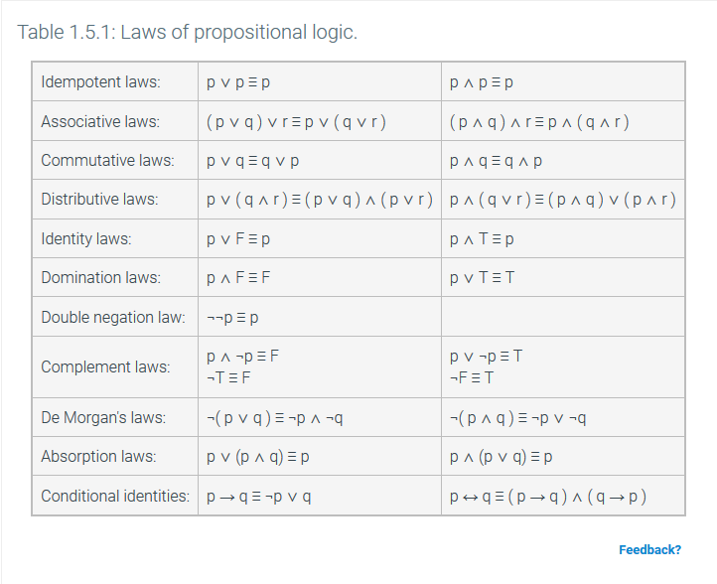

Slide 20
Practice
Rotate both motors 4 rotations
Rotate left motor 2 rotations
Go back to step 1
Notes:
This is an example of an algorithm for a robot.
Is this an algorithm?
Not finite time

Slide 21
Practice
Write an algorithm, for someone who does not know about multiplication, to multiply two numbers, e.g., 5*4
Notes:
Have students create their algorithm, then have them read me instructions and act them out: most likely, there will be step that says, “add x, y times”, or something like that, this is an opportunity to introduce a repeat step.
Have some number of groups of students write their algorithm on the board
A “good” solution might look like this:
Set a value called, y to 4
Add 5 to a value called product
Subtract 1 from y
If y is greater than 0, then go back to step 3
Output product
Emphasize the need for variables, i.e., names for values

Slide 22
Practice (on your own)
Write an algorithm to raise one number to the power of another number, e.g. x^{y}

Slide 23
Task
Write a short story about yourself in a language that you are learning, but not fluent in.
How would you start?
What will your process look like?
Notes:
Here language means a natural language (read: human language).
Emphasize to students that if they were learning another language, and were asked to write a short story in that language, it is unlikely that they would write the first draft in the second language, rather, they would write it in their native language, then translate it to the second language.

Slide 24
Then,
a program is really just a translation of an algorithm into a particular programming language
short story → algorithm
second language → programming language
Notes:
The same is true for computers, where short story -> algorithm (solution to problem), and second language -> programming language

Slide 25
Why do we need algorithms?
You can’t write a program to solve a problem until you know the solution to the problem
Notes:
It is CRITICAL that we design our algorithm before implementing our program
This is the most important slide in the deck!

