Slide 1


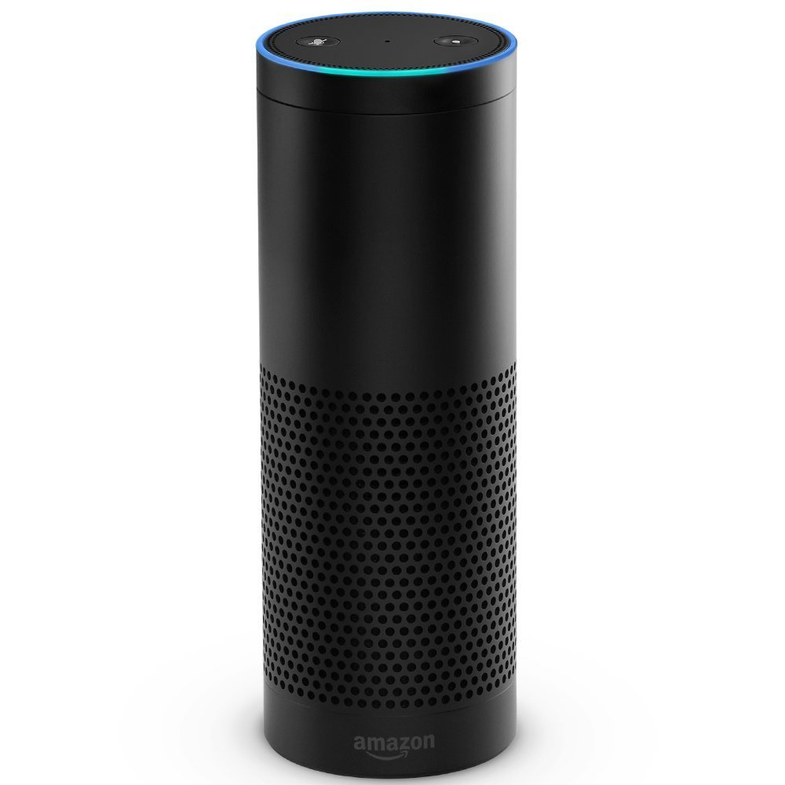
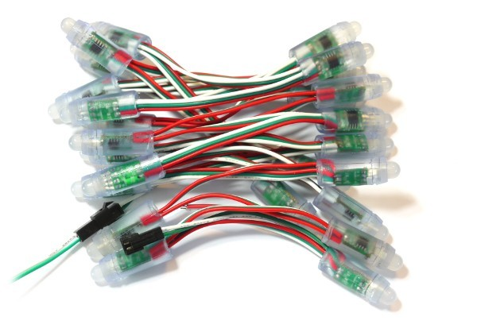

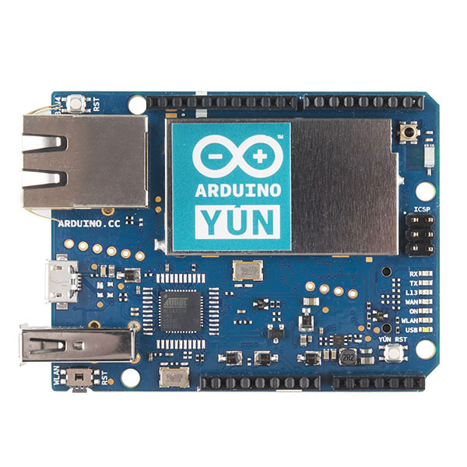





Table with
Tree State
AWS
DynamoDB
MQTT
Delta Topic
1
2
4
5
3
9
8
7
6
Christmas Tree Skill
AWS
Lambda
AWS
IoT
Arduino Yun
WS2811 LED Strand
MQTT
Update Topic
AWS
S3
Bucket
with MP3s

