Slide 1

Graphical Passwords
Masoud Seraji Indra Meyers Evan Harrigan

Slide 2
What is graphical password?
A graphical password is a form of authentication using images rather than letters, digits, or special characters.
The type of images used and the ways in which users interact with them vary between implementations.

Slide 3
Main Objective of Graphical Passwords
Humans remember images better than they remember textual information.
Provide the sound signature in graphical system and reduce the chances to forget the password
Effective in terms of memorability
Effective in terms of security
Easy to learn but typically require longer login time.
The human brain processes image 60,000 times faster than text.

Slide 4
Memory problems are more common than you think
Almost 40% of us will experience some form of memory loss after we turn 65.
More than 6 million Americans of all ages have Alzheimer’s.
Currently, more than 55 million people live with dementia worldwide
There are nearly 10 million new cases every year.

Slide 5
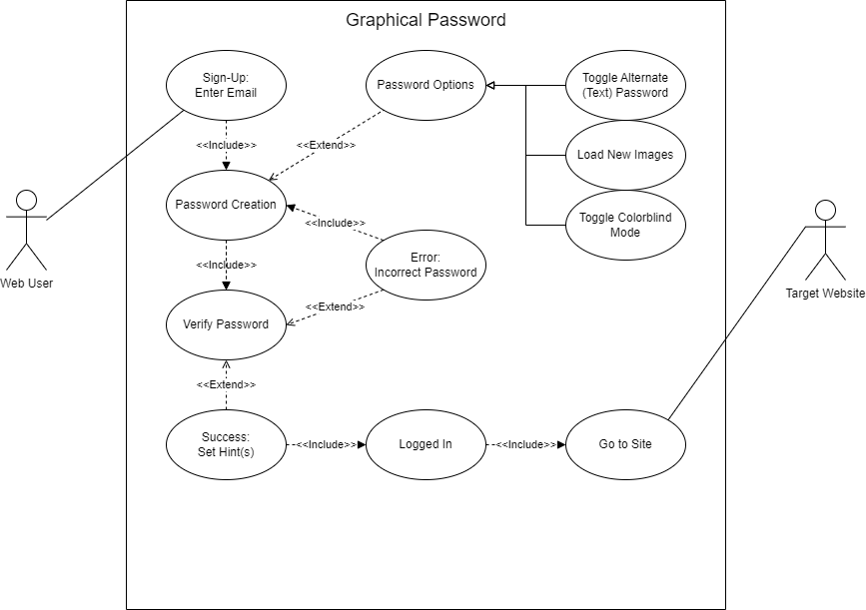
UML Use Case for a Web User (Sign-up)

Slide 6
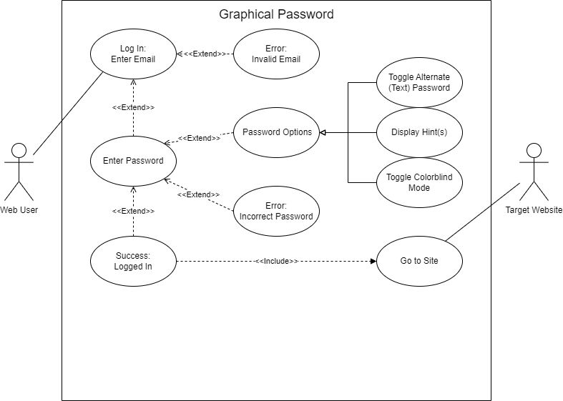
UML Use Case for a Web User (Log in)

Slide 7
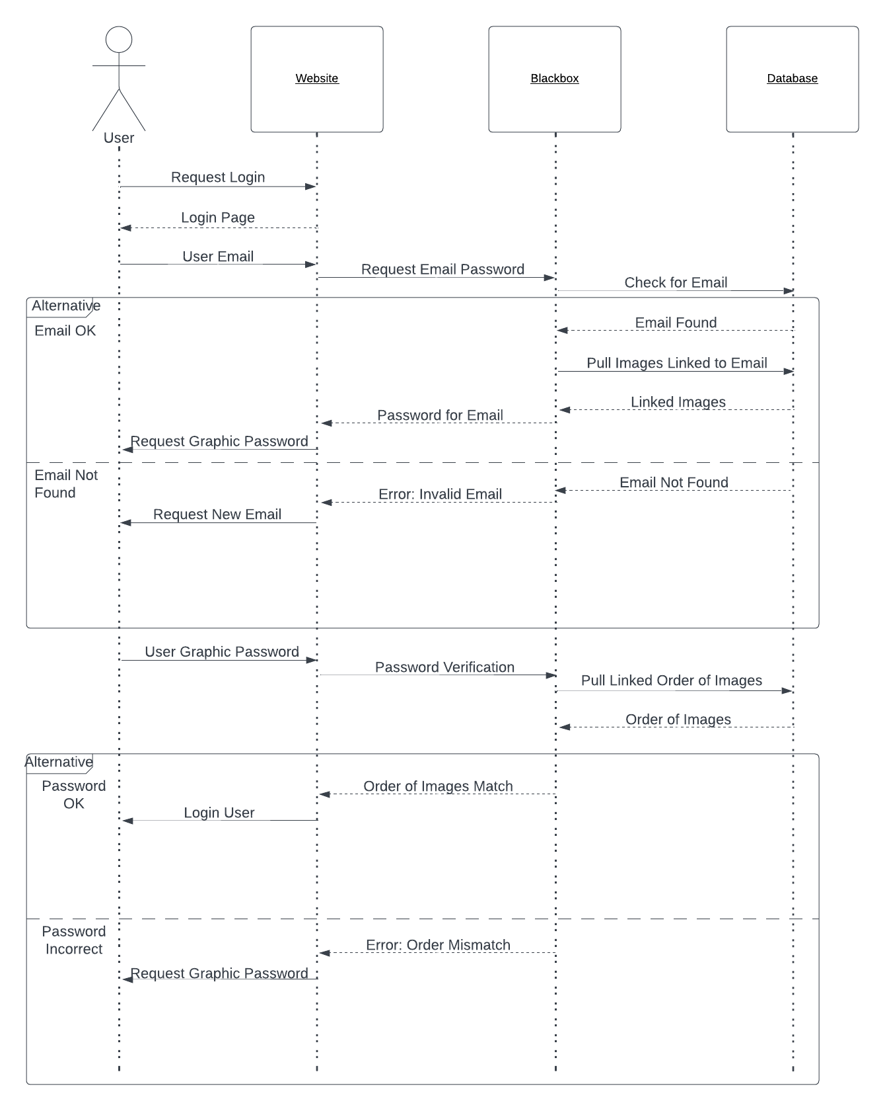
UML Sequence for Logging In

Slide 8
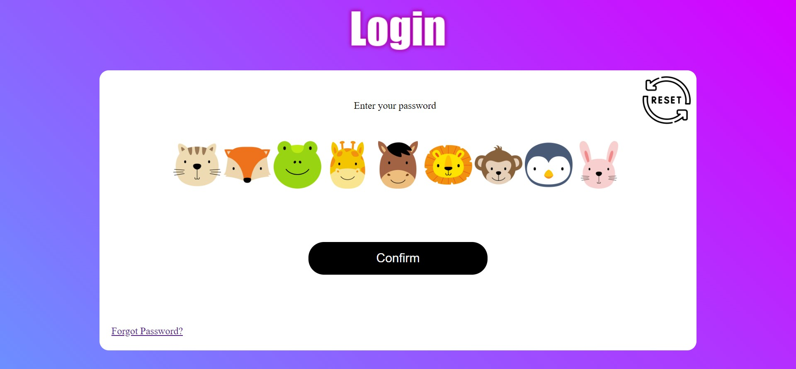
Technical Platforms
Flask
Python
MySQL

Slide 9
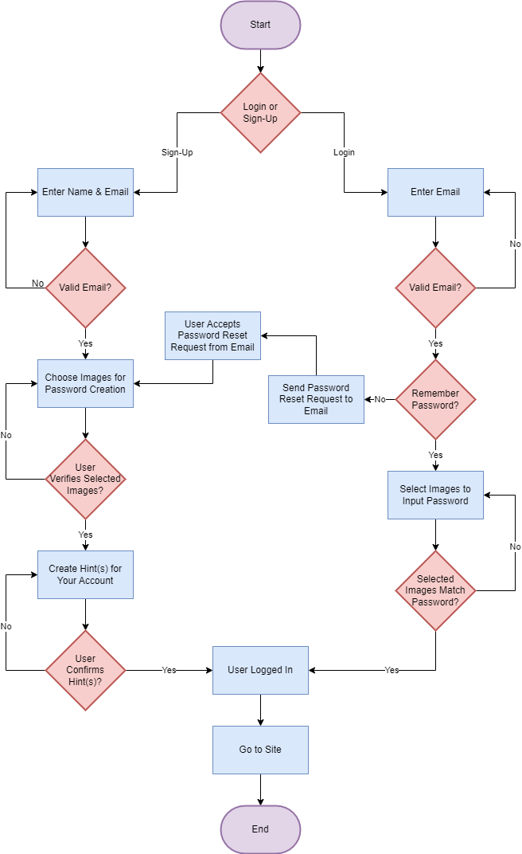
HTML Pages Flow

