Slide 1

Graphical Passwords
Masoud Seraji Indra Meyers Evan Harrigan

Slide 2
Main Objective of Graphical Passwords
Humans remember images better than they remember textual information.
Provide the sound signature in graphical system and reduce the chances to forget the password
Effective in terms of memorability
Effective in terms of security
Easy to learn but typically require longer login time.

Slide 3
Memory problems are more common than you think
Almost 40% of us will experience some form of memory loss after we turn 65.
More than 6 million Americans of all ages have Alzheimer’s.
Currently, more than 55 million people live with dementia worldwide
There are nearly 10 million new cases every year.
The human brain processes image 60,000 times faster than text.

Slide 4
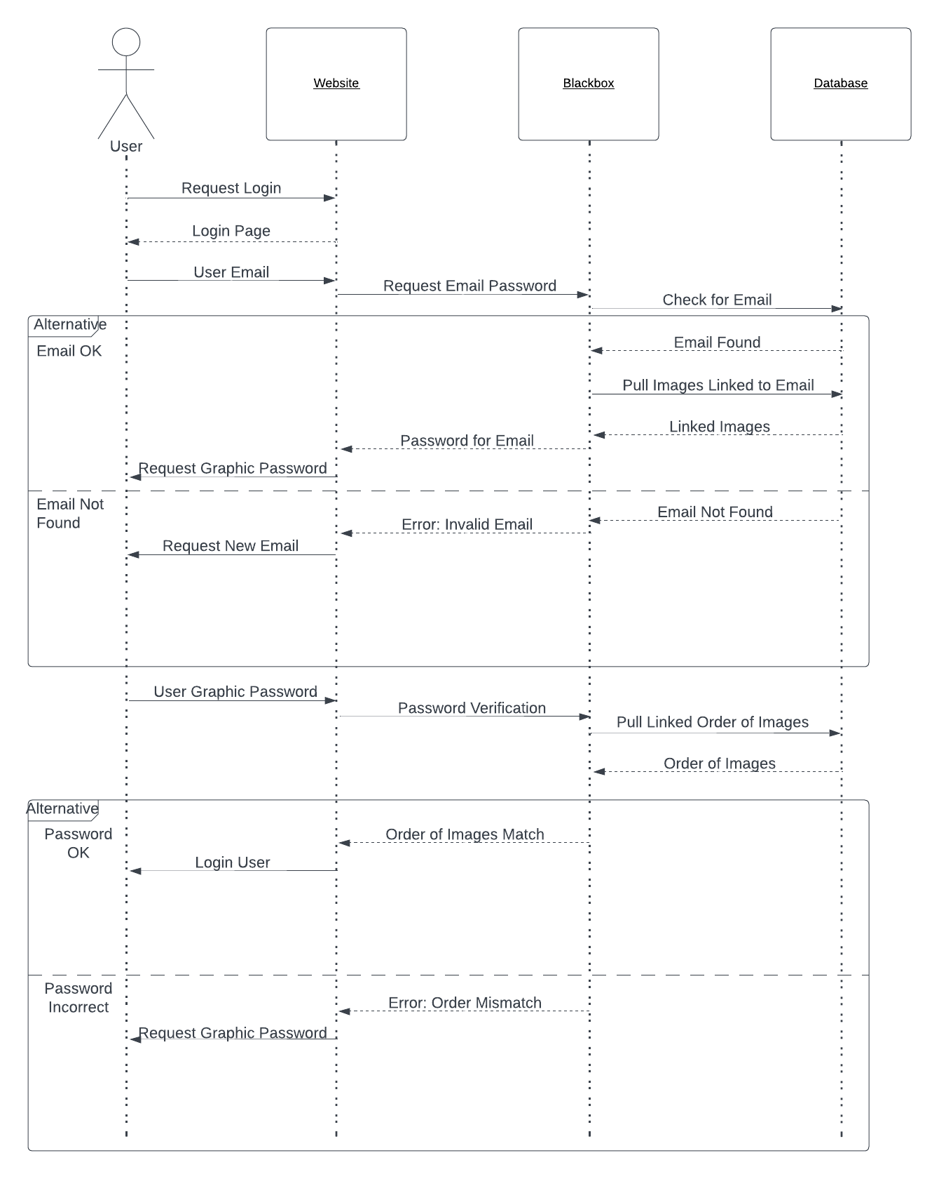
UML Sequence for Logging In

Slide 5
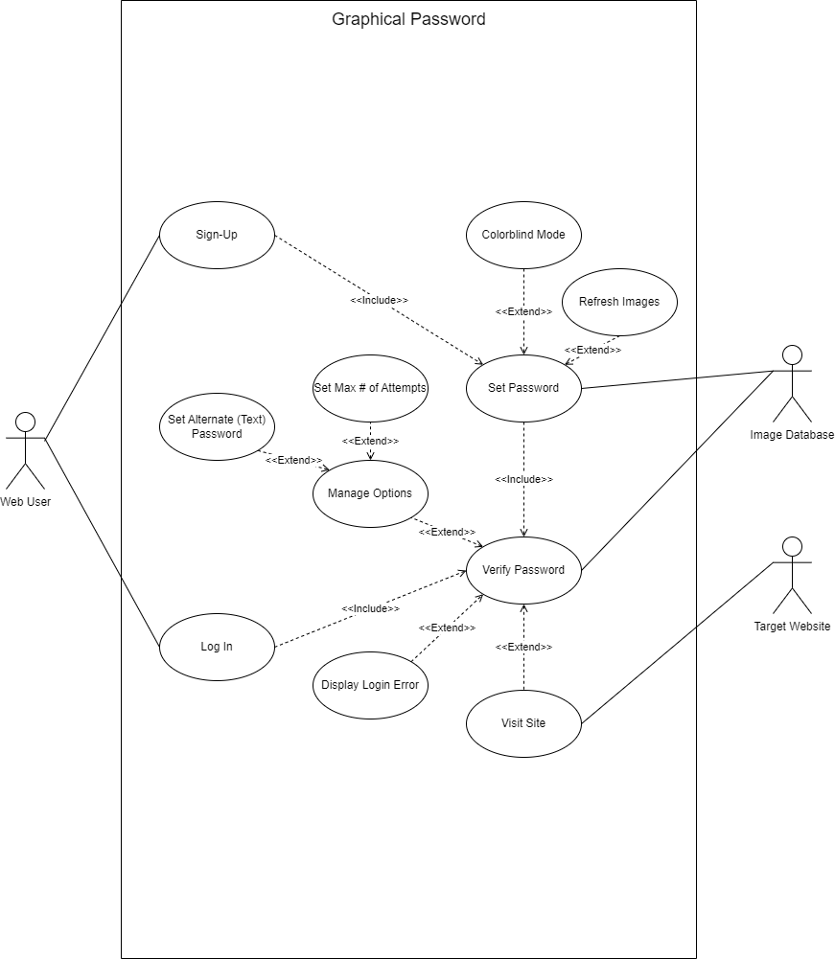
UML Use Case for a Web User

Slide 6
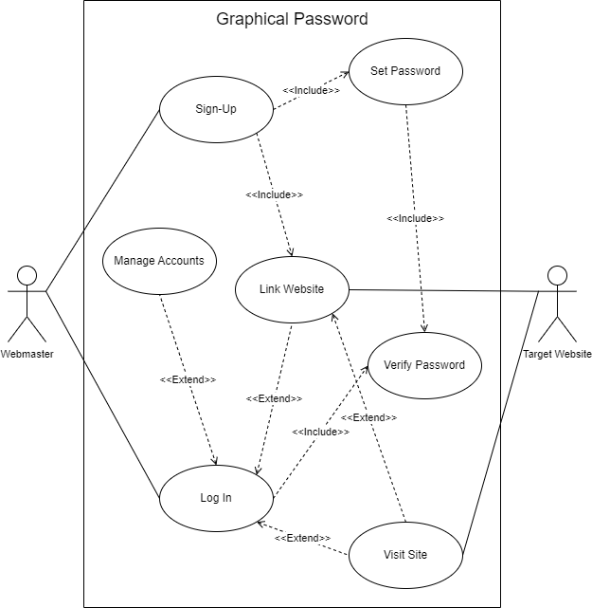
UML Use Case for a Webmaster

