Slide 1
Iteration 1
2b|!2b

Slide 2
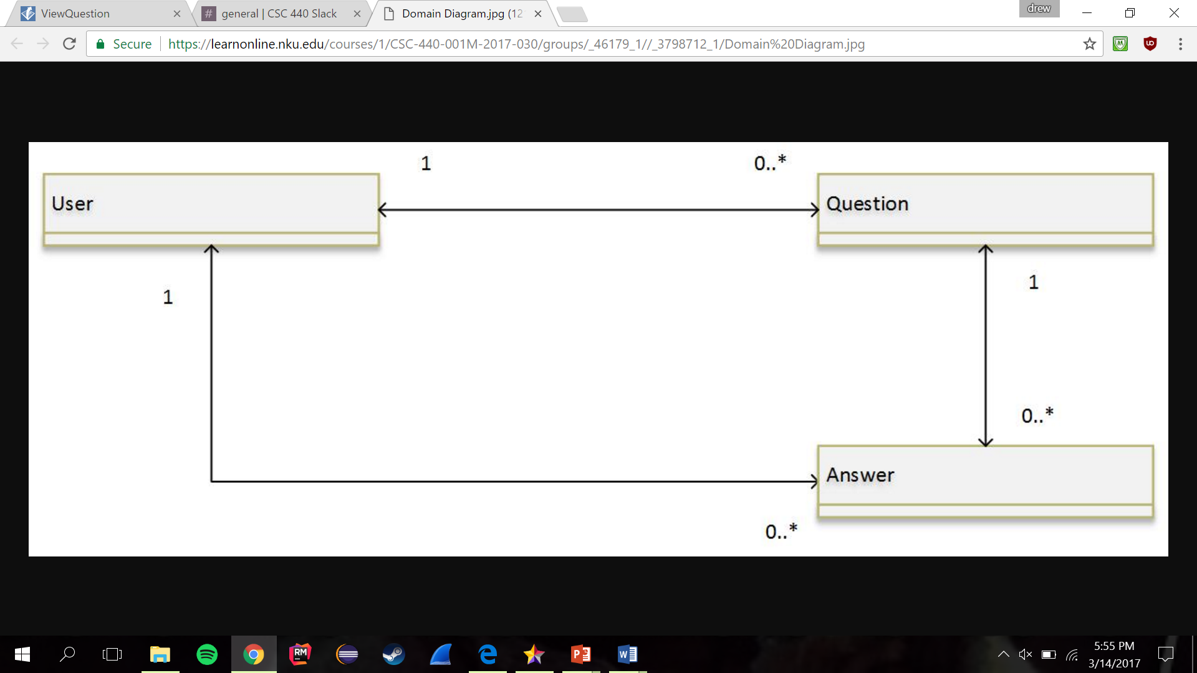
Domain Model
Each User can have many Questions and many Answers, which they have posted to the site. Each Question can have many Answers posted in the question thread.

Slide 3
Design Decisions
Decided to have one single class that would contain our user.
The “User” class would have a role tied to them that would determine if the user was a student, faculty, registrar or administrator.
We achieved this by implementing a role variable, that when defined would allow the user to have the privileges of that role.
Database Model
Each User can have many Questions and many Answers, which they have posted to the site. Each Question can have many Answers posted in the question thread.

Slide 4
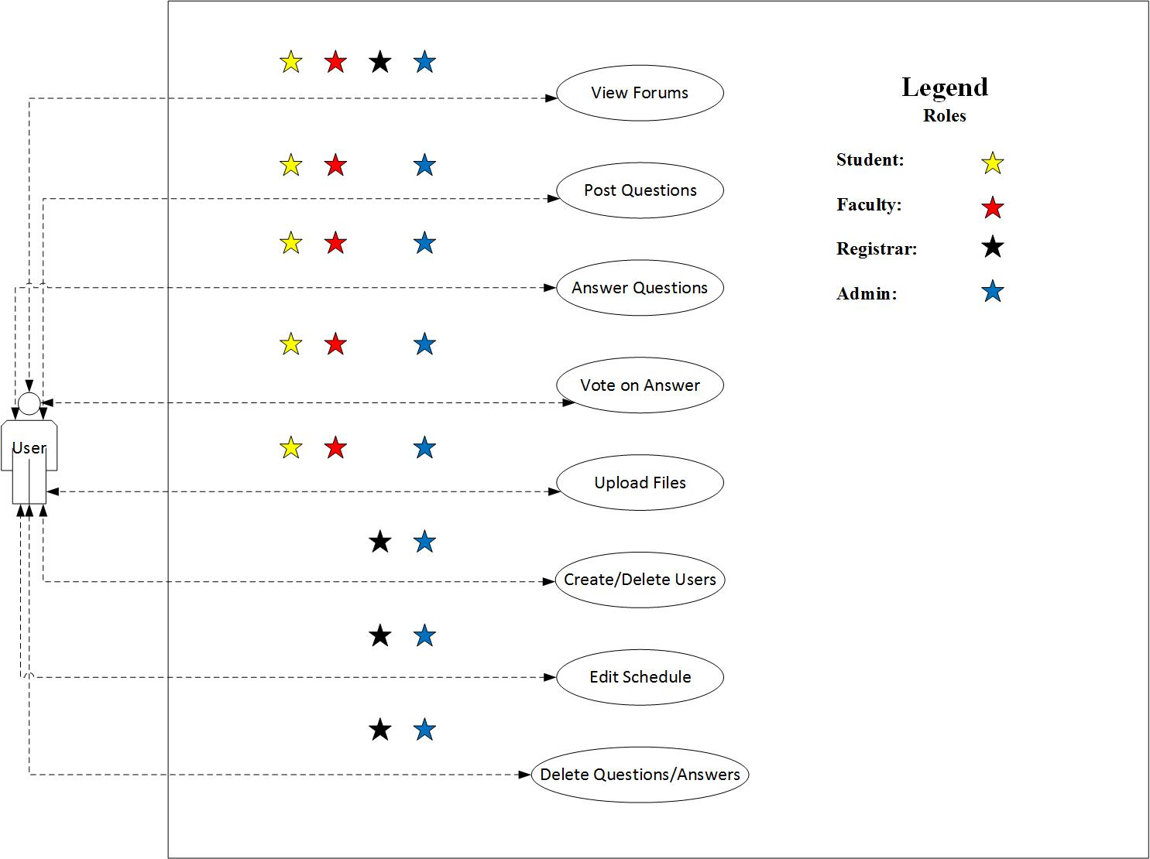
Use Case Model

Slide 5
Use Cases Implemented
UC1: View Forum
View all the questions posted (High priority)
UC2: Post Question
Populate the forum with questions (High priority)
UC3: Answer Question
Populate the question with answers (High priority)
UC5: Delete Questions and Answers
Moderate the questions/answers for appropriateness
UC6: Create and Delete Users
Relate questions and answers to a specific user (Medium priority)

Slide 6
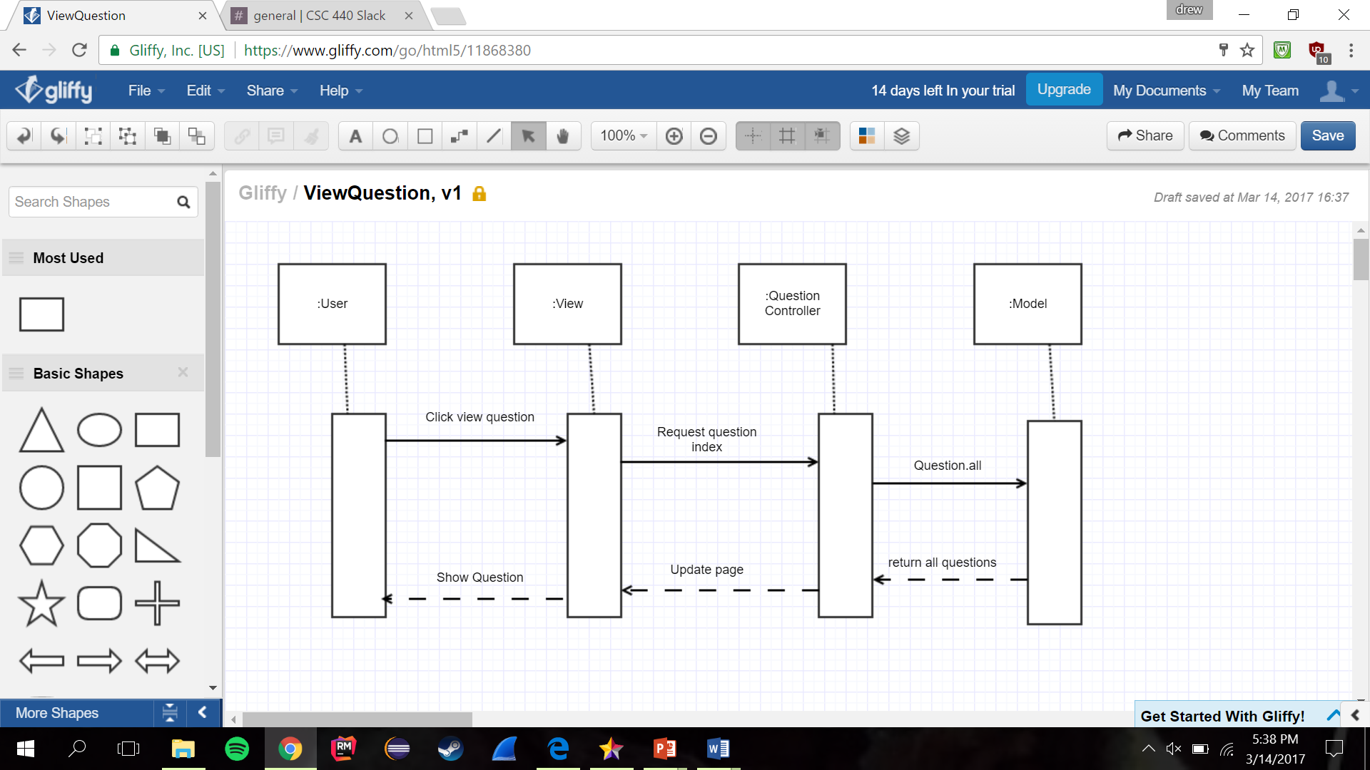
UC1: View Forum

Slide 7
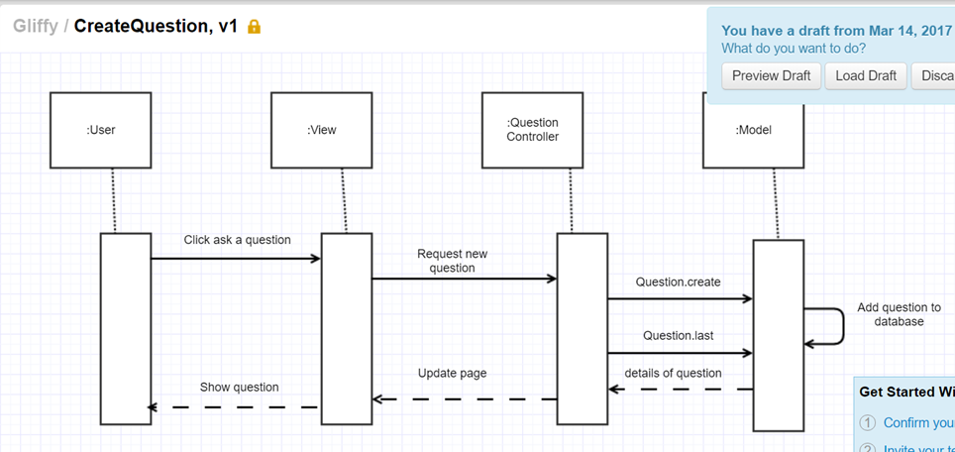
UC2: Post Question

Slide 8
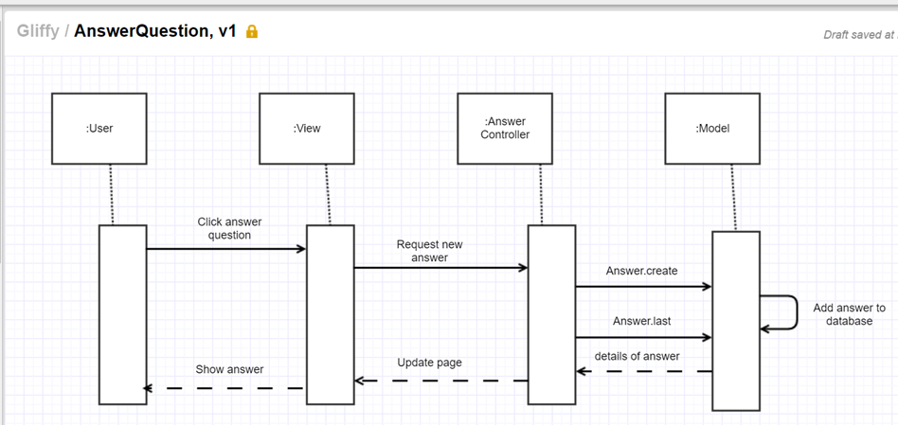
UC3: Answer Question

Slide 9
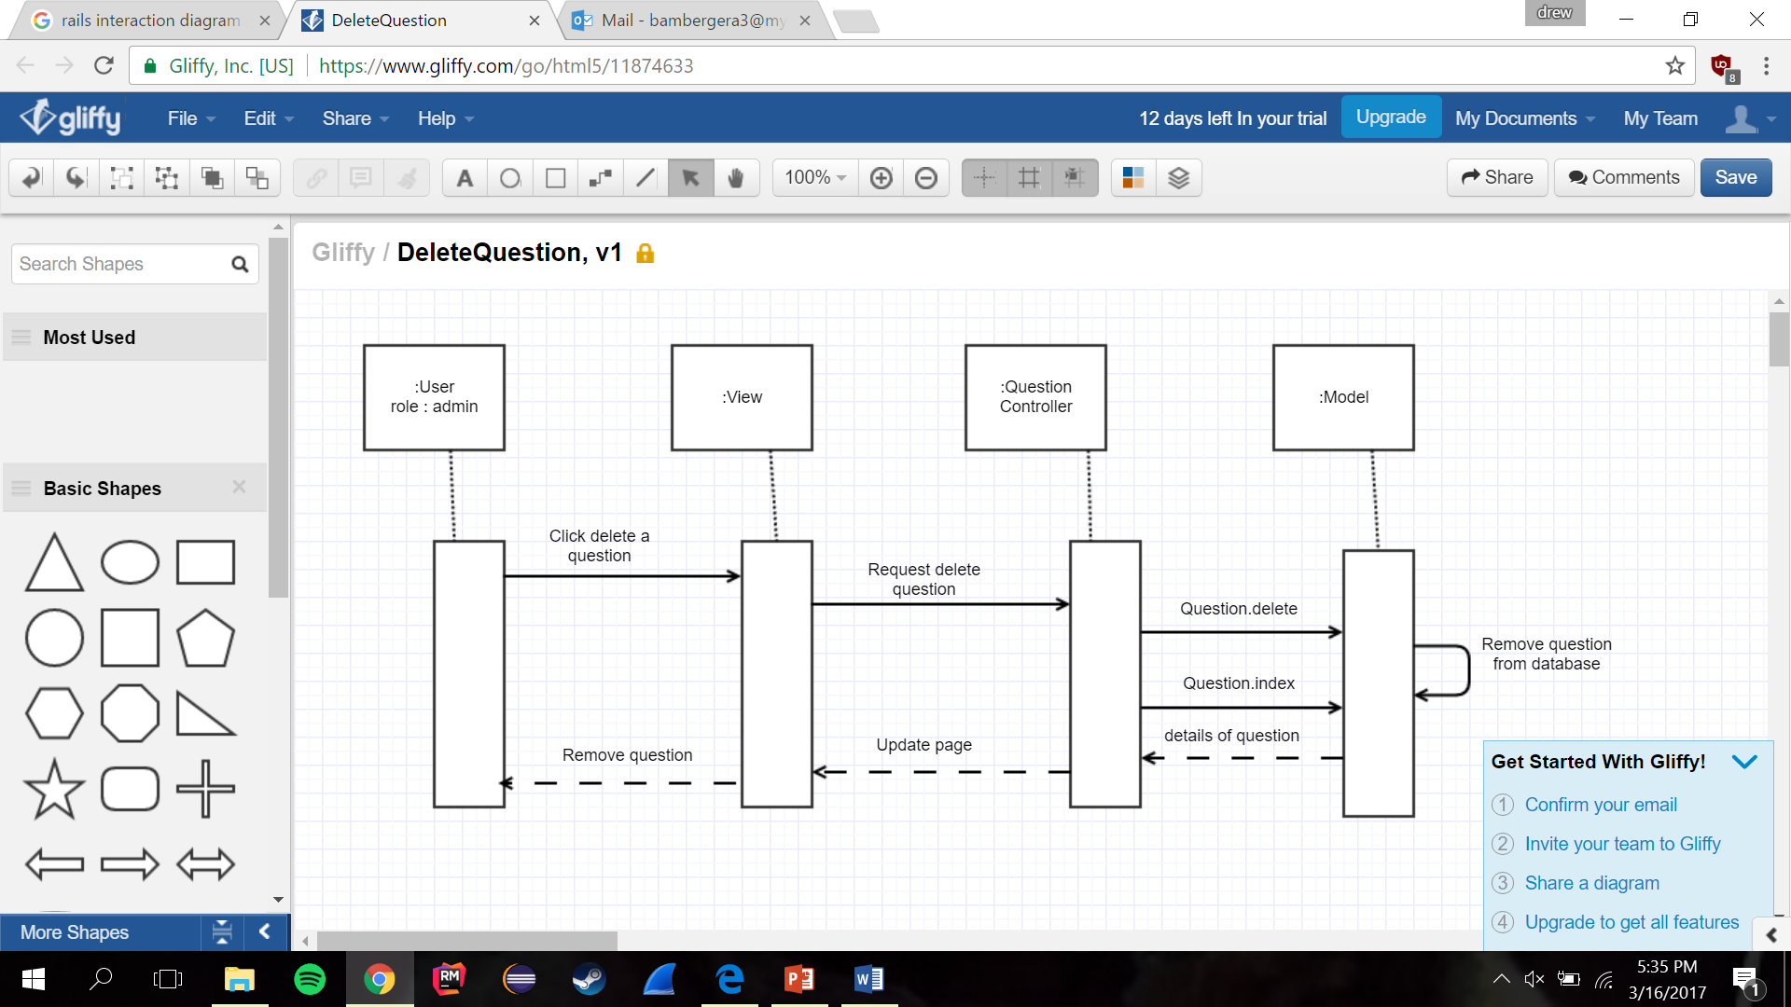
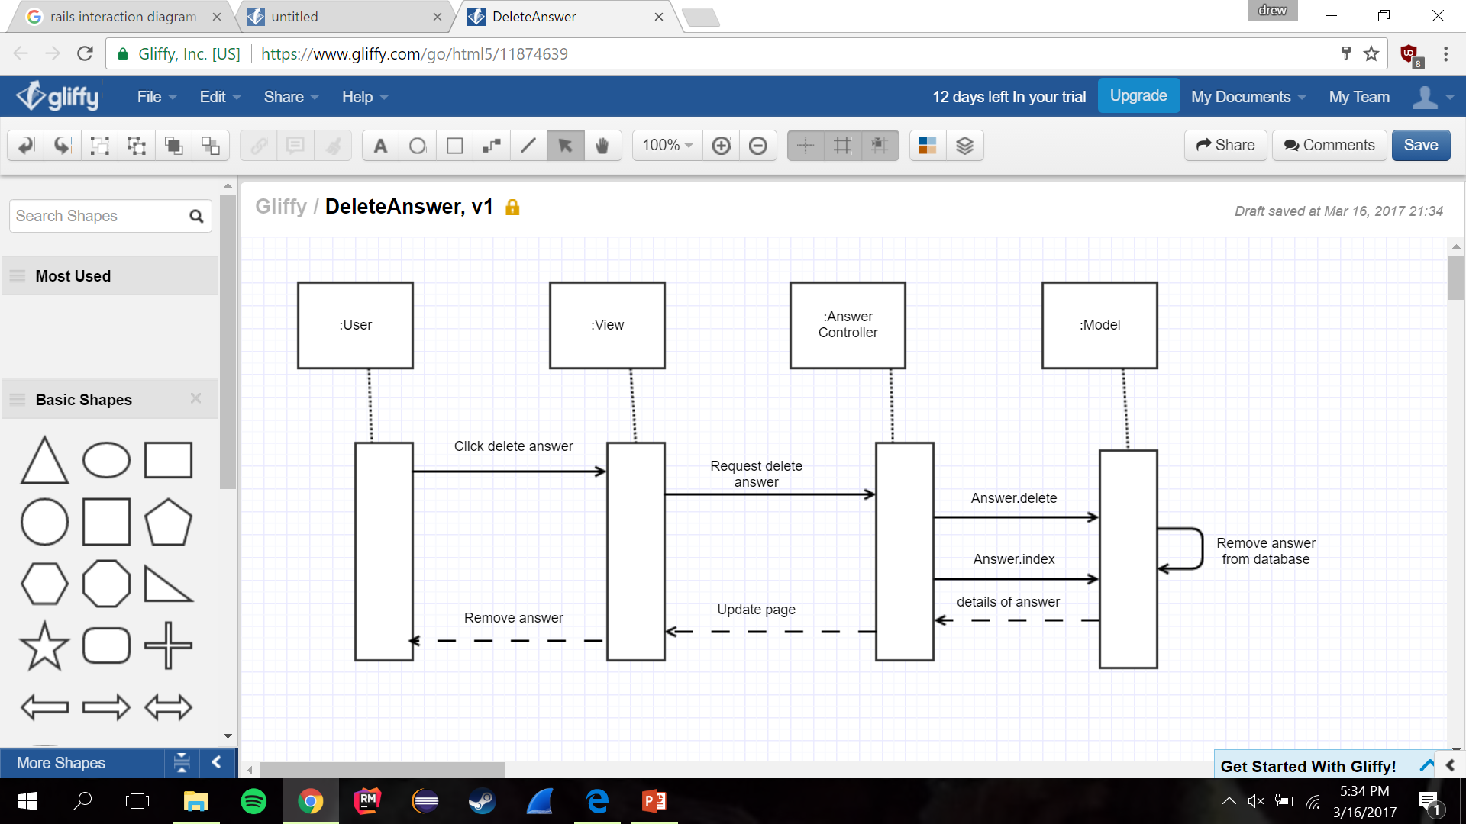
UC5: Delete Questions and Answers

Slide 10
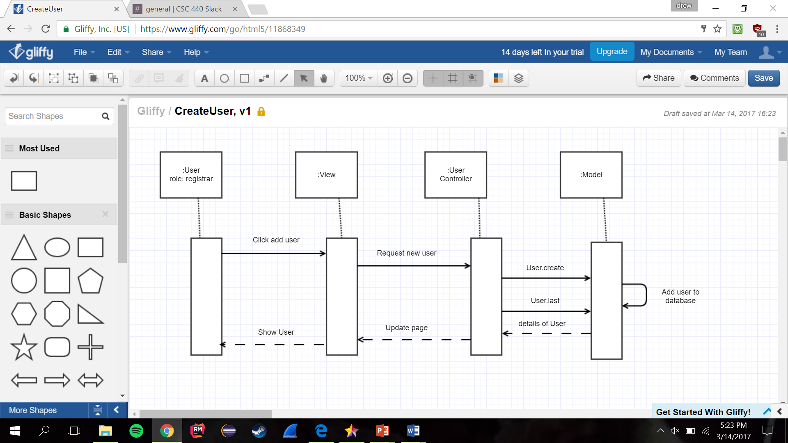
UC6: Create and Delete Users

Slide 11
Demo
Deployed to Heroku
http://nkunet17.herokuapp.com/

