Slide 1
Iteration 3
“May the fourth be with you”

Slide 2
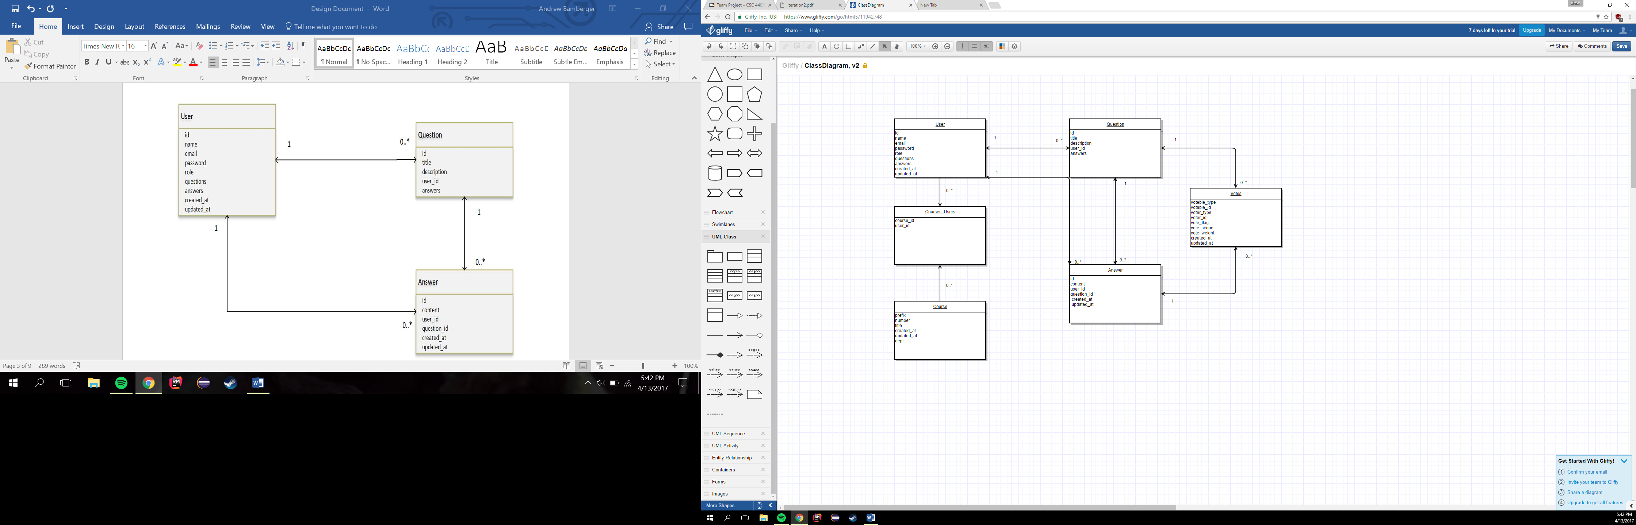
Domain Model
u Each User can have many Questions and many Answers, which they have posted to the site. Each Question can have many Answers posted in the question thread.
u Questions and answers are dependent upon the user. If user is deleted, then so are their questions and answers.

Slide 3
Design Decisions
u Decided to have one single class that would contain our user.
u The “User” class would have a role tied to them that would determine if the user was a student, faculty, registrar or administrator.
u We achieved this by implementing a role variable, that when defined would allow the user to have the privileges of that role.
u Database Model
u Each User can have many Questions and many Answers, which they have posted to the site. Each Question can have many Answers posted in the question thread.

Slide 4
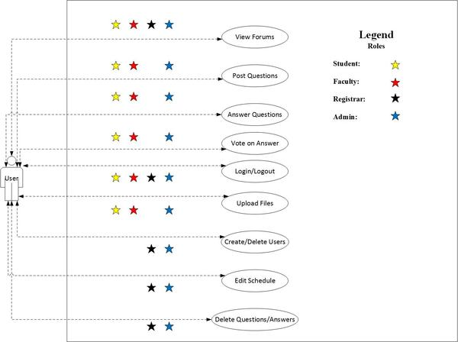
Use Case Model

Slide 5
Use Cases Implemented (iteration 1)
u UC1: View Forum
u View all the questions posted (High priority)
u UC2: Post Question
u Populate the forum with questions (High priority)
u UC3: Answer Question
u Populate the question with answers (High priority)
u UC5: Delete Questions and Answers
u Moderate the questions/answers for appropriateness
u UC6: Create and Delete Users
u Relate questions and answers to a specific user (Medium priority)

Slide 6
Use Cases Implemented (iteration 2)
u UC7: Vote Questions/Answers
u Vote on certain questions/answers posted (High priority)
u UC8: Login/Logout
u Users can login/logout(High priority)
u UC9: Upload Files
u Users can upload files to forums

Slide 7
Use Cases Implemented (iteration 3)
Use Case 10: Change User Role
The admins can change a users’ role
Use Case U11: Search Users
The users can search other users of the site
Use Case UC12: Search Courses
The users can search the courses of the site
Use Case UC13: Solved Question
The users can mark a certain question as solved

Slide 8
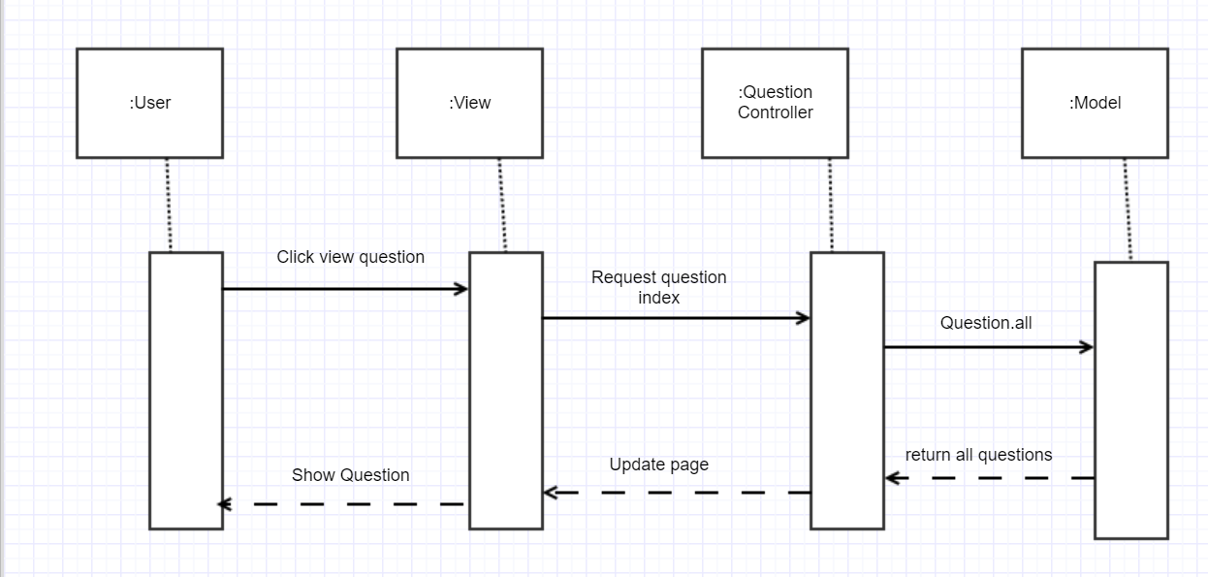
UC1: View Forum

Slide 9
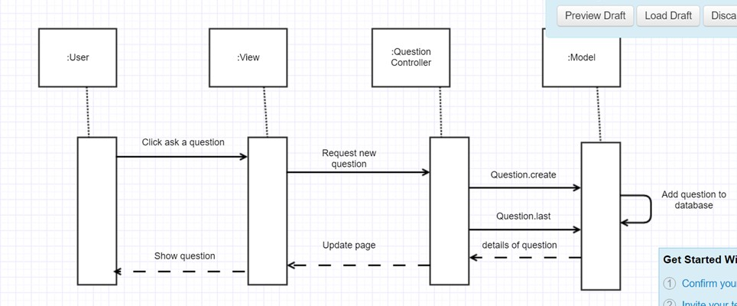
UC2: Post Question

Slide 10
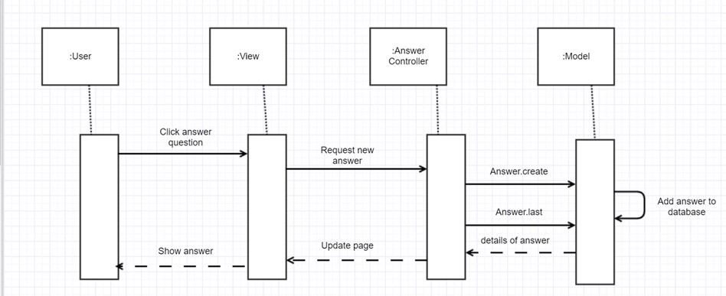
UC3: Answer Question

Slide 11
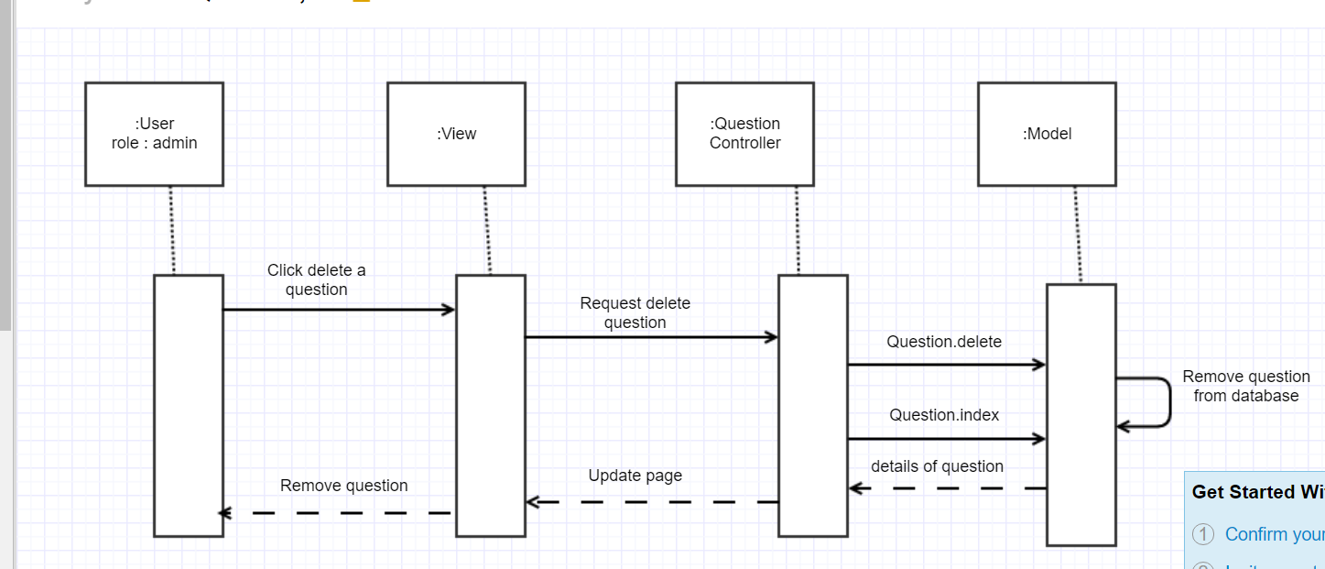
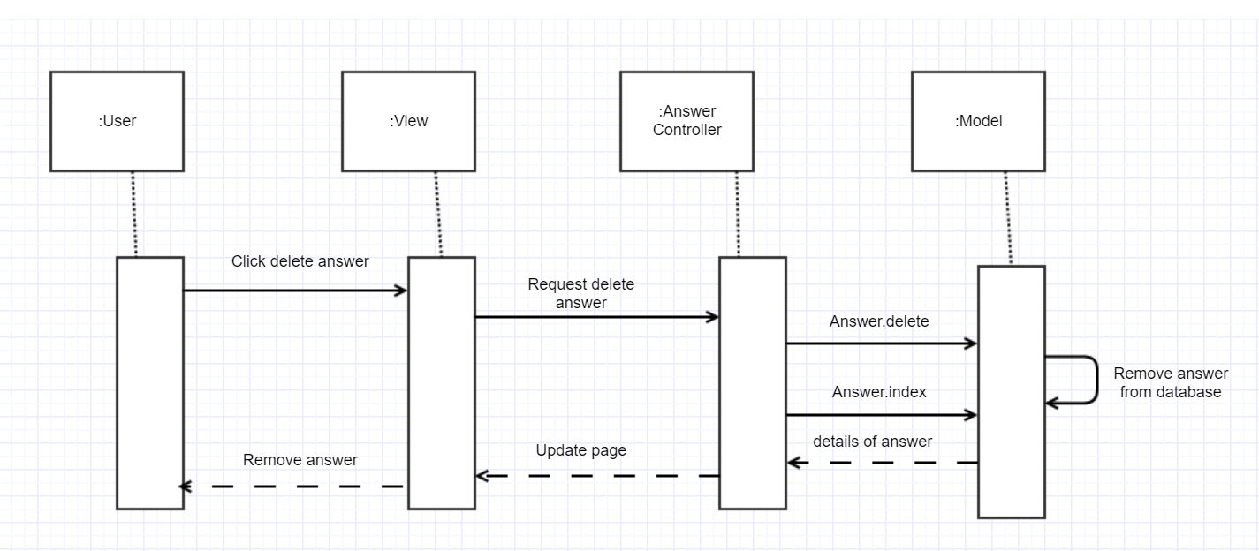
UC5: Delete Questions and Answers

Slide 12
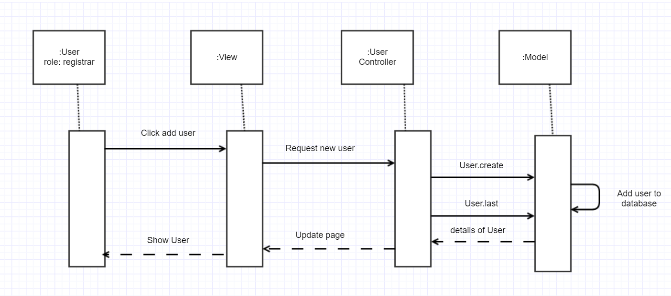
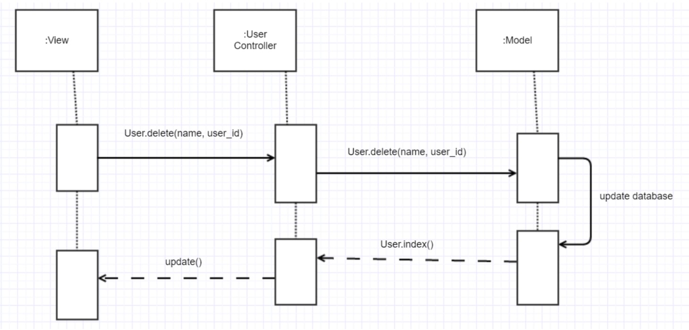
UC6: Create and Delete Users

Slide 13
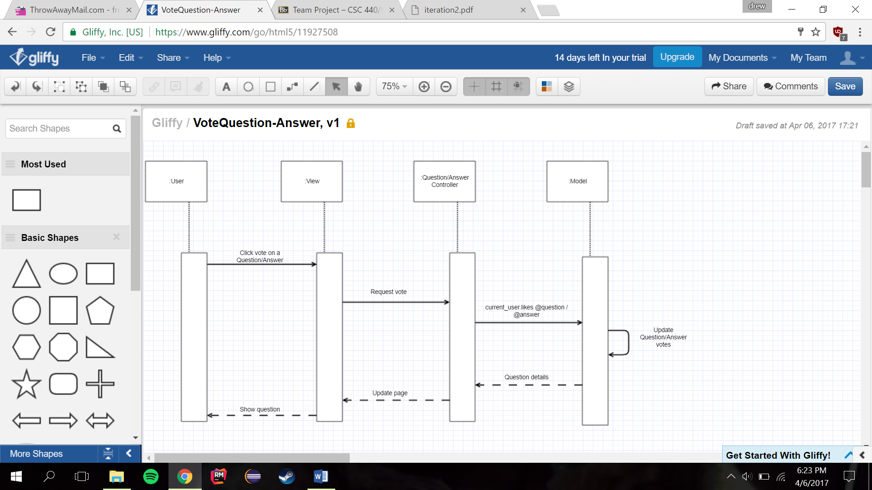
UC7: Vote Questions/Answers

Slide 14
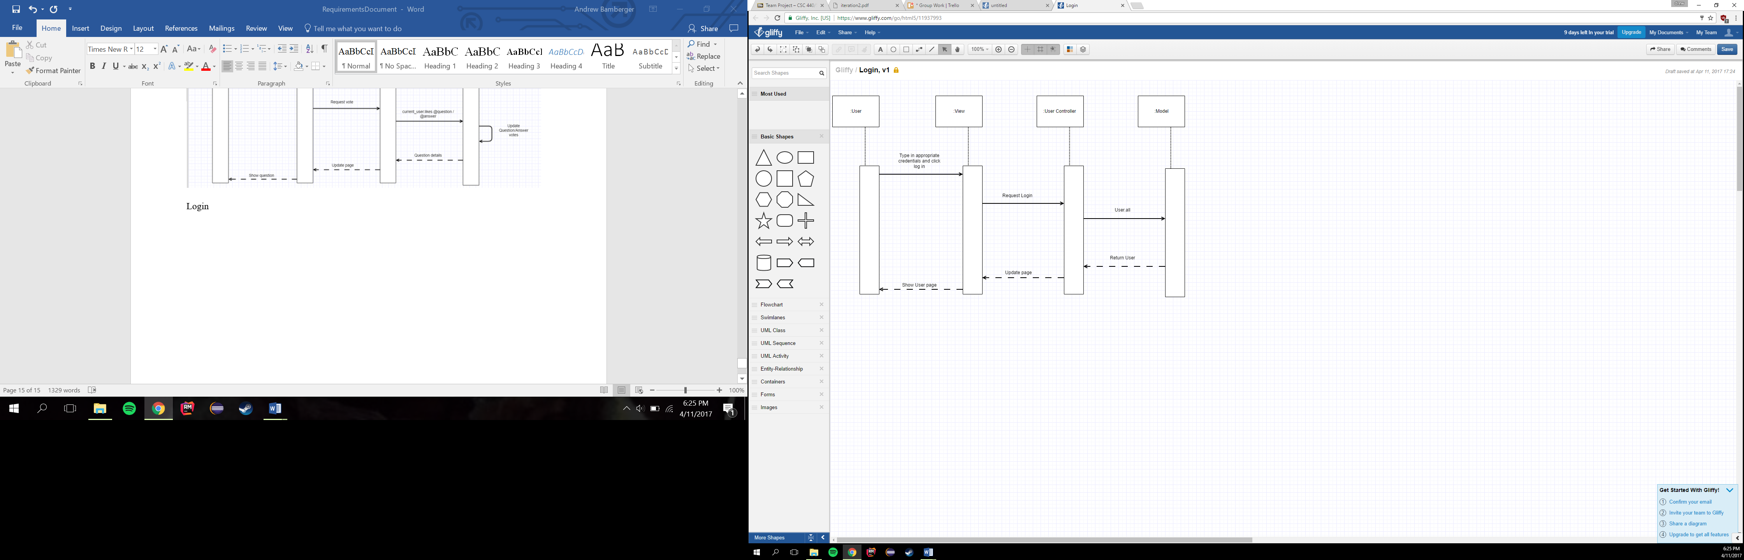
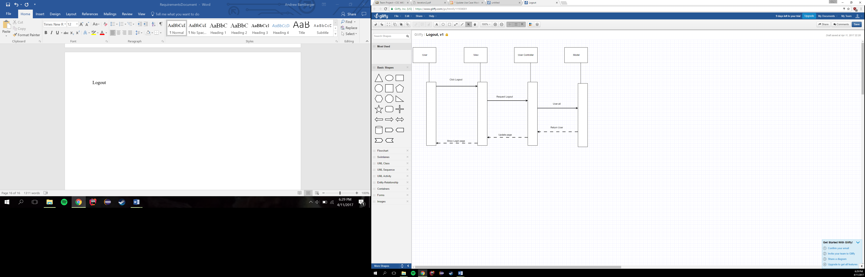
UC8: Login/Logout

Slide 15
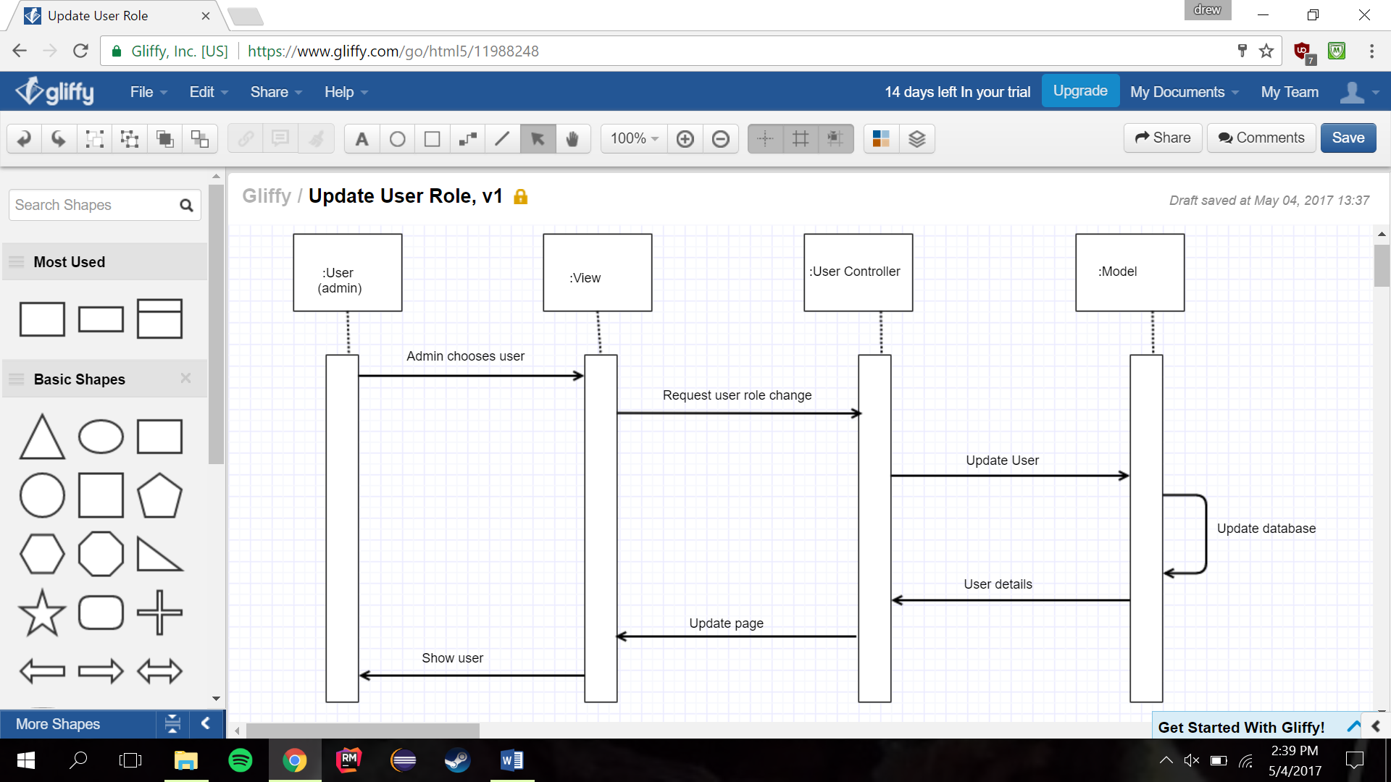
UC10: Change User Role

Slide 16
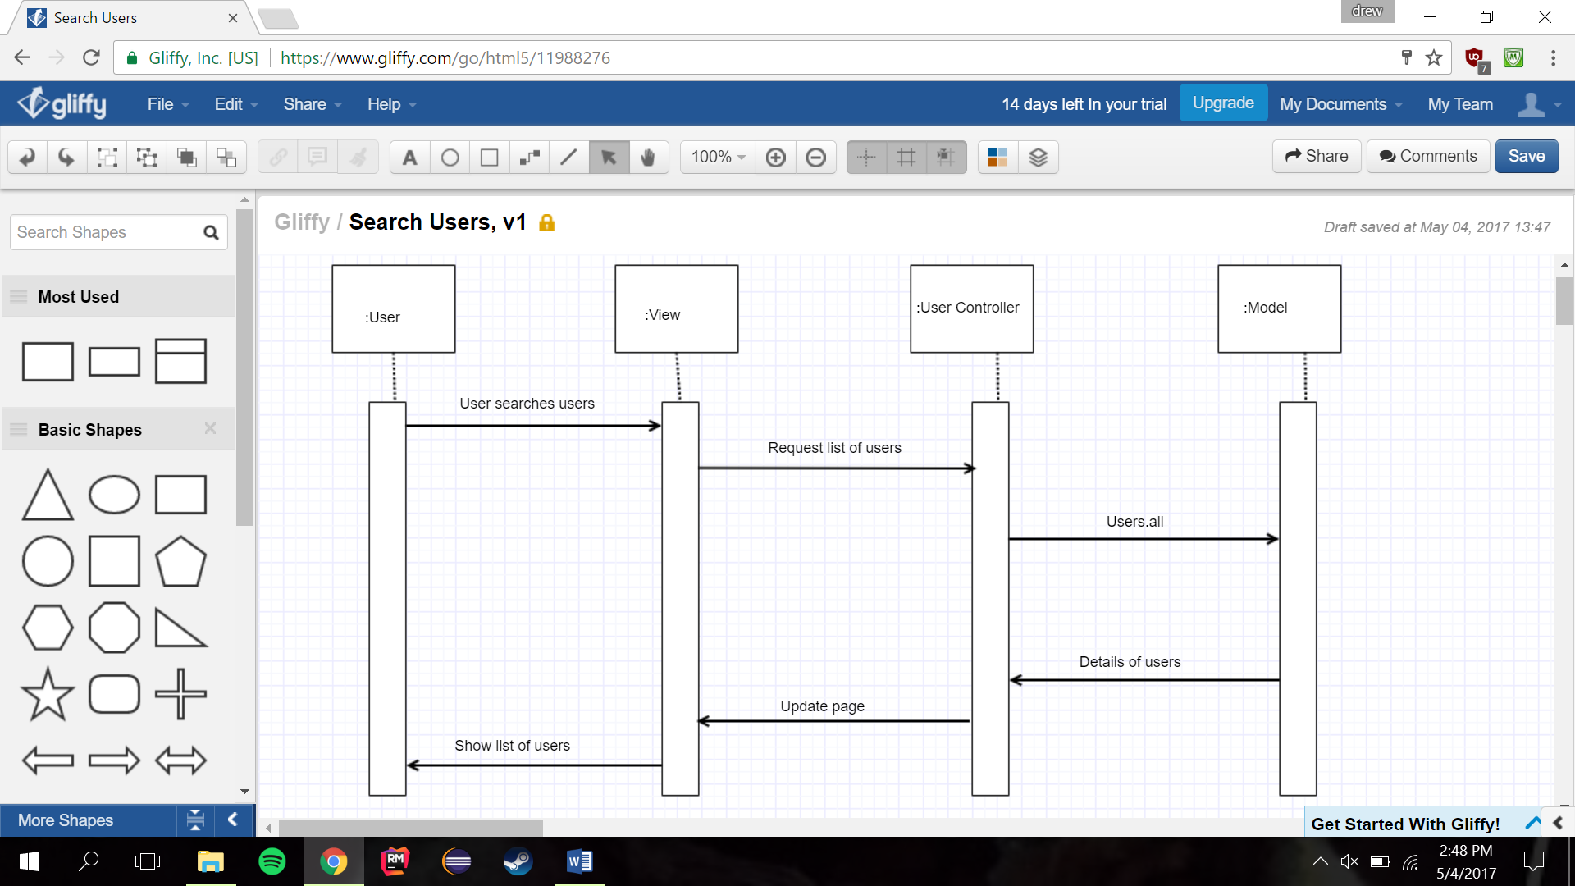
UC11: Search Users

Slide 17
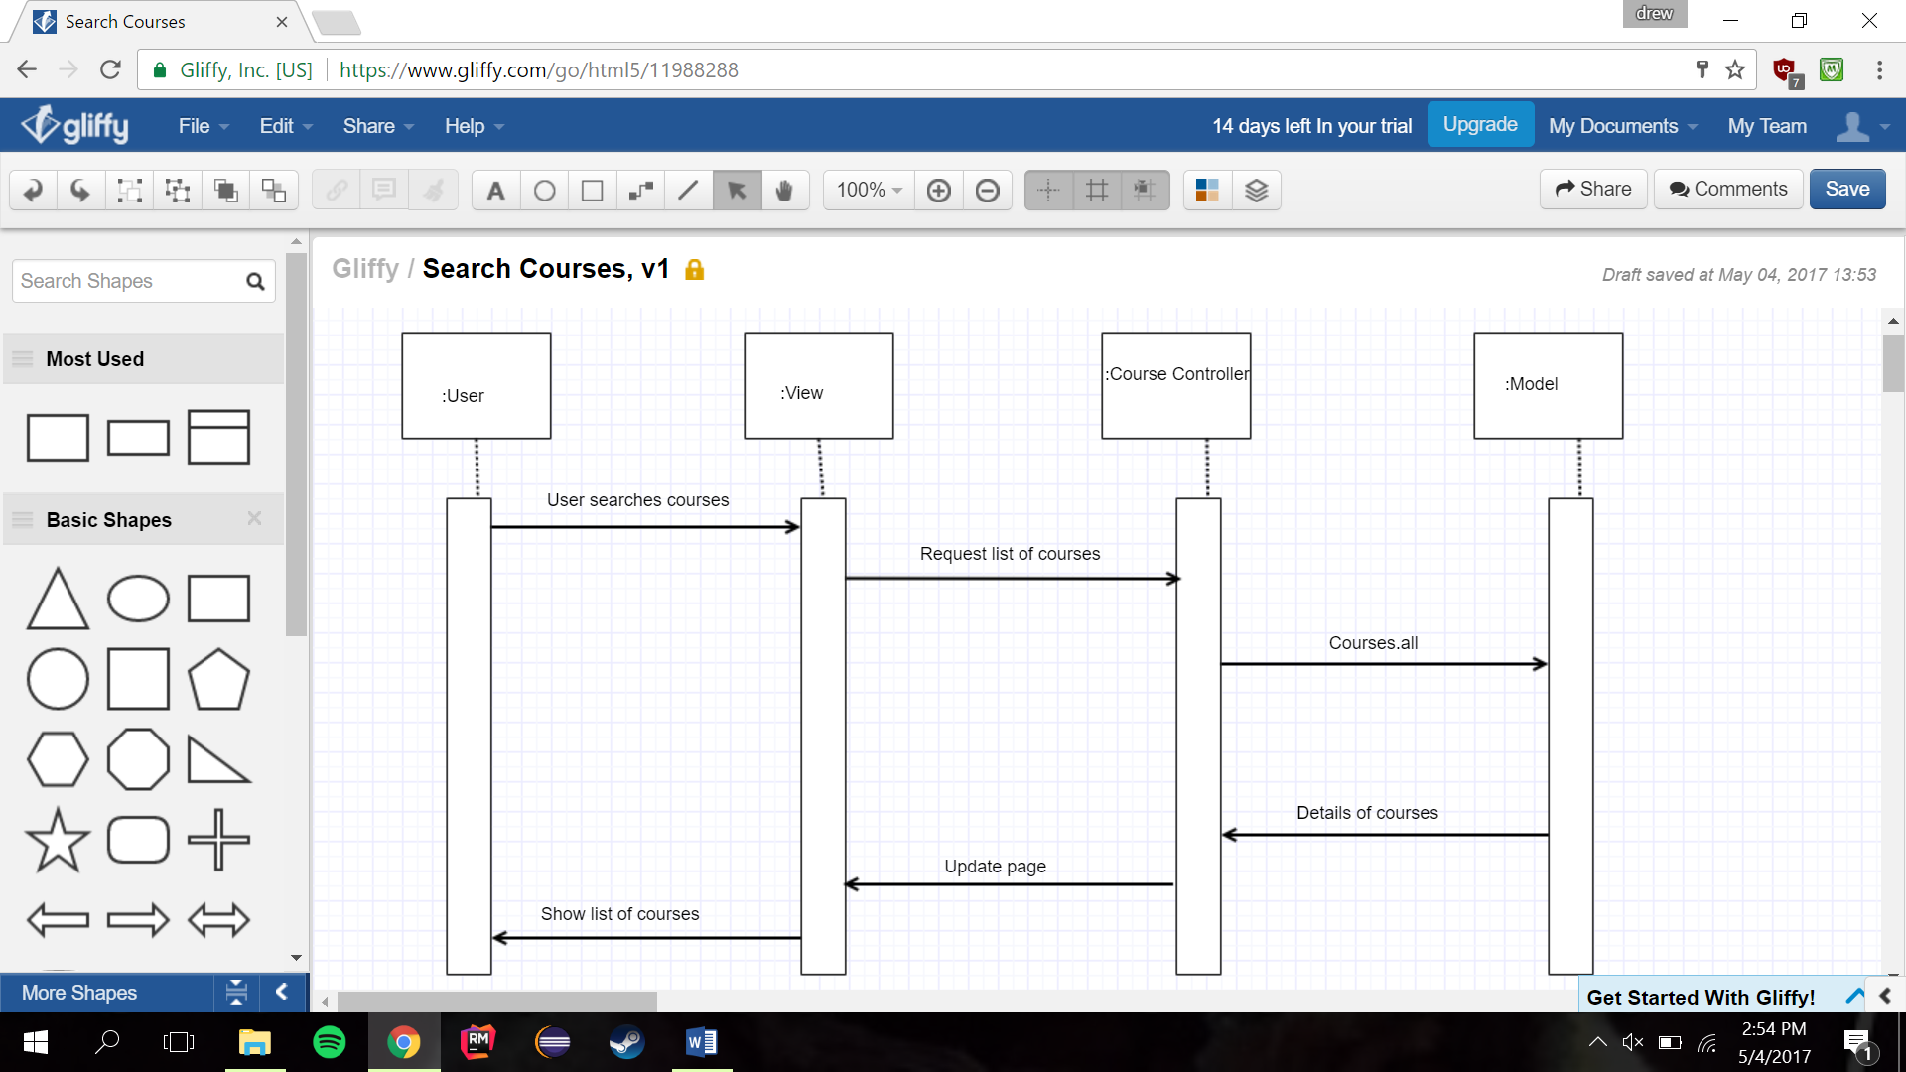
UC12: Search Courses

Slide 18

UC13: Mark Question

Slide 19
Demo
u Deployed to Heroku
u http://nkunet17.herokuapp.com/

