Slide 1
NKUNet Iteration 2 Presentation
I5S: Clint Gross, Doug Bruening, Hunter Oka, Robert Riggs

Slide 2
Selected Use Cases and Justification
Vote on Answer
View User Page
Edit Question
Edit Answer
In Iteration 2 we focused on user authentication and implemented using authlogic plugin. We chose use cases that built on Iteration 1 and provided most of the functionality for Users and Questions. This leaves implementation of Course functionality for Iteration 3.

Slide 3
Domain Model
User
Course
1
registers for
0..*
User ID
Name
Role
Course ID
Course Name
1
1
teaches
0..*
posts
1
1
1
0..*
asks
Question
Forum
0..*
captured on
Resource
0..*
Question Title
Question Description
1
Forum Name
Text
URL
Blob
1
answers
contains
0..*
Answer
0..*
Answer
1
contains
votes
0..*
Vote
0..*
Direction

Slide 4
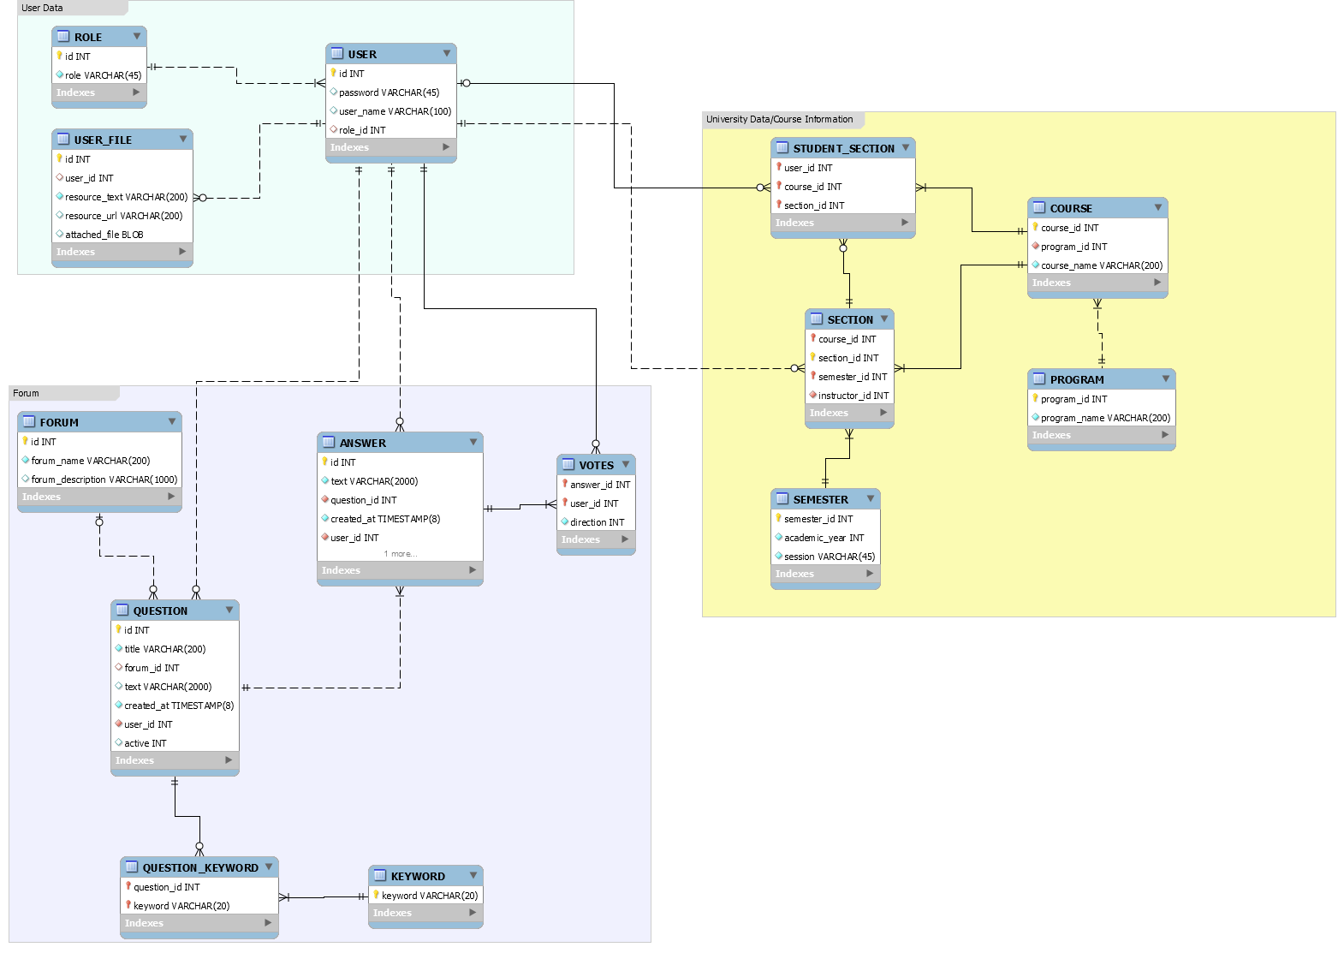
ERD (Entity Relationship Diagram)

Slide 5
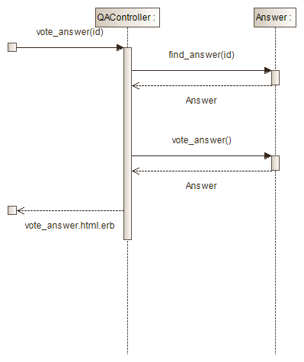
Sequence Diagram
UC-5
Vote on Answer

Slide 6
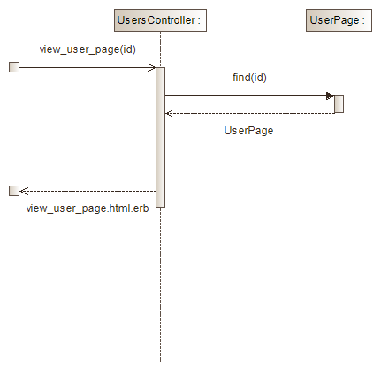
Sequence Diagram
UC-6
View User Page

Slide 7
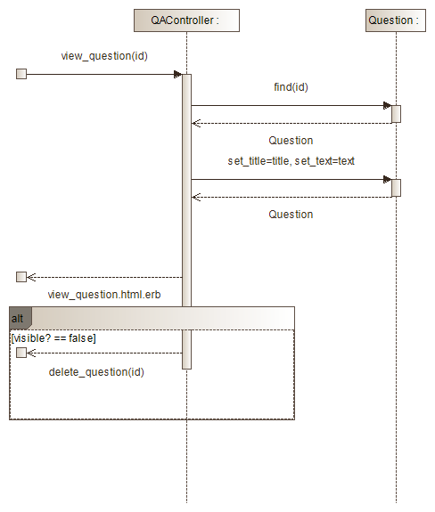
Sequence Diagram
UC-11
Edit Question

Slide 8
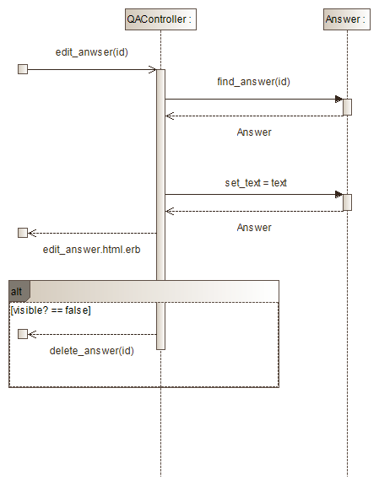
Sequence Diagram
UC-12
Edit Answer

Slide 9
Design Decisions/Discussion
Must be logged-in to view any pages, forums, etc.
Authlogic used for implementing sessions/authentication.
Voting:
Every user has a unique vote per answer.
Changing a vote increments/decrements the total count for the answer by 2. (Once you vote, you cannot remove your vote, only change it).
Visual cues to alert different types of users.
Admins : Gold bars around main NKUnet logo.
Faculty : Blue bars around main NKUnet logo.
Implemented constraints, defaults, associations at the database level not at ActiveRecord level.

Slide 10
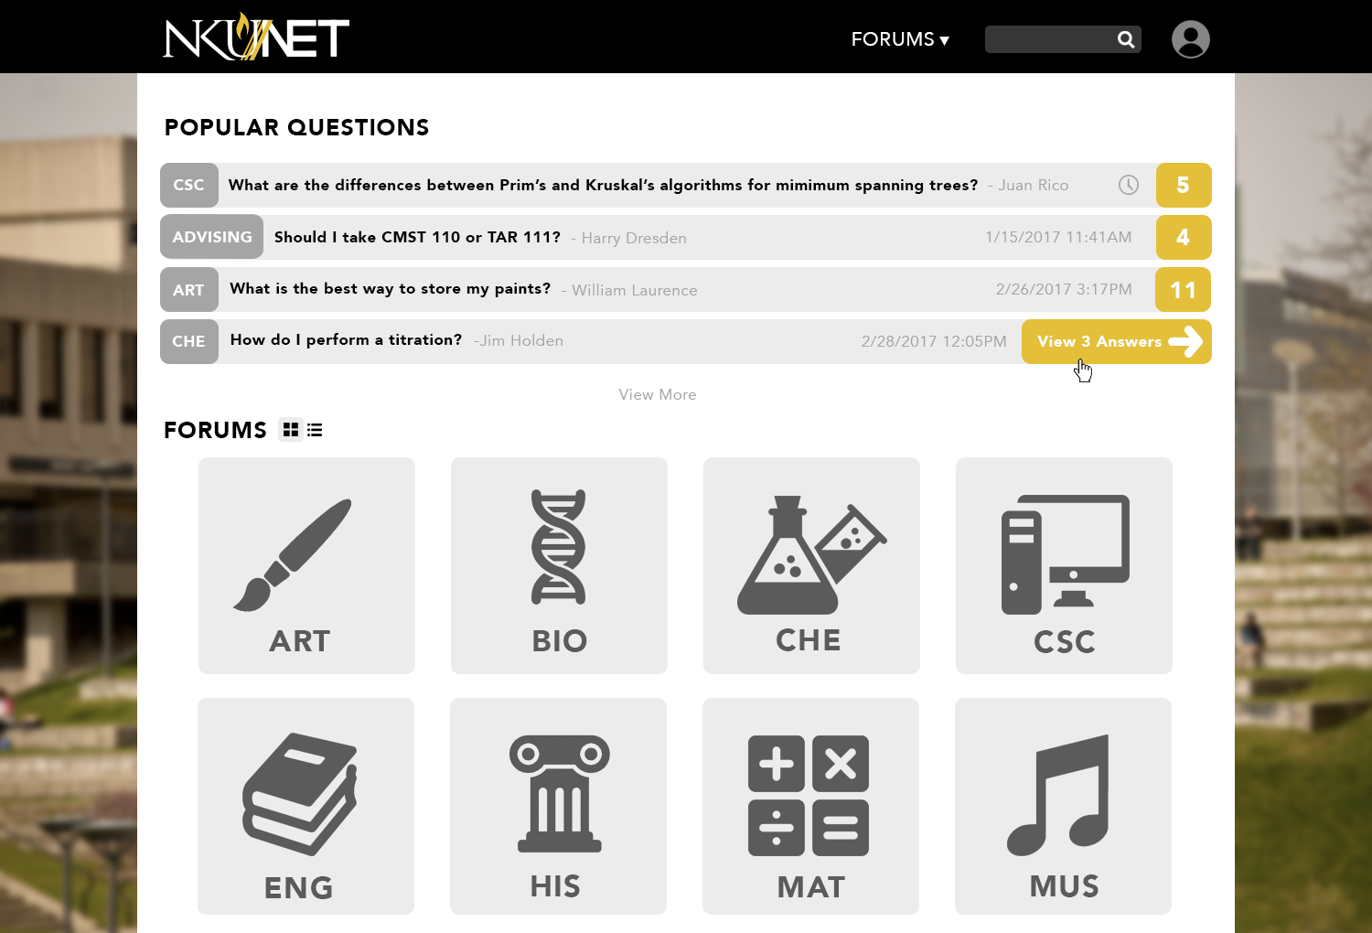
https://csc540-i5s.herokuapp.com/

