Slide 1
NKUNet Inception 1 Presentation
I5S: Clint Gross, Doug Bruening, Hunter Oka, Robert Riggs

Slide 2
Selected Use Cases and Justification
View Forum
Ask Question
View Question
Answer Question
In Iteration 1, we focused mainly on learning how to implement the Rails framework. We chose use cases that were essential, but relatively straight-forward with limited alternate paths.

Slide 3
Domain Model
User
Course
1
registers for
0..*
User ID
Name
Role
Course ID
Course Name
1
1
teaches
0..*
posts
1
1
1
0..*
asks
Question
Forum
0..*
captured on
Resource
0..*
Question Title
Question Description
1
Forum Name
Text
URL
Blob
1
answers
contains
0..*
Answer
0..*
Answer
1
contains
votes
0..*
Vote
0..*
Direction

Slide 4
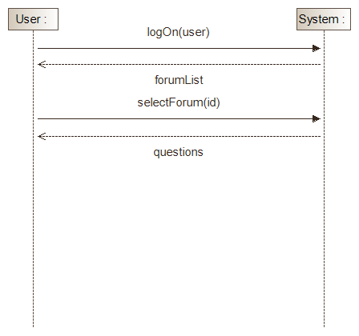
System Sequence Diagram
UC-1
View Forum

Slide 5
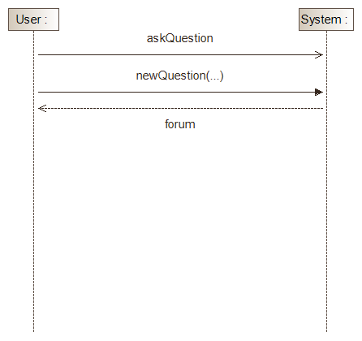
System Sequence Diagram
UC-2
Ask Question

Slide 6
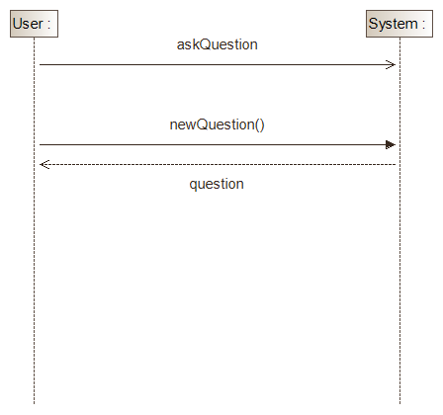
System Sequence Diagram
UC-2 (alt flow)
Ask Question

Slide 7
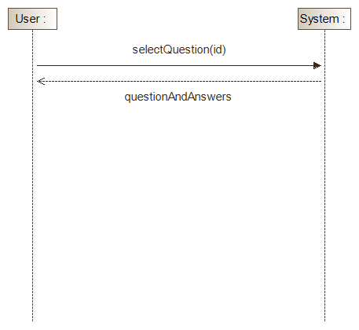
System Sequence Diagram
UC-3
View Question

Slide 8
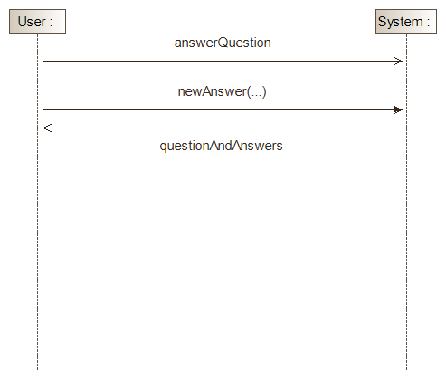
System Sequence Diagram
UC-4
Answer Question

Slide 9
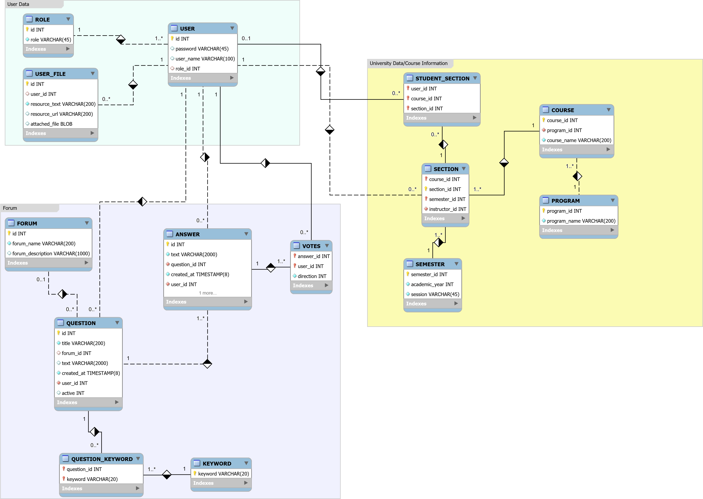
ERD (Entity Relationship Diagram)

Slide 10
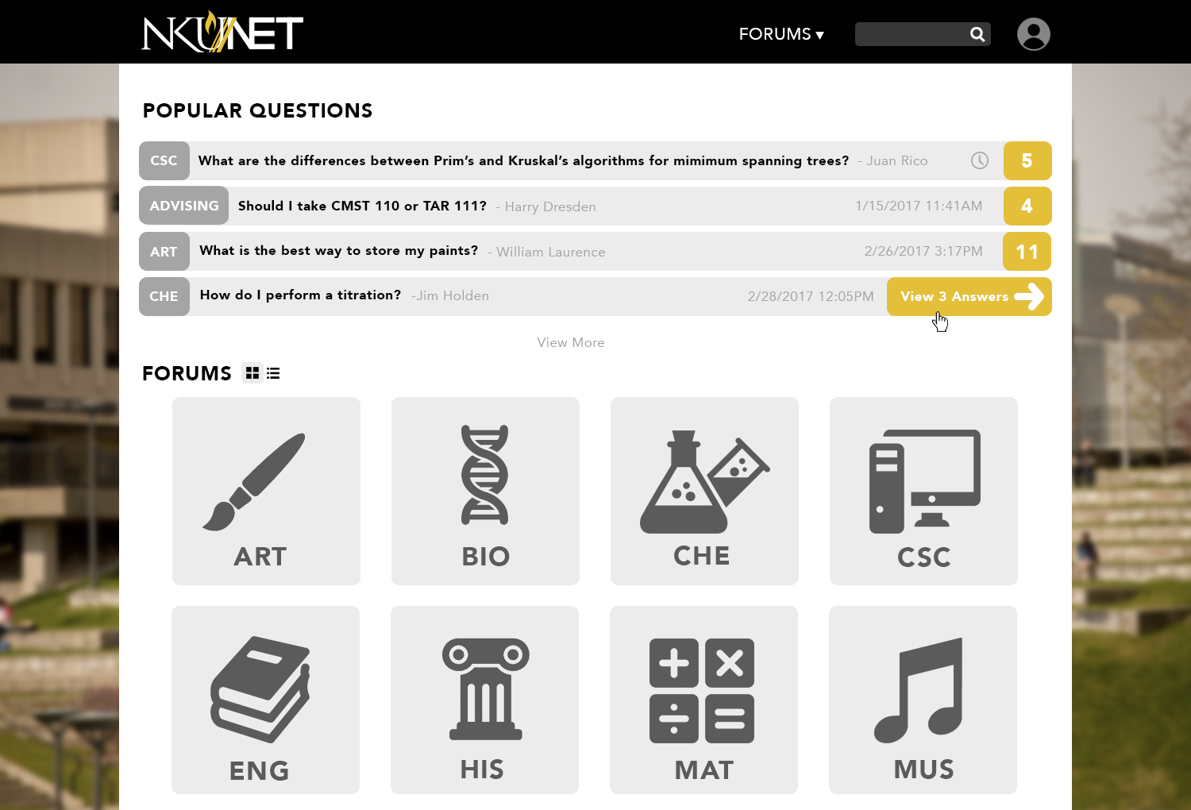
https://csc540-i5s.herokuapp.com/

