Slide 1
Team 17
Iteration 1
Ethan Perry, Jared Bryant, Chris Fitzpatrick, Brian Vach

Slide 2
Iteration 2 Improvements
Added voting and user management
New Use Cases: Vote on Question, Vote on Answer, Authenticate User, Logout User.
New functionality allows greater interaction with the system.
Now user authentication is required and user profiles have more value, since they can add votes to different questions.

Slide 3
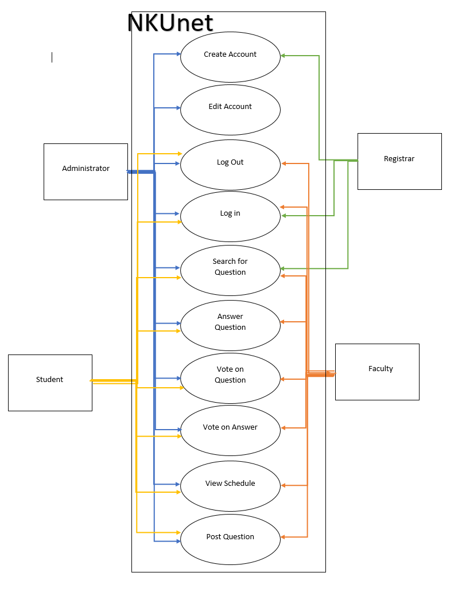
Context Model Diagram

Slide 4
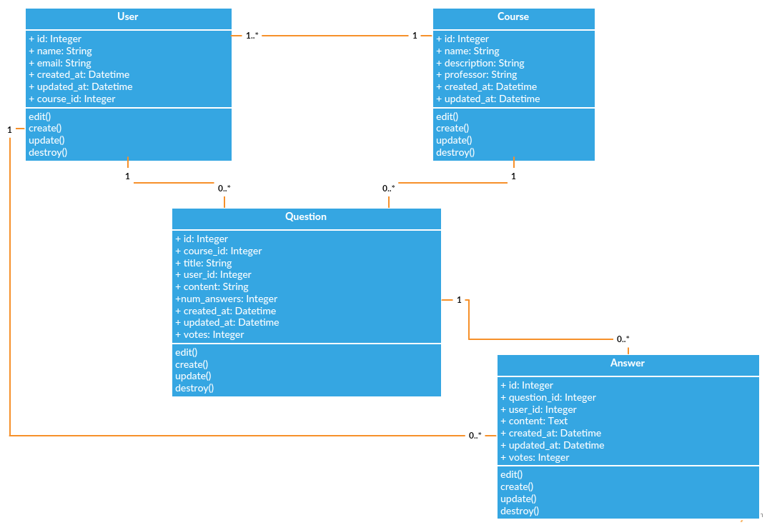
Class Diagram

Slide 5
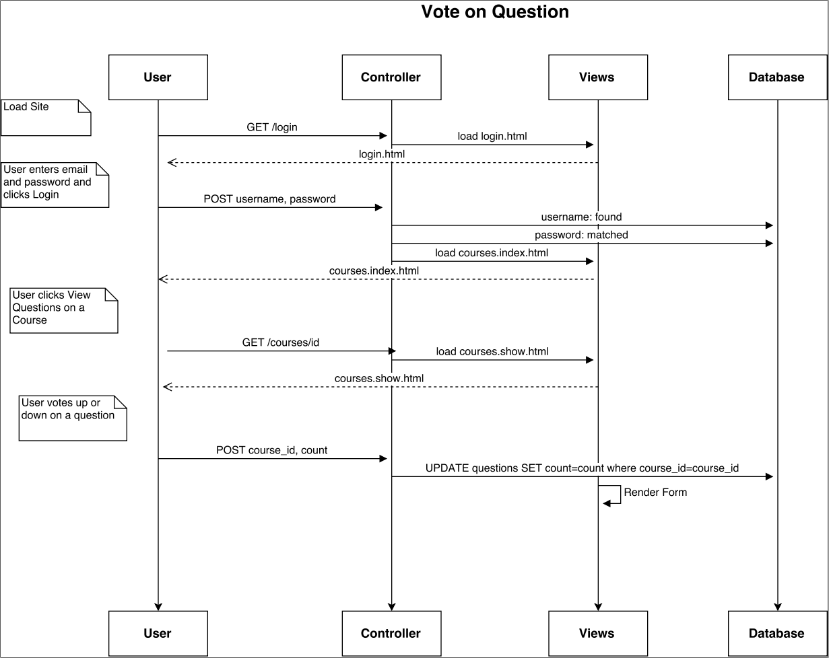
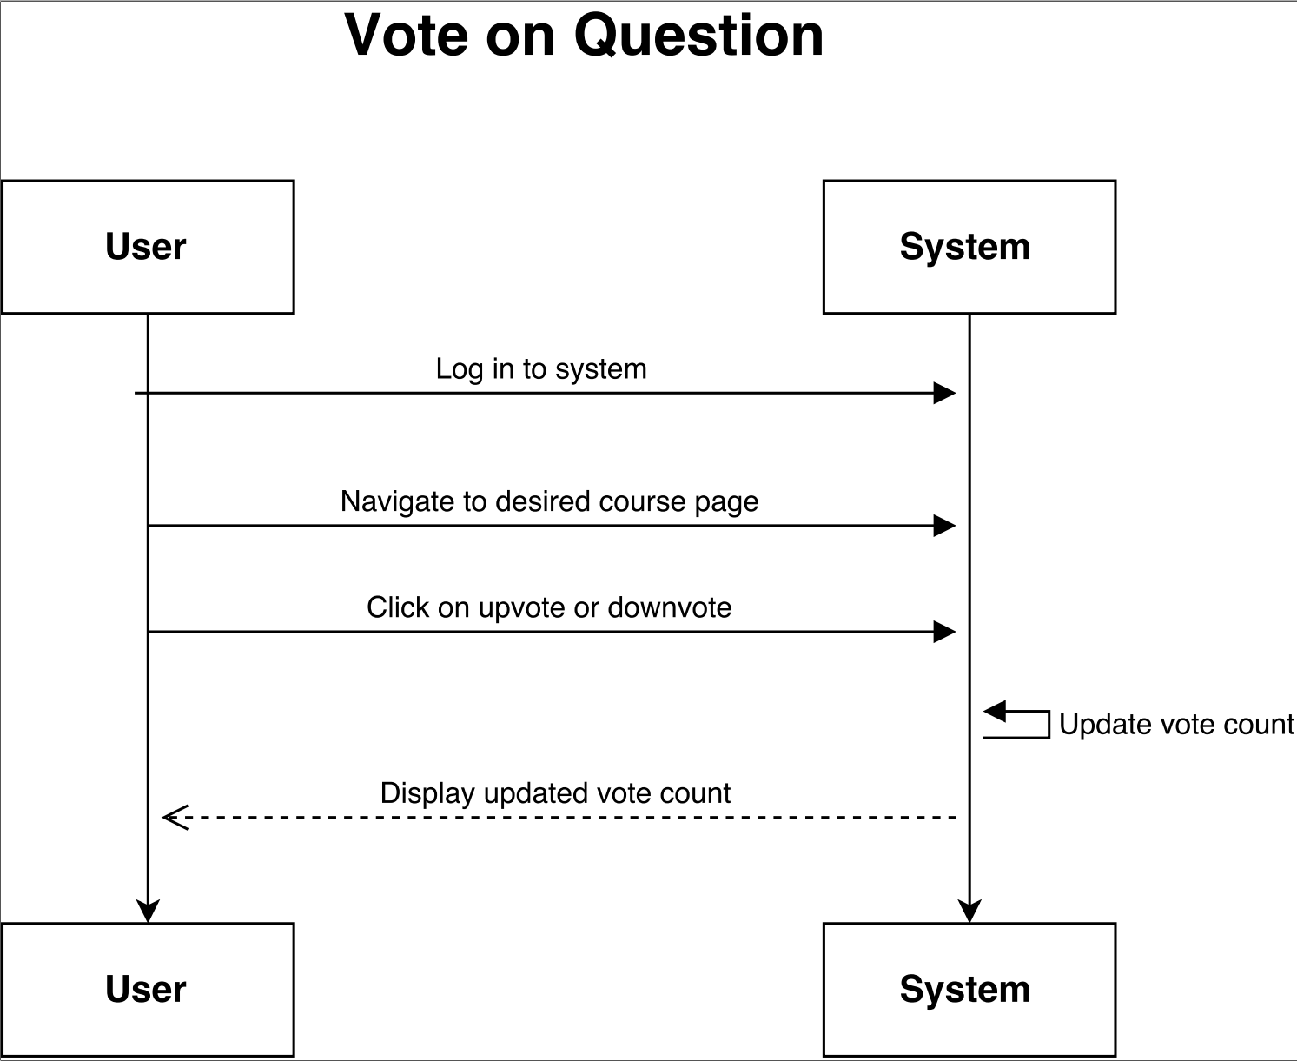
Vote on Question
Design Level Diagram
System Sequence Diagram

Slide 6
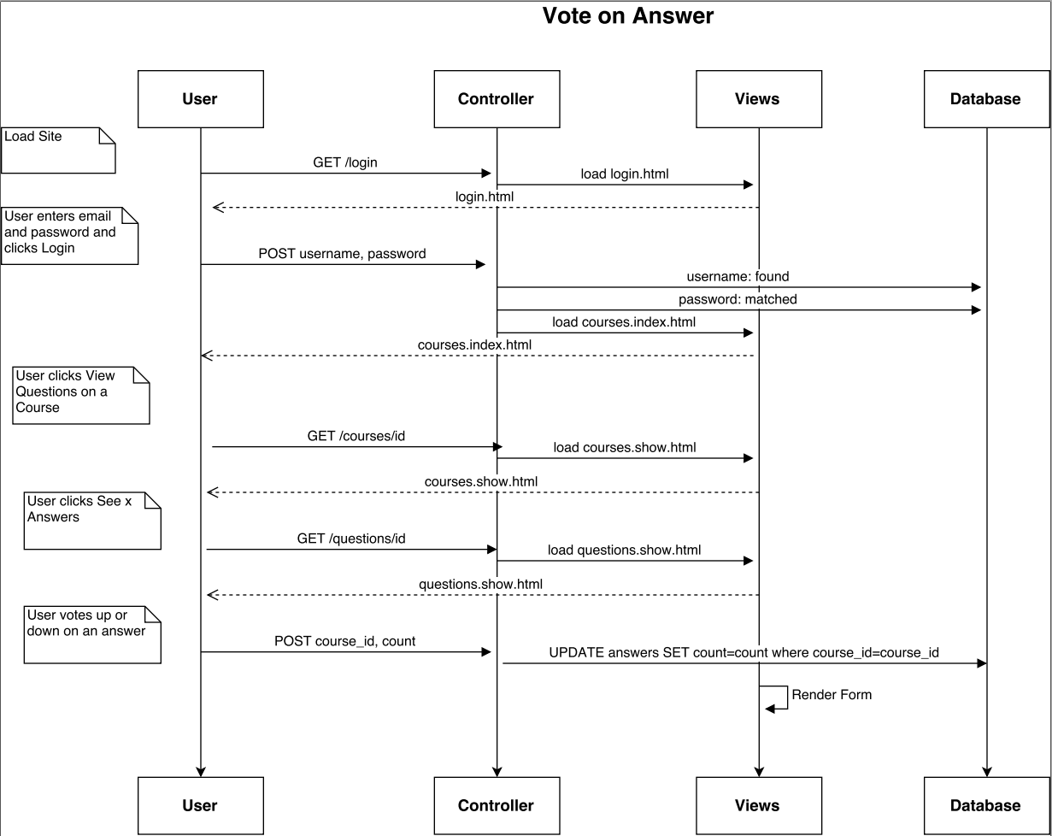
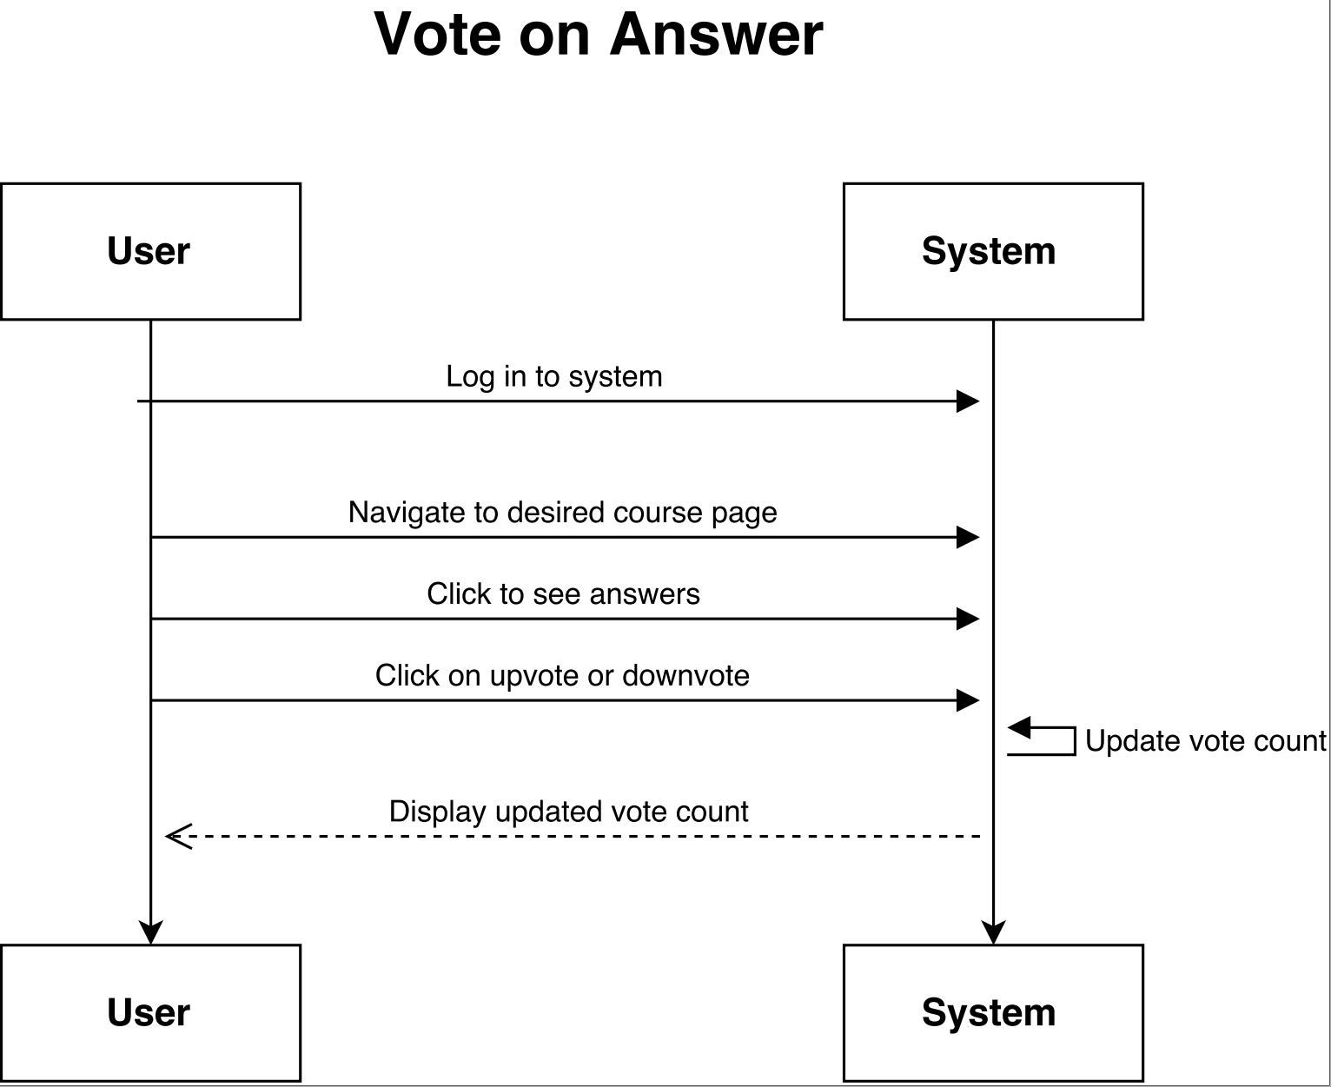
Vote on Answer
Design Level Diagram
System Sequence Diagram

Slide 7
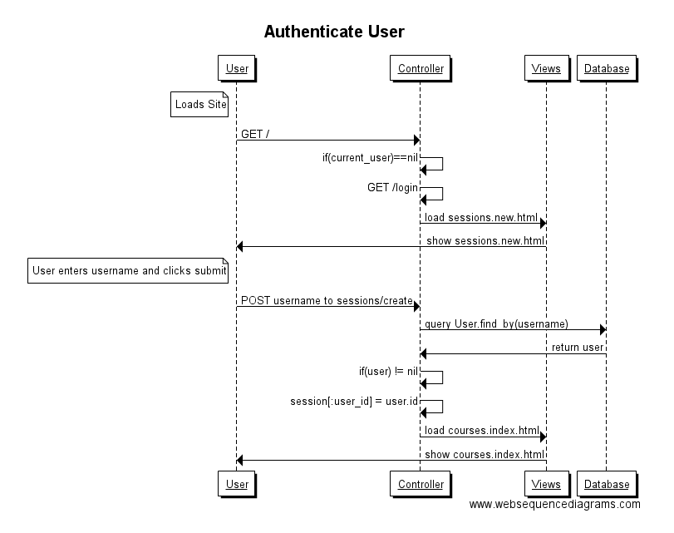
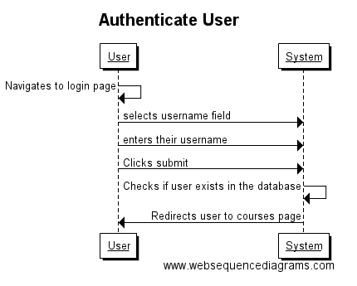
Authenticate User
Design Level Diagram
System Sequence Diagram

Slide 8
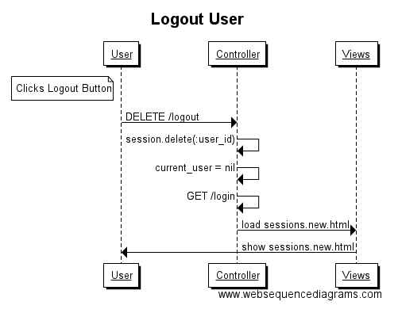
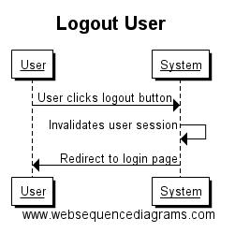
Logout User
Design Level Diagram
System Sequence Diagram

Slide 9
Planned System Features
User authentication
Edit and delete posts
Vote on posts
Search posts
Detailed user pages

Slide 10
System Demo
https://vast-brook-88634.herokuapp.com/

