Slide 1
Team 17
Iteration 1
Ethan Perry, Jared Bryant, Chris Fitzpatrick, Brian Vach

Slide 2
Design Decisions
4 separate databases for simplicity
Databases currently stored only required information, more may be added in the future.
Simple linking that will be added on later.
Eg. Users can only select one course currently.
Databases for Users, Courses, Questions, and Answers

Slide 3
Design Decisions (cont.)
Using ruby with scaffolding for quick setup.
User is immediately presented with a list of courses to select from.
Navigation bar at the top to quickly move around the site.
Using bootstrap due to ease of integration.
Use “Jumbotron” object that complements card structure.
Chose simple neutral color scheme with complementary colors for buttons.

Slide 4
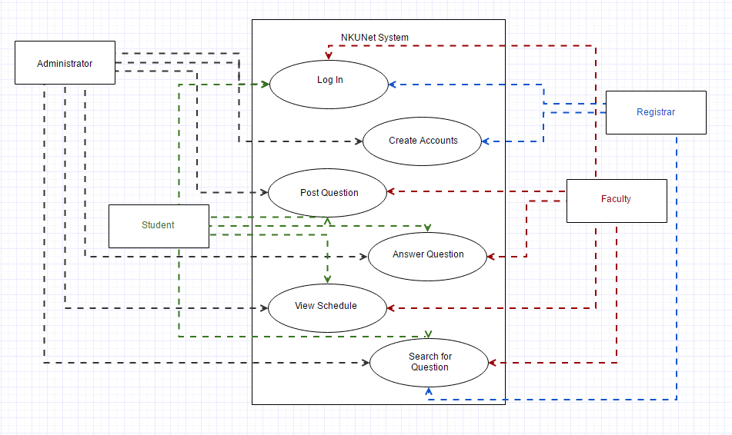
Context Model Diagram

Slide 5
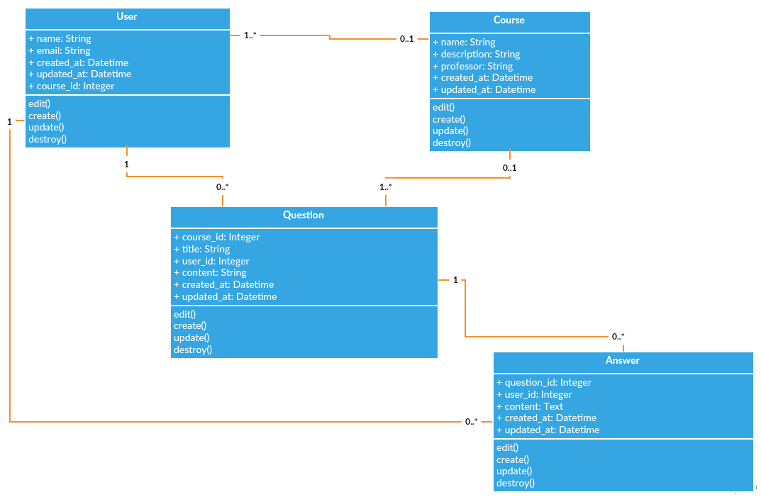
Class Diagram

Slide 6
Implemented Use Cases

Slide 7
Create Question
Current Functionality:
Create question with title and body.
Ability to choose the course to post the question to.
Future Functionality:
Set the author to the logged in user.

Slide 8
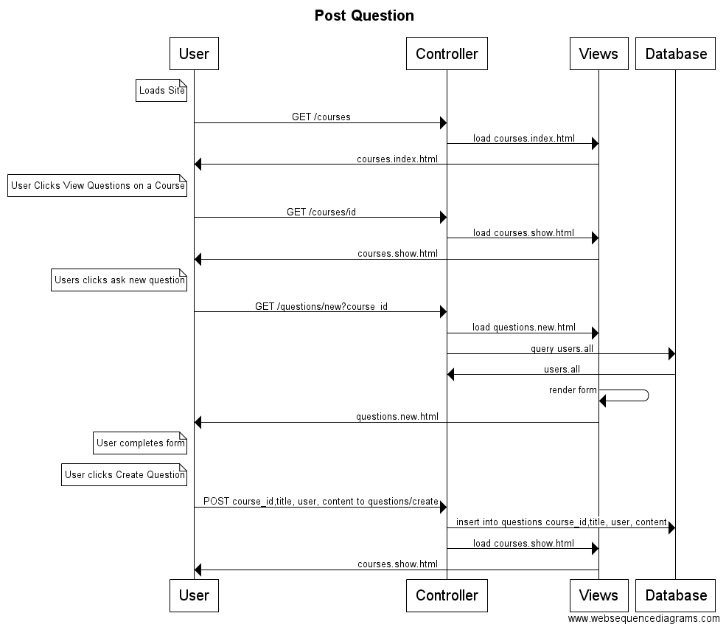
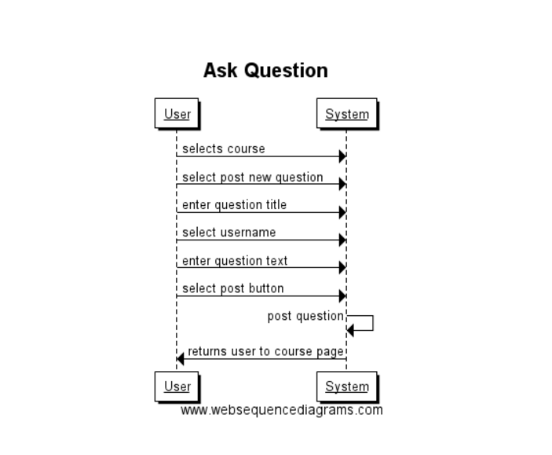
Create Question
Design Level Diagram
System Sequence Diagram

Slide 9
Answer Question
Current Functionality:
Able to select a question and answer it.
Future Functionality:
Set the author to the logged in user.

Slide 10
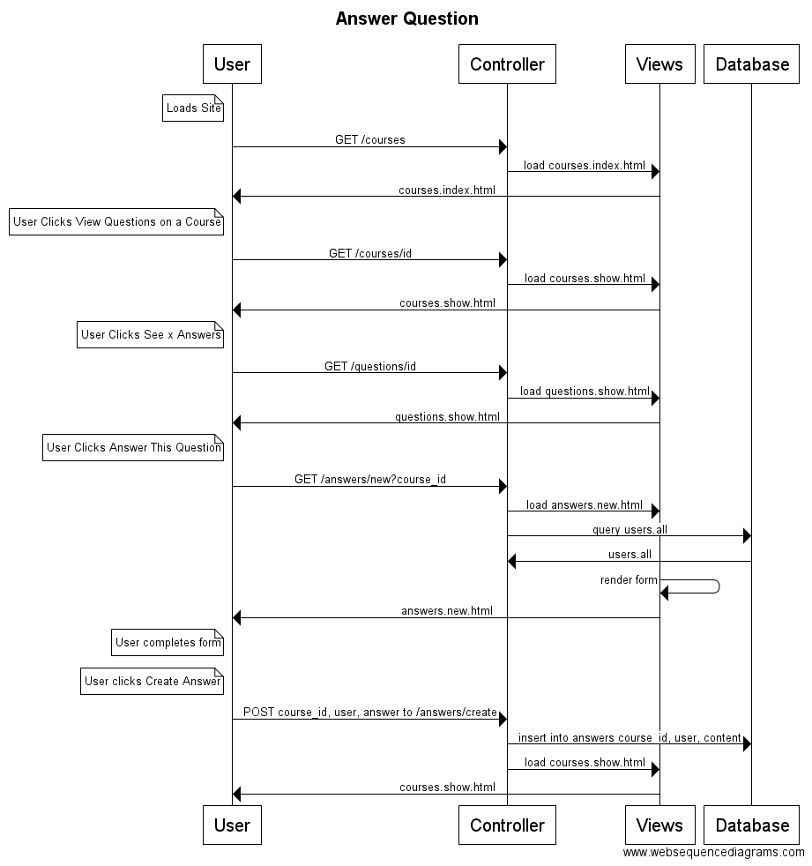
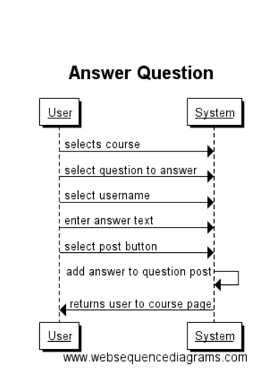
Answer Question
Design Level Diagram
System Sequence Diagram

Slide 11
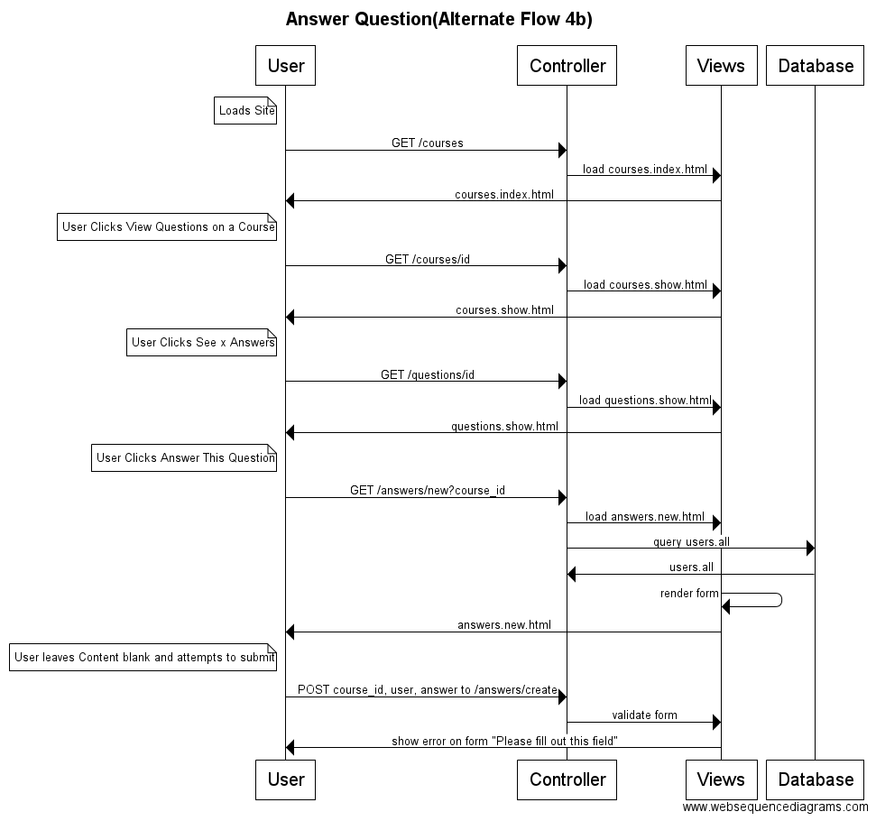
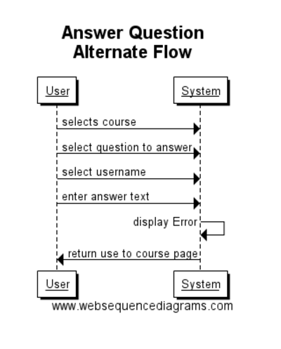
Answer Question Alternate Flow
Design Level Diagram
System Sequence Diagram

Slide 12
Initial System
Implemented basic classes
Implemented Page Styling
Started Form Validation

Slide 13
Planned System Features
User authentication
Edit and delete posts
Vote on posts
Search posts
Detailed user pages

Slide 14
System Demo
https://vast-brook-88634.herokuapp.com/

