Slide 1
Team 17
Iteration 3
Ethan Perry, Jared Bryant, Chris Fitzgerald, Brian Vach

Slide 2
New Functionality
Added ability for Admins to delete or edit any question/answer
Added ability for users to edit or delete their own questions/answers
Added searching by keywords
Added Registrar user type
Added CSV upload for bulk user creation
Added user profile pages
Made changes to voting

Slide 3
Voting changes
Users are now prevented from voting on a question or answer multiple times
The vote buttons are hidden when the user has voted on that question or answer before
Score now dynamically updates when a vote is recorded, rather than having to refresh the page
This is accomplished with AJAX, Rails renders a JQuery partial, that is executed in the browser to update the score, or hide the buttons

Slide 4
CSV bulk user upload
Rails parses the CSV file, and creates a user for each line that is not the header line.
The number of fields in a line is checked to make sure the file is not improperly formatted
Each field is checked individually, to make sure they are of the correct format
Courses are made unique, so duplicates are prevented.

Slide 5
Test Plan
Multiple tests for each use case
Manual tests only
In the format of “Input actions”, “Expected Results”
Tester performs the input actions, such as navigating to a certain URL, and filling out a field, then makes sure the actual results line up with the expected results.

Slide 6
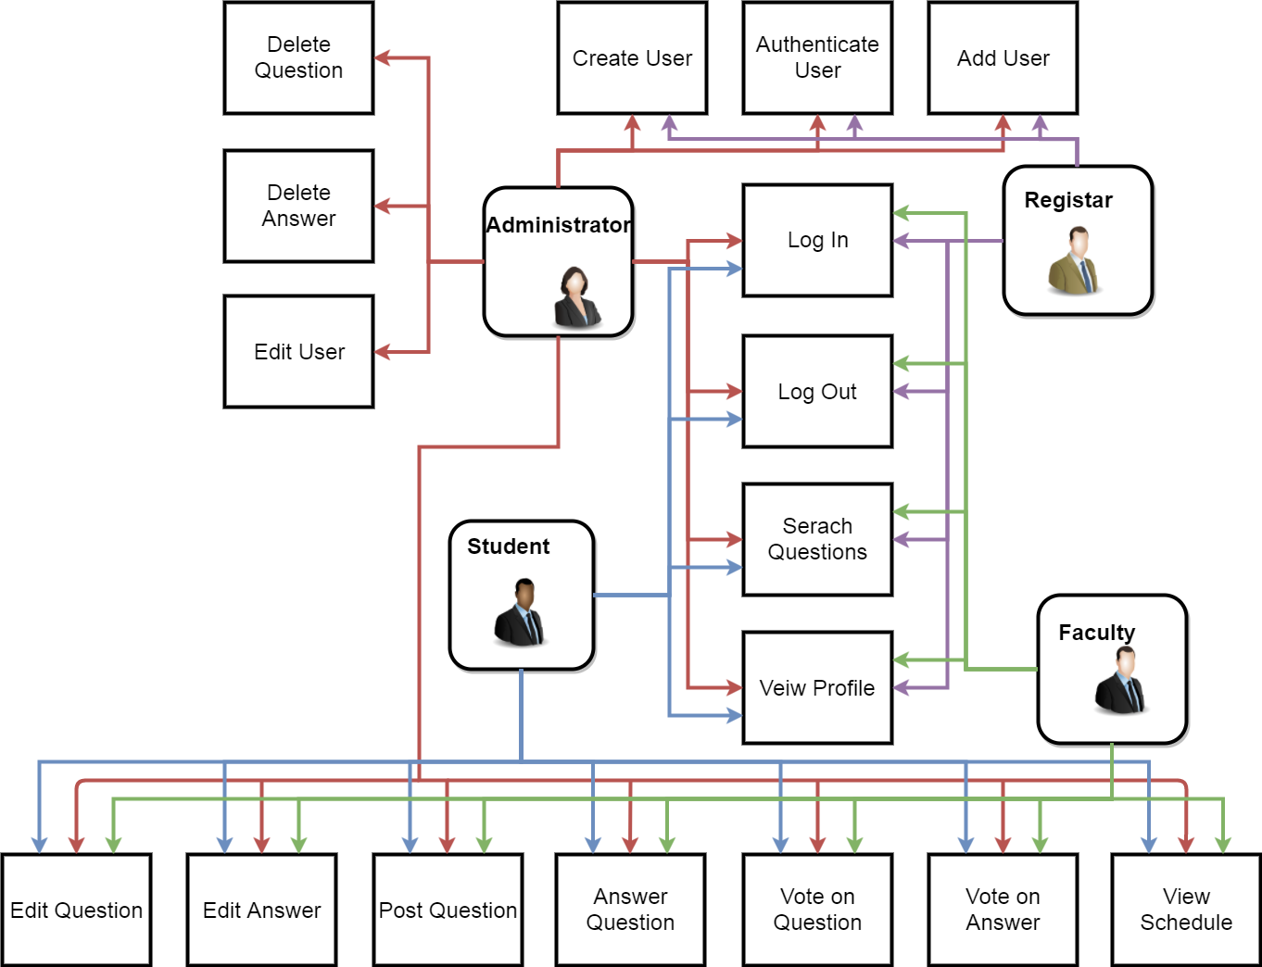
Use Case Model

Slide 7
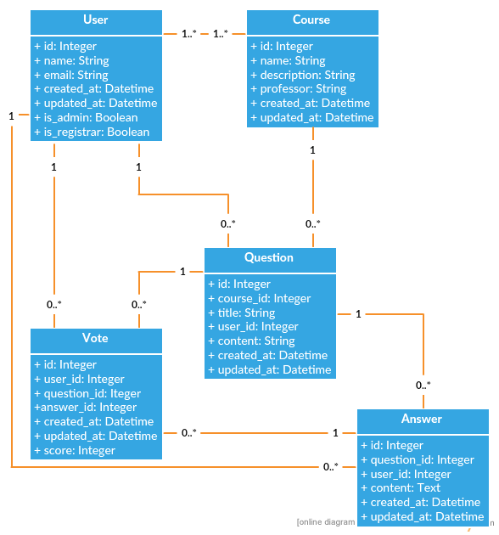
Class Diagram

Slide 8
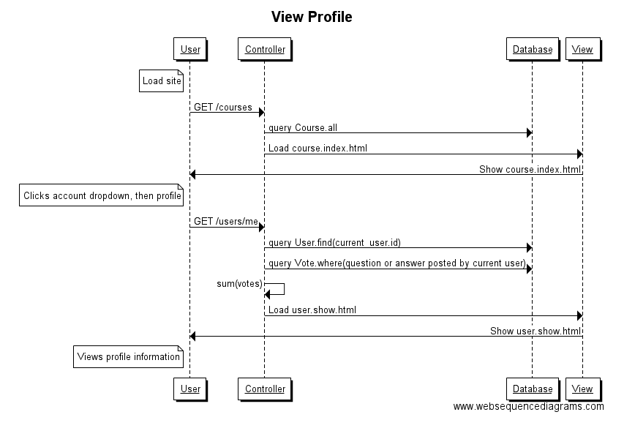
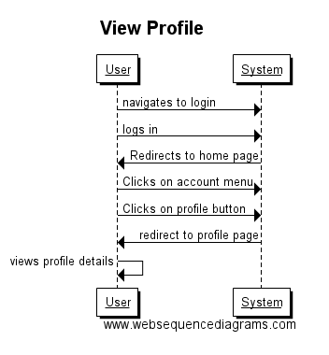
View Profile
Design Level Diagram
System Sequence Diagram

Slide 9
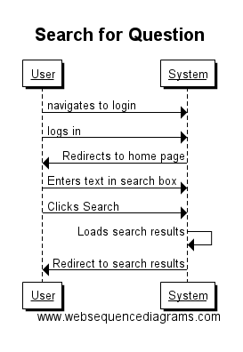
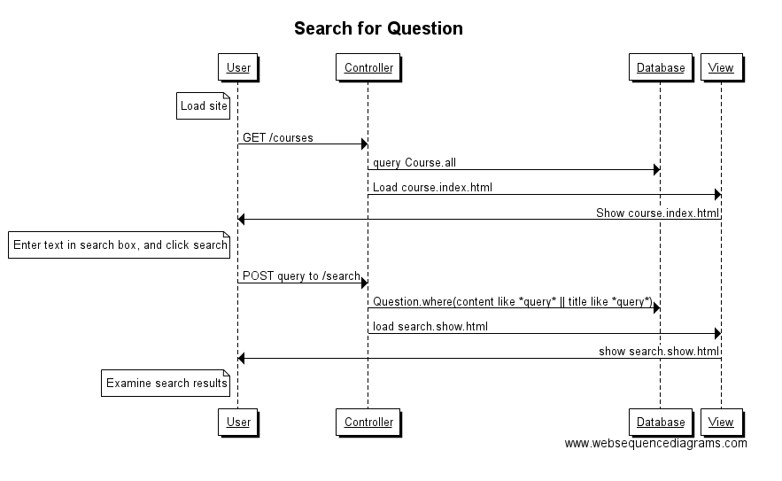
Search for Question
Design Level Diagram
System Sequence Diagram

Slide 10
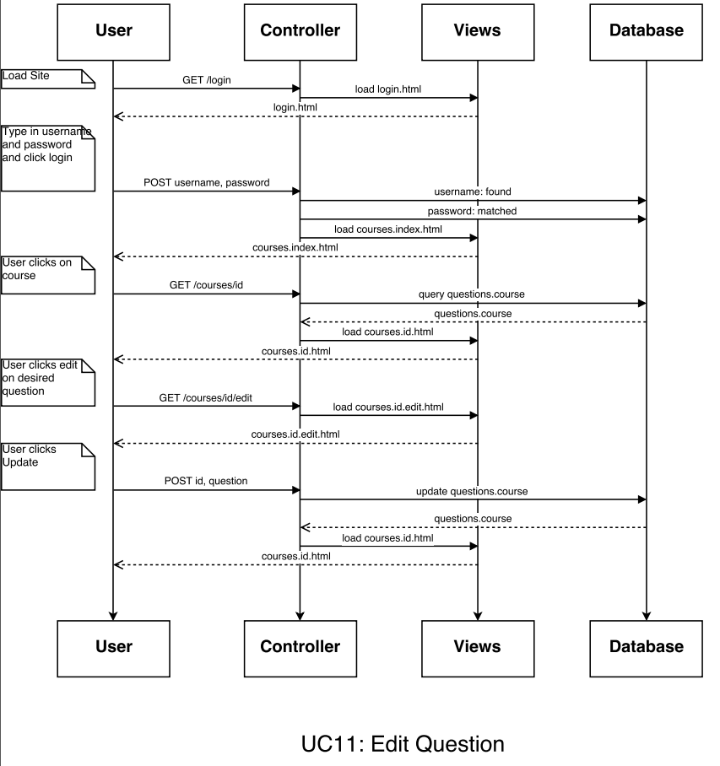
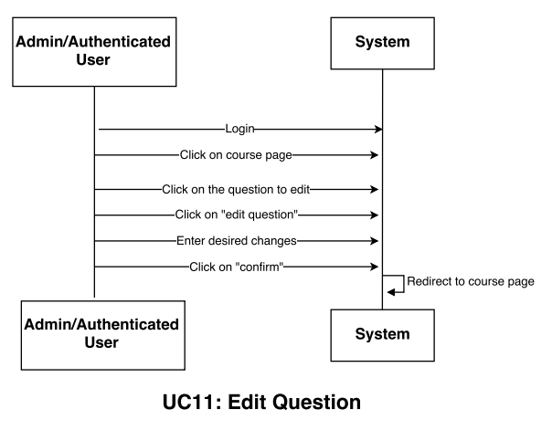
Edit Question
Design Level Diagram
System Sequence Diagram

Slide 11
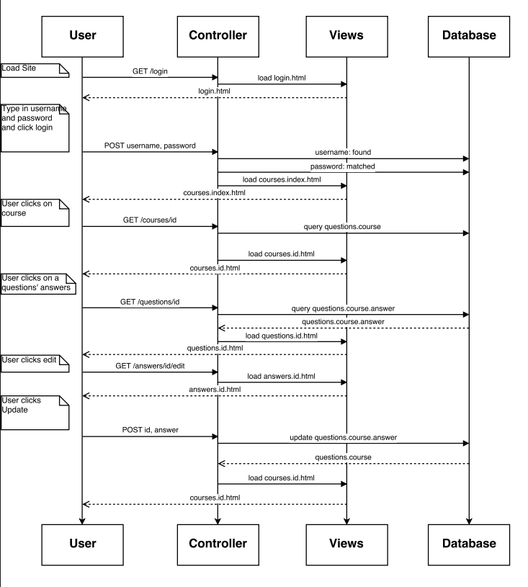
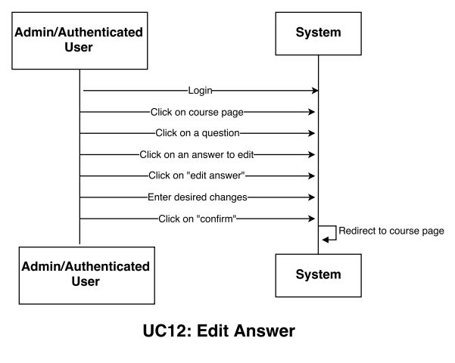
Edit Answer
Design Level Diagram
System Sequence Diagram

Slide 12
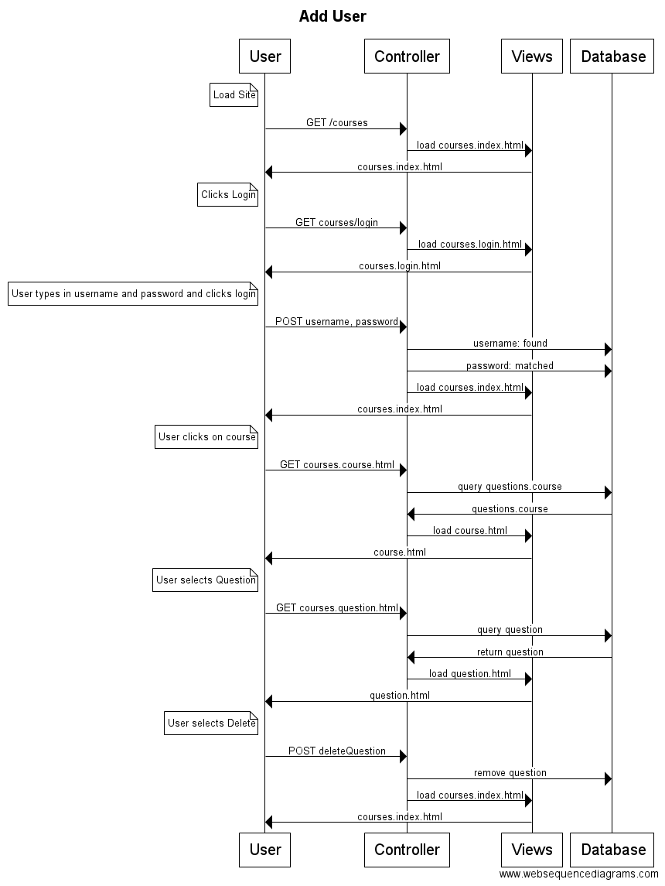
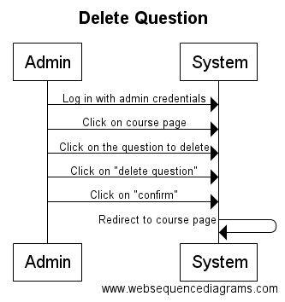
Delete Question
Design Level Diagram
System Sequence Diagram

Slide 13
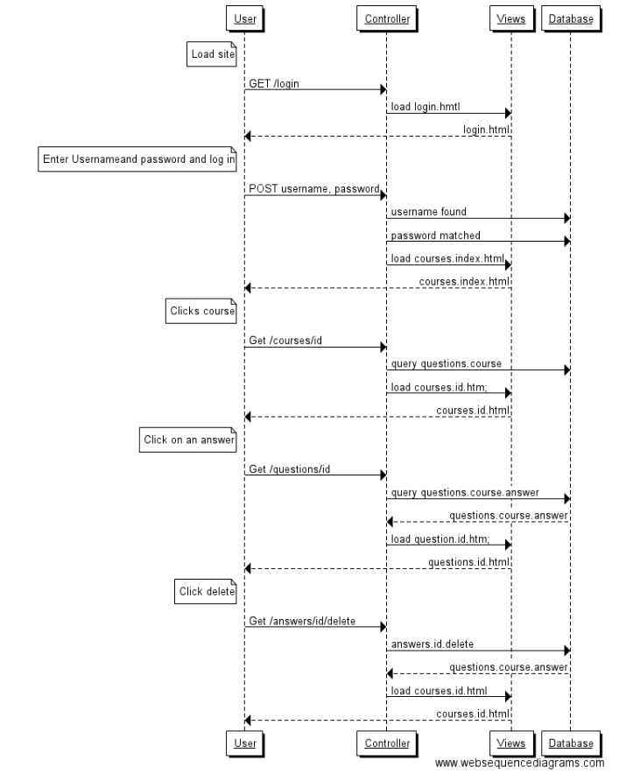
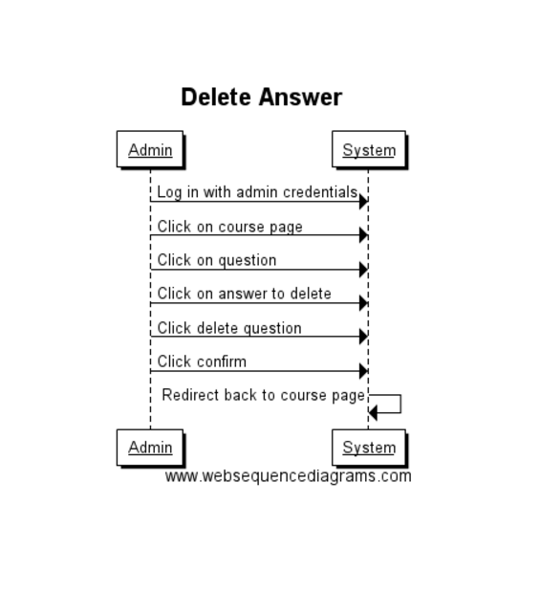
Delete Answer
Design Level Diagram
System Sequence Diagram

Slide 14
System Demo
https://vast-brook-88634.herokuapp.com/

