Slide 1
The Borne Collective
Iteration 1

Slide 2
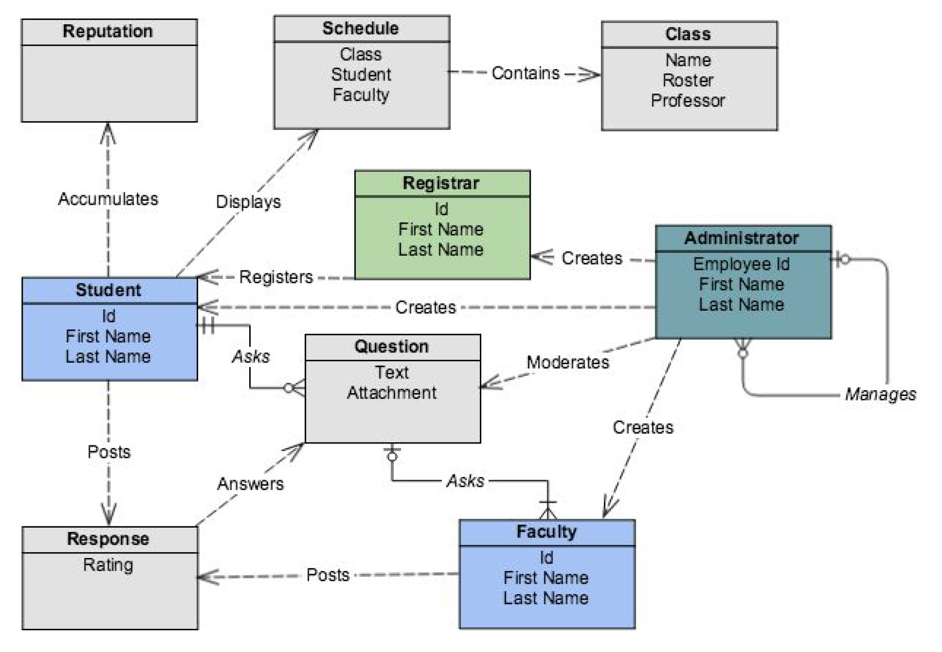
Domain Model

Slide 3
Selected Use Cases
View Forum
Ask Question
Answer Question
View Thread

Slide 4
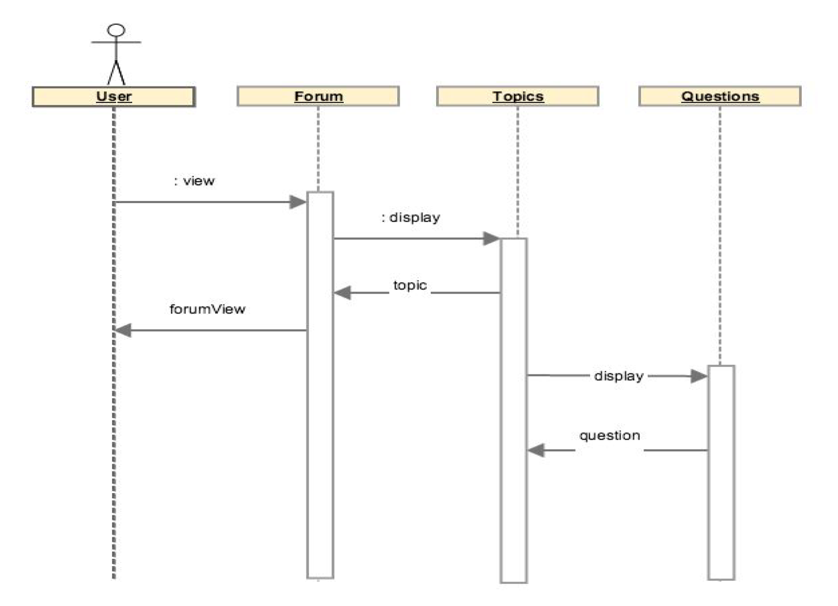
View Forum

Slide 5
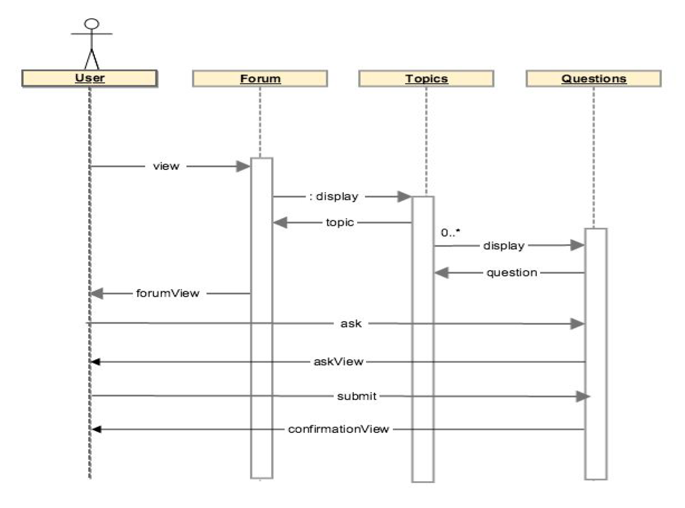
Ask Question

Slide 6
Answer Question

Slide 7
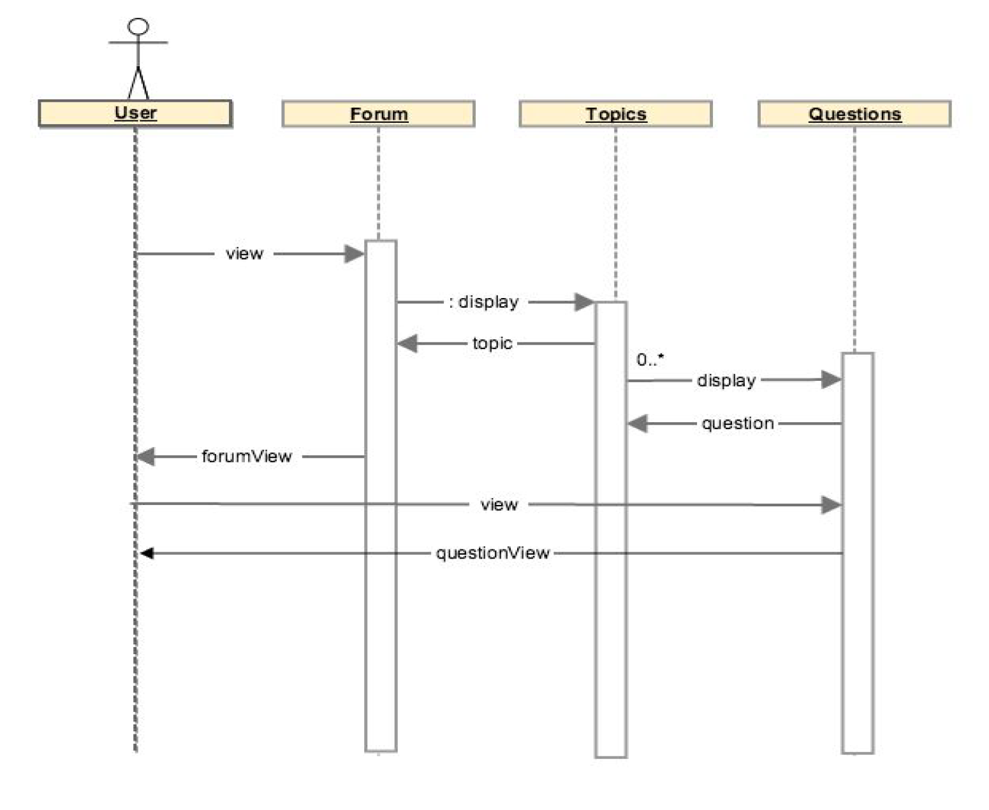
View Thread

Slide 8
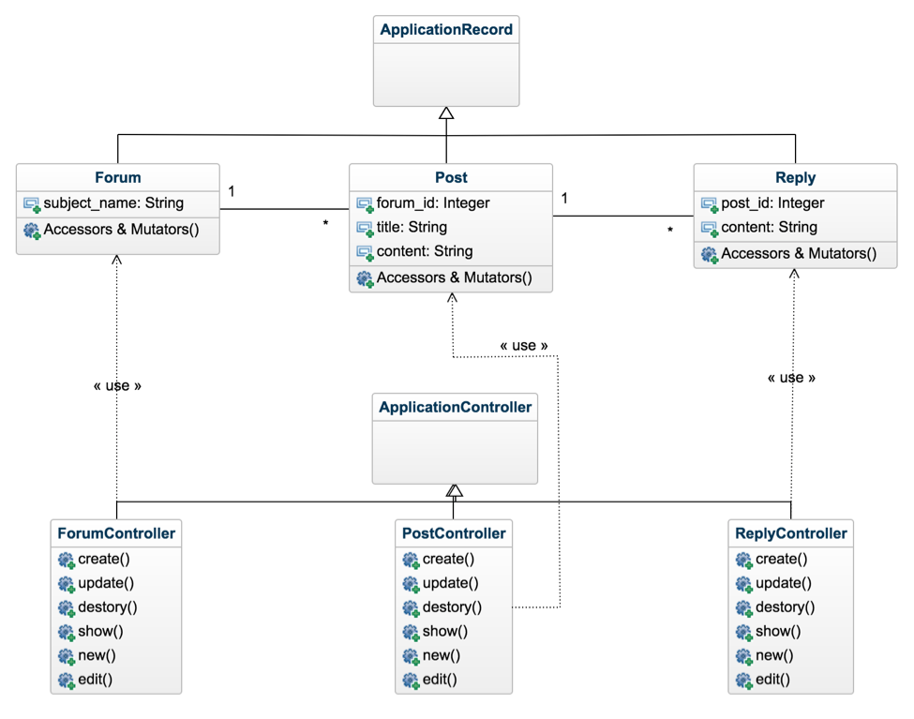
Class Diagram

Slide 9
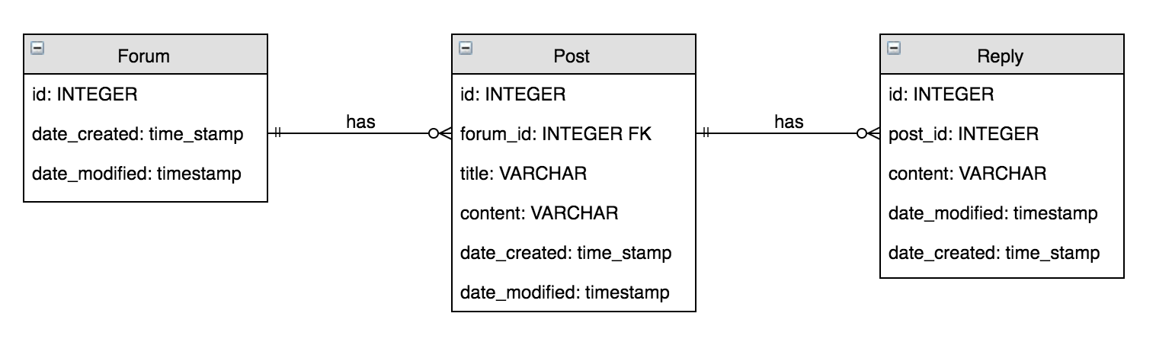
Database Design

Slide 10
Next Steps
Creation of the Users table
Adding a ratings system
Adding admin functionality

