Slide 1
The Borne collective
NKUNet: Inception phase

Slide 2
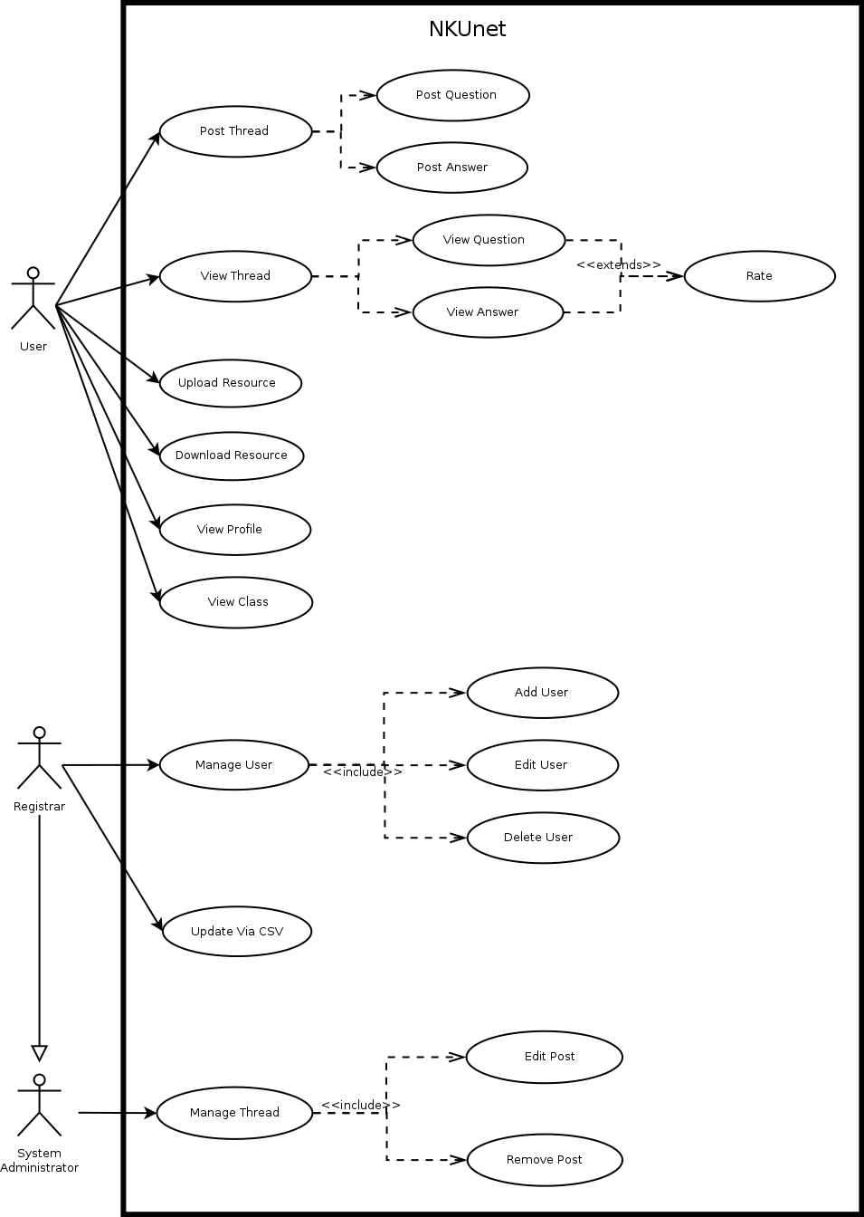
Use case Diagram pT1

Slide 3
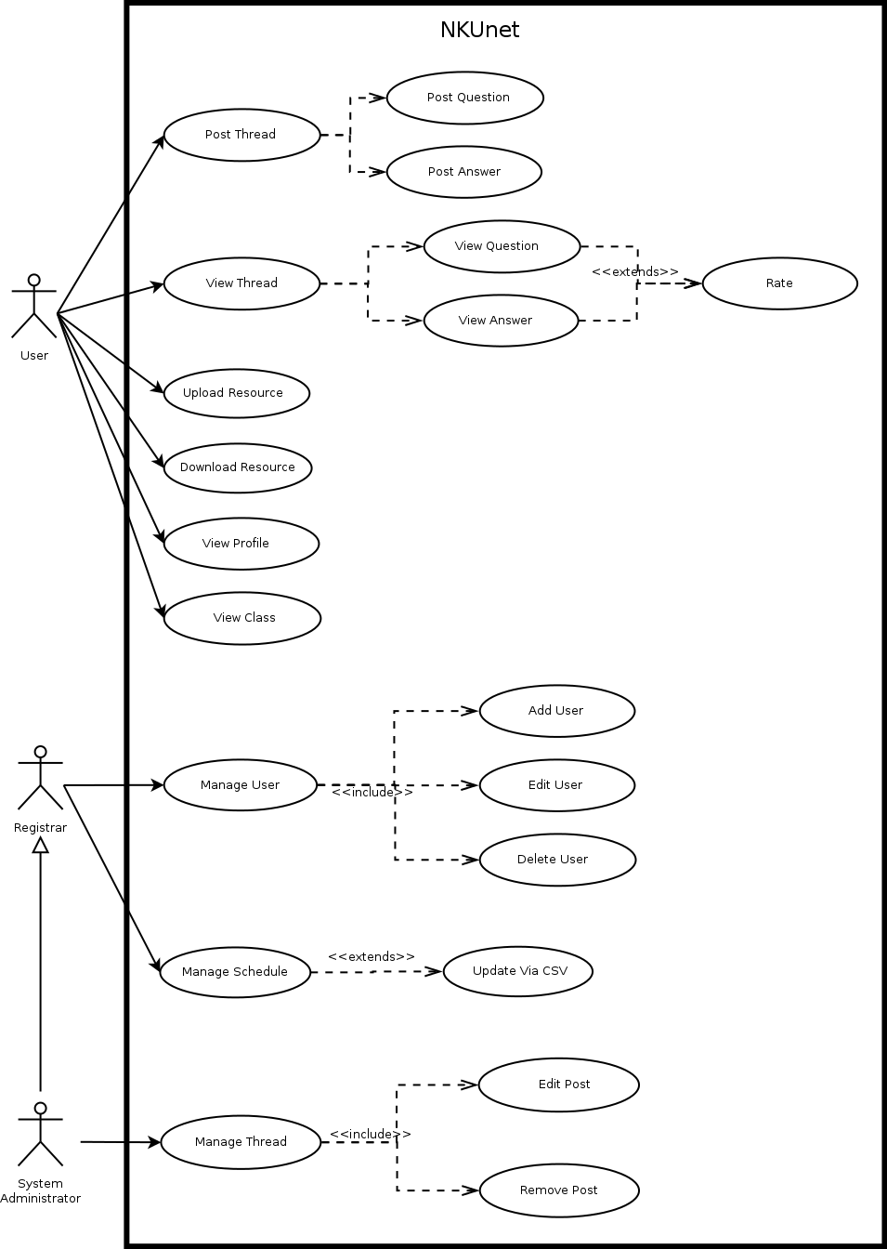
Use case Diagram pT2

Slide 4
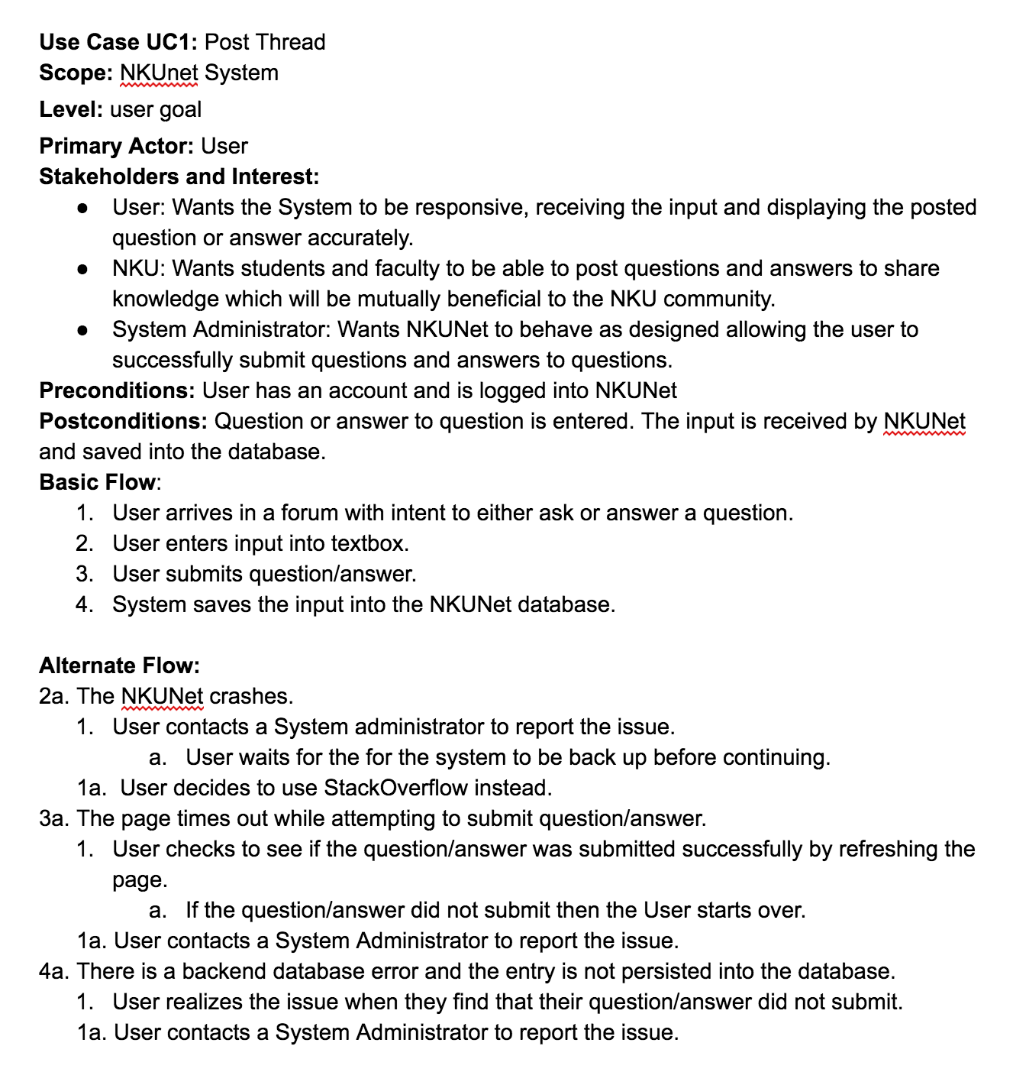
USE CASE: Post Thread

Slide 5
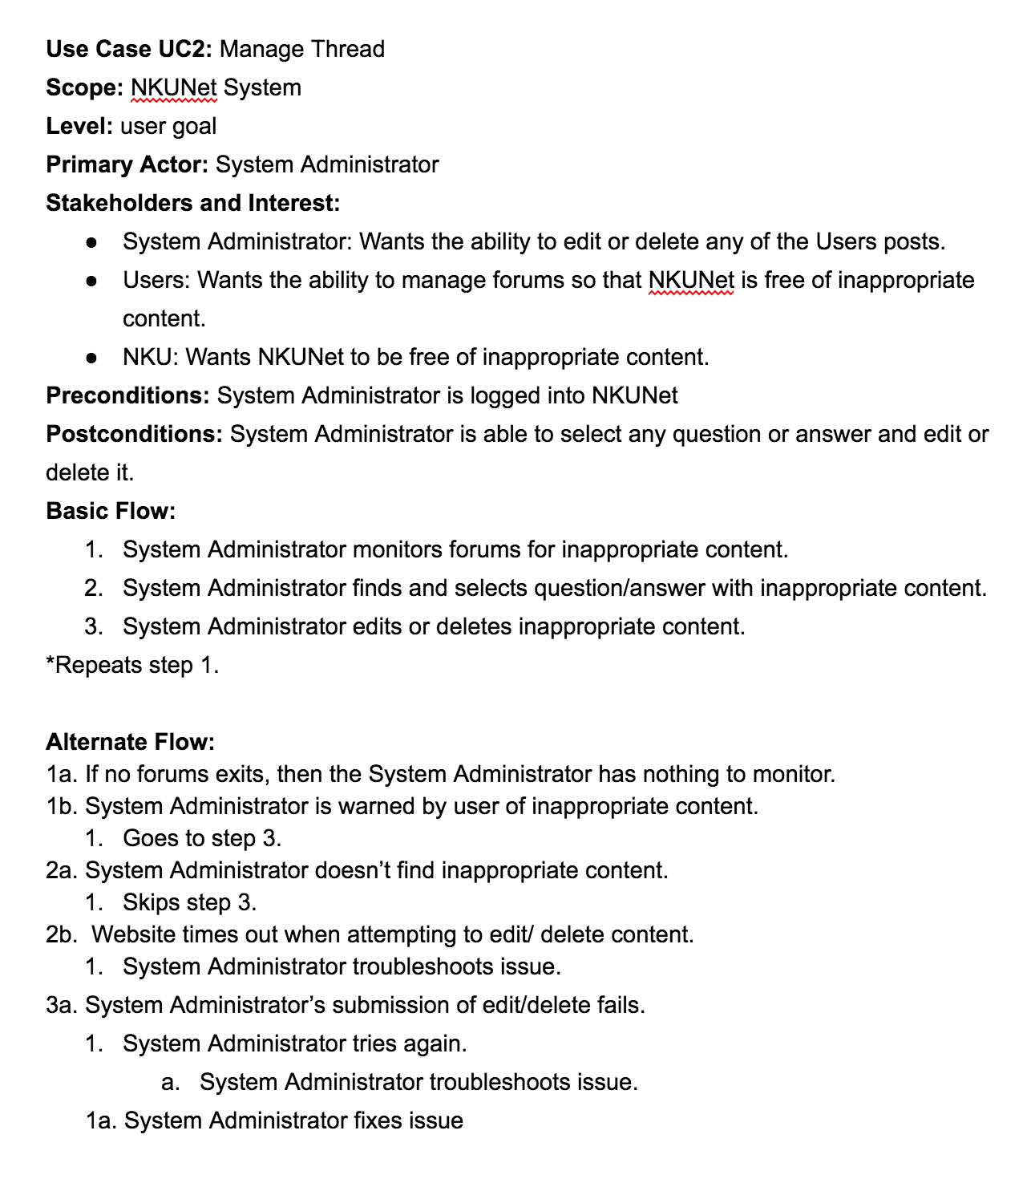
USE CASe: Manage Thread

Slide 6
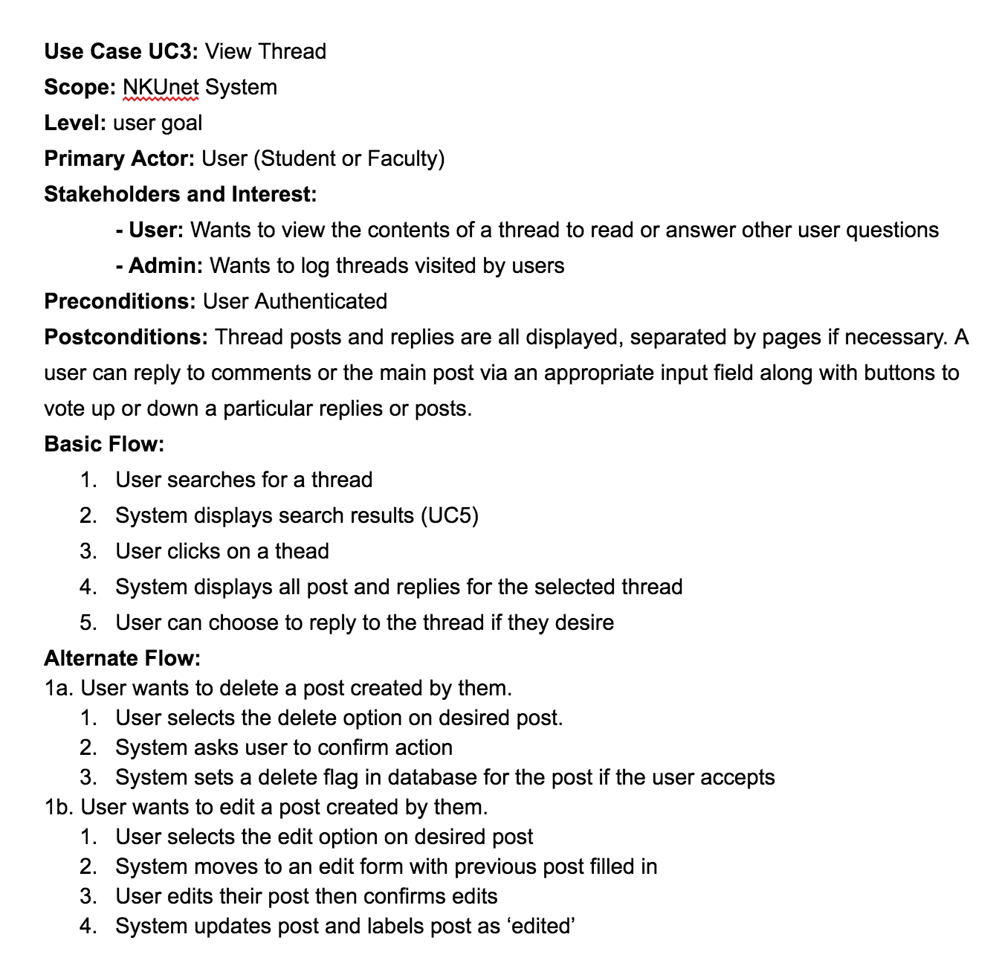
Use case: View Thread

Slide 7
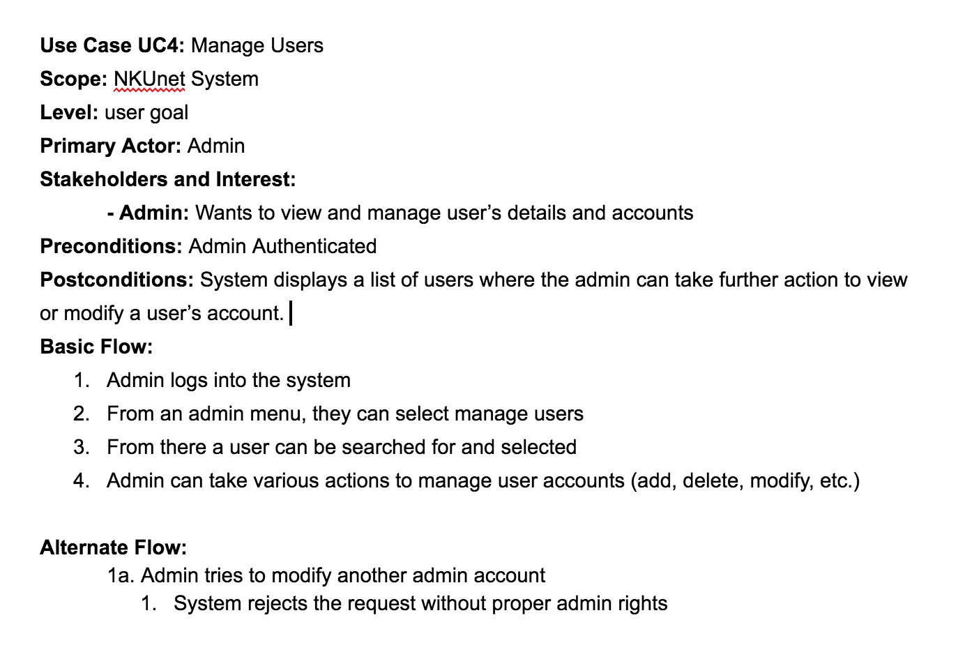
Use case: Manage User

Slide 8
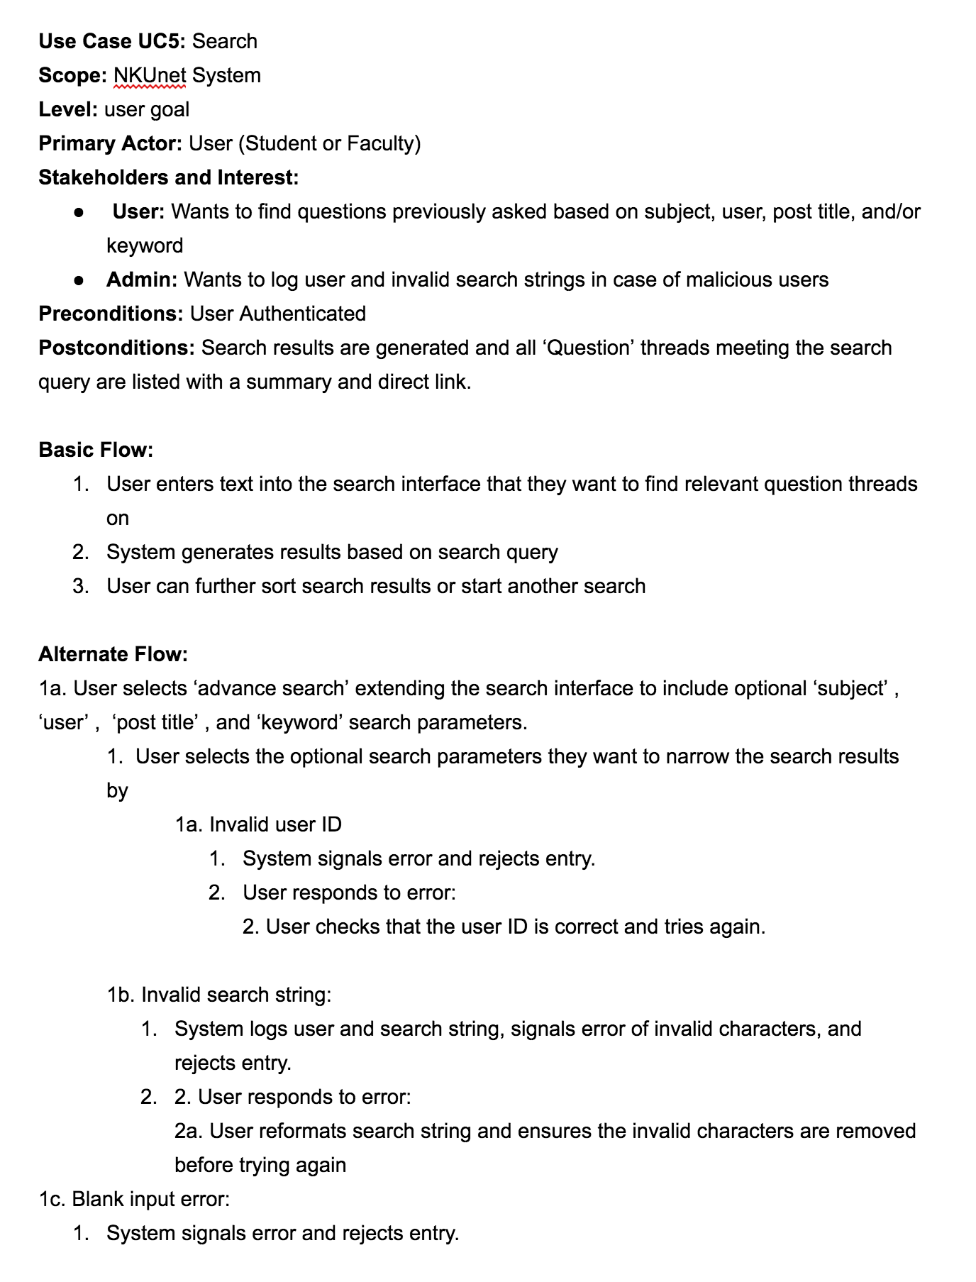
Use case: Search

Slide 9
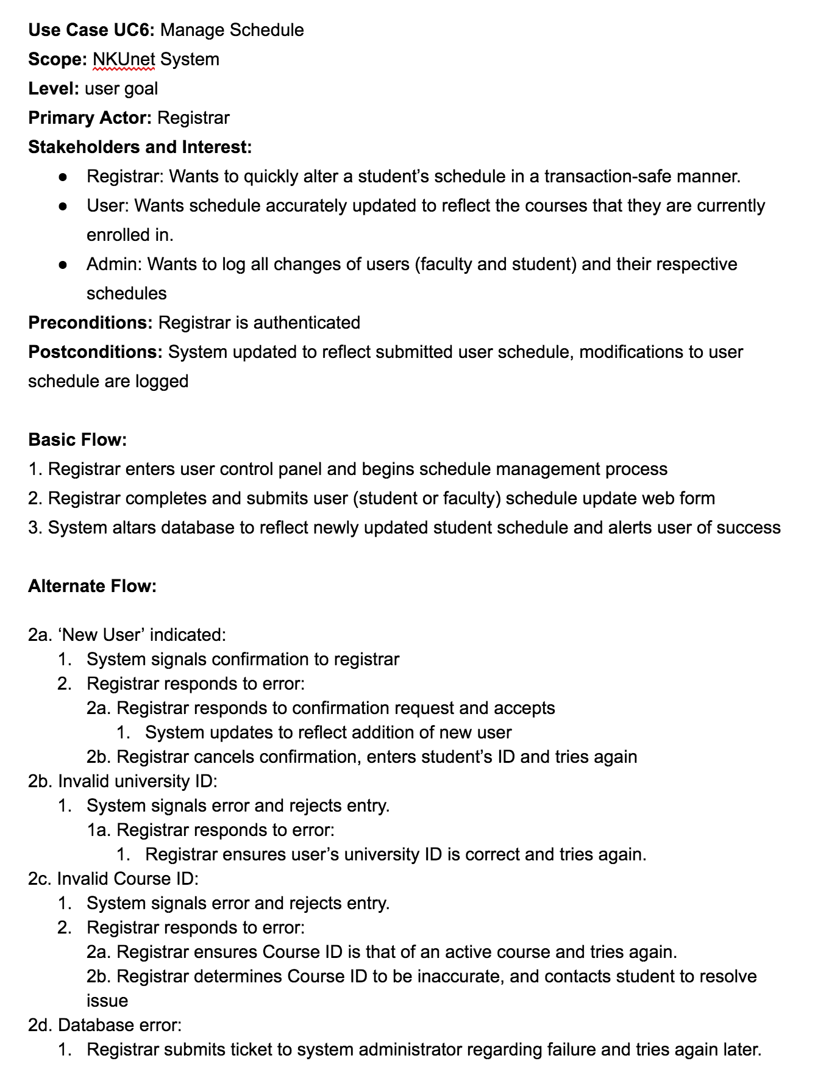
Use case: Manage Schedule

Slide 13
Discussions & disagreements
Should faculty be a separate actor from student?
How to handle CSV file uploads for students and courses.
How would the registrar update a student's schedule?
Does a user have to be logged in to view a thread?

Slide 14
Next steps
Setting Up Trello
Establishing environment with Ruby on Rails
Planning first sprint
Assigning design/coding tasks to each person

