Slide 1
‘GIT’ going with GIT
24 Jun 2014

Slide 2
This Presentation will include
Introduction to GIT
What is Git-hub or Bitbucket?
Let’s try GIT Commands
Why GIT?
To Do Stuff

Slide 3

Has this ever happened to you?
Scenario 1
Your program is working
You change “just one thing”
Your program breaks
You change it back
Your program is still broken--why?
You need to turn in your program now
but you haven't gotten them to work yet
You made a lot of improvements last night...
Your program worked well enough yesterday
Scenario 2

Slide 4
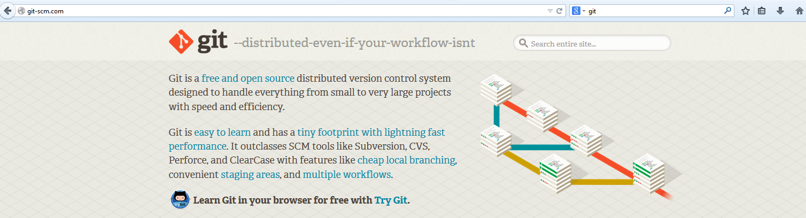
What is GIT?
Distributed
Stores Snapshot of files
Everything is Local
Workflows

Slide 5


Why Git?
Lightening Fast and small
Superior Branching and Merging Mechanism
Work Offline
Easy Switch , No checkouts
Undo Mistakes
Git is the Standard

Slide 6
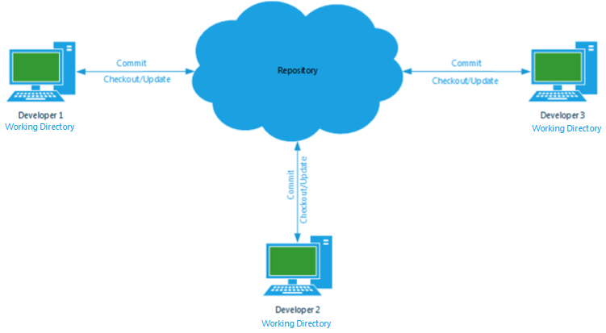
Source Version Control with SVN - Centralization

Slide 7
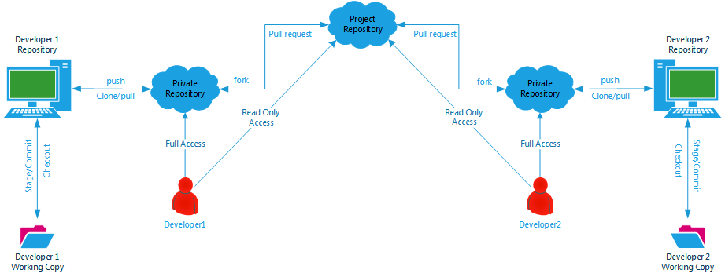
Source Version Control with GIT - Distributed

Slide 8

Let`s try GIT Commands

Slide 9
Essentials
Don't treat GIT like a fancier Subversion or CVS
Download and Install GIT
Use GIT Bash on Windows
Use eGIT on Eclipse
Understand GIT Concepts
Configure GIT Repository
Try GIT Commands

Slide 10

GIT Common Commands
Add
branch
checkout
clone
commit
diff
init
log
merge
pull
push
status
rm
mv

Slide 11
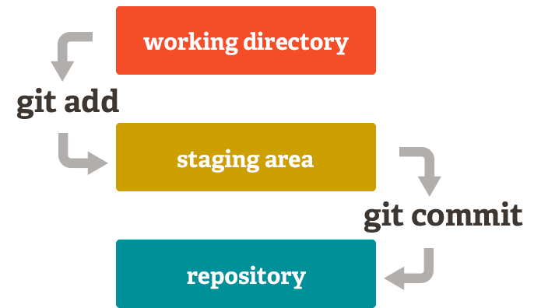
‘Git’ Started (Bootstrap Operations)
Create
Create GIT Repository <git init>
Stage
Additions <git add file> or <git add . >
Removals <git rm file>
Commit
Commit <git commit – m “EXJB-1234: File added” >

Slide 12


Git History and Status Operations
HISTORY
Review latest/all commits < git log> < git log -5>
Branch History
Last Commit in master yesterday <git log -1 master@{yesterday}>
Developer
History
<git log –author=pboonlia>
Status
Status - staged , un-staged and untracked files < git status>
Show
Show Last commit information ,changes author and date <git show>
Show Stats
<git show --stat>

Slide 13

GIT Branches
Default Branch (compare it to trunk in svn)
master
Create new branch
git branch develop-J214
Switch to new branch
git checkout develop-J214
Create and switch to new branch
git checkout –b develop-J215
Switch to branch and merge existing branch as well
git checkout develop-J215
git merge develop-J214
Or
git merge develop-J214 master
List all branches in local
git branch –l (l stands for local)

Slide 14
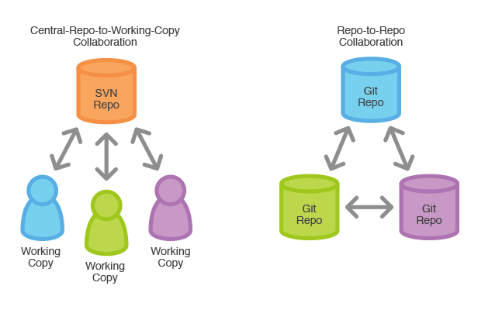
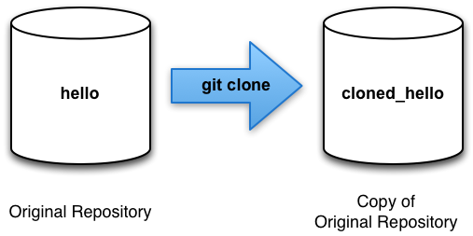
GIT Remote
Centralized vs Distributed
Team/Project Code is on Remote Repository
Specific checkout vs Clone/Fork Entire Repo
GIT don’t differentiate between local and central repositories , all of them are full-fledged git repositories

Slide 15
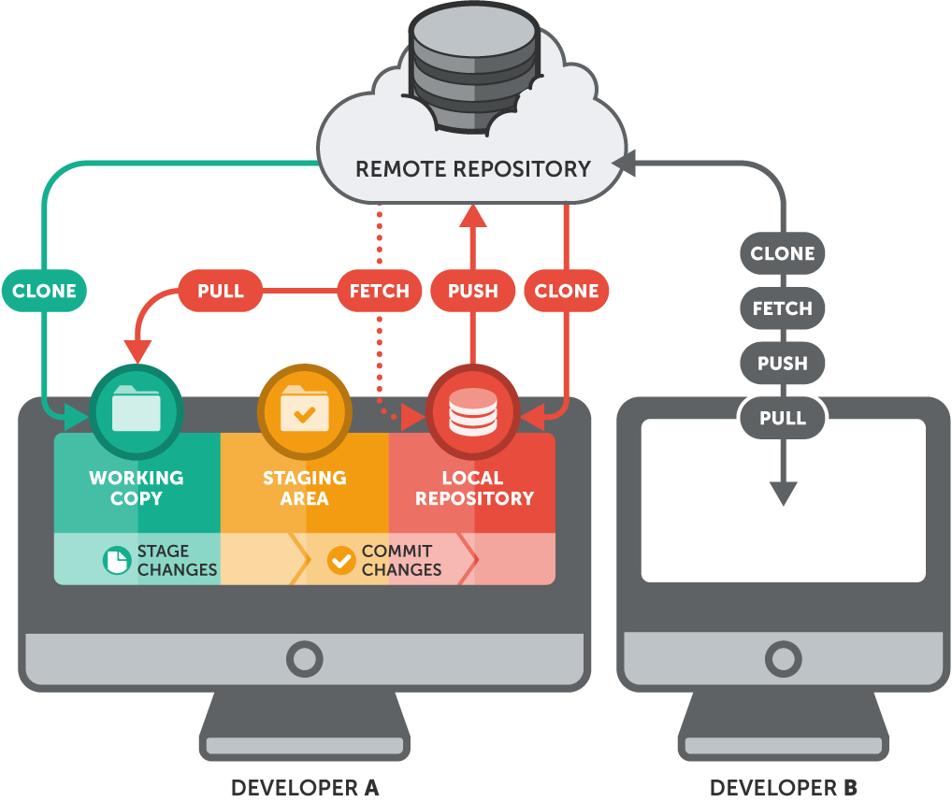
GIT Remote Repository Operations
CLONE
Copy Entire Repository into your machine
FETCH
Bring a local branch up-to-date with its remote version Do not merge any changes
<git clone <remote_url>>
<git fetch>
PUSH
PUSH your local branch to a remote repository
PULL
Bring a local branch up-to-date with its remote version . Merge any changes.
<git pull>
<git push <remote_name> <branch>>

Slide 16
Bitbucket and Github
“Bitbucket or Github are free code DVCS hosting site for Git. It Manages your development environments with a hosted wiki, issue tracker and source code”
“Bitbucket and Github are completely free for individual users with some constraints”
“JIRA and Jenkins Integration”
“Fork , Code , Pull Features”
“Browse your Source”

Slide 17
Thank You

