Slide 1
Coursework CSC1034 25/26 Gender Equality SDG5
Oliver Statham
40483321
Group 52

Slide 2
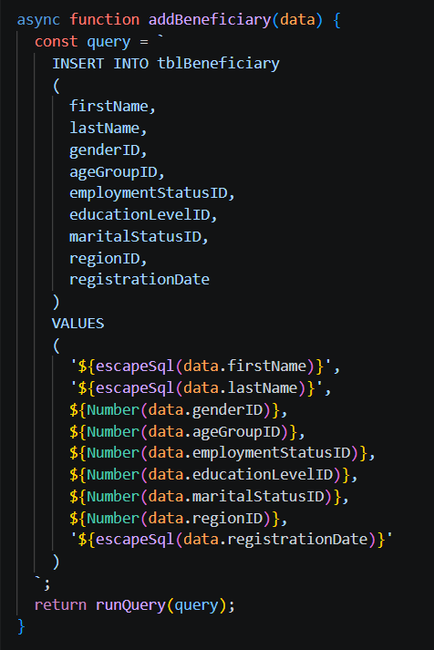
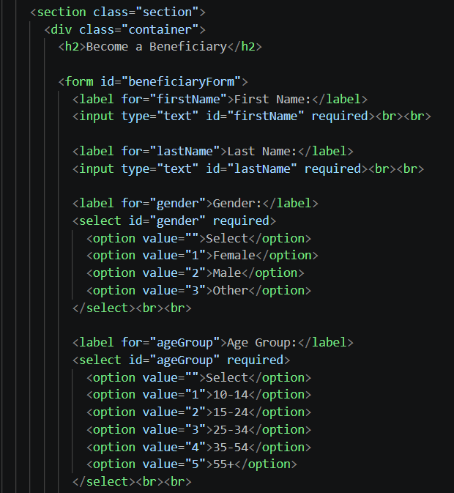
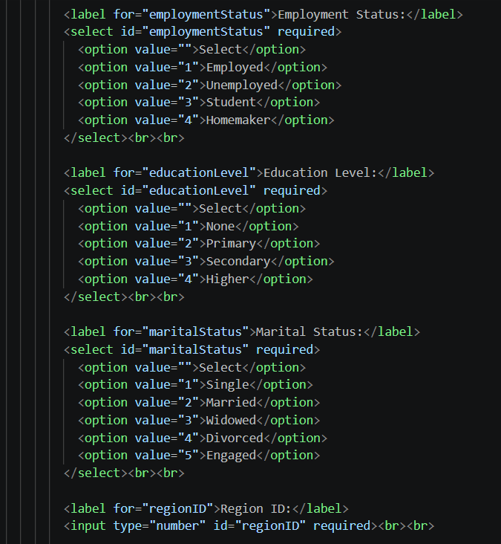
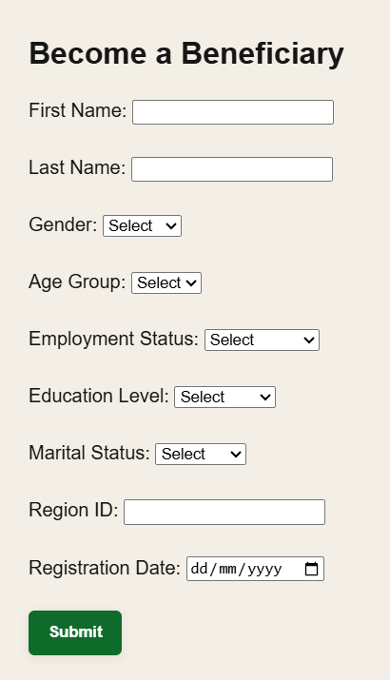

CRUD- Create
escapeSql replaces single quotes with double quotes to work in SQL
User inputs data and selects options that apply to them. HTML then calls addBeneficiary with user data.
Number forces value to be a number, preventing injection
Web view

Slide 3
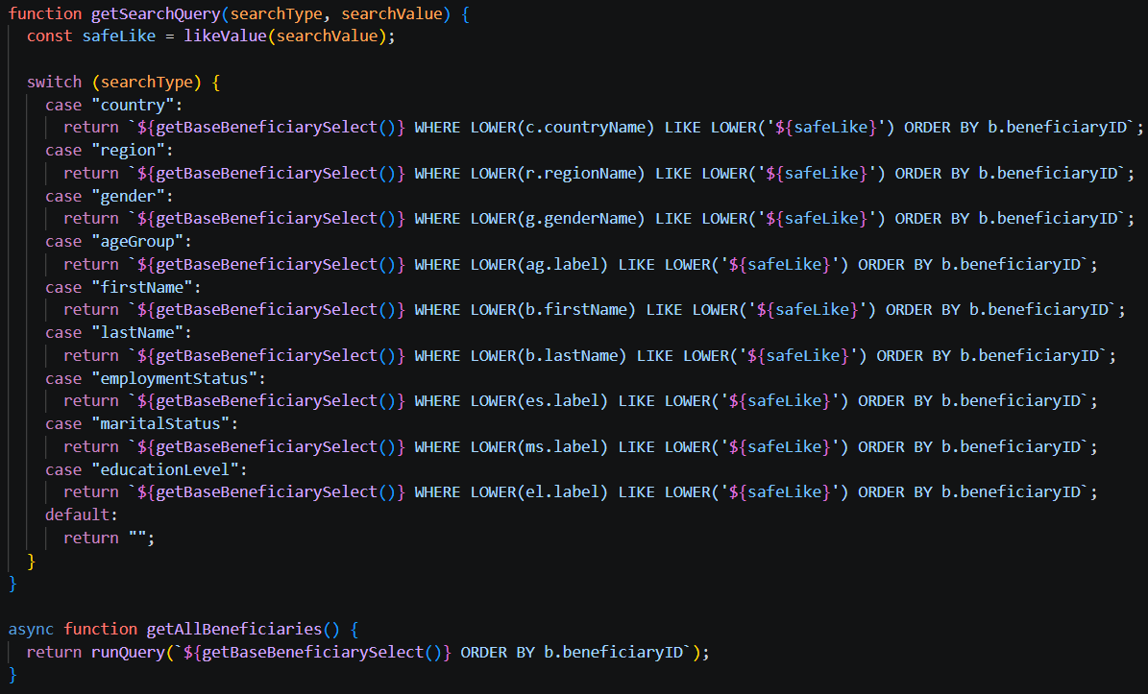
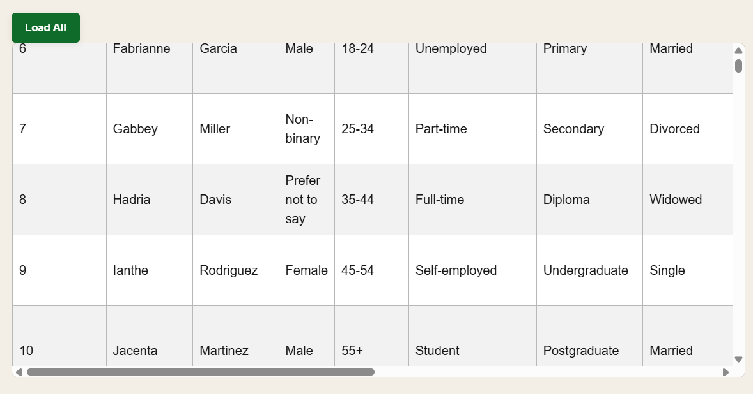

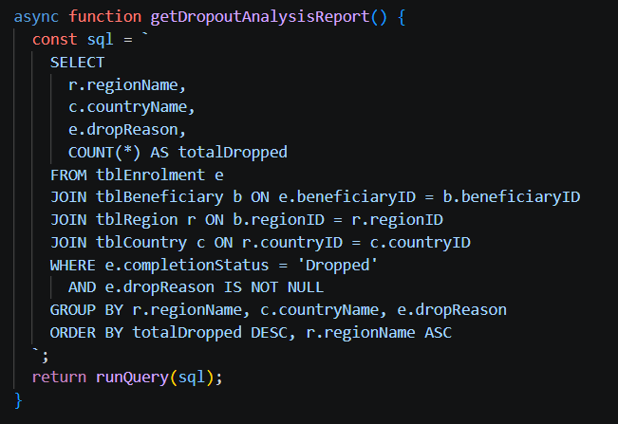
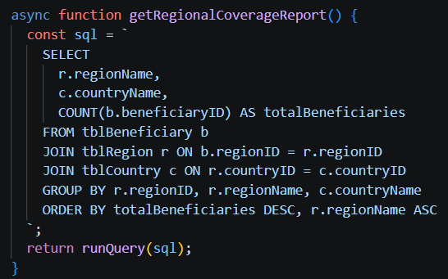
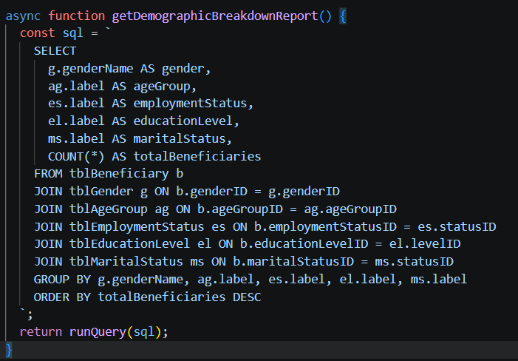
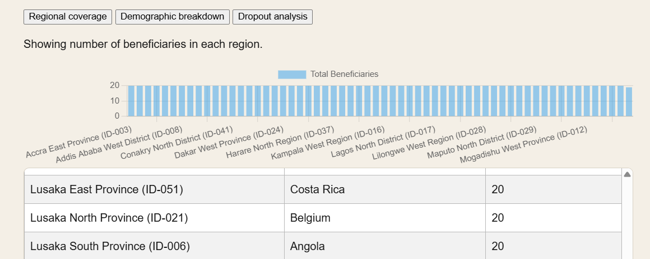
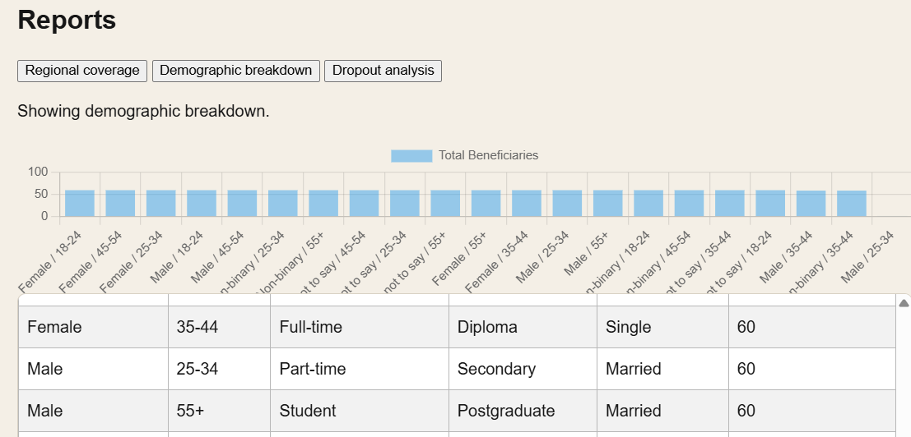
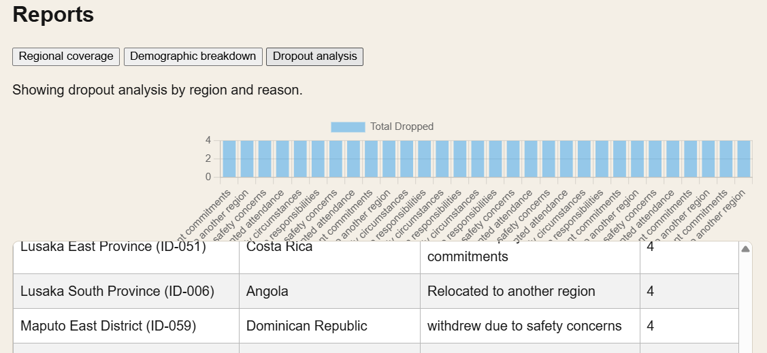
CRUD- Read
getBaseBeneficiarySelect loads all beneficiaries, used by getSearchQuery with filters to search and getAllBeneficiaries to load all to website

Slide 4
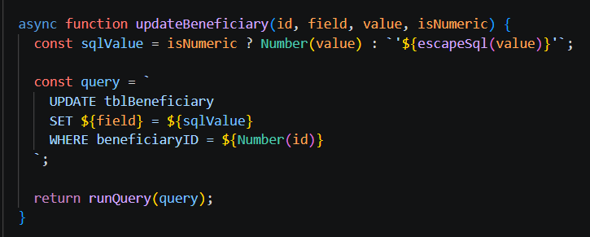
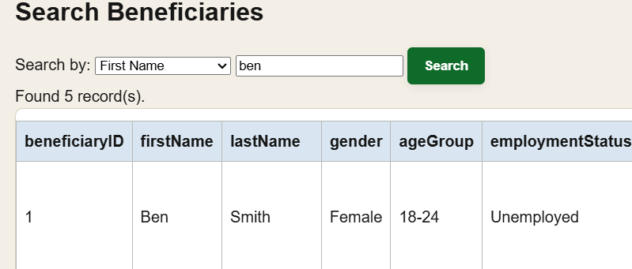
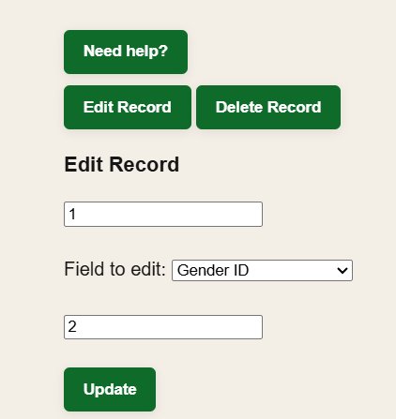

CRUD- Update
isNumeric boolean allows the method to respond accordingly based on whether the field to be changed is a number field or string field
Sets field to new value from user
Only updates correct record

Slide 5
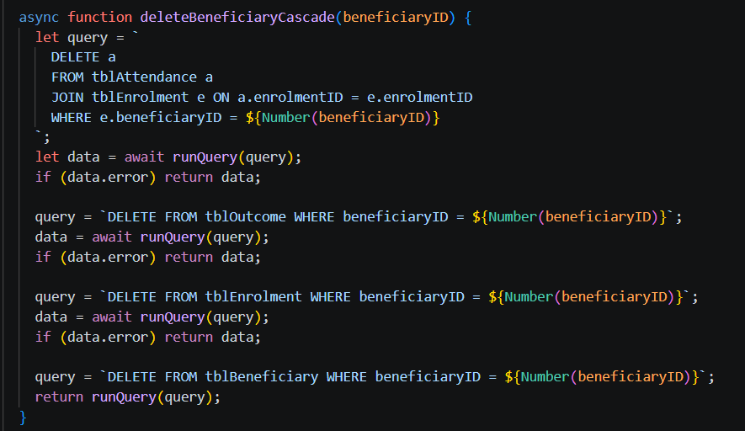
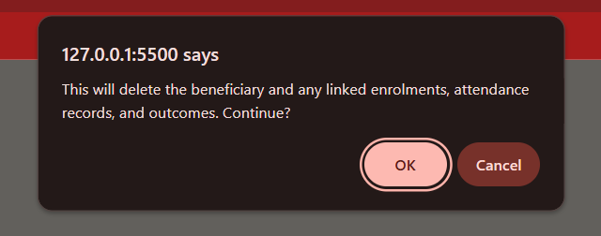
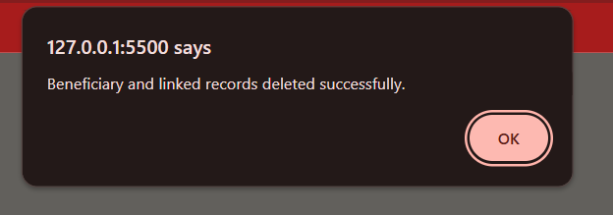
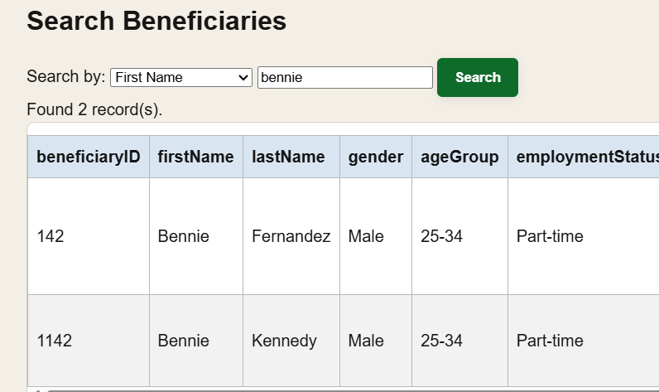
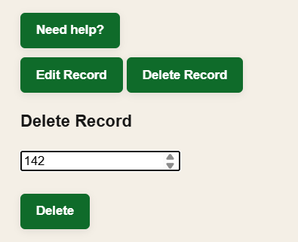
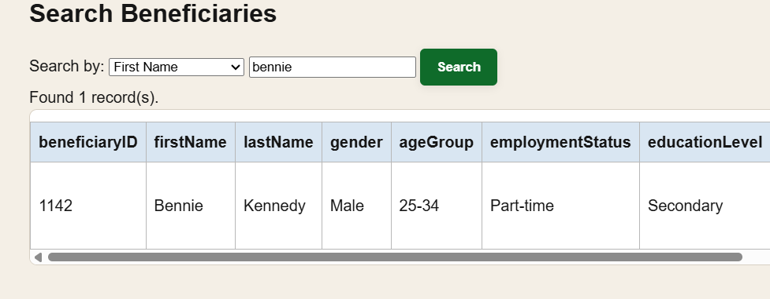
CRUD- Delete
Tells user if error has occurred
Deletes record from all tables
Confirms with user

Slide 6
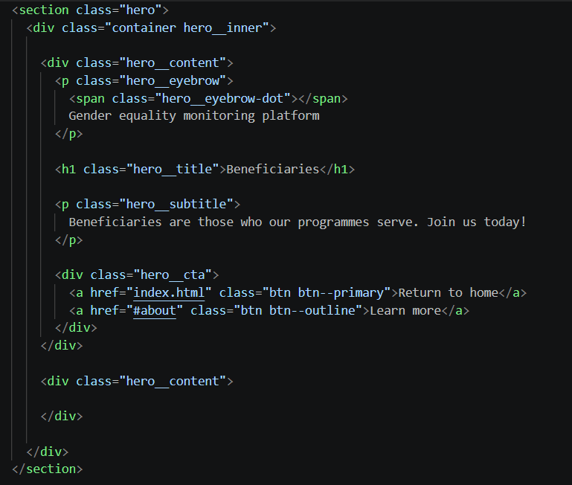

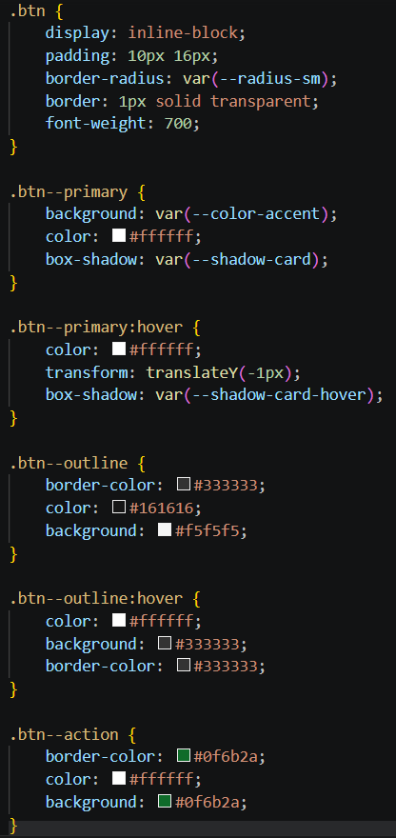
HTML- Header
Header explains to user what the website is and what this page is for
Brings user to home (bottom)
Brings user to home (top)
CSS for buttons
Empty division for space

Slide 7
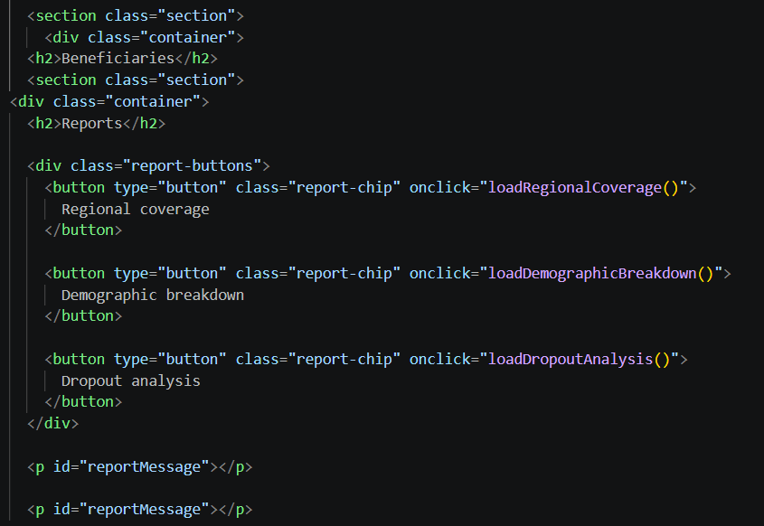

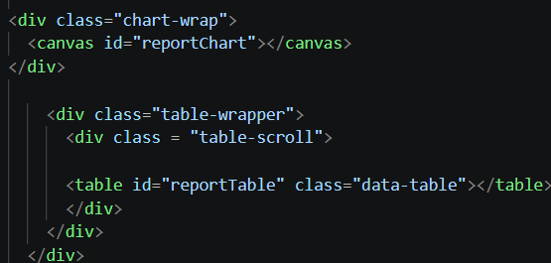
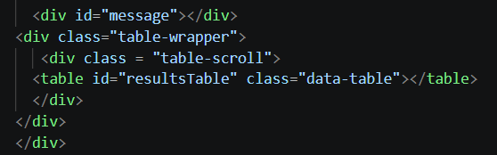
HTML- Reports, tables and charts
Each button calls the relevant method
Chart is evenly spread due to even distribution during seeding
Draws chart and creates wrapped table (user can scroll)

Slide 8
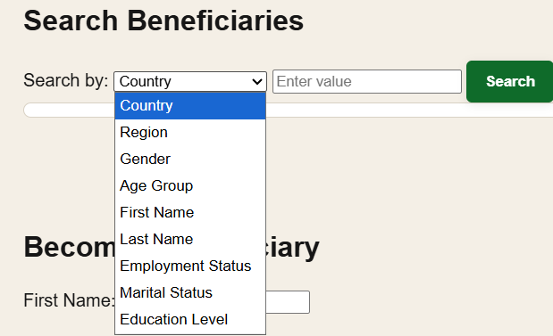
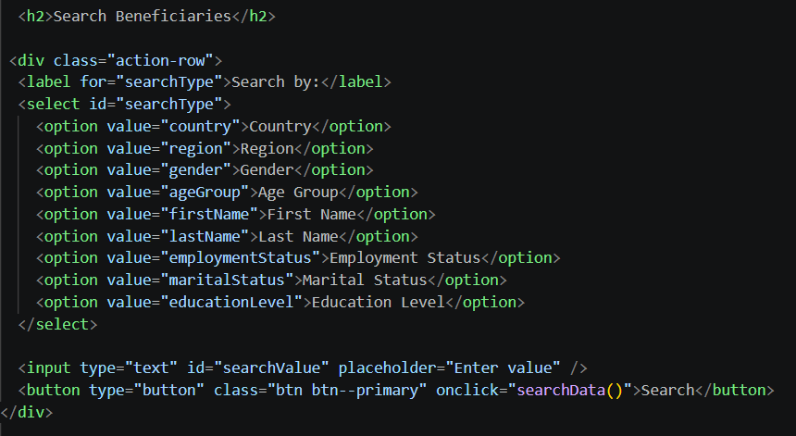
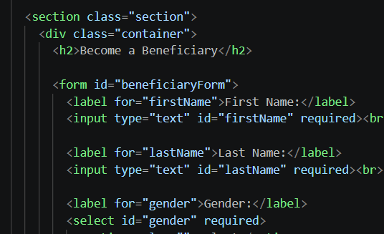
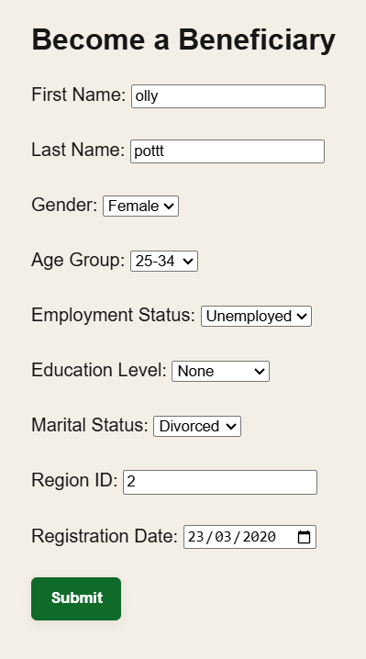
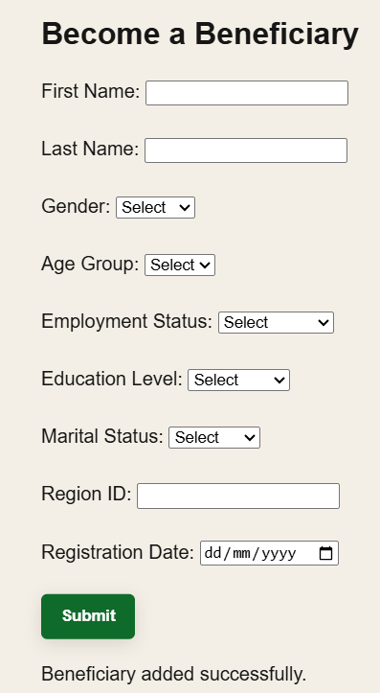
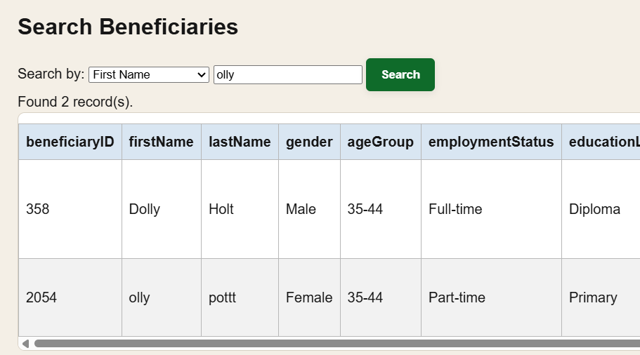
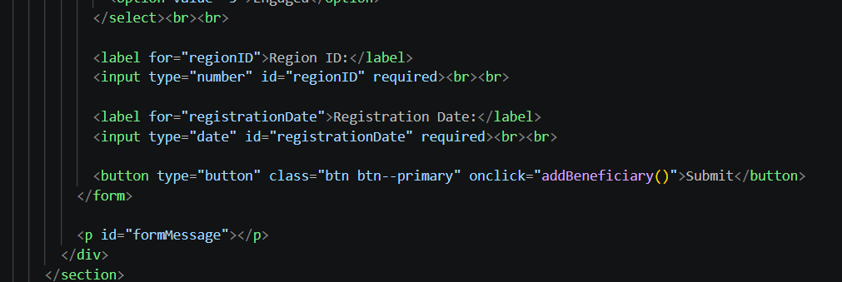
HTML- Search beneficiaries and become beneficiary
Allows user to search via different criteria
Relays data to JS method
User becomes a beneficiary by inputting relevant data
…

Slide 9

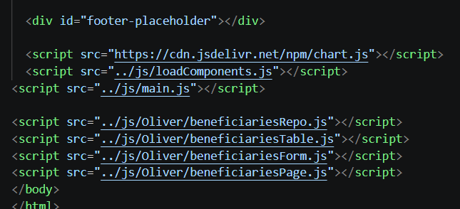
HTML- Footer and JS links
Footer keeps professional feel of website

Slide 10


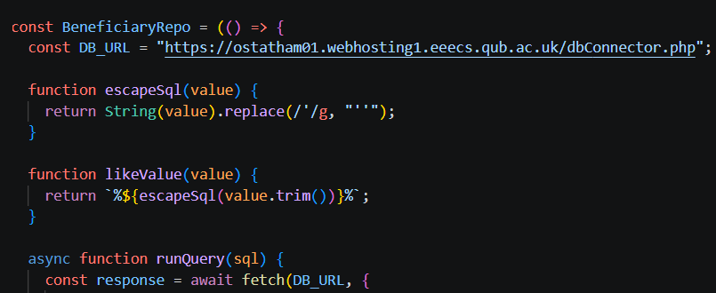


Fetch and DBConnector
FileZilla used to link my computer and live server, keeps DB connector running on page

