Slide 1
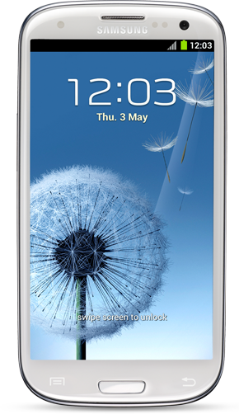

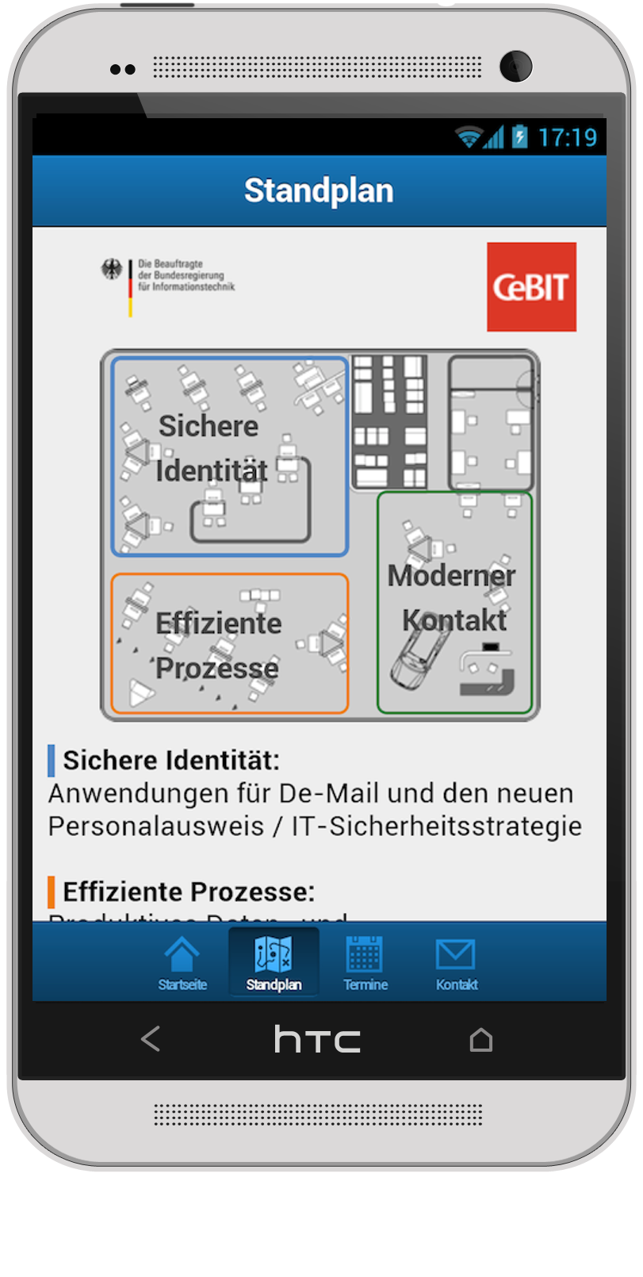
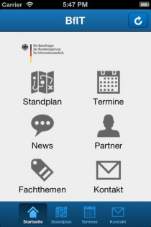
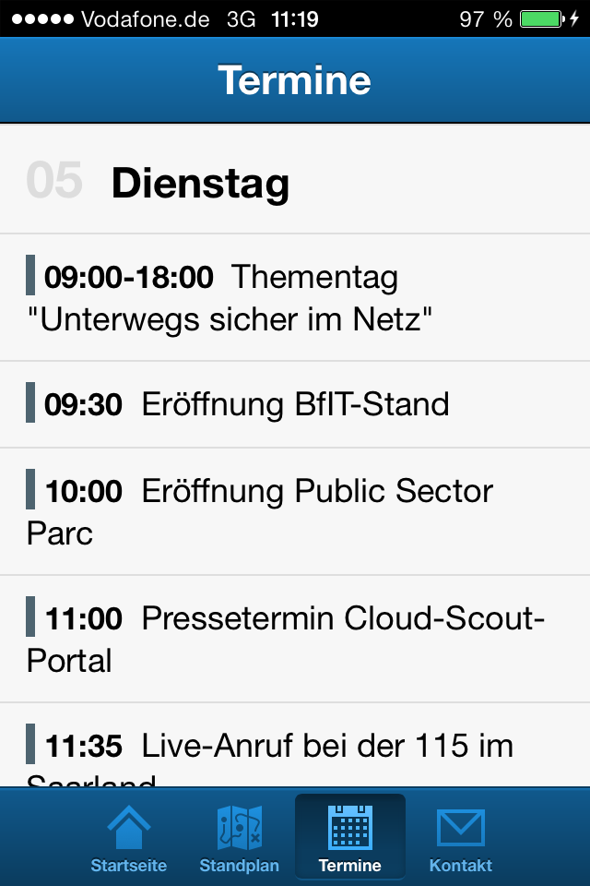
Case Study: Bundesministerium des inneren – BfIT CeBIT 2013
Client
BfIT / Germany’s CIO is responsible to improve the IT collaboration between the economy and the Federal Government
Challenge
Solution
Results
The mission was to captivate the visitors of the world's largest computer expo (CeBIT 2013) with Germany’s IT innovations and to keep them up to date about the BfITs exhibition booth
As an alternative to printed flyers CSC proposed to create a state of the art smartphone app to maximize reach, face the challenge of updated program schedules and save the environment
A hybrid iOS and Android smartphone application features a interactive exhibition map, latest news, schedules, contact form, information about partners and technologies
Due to inconsistent telephone connections on the exhibition the app features a full offline functionality. Once the user has a connection the latest news and updated schedules are loaded automatically
The app is distributed via Google Play and the official Apple AppStore
The client was able to push updates before, live from the CeBIT and after the event directly to the devices
With CSC’s AppFactory approach the development fitted the tight timeline and a narrow budget
Content is fully managed by a backend solution and can be reused by the client for fCeBIT 2014
Visit csc.com/mobility for more information

