Slide 1
Phase 2 Presentation
Group – ASOUL
# tOM LI
# STEVEN LIU
# YANKE (VECTOR) MAO
# MIKE YUAN
# William zhang
# HONGSHUO(TONY) ZHOU

Slide 2
Specification (William)
We designed a FoodTruck ordering program in which the user can place orders through the program and sell food items through their food truck.
Why this?
Backend Functionalities: Inclues all the basic functionalities you can expect from an ordering app
Rating system
Managing/editing foodtruck and its menu
Change user infomarion (nickname, password, add money...)
Review order history lists
View market (sort foodtrucks by rating, name, default)
Front-End: The front-end consists of two seprates parts that will both be demonstrated later.
The commandline interface is our primary front-end display which is interacted within the command line in Intellji.
The Android interface is our secondary front-end display and is interacted through an emulator, it will include all the features covered by our program (same with commandline), but also in addition including accessibility features, better graphics, and easier user interaction.

Slide 3
Demo

Slide 4
Progress report (Steven Liu)
Phase 0:
Implement Entity, Use case classes, some rough Controllers, and a command-line Interface.
Phase 1:
Redesign some of Entity, Use case classes, implement more functionalities in Controllers and make it follow the Single Responsibility Principle, implemented serialization.
Phase 2:
Add more design patterns while designing our command-line interface and Controllers. Update Controllers, so they have all functionalities as a food ordering app. Refactoring and clean up old codes. (Ex. Functionality of ordering food, signing in, registering, rating order, viewing market etc.) Design the Android Interface and immigrate functionalities to the Android app.

Slide 5
Major design decisions(Mike)
Specification Changes:
Merged two user types into one, one food truck for each user
Orders now only have 2 states (in progress, completed) instead of 4 (order placed, in progress, canceled, completed)
Adjusted entity fields (dropped labels of food, added order in progress for users, etc.)
Adjusted entity reference accessibility for FoodTrucks, User and Order, replaced direct reference of each other with string ids
Formalized login process and access restriction to operations that changes the status of the model (change password, nickname, etc)

Slide 6
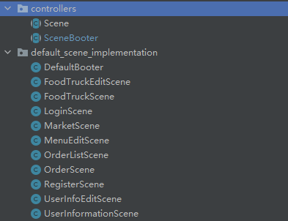
Major design decisions(Mike)
Code Structure Changes:
Methods in use case classes are made static to allow better communication between classes
Scenes are now hidden from outside interfaces, interfaces will now only interact with SceneBooter
Our implementation of scenes (LoginScene, RegisterScene, etc) are now separated from the controller package to allow for other implementations of scenes (plugin), such package is now required to have an extension of SceneBooter which is made public to outside.
Separated serialization / deserialization component from the user case classes
Replaced error / state flags in scenes with the use of exception messages

Slide 7
Clean Architecture & UML (William)
Outer layers always depends on only one layer inside (CommandLine -- > Controllers --> Use cases --> Entities)
All import statements follow clean architecture
Independent UI and database (two UI both using the same back-end codes)
Entities and Use cases easily tested without haivng to worry about the outer layers
Present UML

Slide 8
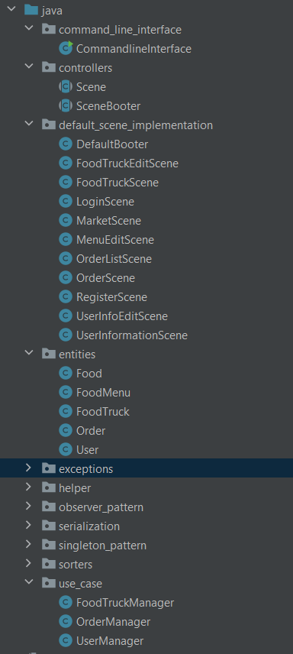
SOLID (Steven Liu)
Single Responsibility Principle:
Each Entity class is responsible for one single entity object (User, Order, FoodTruck etc.)
Each use-case class (Manager class) is responsible for editing one single entity object
Each controller class is responsible for calling managers for one single scene.
Open/Close Principle
Our classes are closed for modification and open for extension. (Ex. Manager -> Entity)
Liskov substitution principle:
All children classes do not modify their sharing functions with their parent classes. Instead, they only extend their class by adding more new methods to meet some special behaviours.
Interface Segregation Principle:
Our interfaces (Observable) are small so classes that use these do not need to override some useless methods.
Our parent classes only define methods that are useful and share commons with all their children classes.
Dependency Inversion Principle:
Entity does not depend on Manager
Manager does not depend on Controller

Slide 9
Packaging strategies - Tom
Package by layers
Follow the clean architechture
More oragnized
Cleaner design structure
Exceptions, serializations, sorters, etc..
Serves a specific feature to the entire program

Slide 10


Design Patterns
Facade:
SceneBooter is the facade which interacts will all the Scene classes.
Observer:
CommandLineInterface observes the output string of each Scene and print it out.
Template method:
Sorting algorithms all have similar structure and the only difference is their way of comaring objects.
Singleton:
Sorters and Scenes will only have one instance.
Simple factory:
Create specific sorters.

Slide 11
Accessibility
Principle 1: Equitable Use:
equivalent for all users
Principle 2: Flexibility in Use:
language setting, night mode,
Principle 3: Simple and Intuitive Use:
hint in the edit text, text on the button, help in command line version, ….

Slide 12
Accessibility
Principle 4: Perceptible Information:
color contrast
Principle 5: Tolerance for Error:
toast and text warning
Principle 6: Low Physical Effort:
automatically switch between activities
Principle 7: Size and Space for Approach and Use

Slide 13
Accessibility
Target user:
UofT students
Workers who usually eat at UofT food truck
People who are less likely to use:
People far away from campus

Slide 14
Future plan
Add Night mode for Android Interface
01
Add language select for Android Interface
02
Make our Android app more fashion and beautiful
03

Slide 15
Member Contributions - Tom
William (Entities, rating system, Android, UML diagram)
Tom (Entities, Controllers, Android)
Tony (Use case, controllers, design patterns, commadline, final refactoring)
Vector (Use case, Android, UML diagram)
Mike (Controllers, design patterns, commandline, Use case, ordering system, serialization)
Steven (Entities, Android)

