Slide 1
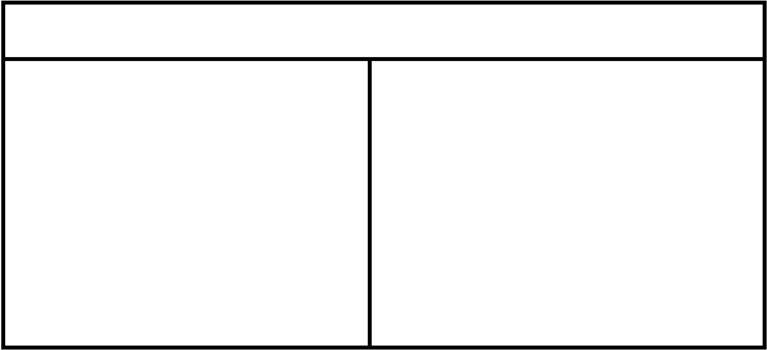
ENTITIES
Card
Deck
rank: string
suit: char
isFace(): bool [whether this Card is a face card]
getRank()
getSuit()
cards: List
drawCard(): Card
shuffle()
peek(): Card [first/top card of deck]
isEmpty(): bool
addCard(Card) [adds to bottom of deck]
Card
Hand
cards: List
getCards(): Card[]
addCard(Card) [to end of hand]
removeCard(): Card [remove first/top card]
removeCard(rank, suit): Card [remove specific card]
getSize(): int
Card

Slide 2
USE CASES
Player
Game (abstract)
players: Player[]
deck: Deck
currPlayer: Player
currPlayerIndex: int
calculateValidMoves()
makeMove(Card)
checkWin(): bool
startGame() [main game loop]
hand: Hand
name: String
addToHand(Card)
removeFromHand(Card)
getHand(): Hand
Hand
Card
Player
Deck
Card
crazyEights extends Game
playingField: Stack
controller: InOut
hasValidMove()
Card
Hand
InOut

Slide 3
CONTROLLERS/UI
InOut (interface)
ConsoleInOut implements InOut
getCard() [return user selected card]
drawCard() [return whether user wishes to draw a card from the deck]
sendOutput() [send output to the user]
Command line interface
Uses inputs from console to implement InOut

