Slide 1
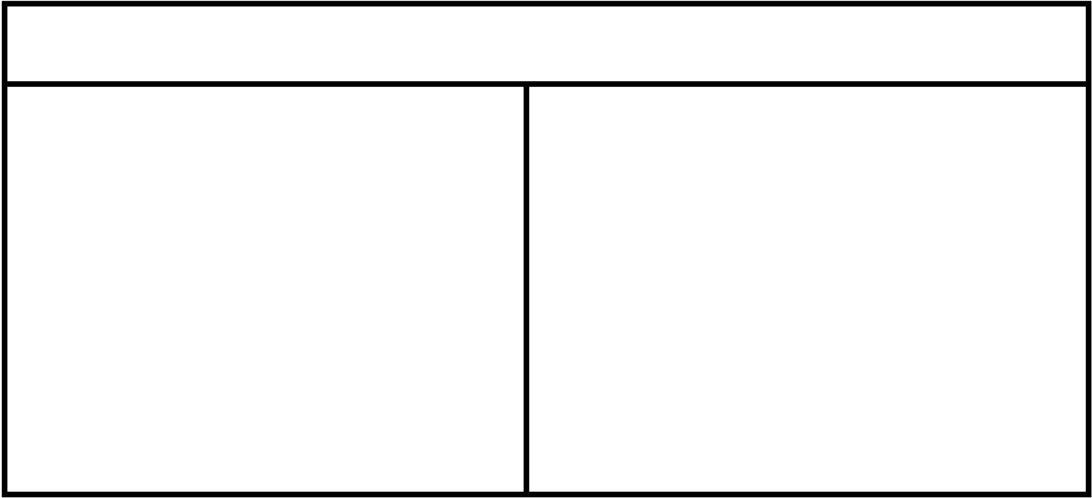
ENTITIES
Card
Deck
rank: string
suit: char
isFace(): bool
getRank()
getSuit
getface
cards: List
drawCard(): Card
shuffle()
peek(): Card
isEmpty(): bool
addCard(Card)
Card
Hand
cards: List
getCards(): Card[]
addCard(Card)
removeCard(): Card
removeCard(String): Card
getSize(): int
Card

Slide 2
USE CASES
Player
Game (abstract)
players: Player[]
deck: Deck
currPlayer: Player
calculateValidMoves()
makeMove(int)
checkWin(): bool
hand: Hand
name: String
addToHand(Card)
removeFromHand(Card)
getHand(): Hand
Hand
Card
Player
Deck
Card
crazyEights extends Game
playingField: Stack

Slide 3
GUI, CONTROLLER
Card Picker
Card Printer
takeInput()
printCard()
printHand()

