Slide 1

CSC207 Group Project Group_13
Phase zero
Junhao Saw, Zeyuan li, Kuang Jiang,
Zhijun Wang ,Hanqi Zhang, Chuangyang Qiao.

Slide 2

Specification
Junhao Saw

Slide 3
Specification
Our program provides a service for students to discuss course content, for faculty to post about course and program information, and for professors to post and delete comments. All three types of users should go through the registration process to access this program. All users will need a name, user id and password.
Students and professors can enroll themselves into existing courses, while professors will be added to the course page after the enrollment. Students who enrolled in the same courses can post to the current course discussion board, reply to others’ comments, and delete their own comments. They also have access to the past post pages to learn from past students who previously enrolled in the course. They can also see other courses taught by their professors to learn about them.
Inside the course page, students can see course name, course information, professor information, current discussion board and the discussion boards in the past three semesters. Professor and faculty can see the same course page, both with ability to delete comments. Faculty can create and update course pages, while professors have the right to reply to the comments and make announcements.

Slide 4
CRC model
Zeyuan Li

Slide 5

Scenario walk through
Kuang Jiang

Slide 6
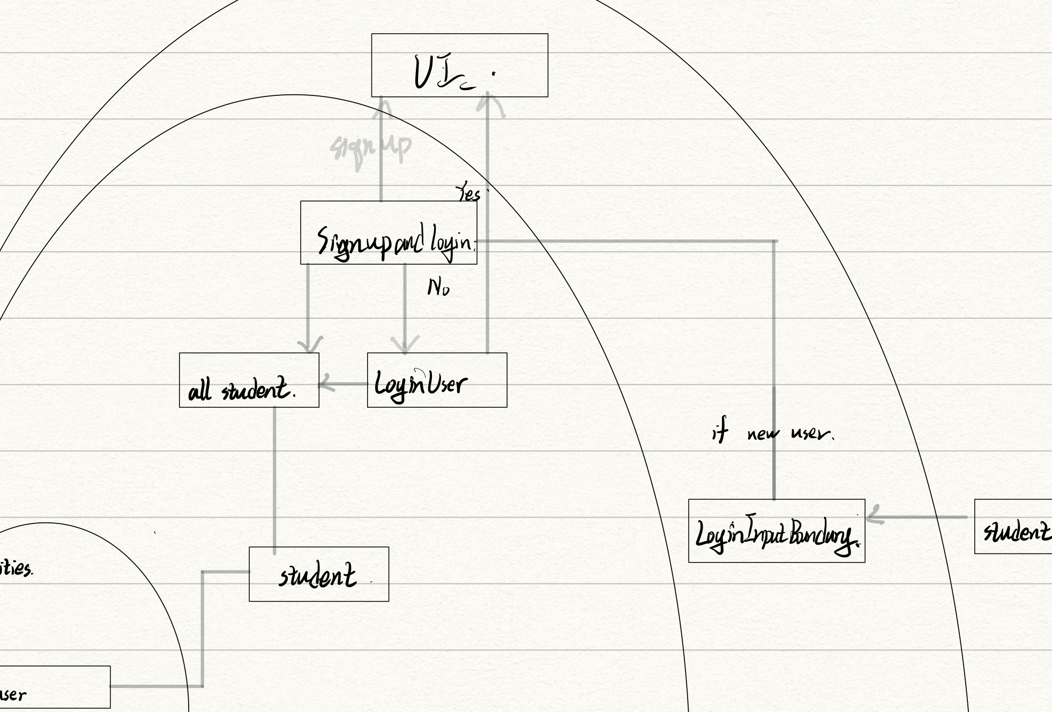
Scenario walk through
To register as a student
To login

Slide 7
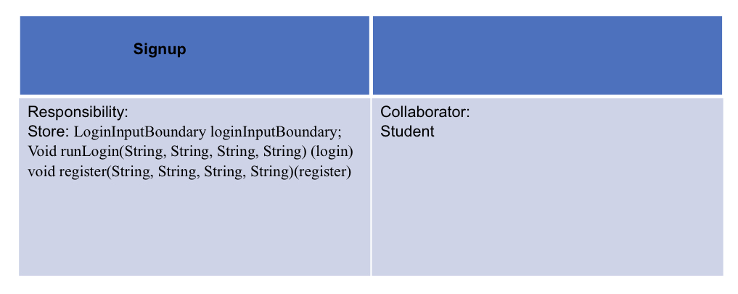
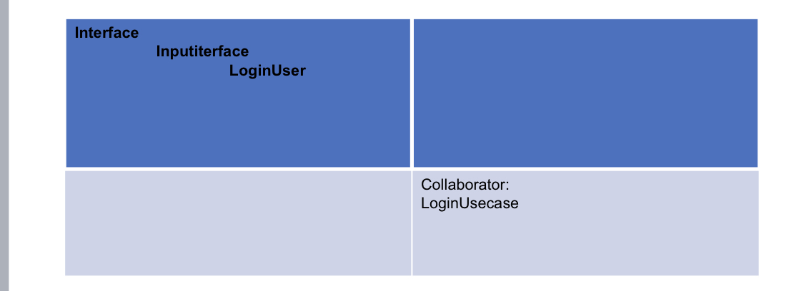
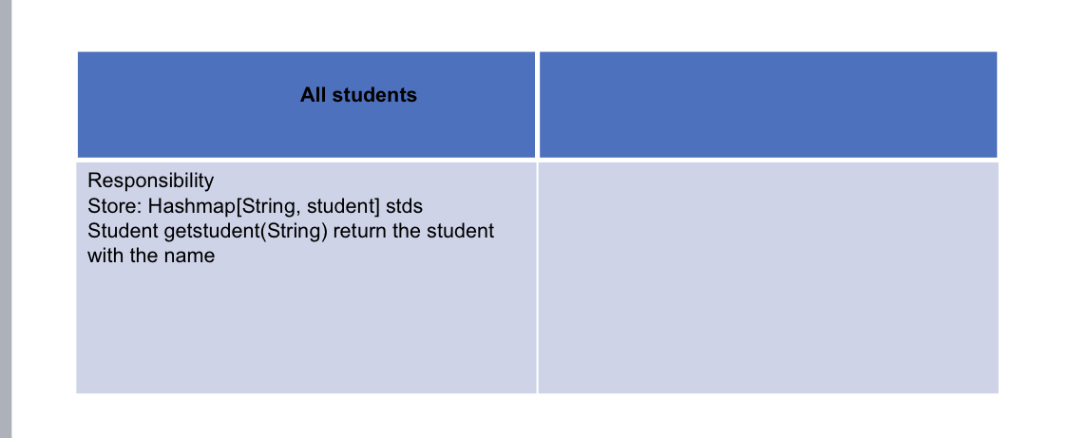
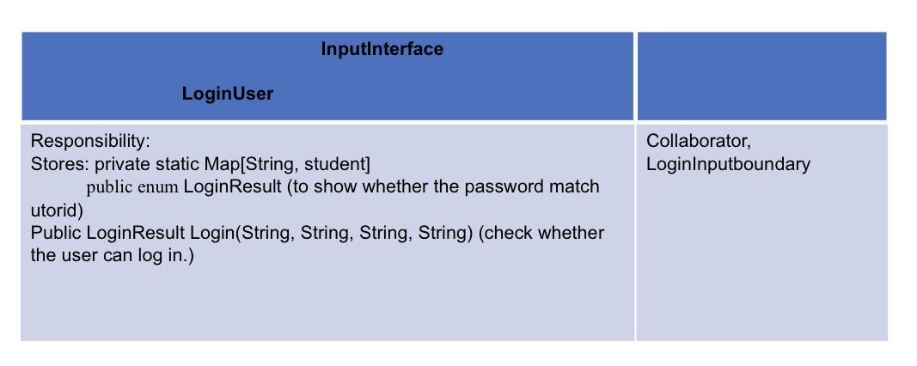
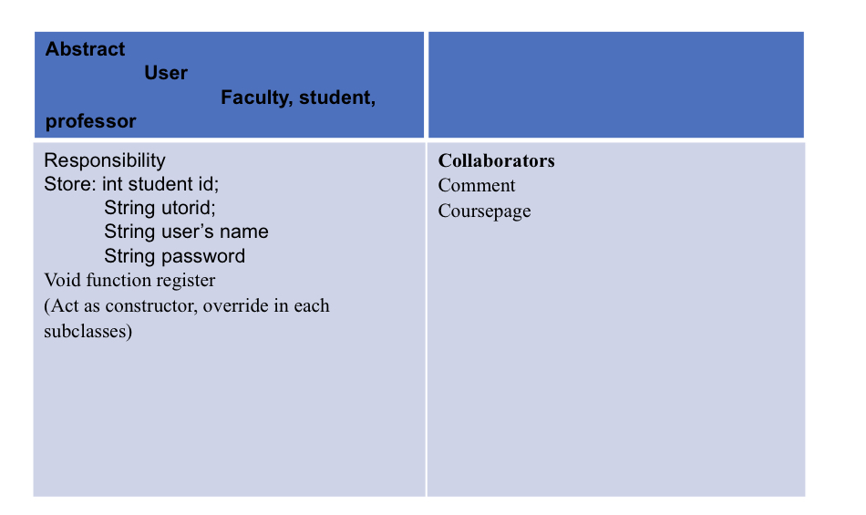
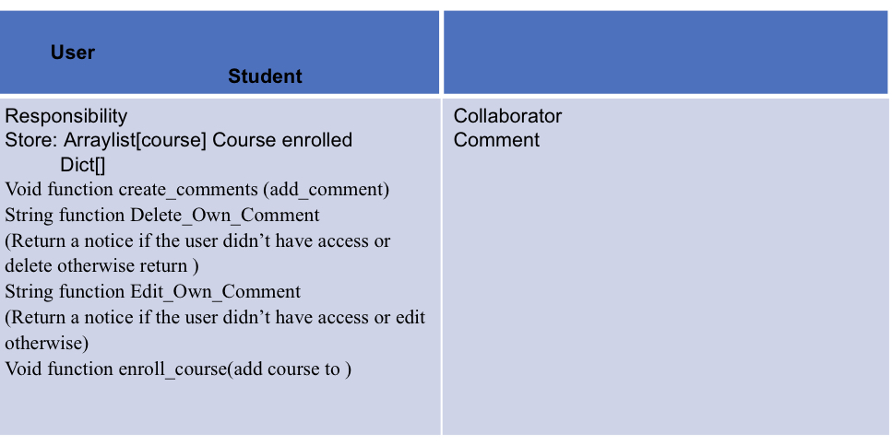
Architecture and CRC card

Slide 8
To register as a student
type in a string student to claim it’s a student account,
type in whether it’s a new student account. (yes for new student )
enter student name, student id, and account’s password in order.
Then, the LoginInputInterface act as controller package all the data into string objects and passes these objects to the Signupandlogin.
we will build a new student and stored them to the attribute of AllStudent class(.This is a class store the all the students’ information implementing the student class. Student class is a subclass of entities User)
present “successfully signup” at UI.

Slide 9
To login
type in a string student to claim it’s a student account,
type in whether it’s a new student account. (no for login)
enter student name, student id, and account’s password in order.
Then, the LoginInputInterface act as controller package all the data into string and int objects and passes these objects to the Signupandlogin.
check them in LoginUser by compare weather the input data matches the information stored in AllStudent.
If it matches, present “success login” at UI. If doesn’t present “login in fails, please try again”.

Slide 10

Skeleton program Zhijun Wang

Slide 11
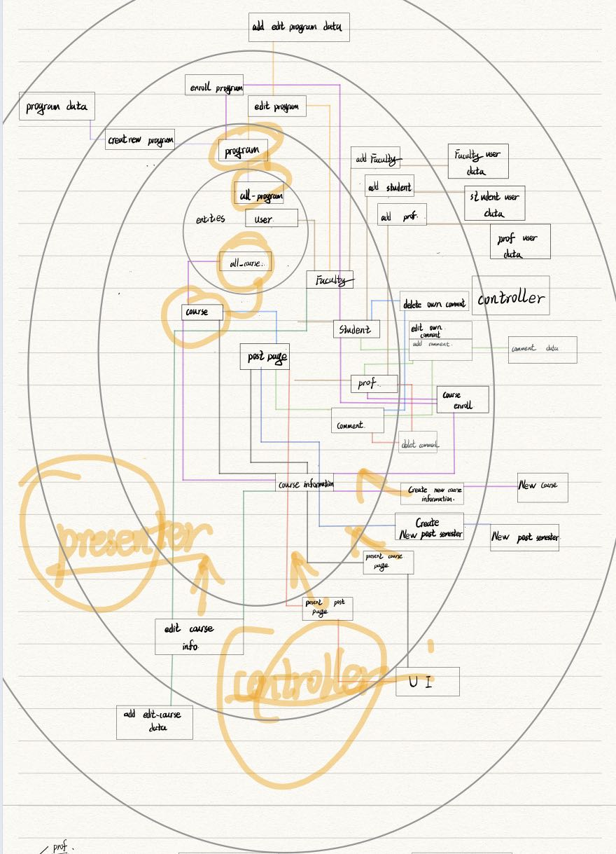
What part we have struggled with?
Chuanyang Qiao
Notes:
Struggling part:
We had a hard time on drafting CRC card and combing relationship between each class. Distributing classes and methods into different architectural level is also very time consuming. For instance, at first, our comprehension of classifying difference between entity level and use case level was pretty vague. We argued a lot before we finally decided to put “all program” class in entity level. (Connecting lines, functions……)
How those pieces communicating to each other………

Slide 12

What part we did well?

Slide 13
Introduction to division of labour
All together: Discuss software architecture and input/output between layers.
Jun: specification. Discuss layers of architecture.
Wang: skeleton program. elaborated on the code for the skeleton program
Jiang: scenario walk-through. wrote the scenario walkthrough section, and draw the layers of architecture
Qiao: coding/summarizing feedback. wrote the things we do well, the things we struggle, and open questions.
Li: CRC card. wrote the CRC model, clean architecture and SOLID principle section
Zhang: coding. wrote code for skeleton program, the prospect of program, and revised and organized the progress report
Notes:
your specification? Junyour CRC model? Liyour scenario walk-through? (add graph) kuangyour skeleton program? wangwhat each group member has been working on and plans to work on next? Qiaowhat has worked well so far with your design as you have started implementing the code? ZhangHave you clearly indicated at least one open question your group is struggling with, so that your TA can address it in their feedback for phase 0? (Qiao/Zhang)

Slide 14
Prospect
We will continue to implement our methods.
Implement the core part of Comment class and use breath recursion to delete comment
Figure out how to improve our controller
Figure out how to make use of Andriod Studio to make a real app with user interface
Figure out how to increase efficiency for our program
Figure out how to integrate more functions like ratings and verify student identity in help with university data
Decide the way of packaging and make decision for the access modifiers
Hanqi Zhang

Slide 15
Open question
Are we able to use the Andriod Studio IDE to make an app?
How should we revise our structure to make it adhere to the clean architecture and SOLID principles more?

Slide 16
Thank you for listening!

