Slide 1
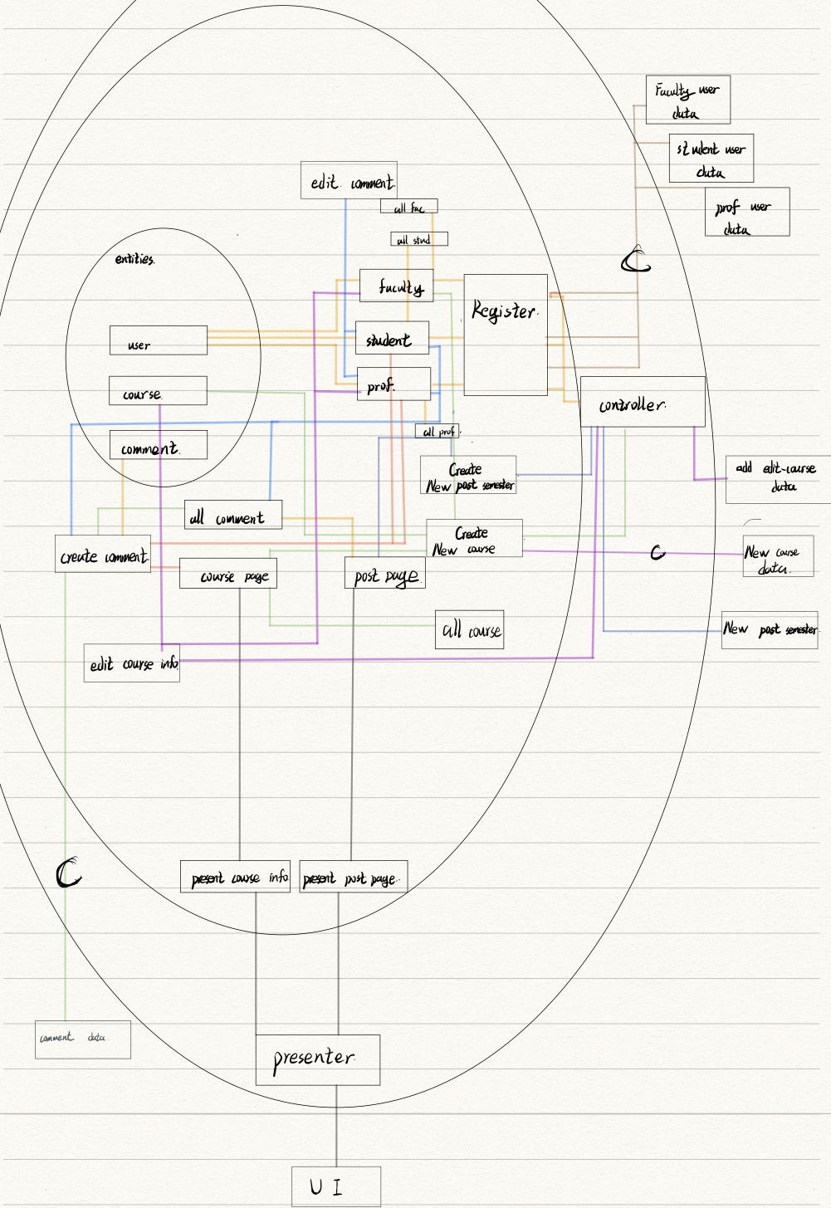

Slide 2
Abstract Class implement Registration User Faculty, student, professor
Responsibility Store: String identifier; String utorid; String user’s name String password Void function register (Act as constructor, override in each subclasses) | Collaborators Comment Coursepage

Slide 3
User Faculty
Responsibility Void function Change_course_info Void function add_course Void function add_postpage | Collaborator Coursepage Course

Slide 4
DeleteComment User Student
Responsibility Store: Arraylist[course] Course enrolled Dict[] Arraylist[comments] comments made Void function create_comments (add_comment) String function Delete_Own_Comment (Return a notice if the user didn’t have access or delete otherwise return ) String function Edit_Own_Comment (Return a notice if the user didn’t have access or edit otherwise) Void function enroll_course(add course to ) | Collaborator Comment

Slide 5
User Professor
Responsibility Store Arraylist[course] Course_enrolled Arraylist[comments] comments_made Void function create_comments (add_comment) String function Delete_Own_Comment (Return a notice if the user didn’t have access or delete otherwise return ) String function Edit_Own_Comment (Return a notice if the user didn’t have access or edit otherwise) Void function enroll_course(add course to )

Slide 6
Interface DeleteComment student professor
Responsibility Void function delete_comment() | Collaborator: User Coursepage Postpage

Slide 7
Interface Registration User
Responsibility Void function register() | Collaborator: Student Professor Faculty User

Slide 8
Interface AddComment student professor
Responsibility Void function add_comment() | Collaborator: User Coursepage Postpage

Slide 9
Interface Enrollcourse Student, Professor
Responsibility Void function enroll() | Collaborator: Student Professor

Slide 10
Interface InputInterface LoginUser
LoginUser.ResultOutput Login() | Collaborator: LoginUser

Slide 11
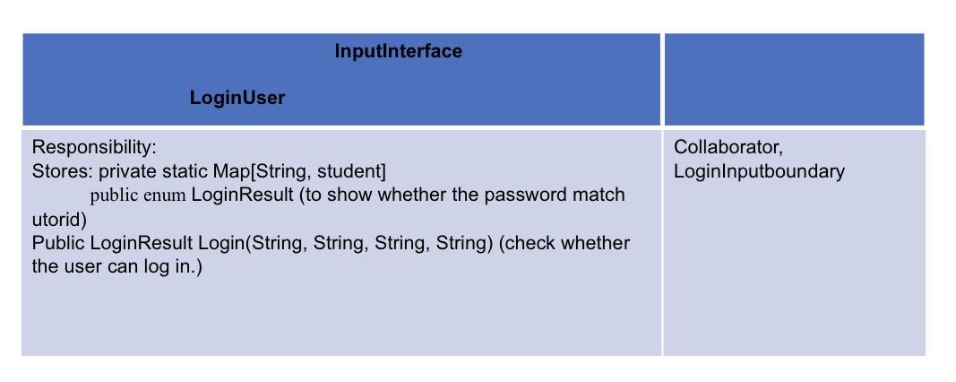

Slide 12
LoginController
Responsibility: Store: LoginInputBoundary loginInputBoundary; Void runLogin(String, String, String, String) (login) void register(String, String, String, String)(register) | Collaborator: Student

