Slide 1


TabSurv: an interpretable deep learning survival analysis for Tabular Data
Shihao Ma¹
Weiqing Wang^{1, 2}
Cong Wei¹

Slide 2

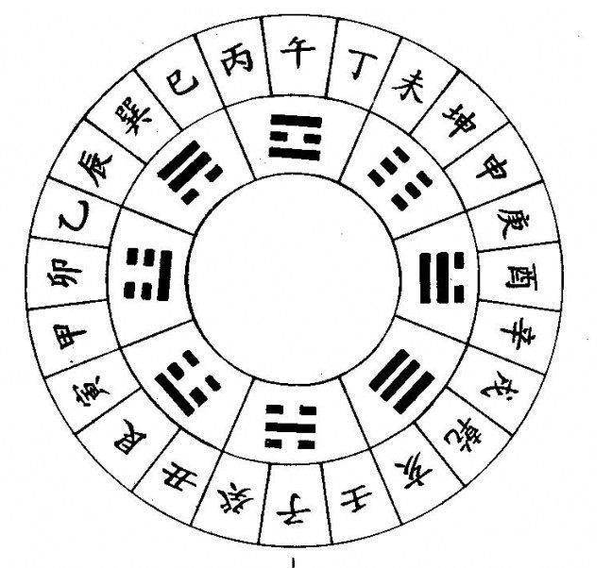

Slide 3

RSF
Explainability
Cox
Deepsurv
Deephit
Accuracy

Slide 4
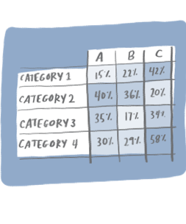
Decision Tree
COVID Symptoms?
PCR Positive?
Close Contact?
Confirmed
X-Ray
PCR Positive?
Travelled?
…
…
…
…
…
…

Slide 5
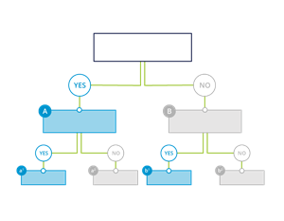



Slide 6






Slide 7

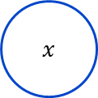
TabNet: Attentive Interpretable Tabular Learning
$$+$$
ReLU
ReLU
Split
Split
Split
Feature Transformer
Feature Transformer
Feature Transformer
Attentive
Transformer
Feature Selection
Attentive
Transformer
Feature Selection
Batch Normalisation
$$x$$

Slide 8



$$+$$
$$+$$
$$+$$
ReLU
ReLU
ReLU
ReLU
Split
Split
Split
Split
Split
Feature Transformer
Feature Transformer
Feature Transformer
Feature Transformer
Feature Transformer
Attentive
Transformer
Feature Selection
Attentive
Transformer
Feature Selection
Attentive
Transformer
Feature Selection
Attentive
Transformer
Feature Selection
Batch Normalisation
$$x$$
8

Slide 9






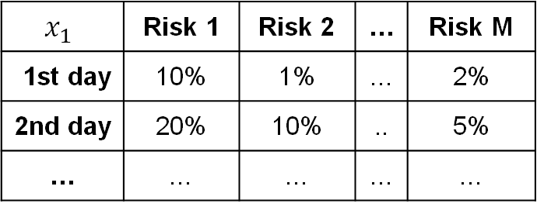







Nov 2066 - Apr 2069
2018 - 2022
2022 - 2028
2028 - 2054
2054 - 2067
12.5 years
4.5 years
5.5 years
8.5 years
11 years
7 years
0%
0%
0%
0%
0%
0%
0%
0%
0%
0%
0%
$$x_{1}$$
$$t_{1}$$
$$b_{1}$$
$$k_{1}$$
$$x_{2}$$
$$t_{2}$$
$$b_{2}$$
$$k_{2}$$
…
Data
2018
2071
Today
2.5 years
$$x_{1}$$ | Risk 1 | Risk 2 | … | Risk M
1st day | 10% | 1% | … | 2%
2nd day | 20% | 10% | .. | 5%
… | … | … | … | …
$$p\left(T=t,K=k|x;θ\right)$$

Slide 10


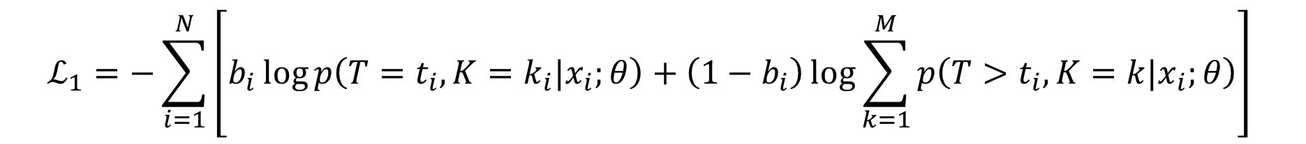

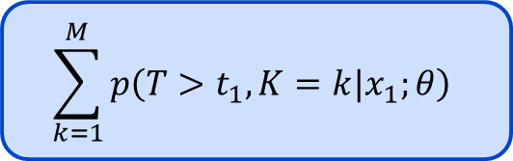

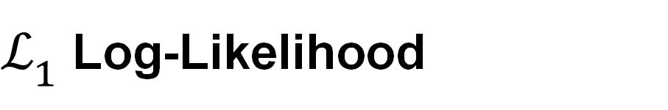



$ℒ_{1}$Log-Likelihood
Nov 2066 - Apr 2069
2018 - 2022
2022 - 2028
2028 - 2054
2054 - 2067
12.5 years
4.5 years
5.5 years
8.5 years
11 years
7 years
0%
0%
0%
0%
0%
0%
0%
0%
0%
0%
0%
$$t_{1}$$
$$t_{2}$$
$$p\left(T=t_{2},K=k|x_{2};θ\right)$$
Uncensored
$$b_{i}=1$$
2018
$$\sum_{k=1}^{M}{p\left(T>t_{1},K=k|x_{1};θ\right)}$$
2071
Censored
$$b_{i}=0$$
Today
2.5 years
$$ℒ_{1}=−\sum_{i=1}^{N}{\left[b_{i}\log{p\left(T=t_{i},K=k_{i}|x_{i};θ\right)}+\left(1−b_{i}\right)\log{\sum_{k=1}^{M}{p\left(T>t_{i},K=k|x_{i};θ\right)}}\right] }$$

Slide 11
Indicator Function
Nov 2066 - Apr 2069
2018 - 2022
2022 - 2028
2028 - 2054
2054 - 2067
12.5 years
4.5 years
5.5 years
8.5 years
11 years
7 years
0%
0%
0%
0%
0%
0%
0%
0%
0%
0%
0%
Jan
Feb
Mar
Apr
May
Jun
Jul
Aug
Sep
Patient 1
administrated
Risk A
2018
administrated
2071
Patient 2
Today
Jan
Feb
Mar
Apr
May
Jun
Jul
Aug
Sep
2.5 years
Patient 3
administrated
Risk B
Reviews
Patient 4
administrated
$$A_{k,i,j}≜𝕀(k_{i}=k_{j}=k and t_{i}<t_{j})$$

Slide 12


Cumulative Incidence Function (CIF)
$$F_{k}\left(t\right|x;θ)=p\left(T≤t, K=k\right|x;θ)$$
$$=\sum_{s=0}^{t}{p\left(T=s, K=k\right|x;θ)}$$

Slide 13
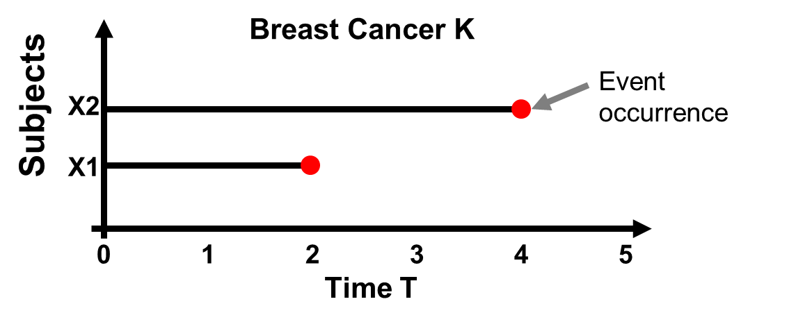

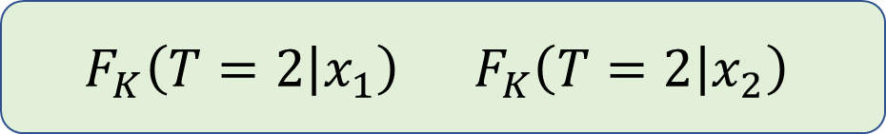
Ordering Function
$$F_{K}\left(T=2 | x_{1}\right) F_{K}\left(T=2 | x_{2}\right)$$
$f($ $,$ $)$
$$>$$
$x_{1}x_{2}$are concordant pairs if $F_{K}\left(T=2 | x_{1};θ\right)>F_{K}\left(T=2 | x_{2};θ\right)$

Slide 14


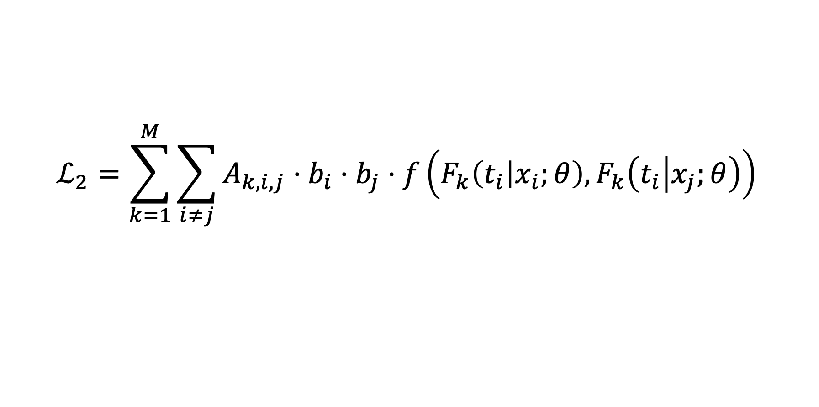




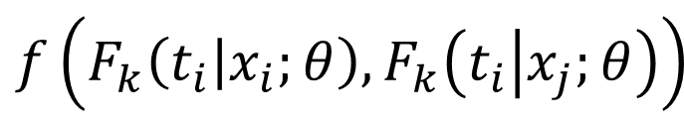


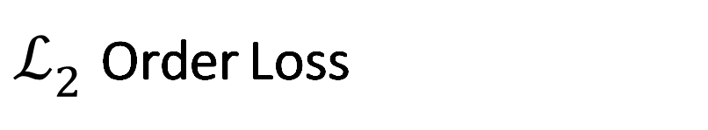





$ℒ_{2}$Order Loss
$$x_{1}$$
$$t_{1}$$
$$b_{1}$$
$$k_{1}$$
$$x_{2}$$
$$t_{2}$$
$$b_{2}$$
$$k_{2}$$
$$x_{3}$$
$$t_{3}$$
$$b_{3}$$
$$k_{3}$$
Dataset (N=3)
$$A_{k,i,j}≜𝕀(k_{i}=k_{j}=k,t_{i}<t_{j})$$
Indicator Function
$$F_{k}\left(t\right|x;θ)=p\left(T≤t, K=k\right|x;θ)$$
Cumulative Incidence Function
$$f\left(F_{k}\left(t_{i} | x_{i};θ\right),F_{k}\left(t_{i} | x_{j};θ\right)\right)$$
Correct Order Function
$$ℒ_{2}=\sum_{k=1}^{M}{\sum_{i≠j}{A_{k,i,j}⋅b_{i}⋅b_{j}⋅f\left(F_{k}\left(t_{i} | x_{i};θ\right),F_{k}\left(t_{i} | x_{j};θ\right)\right)} }$$

Slide 15



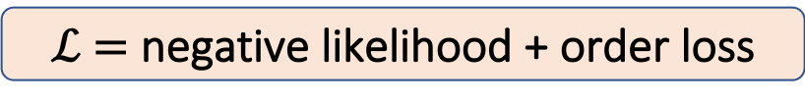
$$x_{1}$$
$$t_{1}$$
$$b_{1}$$
$$k_{1}$$
$$x_{2}$$
$$t_{2}$$
$$b_{2}$$
$$k_{2}$$
…
Data
TabSurv
Output
loss
backward
$$p\left(T=t,K=k|x;θ\right)$$
$ℒ$ $=$ negative likelihood + order loss

Slide 16

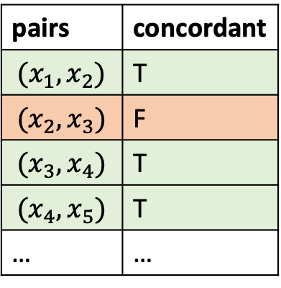
Performance Metric: C-index
Nov 2066 - Apr 2069
2018 - 2022
2022 - 2028
2028 - 2054
2054 - 2067
12.5 years
4.5 years
5.5 years
8.5 years
11 years
7 years
0%
0%
0%
0%
0%
0%
0%
0%
0%
0%
0%
pairs | concordant
$$(x_{1},x_{2})$$ | T
$$(x_{2},x_{3})$$ | F
$$(x_{3},x_{4})$$ | T
$$(x_{4},x_{5})$$ | T
… | …
$$C=p\left(F_{k}\left(t_{i} | x_{i};θ\right)>F_{k}\left(t_{i} | x_{j};θ\right) | t_{i}<t_{j}\right)$$
$$≈\frac{\#concordant pairs}{\#concordant pairs+\#discordant pairs}$$
2018
2071
Today
2.5 years

Slide 17
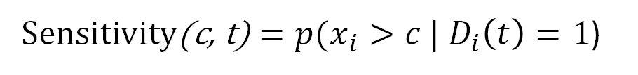

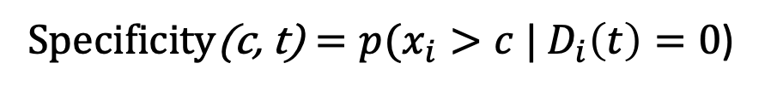
Performance Metric: time-dependent AUC
Nov 2066 - Apr 2069
2018 - 2022
2022 - 2028
2028 - 2054
2054 - 2067
12.5 years
4.5 years
5.5 years
8.5 years
11 years
7 years
0%
0%
0%
0%
0%
0%
0%
0%
0%
0%
0%
Sensitivity(c, t) $=p({x_{i}>c | D}_{i}\left(t\right)=1$)
True Positive Rate
Specificity(c, t) $=p({x_{i}>c | D}_{i}\left(t\right)=0$)
True Negative Rate
2018
2071
Time dependent AUC quantifies how well a model can distinguish subjects who fail by a given time ($t_{i}$ $≤$ $t$) from subjects who fail after this time ($t_{i}$ $>$ $t$).
Today
2.5 years
Time-dependent AUC:
$$AUC\left(t\right)=\int_{−∞}^{∞}{Se\left(c, t\right)d[1−Sp\left(c,t\right)] }$$
Notes:
AUCSeS$\int_{−∞}^{∞}{}$

Slide 18




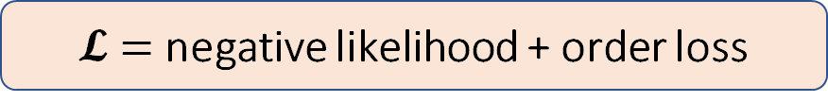


Proposed idea
$$x_{1}$$
$$t_{1}$$
$$b_{1}$$
$$k_{1}$$
$$x_{2}$$
$$t_{2}$$
$$b_{2}$$
$$k_{2}$$
…
Data
TabSurv
loss
backward
Output
$$p\left(T=t,K=k|x;θ\right)$$
$𝓛$ $=$ negative likelihood + order loss

Slide 19

Our contribution
Nov 2066 - Apr 2069
2018 - 2022
2022 - 2028
2028 - 2054
2054 - 2067
12.5 years
4.5 years
5.5 years
8.5 years
11 years
7 years
0%
0%
0%
0%
0%
0%
0%
0%
0%
0%
0%
Modify TabNet architecture to model survival probability across time
2018
Innovatively adopt the likelihood loss and ranking loss for survival analysis
2071
Today
2.5 years
Successfully trained our Tabsurv model with hyperparameter tuning
Benchmarked with cox model and RSF on 3 datasets

Slide 20
Datasets used
Nov 2066 - Apr 2069
2018 - 2022
2022 - 2028
2028 - 2054
2054 - 2067
12.5 years
4.5 years
5.5 years
8.5 years
11 years
7 years
0%
0%
0%
0%
0%
0%
0%
0%
0%
0%
0%
 | Number of samples | Number of features | Event rate
German Breast Cancer Study Group 2 (gbsg2) | 686 | 8 | 43.6%
Worcester Heart Attack Study (whas500) | 500 | 14 | 43.0%
Molecular Taxonomy of Breast Cancer International Consortium (METABRIC) | 1981 | 79 | 44.8%
2018
2071
Today
2.5 years
Extent to higher-dimension, imbalance datasets in the future.
Notes:
Molecular Taxonomy of Breast Cancer International Consortium%

Slide 21
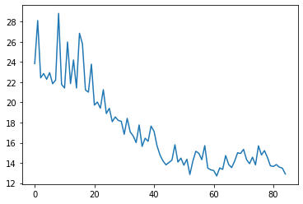
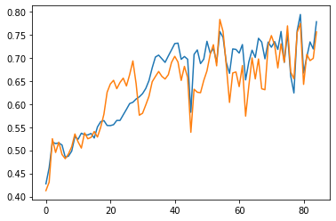
Sample training curves:
Nov 2066 - Apr 2069
2018 - 2022
2022 - 2028
2028 - 2054
2054 - 2067
12.5 years
4.5 years
5.5 years
8.5 years
11 years
7 years
0%
0%
0%
0%
0%
0%
0%
0%
0%
0%
0%
On Whas500 dataset:
2018
2071
Today
2.5 years
Training loss curve
C-index curve

Slide 22
Preliminary Results 1 – C-Index comparison
Nov 2066 - Apr 2069
2018 - 2022
2022 - 2028
2028 - 2054
2054 - 2067
12.5 years
4.5 years
5.5 years
8.5 years
11 years
7 years
0%
0%
0%
0%
0%
0%
0%
0%
0%
0%
0%
Algorithms | Datasets
 | METABRIC | gbsg2 | whas500
Cox model | 0.676 | 0.648 | 0.723
RSF | 0.686 | 0.688 | 0.741
Tabsurv | 0.701 | 0.660 | 0.783
2018
2071
Today
2.5 years

Slide 23
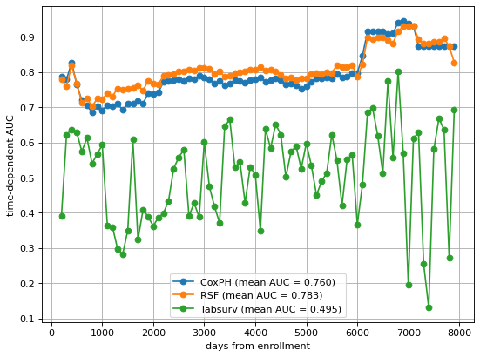
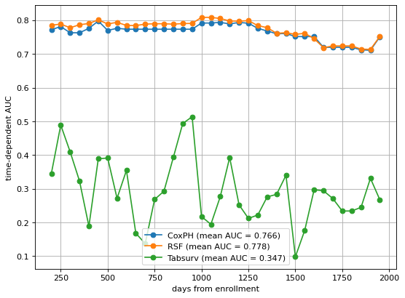
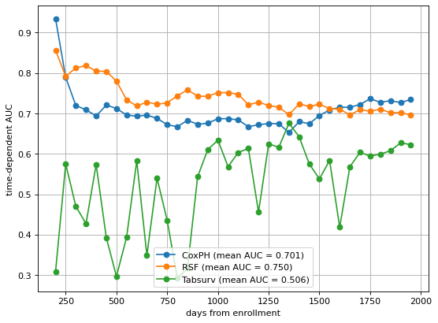
Preliminary Results 2 – Time dependent AUC:
Nov 2066 - Apr 2069
2018 - 2022
2022 - 2028
2028 - 2054
2054 - 2067
12.5 years
4.5 years
5.5 years
8.5 years
11 years
7 years
0%
0%
0%
0%
0%
0%
0%
0%
0%
0%
0%
2018
2071
Today
2.5 years
Metabric
Whas500
gbsg2
We don’t have good intuition why this happened yet. Welcome for any feedback!

Slide 24
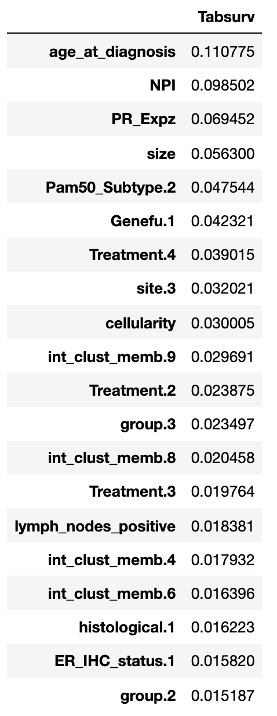
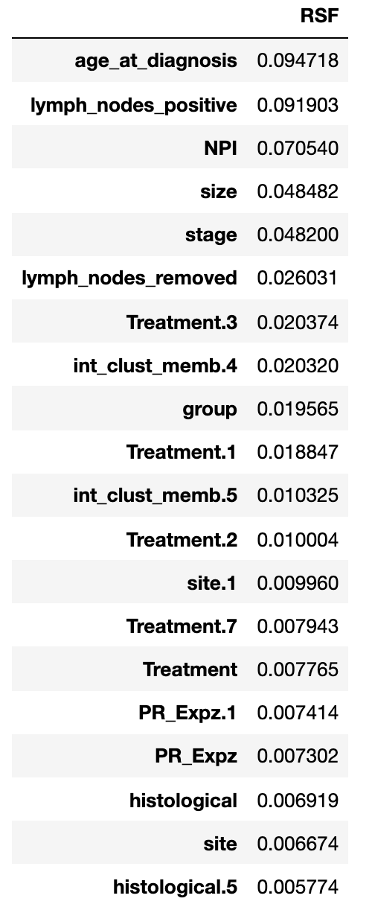
Preliminary Results 3 - Feature important ranking
Nov 2066 - Apr 2069
2018 - 2022
2022 - 2028
2028 - 2054
2054 - 2067
12.5 years
4.5 years
5.5 years
8.5 years
11 years
7 years
0%
0%
0%
0%
0%
0%
0%
0%
0%
0%
0%
METABRIC:
2018
2071
Today
2.5 years
Number of feature overlaps: 8

Slide 25
Future works
Investigate
Investigate the performance on time dependent AUC
Extend
Extend to competing risk analysis
More Complexity
Extend to more complex datasets, such as high-dimensional data and imbalanced dataset.
Compare
We have compared our model’s performance with Cox and RSF, but not yet with models using deep learning.

Slide 26
Thank you
Shihao Ma
—
rex.ma@mail.utoronto.ca
Weiqing Wang
—
weiqing.wang@utoronto.ca | weiqing.wang@ibm.com
Cong Wei
—
cong.wei@mail.utoronto.ca

