Slide 1
East Scarborough Storefront
Scheduling software

Slide 2

What is the East Scarborough Storefront?
The East Scarborough Storefront is a partnership of community members and services working together to create a thriving community in East Scarborough.

Slide 3
What did they need help with?
-For years the East Scarborough Storefront has scheduled their clients by using pen and paper combined with a calendar system they had on their computers.
-This system did nothing but add stress to the employees and clients of the E.S.T.
-To fix this problem they asked us to create a online interface in which their clients would be able to login to and book their events.

Slide 4
What DID WE DO TO SOLVE THIS?
We created an online scheduling system that allows clients to request bookings for any date
Any of their 40 clients can log onto the site online
Admin has full control of the system
Streamlined version of their current system but entirely online

Slide 5
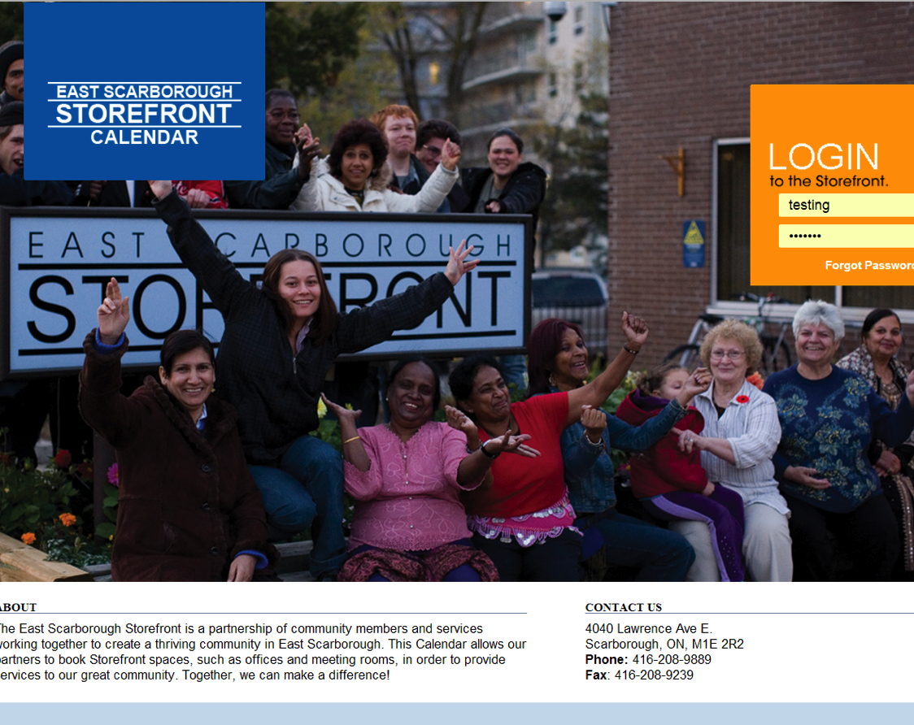
How did WE DO IT?
-Using PHP, CodeIgniter, HTML, CSS, json, qtip, and FullCalender we created a website in which their clients could book events.

