Slide 1
East Scarborough Storefront
Scheduling software

Slide 2

What is the East Scarborough Storefront?
The East Scarborough Storefront is a partnership of community members and services working together to create a thriving community in East Scarborough.

Slide 3
What did they need help with?
-For years the East Scarborough Storefront has scheduled their clients by using pen and paper combined with a calendar system they had on their computers.
-This system did nothing but add stress to the employees and clients of the E.S.T.
-To fix this problem they asked us to create a online interface in which their clients would be able to login to and book their events.

Slide 4
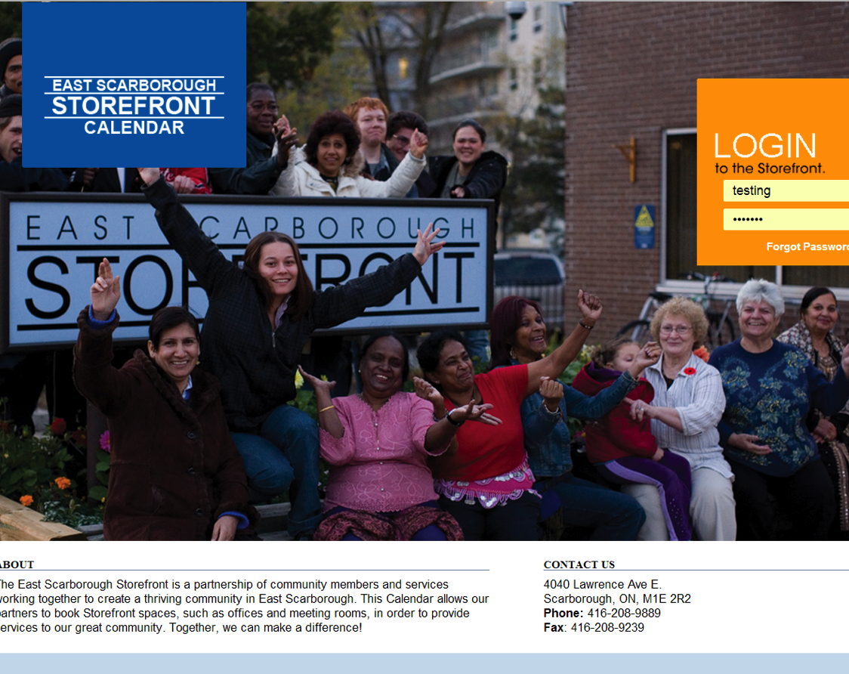
How did we fix this problem?
-Using PHP, CodeIgniter, HTML, CSS, json, qtip, and FullCalender we created a website in which their clients could book events.

Slide 5
Functions of our Website
Types of users
Admin
-can create new Client/User
-can create a new event on behalf of any client
-can confirm bookings made by any client
Client
-can make a booking (tentative) on behalf of them selves
Front Desk
-can make a booking on behalf of any client.

Slide 6
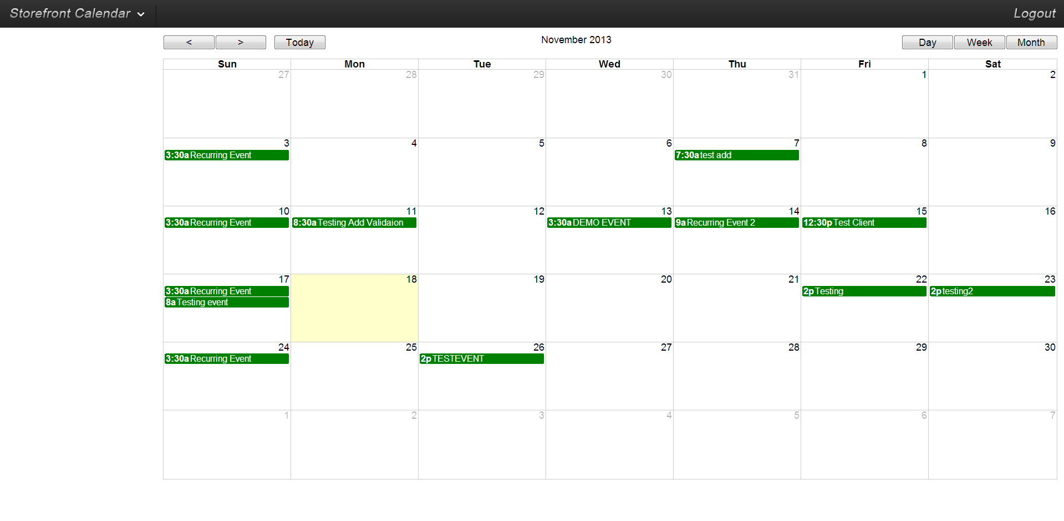
Functions of our website
When any user logs in they will first be presented by the calendar page. Here they can view what events are scheduled when.
asd

Slide 7
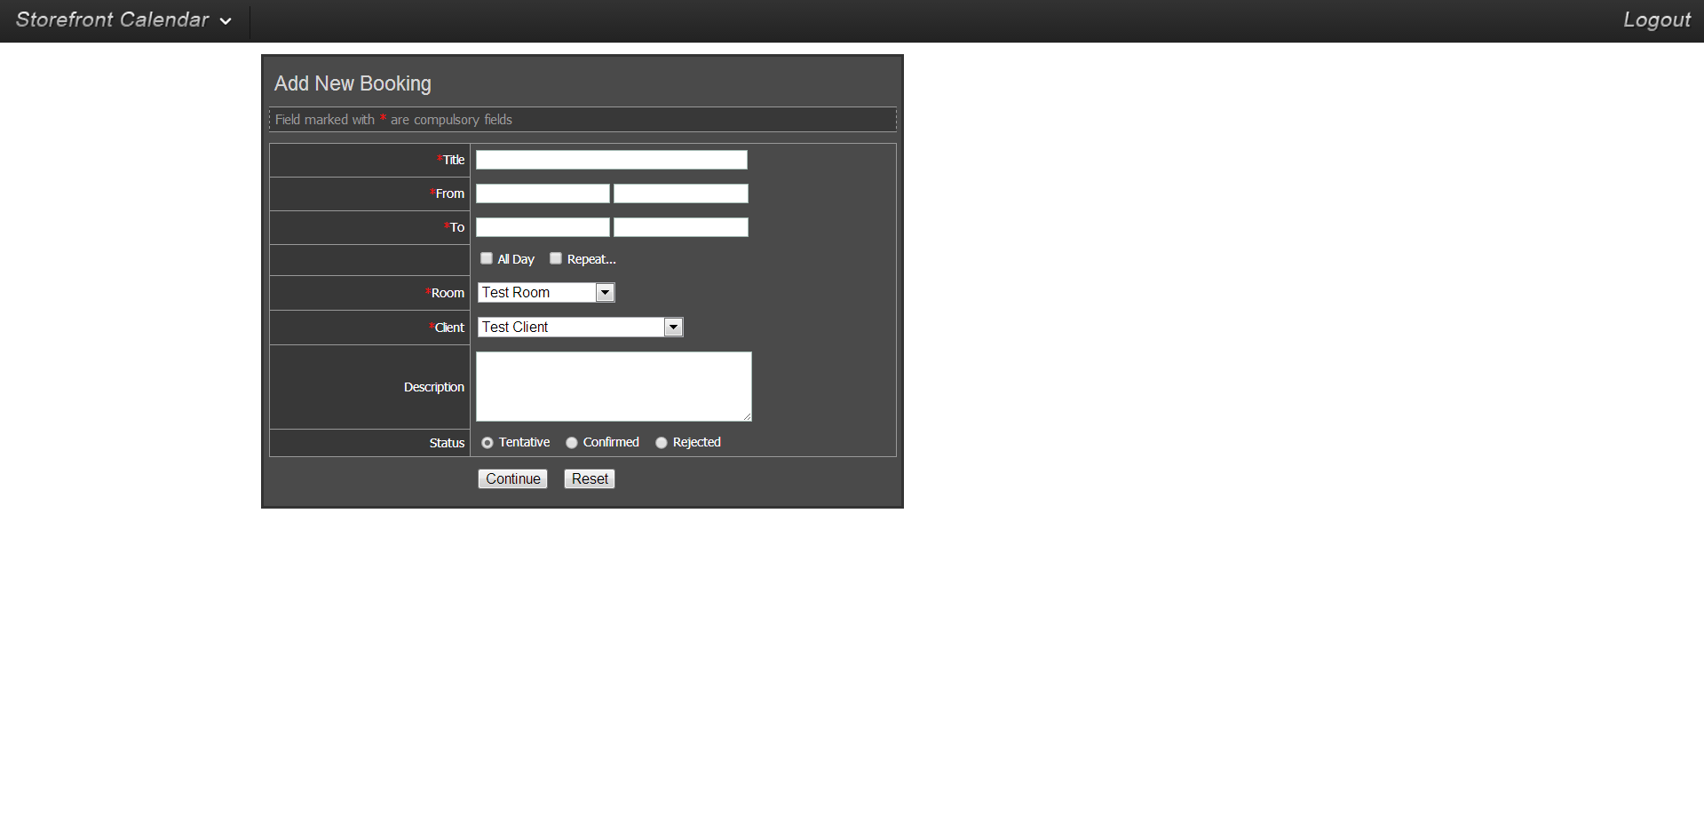
FUNCTIONS OF OUR WEBSITE
From either clicking “New Event” from the drop down commands or by doubling clicking on a empty day adds a New Event

Slide 8
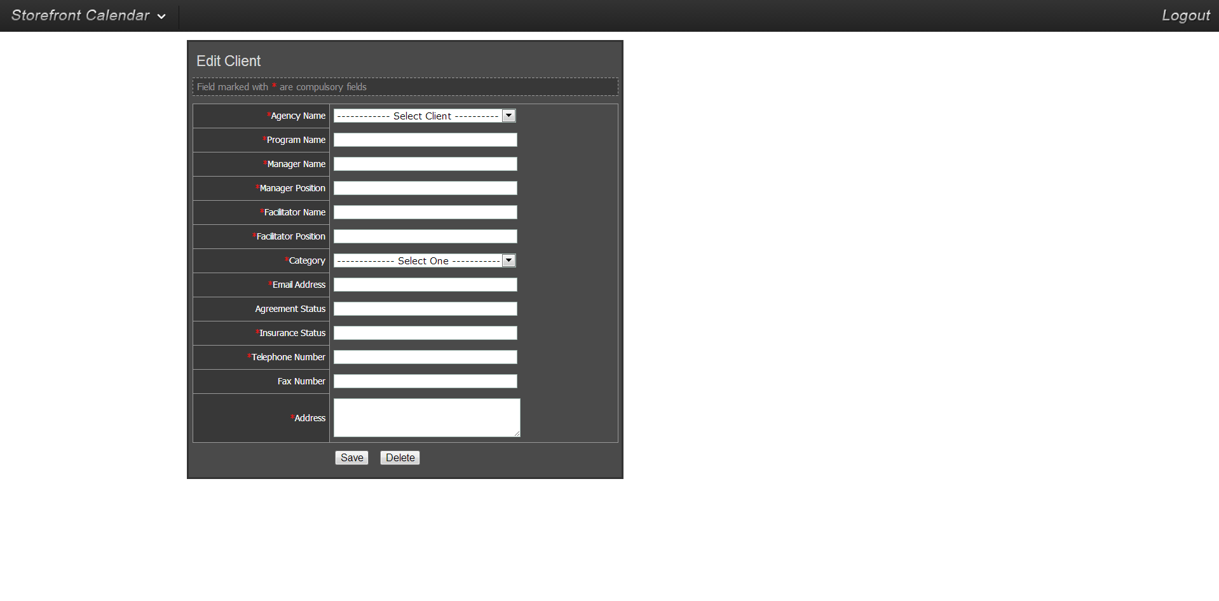
FUNCTIONS of our website
From the main page a user can then add a new event

Slide 9
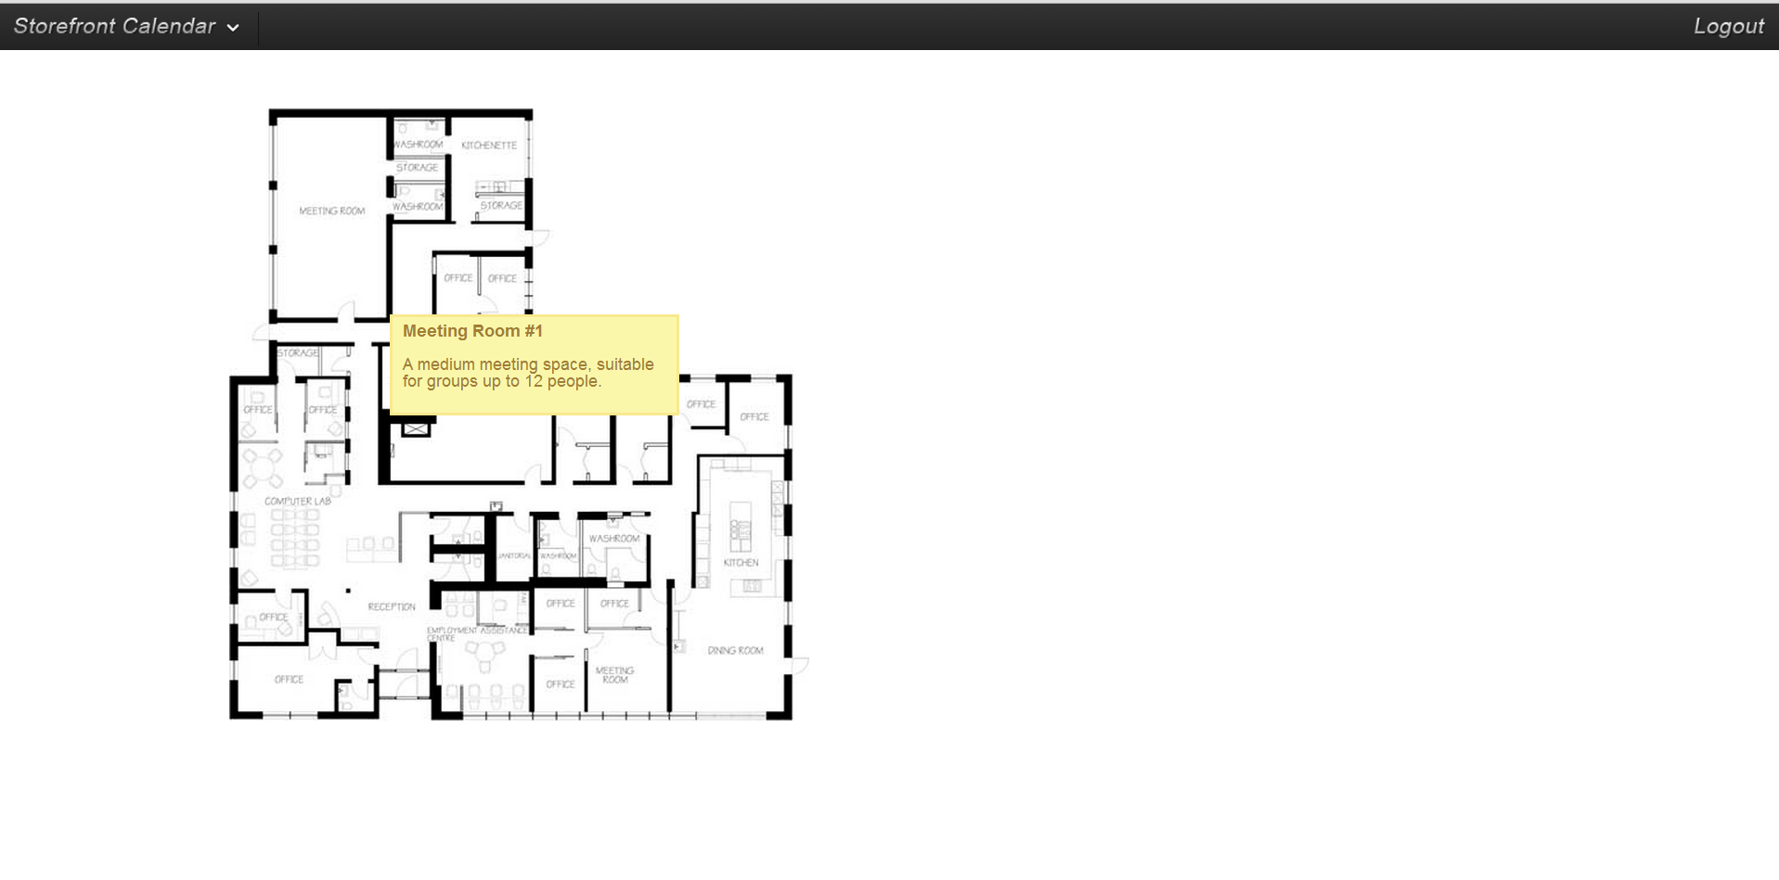
FUNCTIONS OF THE WEBSITE
Any user can go to the room view in which they can see information on the bookable rooms by interacting with the map

