Slide 1
ULTRA-REMOTE-MEDICINE
TEAM DUBAWNT

Slide 2
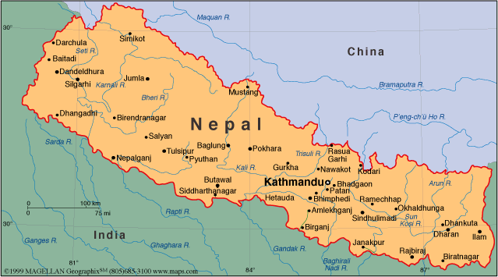
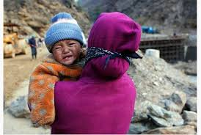
Problem
Lack of Doctors in Nepal
Nepal maternal mortality rates 740 per 100,000 births
Field workers don’t have proper knowledge reading ultra sound image

Slide 3


Solution
Portable Ultra sound reader
Communication between Field worker and Doctor through app
Doctors can help the field workers understand the ultra sound image
Doctors can reply to field worker with ease using a website.

Slide 4
Technologies we used
Android App
Django (Web FrameWork)
Heroku
Postgres

Slide 5
Android App
Log in as Field Worker and can sign out.
Search a Patient and make a new case.
Make a new patient and make a new case.
Field worker have an option to upload an image and can sign a priority to its case and reply with comments.

Slide 6
Website
Doctors can view patient cases from the dashboard
The Case can have an image file and the doctor can view the image and reply it with comments and have an option to upload an image
Doctors can sort the columns of the dashboard and search the case

