Slide 1
Project Organization: Makes calls to
Main
Uses Tokenizer to parse user commands, and passes appropriate
CommandInterpreter: 50
Tokenizer
Database: 6
Table: 100
Row: 10
Condition: 30
Utils
Column
DBException

Slide 2
Project Organization (full picture)
Main
contains instance(s) of
Uses Tokenizer to parse user commands, and interacts with database or creates conditions.
utility method for creating
CommandInterpreter: 50
has a method for creating
Tokenizer
Container for Tables.
Database: 6
Represents a where condition in a select command.
The brains of the project. Writes and reads from files. Performs db operations when given commands by CommandIntepreter.
Table: 100
Condition: 30
getFrom() helps construct
Represents a single row of data.
Utils
Row: 10
Column
DBException
Acts as an index of a column in a list of rows (a lil tricky)

Slide 3
Project Organization (Up through step 6 only) (phase I)
Main
contains instance(s) of
Uses Tokenizer to parse user commands, and interacts with database or creates conditions.
utility method for creating
CommandInterpreter: 50
Tokenizer
Container for Tables.
Database: 6
The brains of the project. Writes and reads from files. Performs db operations when given commands by CommandIntepreter.
Table: 100
Represents a single row of data.
Utils
Row: 10
Column
DBException
Acts as an index of a column in a list of rows (a lil tricky)

Slide 4
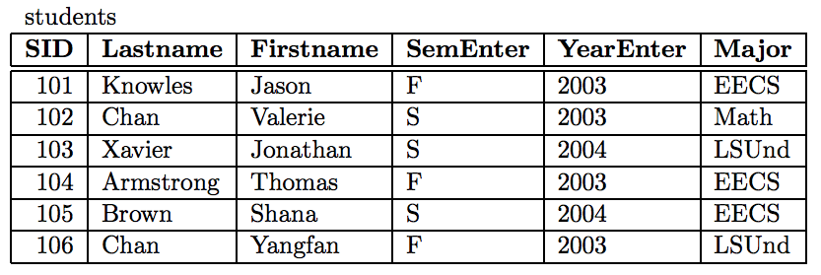
Example Select Query #1
select Lastname from students
Implicit empty condition

Slide 5
Example Select Query #2
select Lastname, FirstName from students
Implicit empty condition

Slide 6
Example Select Query #3
select Lastname from students where SID > ‘102’
Nonempty condition
Restricts ROWS only!

Slide 7
Example Select Query #3.5
select Lastname from students where Firstname > Lastname
Nonempty condition
Restricts ROWS only!
Notes:
----- would we ever use thes ame column name twice and if so why?

Slide 8
Example Select Query #4
select Lastname from students where SID > ‘102’ and Major = ‘EECS’
Two conditions

Slide 9
Example Implementation of a select
select Lastname, FirstName from students
New Row: r0
KNOWLES
JASON
Column cL = new Column(“Lastname”, studentsTable)
Column cF = new Column(“Firstname”, studentsTable)
List<Column> ListOfColumns = List containing cL, cF
Row r0 = new Row(ListOfColumns, row 0 of studentsTable)
_table = 0
_column = 1
_table = 0
_column = 2

Slide 10
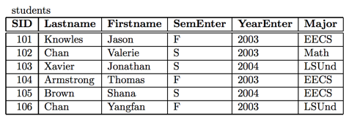
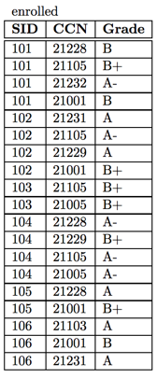
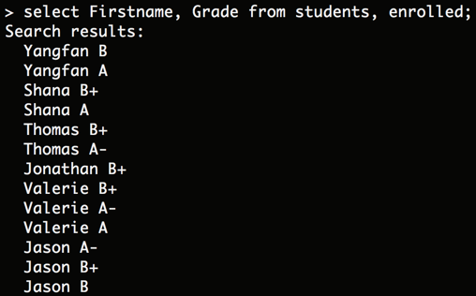
Two Table Select
New Row: r0
YANGFAN
A

Slide 11
Two Table Select
New Row: r0
YANGFAN
A
Column c1 = new Column(???, ???)
… (how many columns?)
List<Column> ListOfColumns = List containing c1, …, ??
Row r0 = new Row(ListOfColumns, ???)

Slide 12
Two Table Select
New Row: r0
YANGFAN
A
日
Column c1 = new Column(“Firstname”, students, enrolled)
Column c2 = new Column(“Grade”, students, enrolled)
List<Column> ListOfColumns = List containing c1, c2
Row r0 = new Row(ListOfColumns, row #日, row #月)
月

Slide 13
Even trickier example follows (not covered in video)
You might find this useful for really understanding how Two table select works.

Slide 14
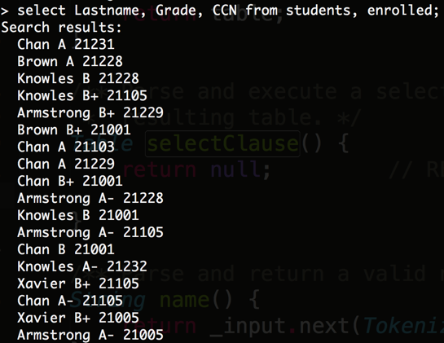
Goal: Select Lastname, Grade, CCN from students, enrolled
New Row: r0
YANGFAN
A
21228
Similar to what we did in the video, let’s try to generate a row of this trickier table.

Slide 15
Goal: Select Lastname, Grade, CCN from students, enrolled
New Row: r0
YANGFAN
A
21228
Column c1 = new Column(???, ???)
… (how many columns?)
List<Column> ListOfColumns = List containing c1, …, ??
Row r0 = new Row(ListOfColumns, ???)
Repeat the exercise from the video, but now where we need three columns instead of 2! Solution on next slide.

Slide 16
Goal: Select Lastname, Grade, CCN from students, enrolled
New Row: r0
YANGFAN
A
21228
鳌
Column c1 = new Column(“Lastname”, enrolled, students);
Column c2 = new Column(“Grade”, enrolled, students);
Column c3 = new Column(“CCN”, enrolled, students);
List<Column> ListOfColumns = List containing c1, c2, c3
Row r0 = new Row(ListOfColumns, row #阝, row #鳌)
阝

Slide 17
Example of Two Table Select with No Conditions

Slide 18

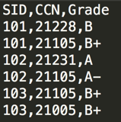
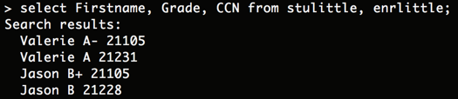
Example of natural inner join (as defined in the spec)
Suppose I have two tables stulittle.db and enrlittle.db
Then if we select firstname, Grade, CCN from both, we should only get 4 results (those pairs for which the SIDs match):

