Slide 1
Project Option 3 -- DBMS
Microhard

Slide 2


Background
OUTLINE
Basic test
Design
Enhanced test

Slide 3
Background
PART ONE

Slide 4




Project Background
UCB CS61B
DBMS
Java
Commands
This project is a project of
the course CS61B in UCB.
Implement a miniature relational database management system.
This DBMS supports several basic mysql commands.
This project is done
by Java.

Slide 5
Design
PART TWO

Slide 6

Project Design
Row
Table
DataBase
Basic Function
Tokenizer
Column
Data(.db file)
Condition
Enhanced Function
CommandInterpreter
DBException

Slide 7
DataBase Module
Function
Method
To store several Tables;
DB is a collection of Tables, indexed by name.
get()/ put() table from/into DB.

Slide 8
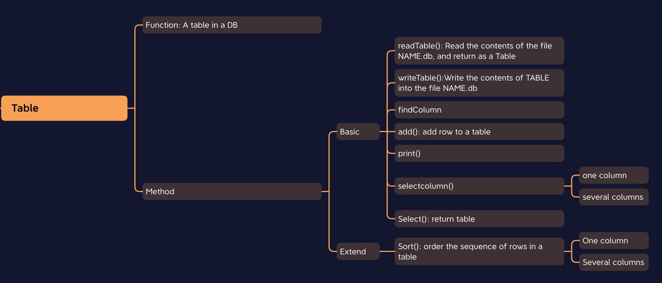
Table Module

Slide 9
Row&Column Module
Row
Function: describes a single row of a table
Method: equals()
Column
Function: efficient index of a row list
Method: column(): Selects column according to the name from a row of one of the given TABLES

Slide 10
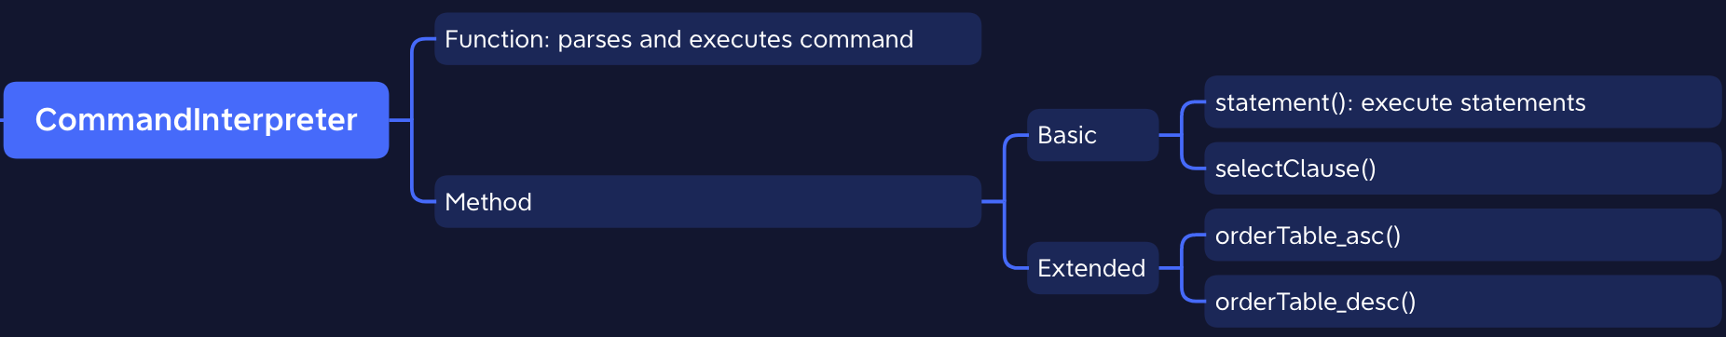
CommandInterpreter Module

Slide 11
Condition & Tokenizer & DBException Module
Condition
Function: Check whether rows are satisfied all condition
Method: test()
Tokenizer
Function: read command from a given Scanner
DBException

Slide 12
Program Running Steps
1
3
5
2
4
Scanner
CommandInterpreter
Main()
Tokenizer
Execute the statement
Get input
ComInt/DBException
Check and deal with the input of user
Print outcome or error

Slide 13
Basic Tests
PART THREE

Slide 14
Basic Function
Omit comments in expressions
Basic select from where
Print table after loading
Create table from select clause
Join two tables

Slide 15
Enhanced Tests
PART FOUR

Slide 16
Enhanced Test
No matter the input is “uppercase/ lowercase”
Case-Insensitive to
User’s Input
Enhanced
Function
Aggregate Function
avg(), count(column name), count(*), min(), max()

Slide 17
Enhanced Test
Select All
Enable “Select *” to see all the data from the table
Enhanced
Function
Multiple-Relations Joint
Not just “select from a and b”;
But “select from a and b and c and ….”

Slide 18
Enhanced Test
Condition
“OR”
Not just “from .. where conditionA and conditionB ”;
But“from .. where conditionA or conditionB ”;
Enhanced
Function
Results
“Order by”
Enable printing results in “ascending/descending” order.
Multi-Load
Enable “load a, b, c;” instead of “load a; load b; load c;”

Slide 19
Notes:
51PPT模板网 www.51pptmoban.com

