Slide 1
Csc3170 final project -- option 3
Team 21
李珈祺 刘起 连珈玮 杨亮 王茗萱
Darren Boesono Yohanes James

Slide 2
Project abstract
We choose option 3 as our final project.
In this project, we will write a miniature relational database management system (DBMS) that stores data tables, one of which consists of several (labeled) rows of information. In addition, our system will include a database query language similar to SQL to extract information from these tables.

Slide 3
Project abstract
We will mainly use C++ to implement our code.
To implement the specific database and related methods, we divide it into a number of classes. The specific architecture we will adopt is as follows:
Row class
SchemaItem class
Table class
CommandInterpreter class
Database class

Slide 4
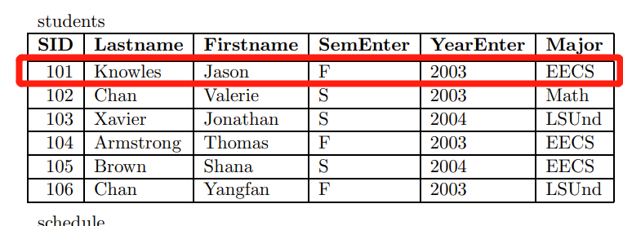
Row class
Serves as the underlying storage unit for information about tables in the database, recording row information. (A row corresponds to a vector variable)
Methods:
getValues, setValues
Notes:
根据pre时间调整讲解详细程度（5个类的实现）

Slide 5
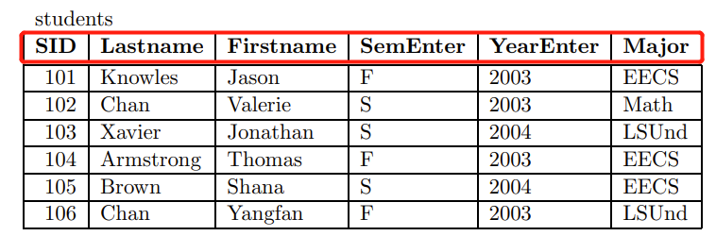
SchemaItem class
Records tables’ schemas. (Similar to row class)
Methods:
getName, getType, getTypeFromString

Slide 6
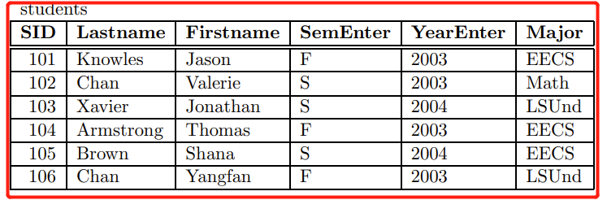
Table class
A data structure that stores tables in a database. It contains three attributes, the rows (`Row` class) to record the row information, the schema (`SchemaItem` class) to record the schema, and the database (`Database` class) to record the database which the table belongs. It also contains some simple methods, such as insert, print, delete.
Methods:
printOut, saveToFile, loadFromFile, getSchema, insertAt

Slide 7
CommandInterpreter class
command
tokenizer
Createtable
Exit
Load
Print
Select
Insert
User input command (string)
Used to accept and execute commands. Contains the specific implementation method of the command. (exit, select, help…)
It first decomposes the command using the takon variable, and then implements the operations corresponding to the command.
Split the input command
Process the commands case by case

Slide 8
Database class
As a whole database, which contains instances of the Table and CommandInterpreter classes as attributes.
Tables
Students table
Methods
removeTable, execute, switchTable, addTable, setTable, getDatabase
Enrolled table
Schedule table

Slide 9
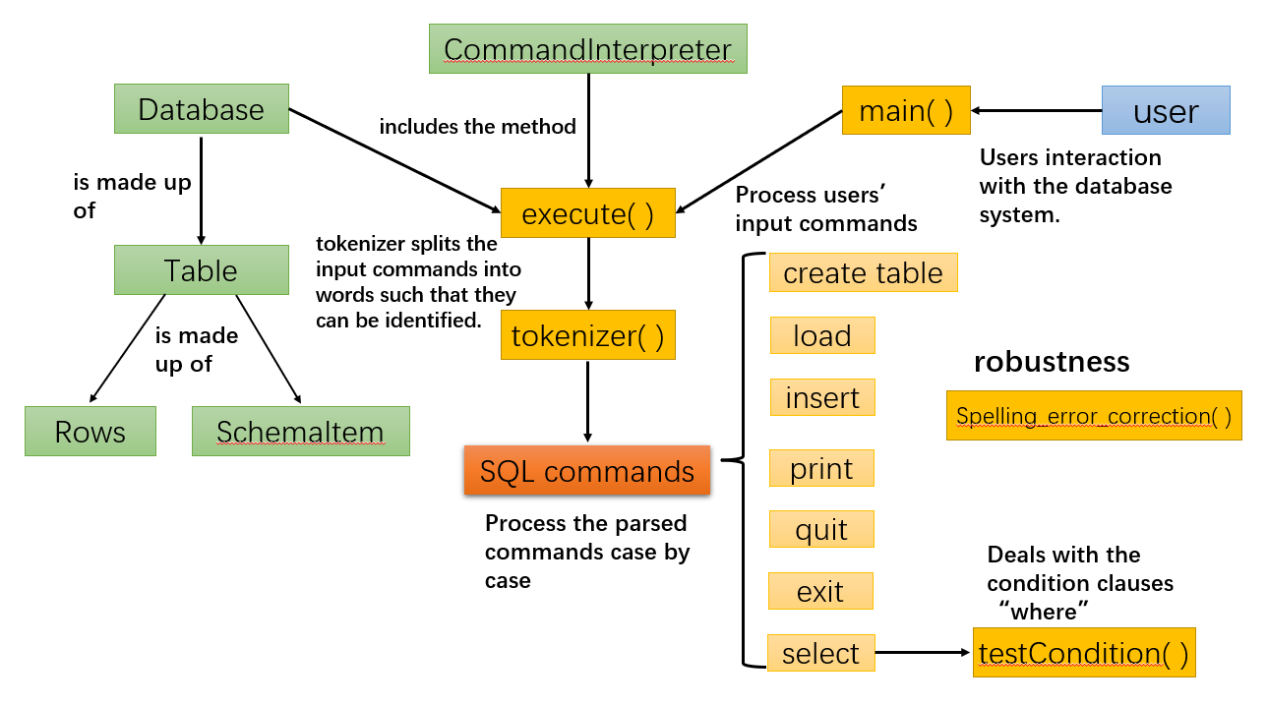
Project description

Slide 10
Test Examples
> /* What are the names and SIDS of all students whose last name is ’Chan’ ? */
> select SID, Firstname from students where Lastname = ’Chan’;
Search results:
102 Valerie
106 Yangfan
Notes:
补充代码运行结果做对比

Slide 11
Test Examples
> /* Who took the course with CCN 21001, and what were their grades? */
> select Firstname, Lastname, Grade from students, enrolled where CCN = ’21001’;
Search results:
Jason Knowles B
Shana Brown B+
Yangfan Chan B
Valerie Chan B+

Slide 12
Test Example
> /* Who has taken the course named 61A from EECS? */
> /* First, create a table that contains SIDs and course names */
> create table enrolled2 as select SID
from enrolled, schedule
where Dept = ’EECS’ and Num = ’61A’;
> /* Now print the names of the students in this list. */
> select Firstname, Lastname from students, enrolled2;
Search results:
Jason Knowles
Valerie Chan
Thomas Armstrong
Shana Brown
Yangfan Chan

Slide 13
Test Example
Other cases we may come up with

Slide 14
Test Example
Other cases we may come up with

Slide 15
Other additional features And GUI implementation

Slide 17
Thank you!

