Slide 1

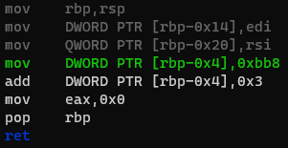

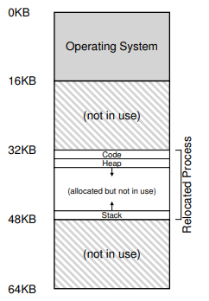
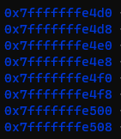
Program Code
Heap
(free)
Stack
0x7fffffffe46c
3000

Slide 2
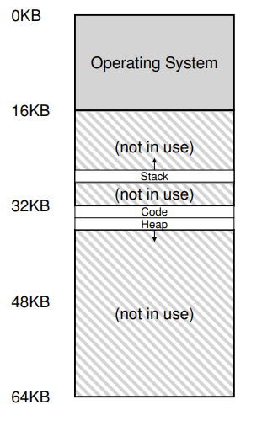
Program Code
Heap
(free)
Stack
0x7fffffffe46c
3000

