Slide 1
CSC335-ereader-team1
Ali Hamza, Jack Guerin, Sultan Alnhari, Anthony Lau

Slide 2
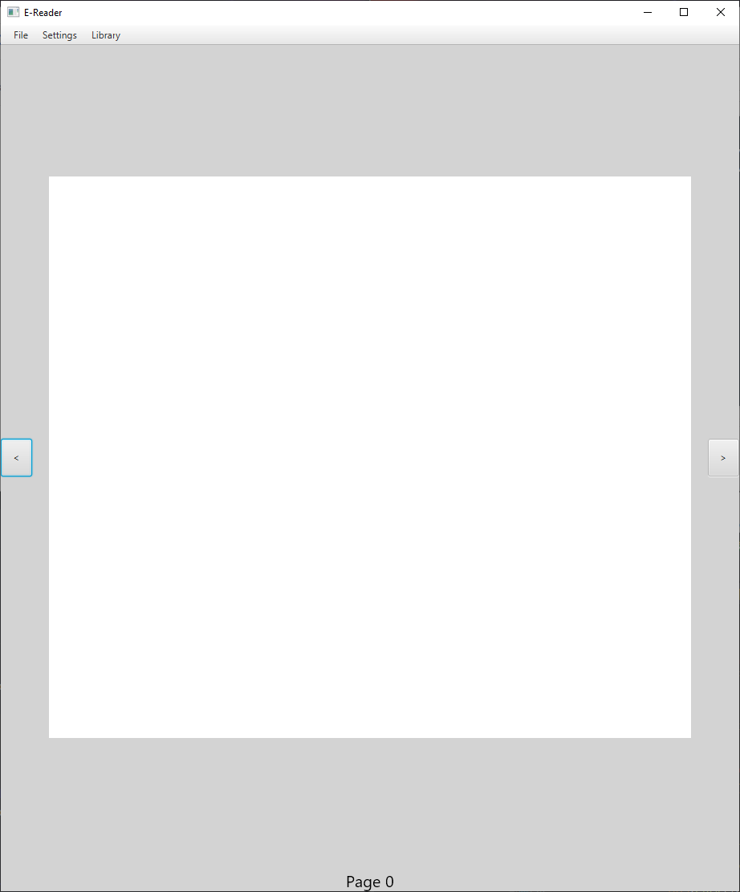
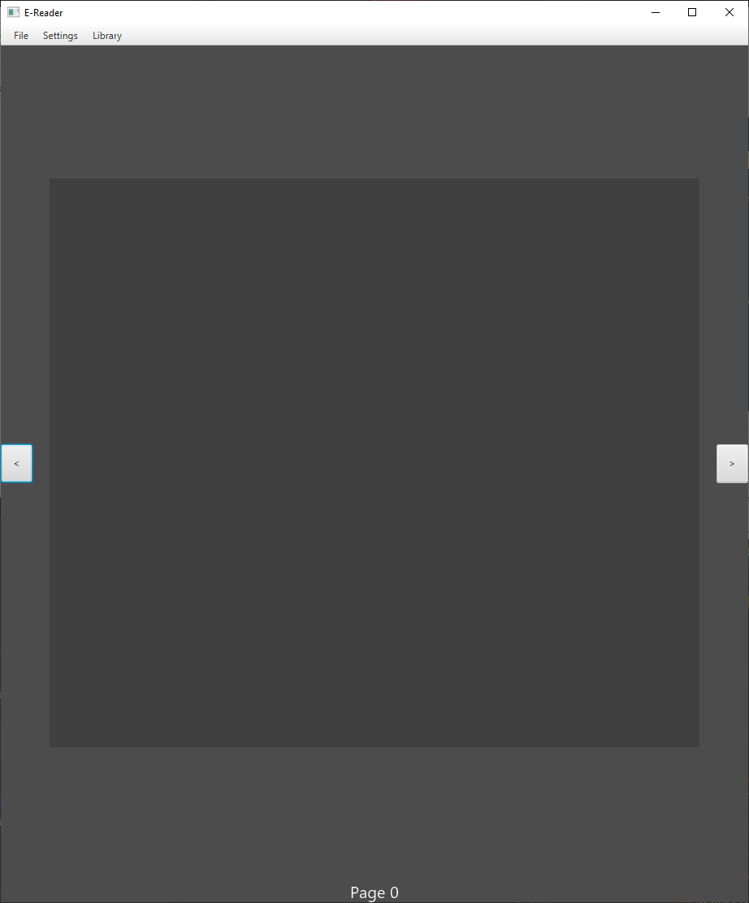
Landing Page, no Book opened.
Landing page shows blank rectangle instead of text, current page is 0, prev/next page buttons not functional.
Left is light mode version, Right is dark mode.

Slide 3
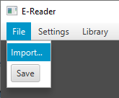
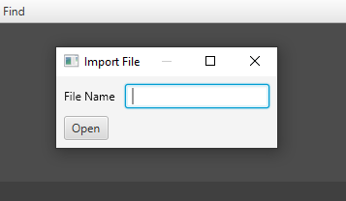
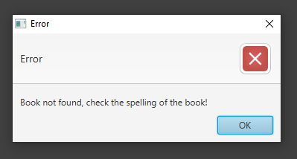
Import New Book (plaintext file)
Accessed under
File > Import…
Opens a new window, type in filename, if in program’s working directory, or file path to text file.
Shows an Error message if book/path-to-book does not exist.

Slide 4
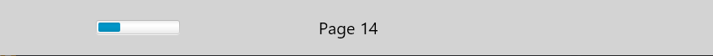
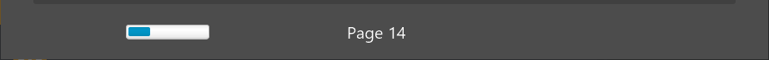
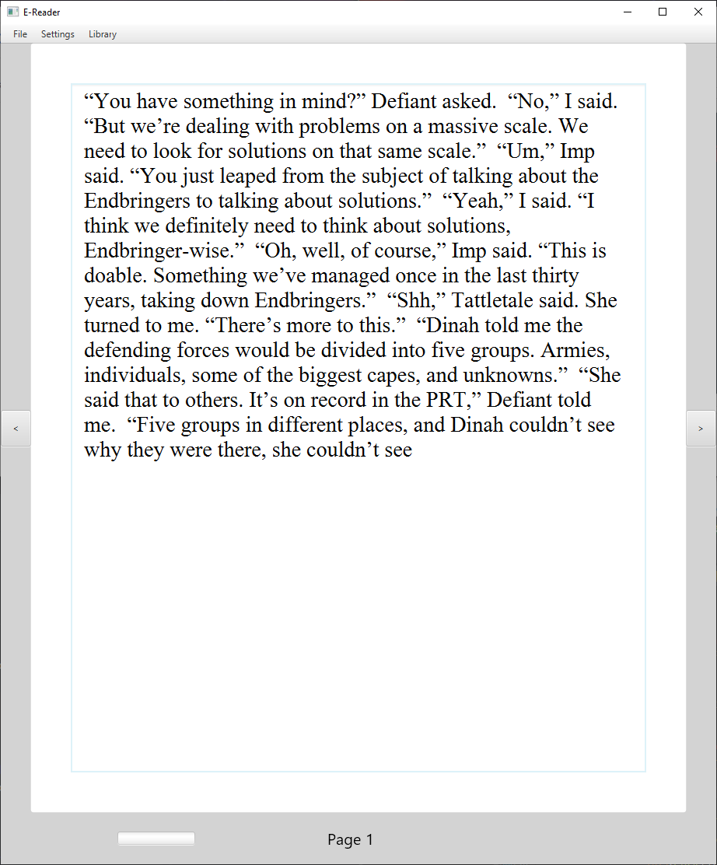
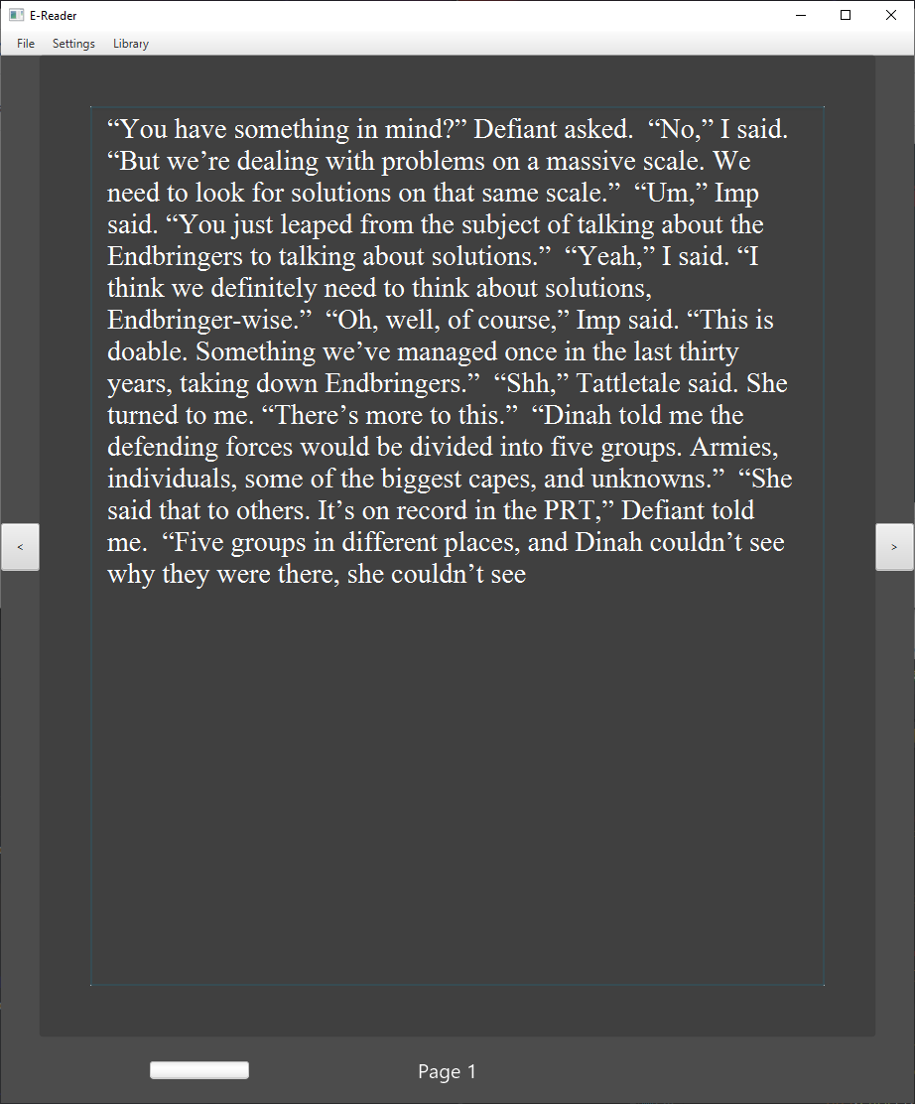
Display Book (plaintext file)
Displays each page as a 150-word-long block of text, with the current page number displayed at the bottom and the progress bar representing overall progression filling up as the user gets higher page numbers.
Prev/next buttons now work.

Slide 5
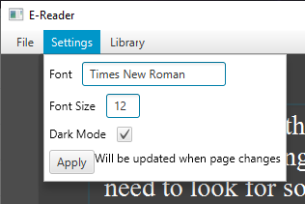

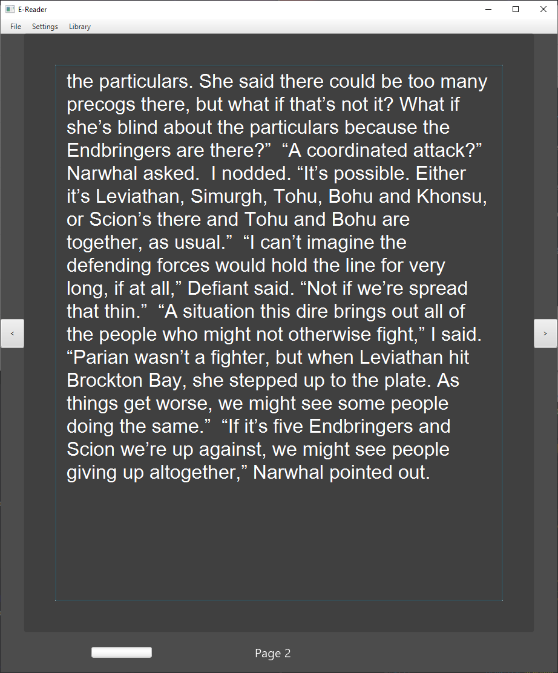
Display Book (cont’d)
Settings menu has options for Text Font (TypeFace), Text Size, and a toggle for Dark/Light Mode. Changes are applied after clicking “Apply” when page changes, or new book is opened.
Times New Roman, 12, Light Mode → Arial, 16, Dark Mode

Slide 6
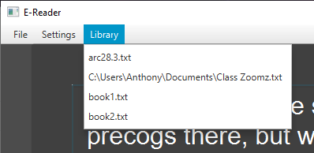

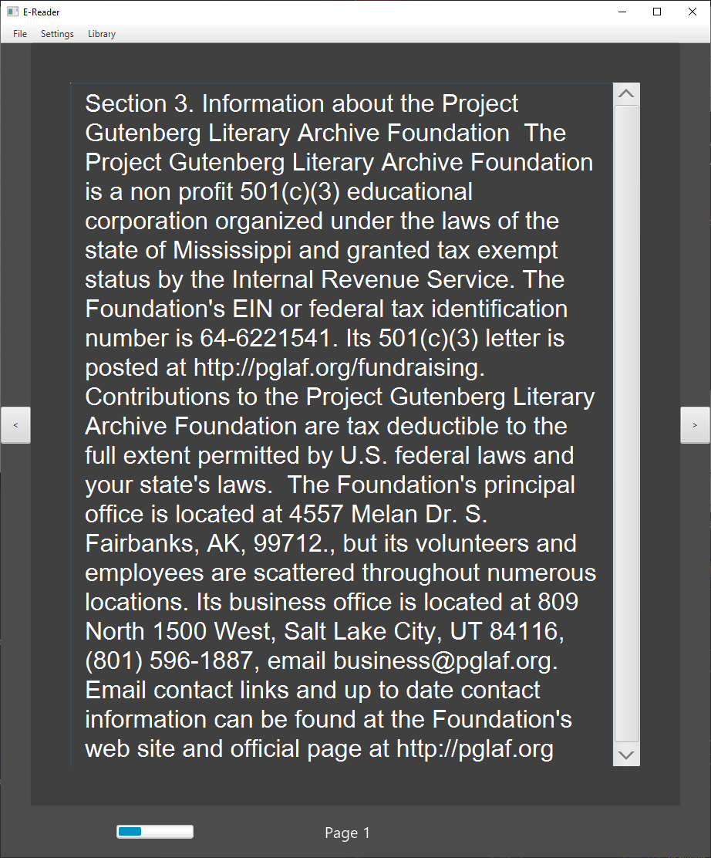
Library (Book List)
Displays a list of books that have been opened before. Can be represented as file names or as paths.
arc28.3.txt → book1.txt

Slide 7
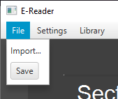

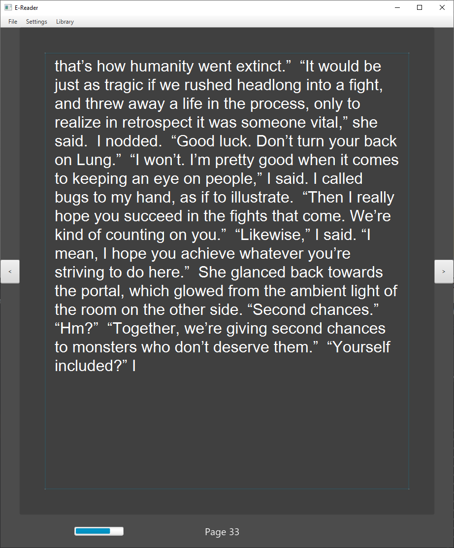
Bookmarks
Clicking the Save button will bookmark the Book at the specified page. This will cause the Book to always open at that page when accessed via import or library until it is updated again with save.
book1.txt, page 1 → arc28.3.txt, page 33

