Slide 1

3
C
3
S
C
5
X
TAMAGOTCHI
Team 11

Slide 2
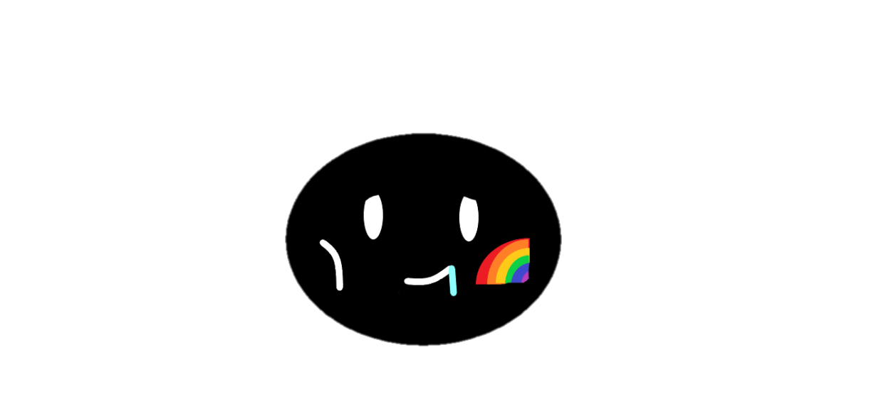
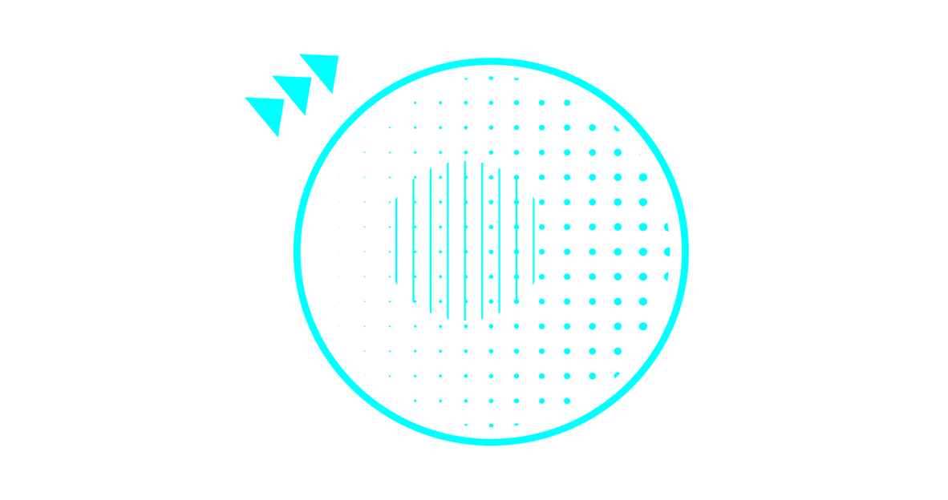
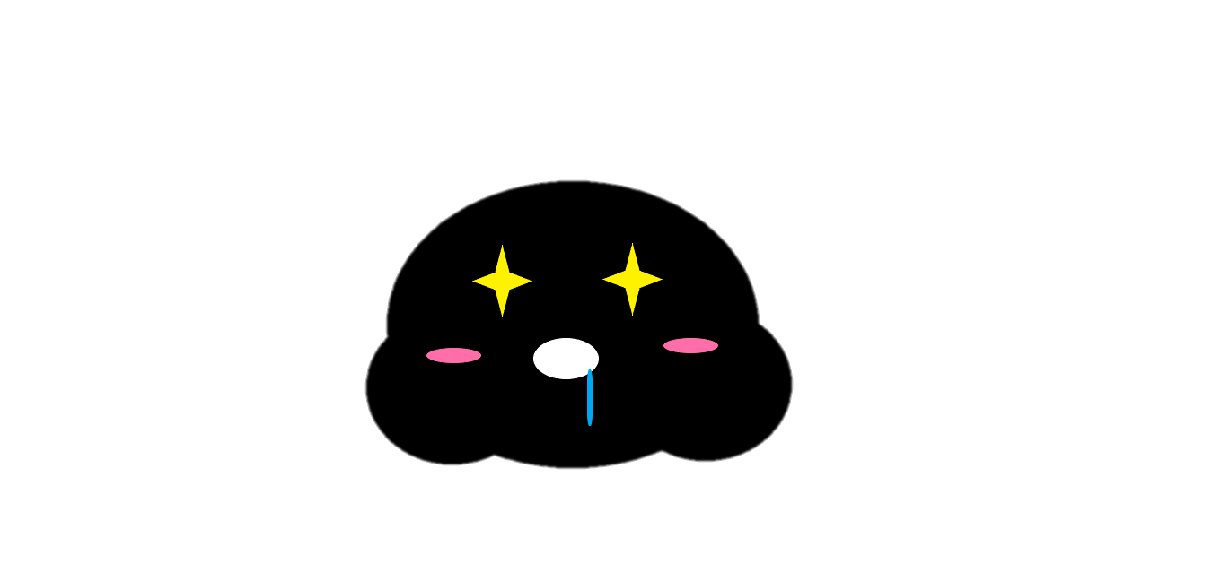
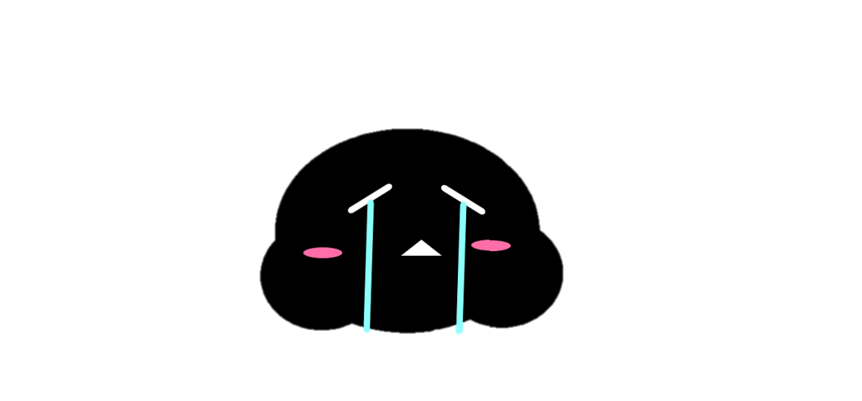
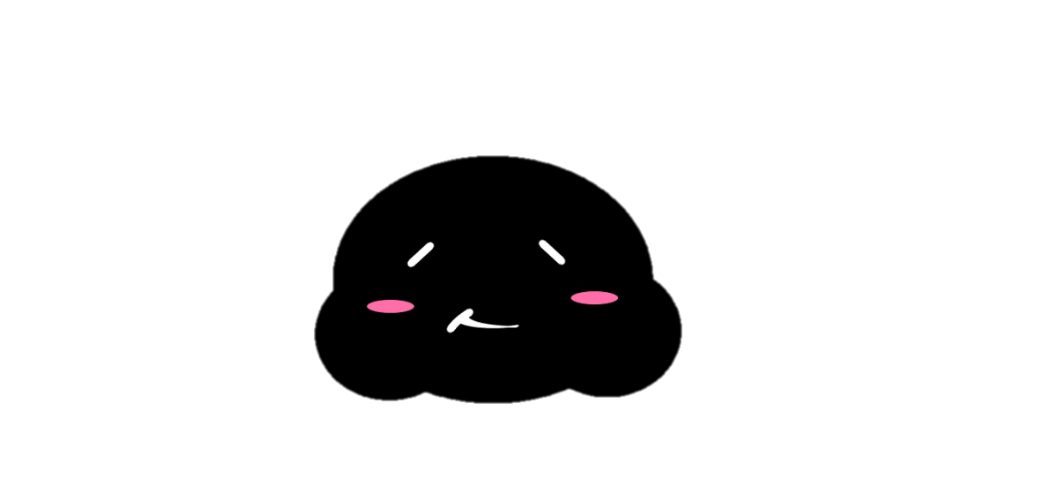
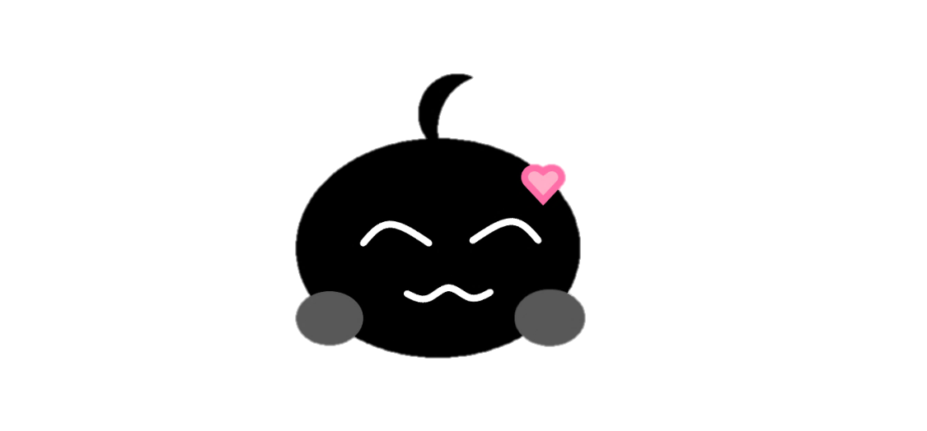
MILESTONES
X
1.
Display for Tamagotchi, stat bars, and buttons for interaction, ability to create new Tamaclonechi.
2.
Passing of time implemented for all stats, Tamaclonechi health will be affected by all implemented stats.
3.
All interactions/tradeoffs coded, wow factors includes.

Slide 3
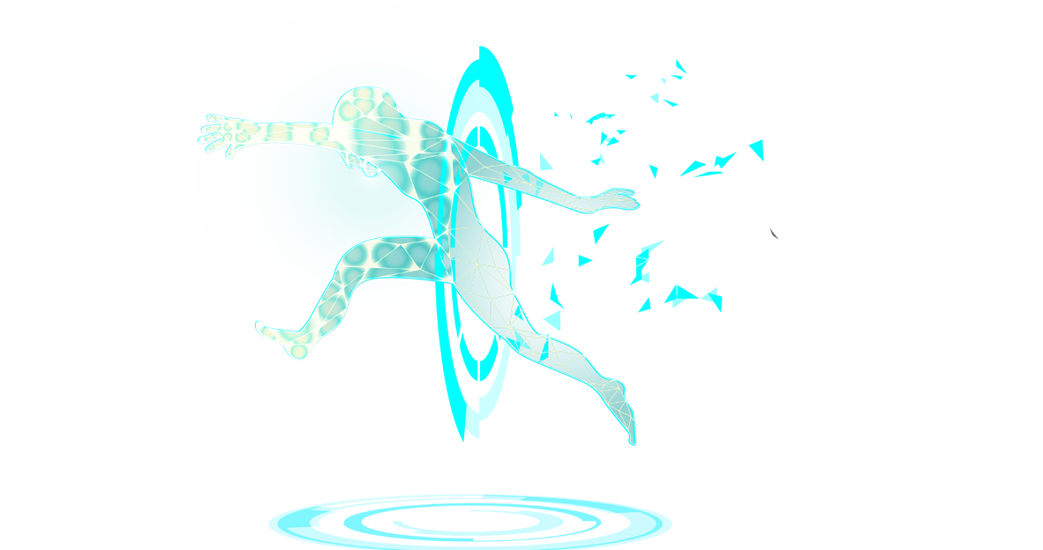
X
Zhengxuan
Team Member
Xie

Slide 4
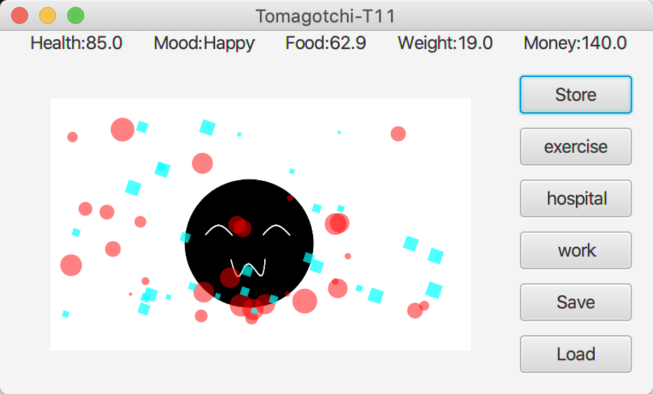
Part one
Using JavaFX to create an interface for an electronic pet, the interface is simple and elegant, using the BorderPane layout.
X

Slide 5
Part one
The UI components of JavaFx make use of Button, Label, Image, ImageView, ListView and so on.
JavaFx uses animation to implement this effect, controlling the number and speed of effects to make the page richer.
X
Click me
Click me
Click me
Click me
JavaFx adds events through ActionEvents to get the pet to exercise, take the pet to the hospital, and get the pet to work.
For the program has a good comment habit, the program is very readable.

Slide 6
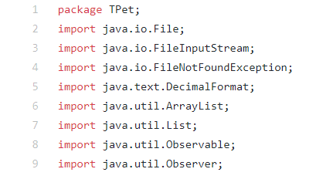
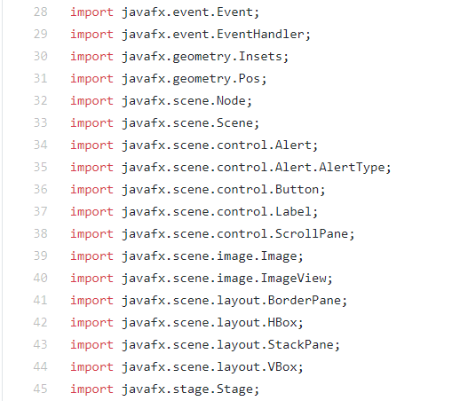
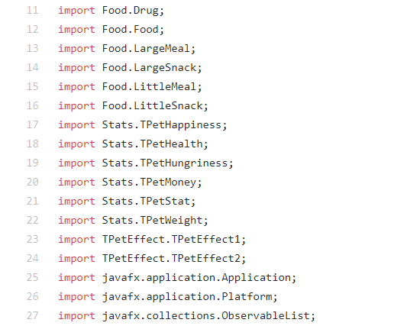
The UI components of JavaFx make use of Button, Label, Image, ImageView, ListView and so on.
Part one
X

Slide 7
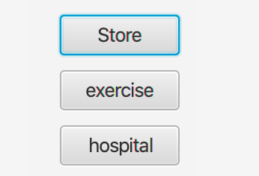
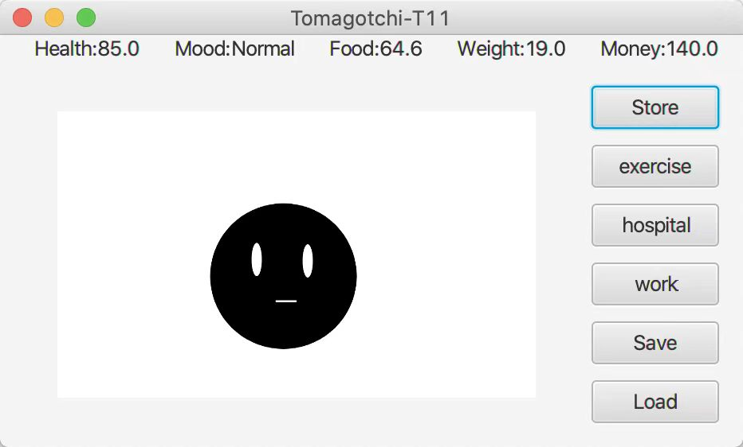
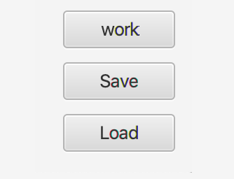
JavaFx adds events through ActionEvents to get the pet to exercise, take the pet to the hospital, and get the pet to work.
Part one
X

Slide 8
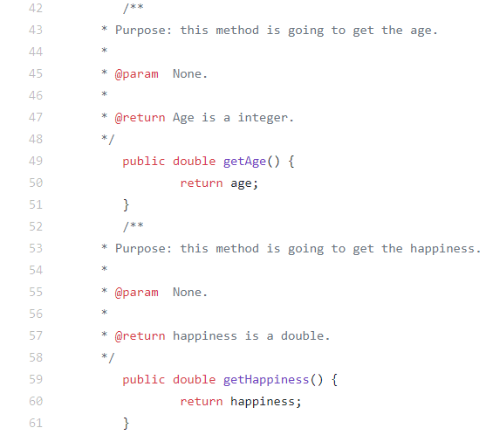
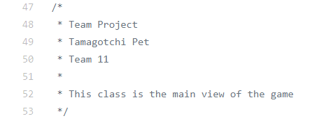
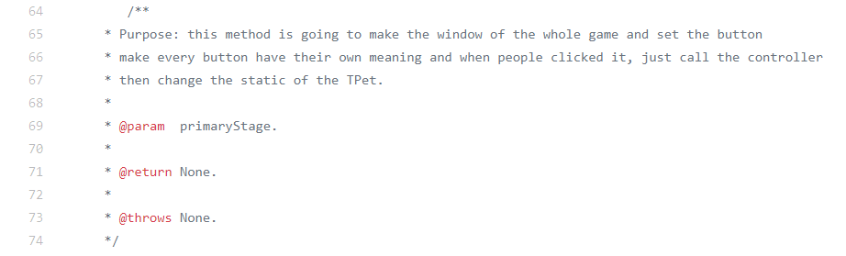
For the program has a good comment habit, the program is very readable.
Part one
X

Slide 9
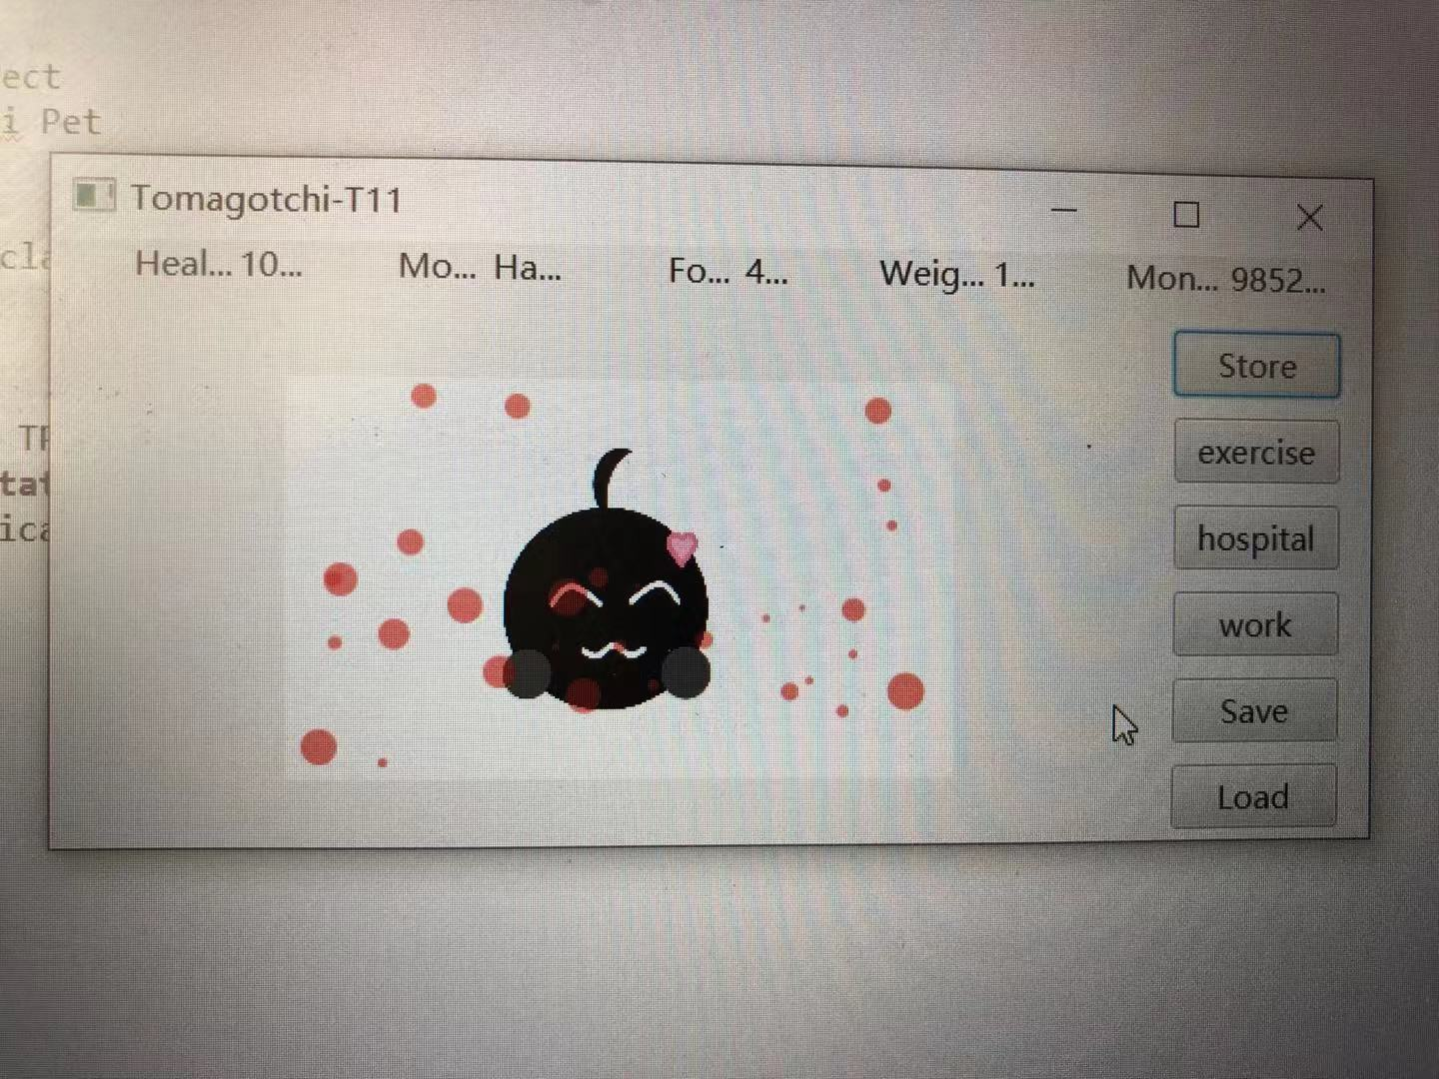
JavaFx uses what classes to implement this effect, controlling the number and speed of effects to make the page richer.
Part one
X

Slide 10
X
Chen
Team Member
Fuduo

Slide 11
Part two
Object-oriented programming is used
X
1
2
3
4
TPet interface is constructed, and the specification of Stats is defined. It has methods of TPetAge, TPetHappiness, TPetHealth, TPetHungriness, TPetMoney, TPetStat, TPetWeight, and so on.
Construct abstract classes, implement interfaces, have properties such as money, health, mood, satiety, weight, store, exercise, go to hospital, go to work, and some get and set serialization and deserialization methods.
It defines the appearance of each body shape and each mood, and then realizes the details of each body shape. Therefore, the program is of good expansibility. If you want to increase the content of the game, you just need to add new appearance according to the mood or body shape.
It constructs structures that show that electronic pets lose weight, mood, satiety, and health over time.

Slide 12
Part two
Wow Factor!!
Bubble effects
X
If you earn enough gold coins, you can buy bubbles. There can be 60 bubbles at a time. There are two colors to choose from, in order to enrich the interface and make it look better.
Automatic archive
Has the archive function, after clicking the archive will be saved in a location, using the load button, the archive will be presented.
Money system
Basically to make money, and then you can go to the store to buy all kinds of electronic pet to increase the number of each item.
Click me

Slide 13
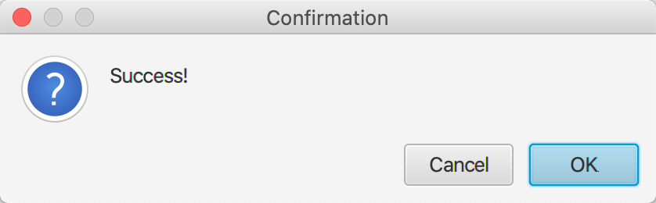
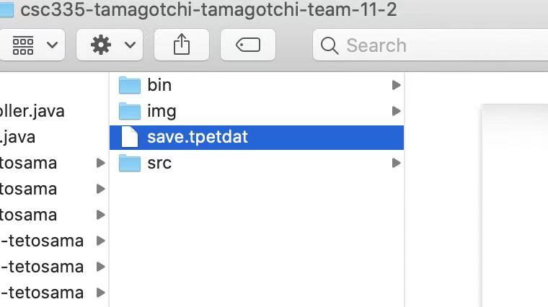
Part two
Automatic archive
X
Save button
Load button
Show success!

Slide 14
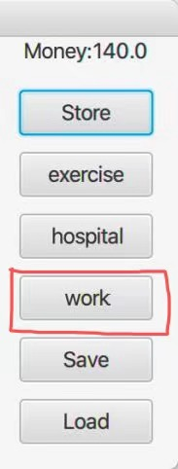
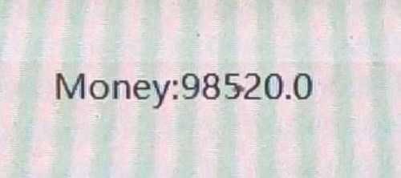
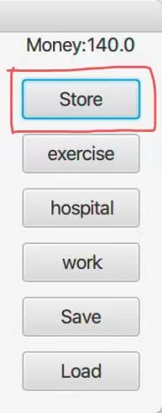

Part two
Money System
Work for money
Go to the store
X
Get money
Buy different things for your pet

Slide 15
Part two
Bubble effects
X

Slide 16
X
Yujie
Team Member
Yan

Slide 17
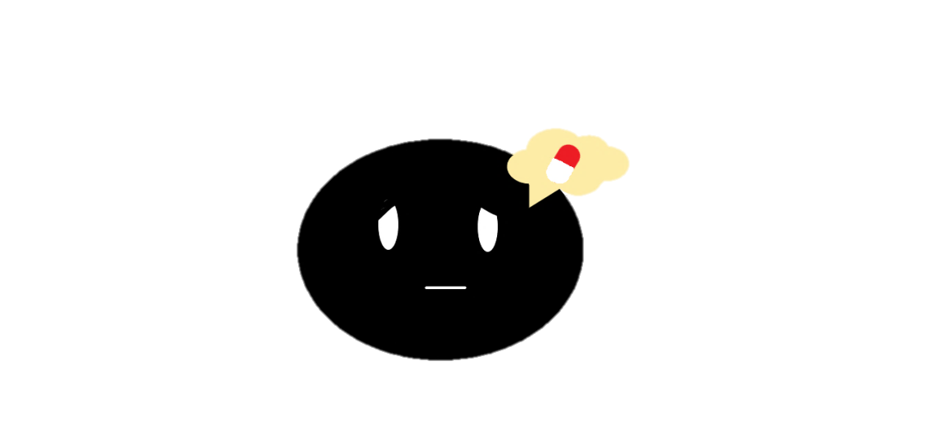
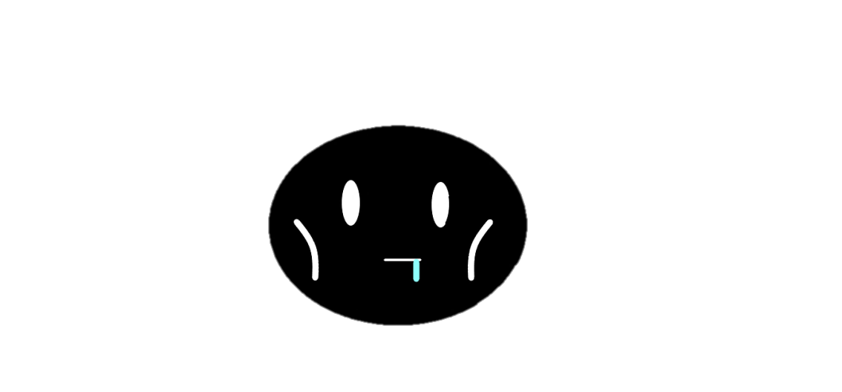

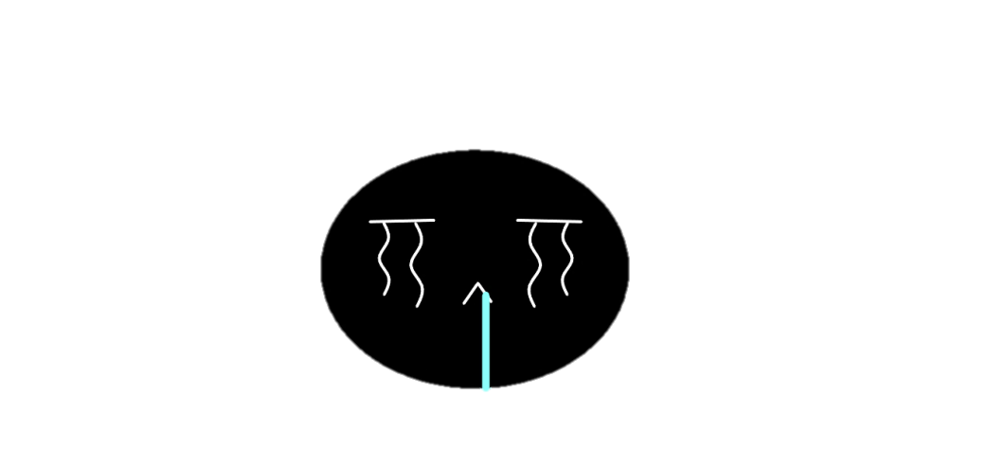


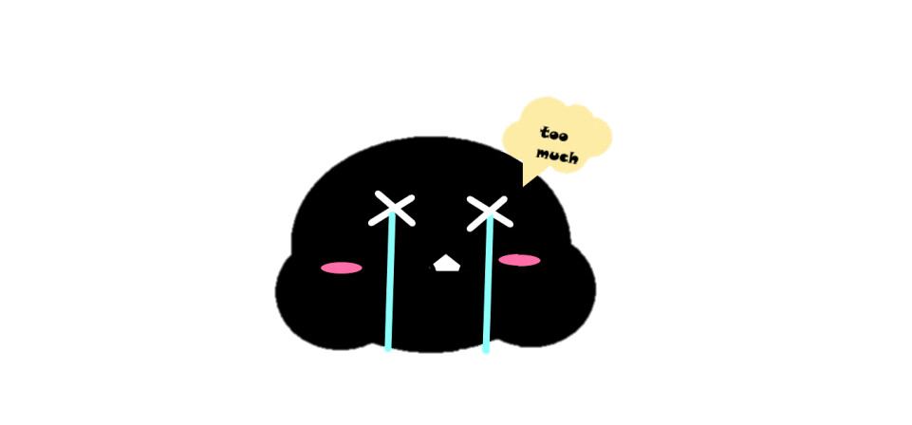


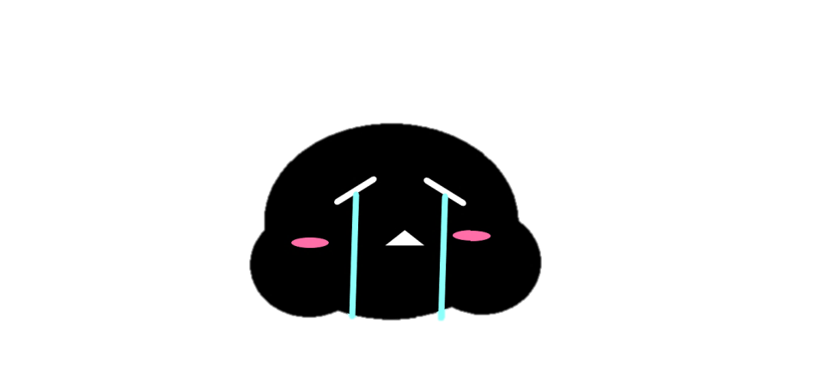

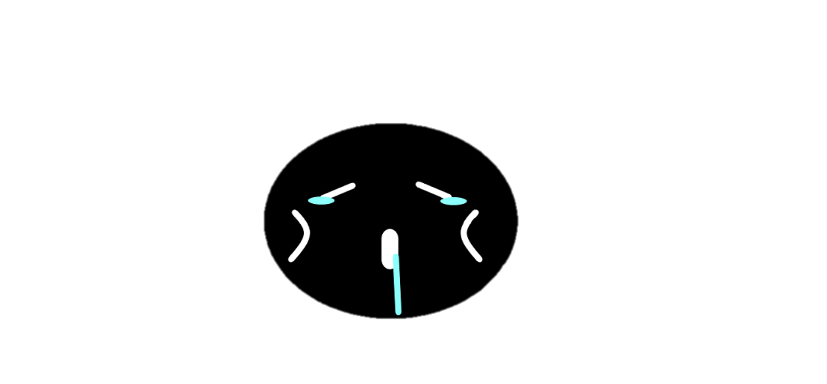


Part three
X
A list of all images

Slide 18
X
Fan
Team Member
Xutong

Slide 19
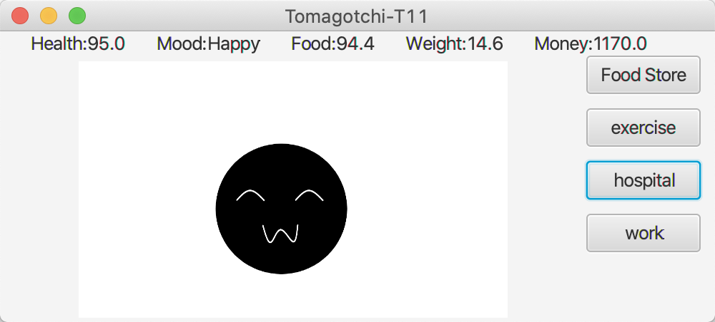
Part four
Screenshots of running the program
X
The initial design of the minimalist interface.

Slide 20
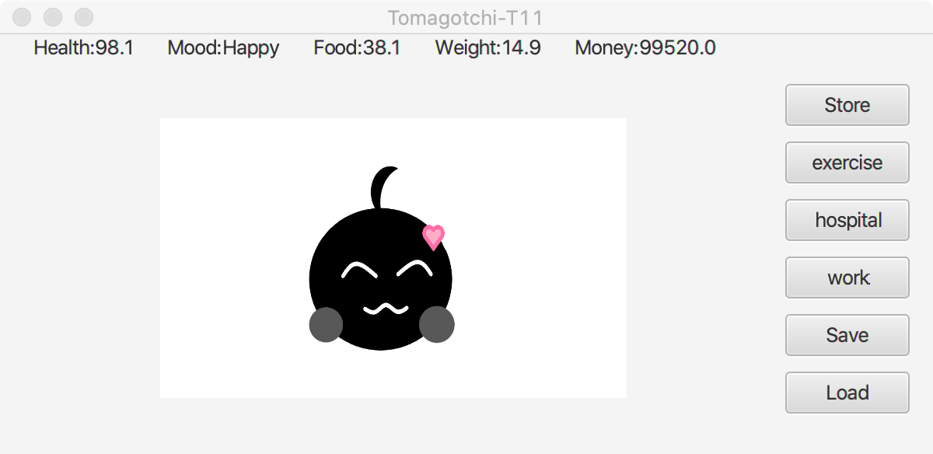
Part four
Screenshots of running the program
X
Buttons for save and Load have been added, and the content of store has been added.

Slide 21
Part four
Screenshots of running the program
X
After purchasing the electronic pet with special effects, the Mood stays at Happy.

Slide 22
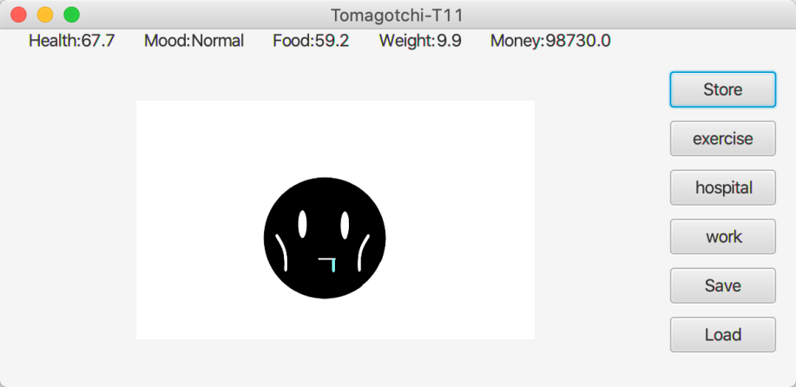
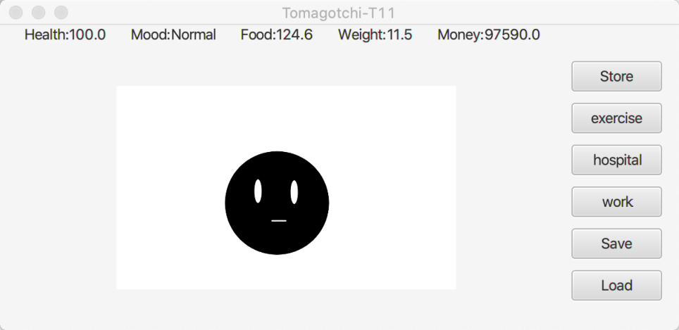
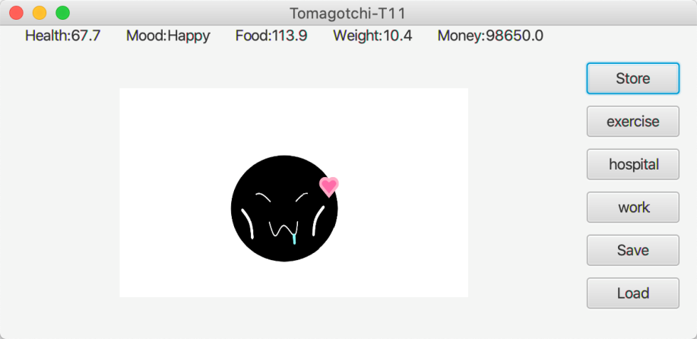
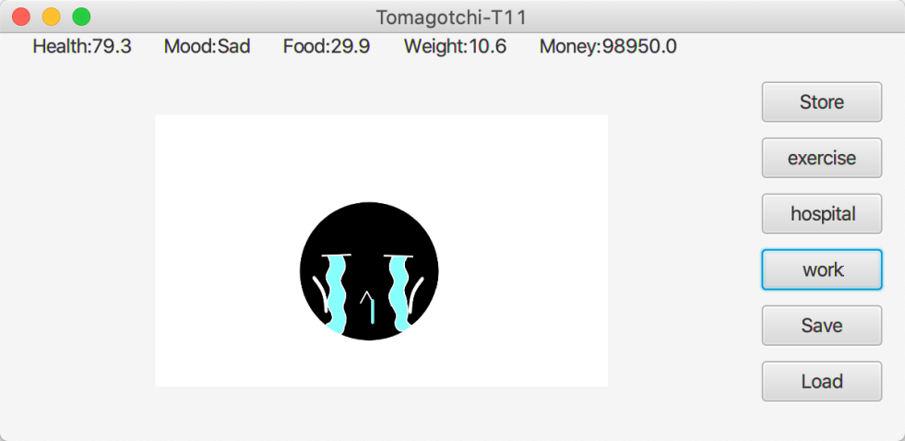
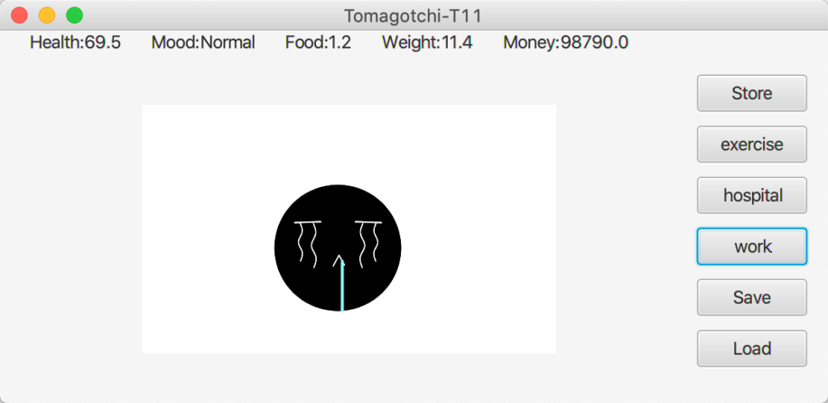
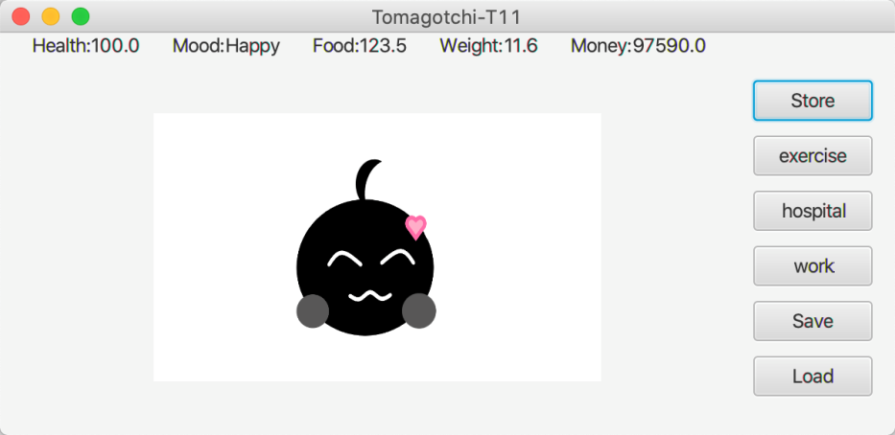
Part four
X
The image changes as the state changes

Slide 23
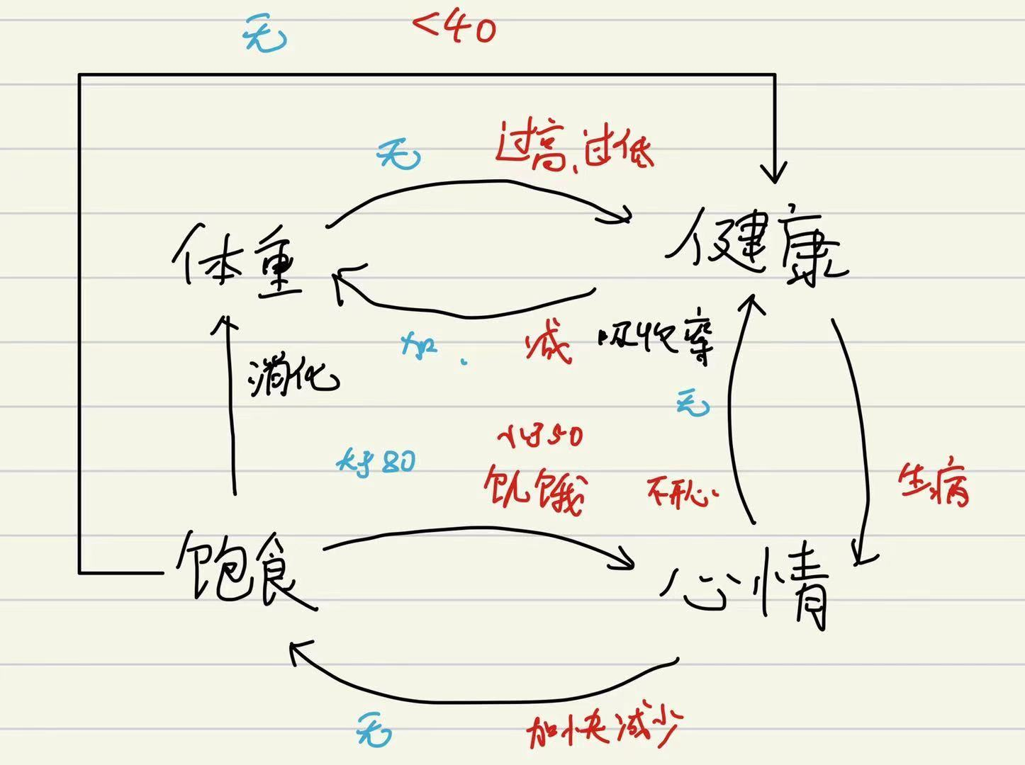
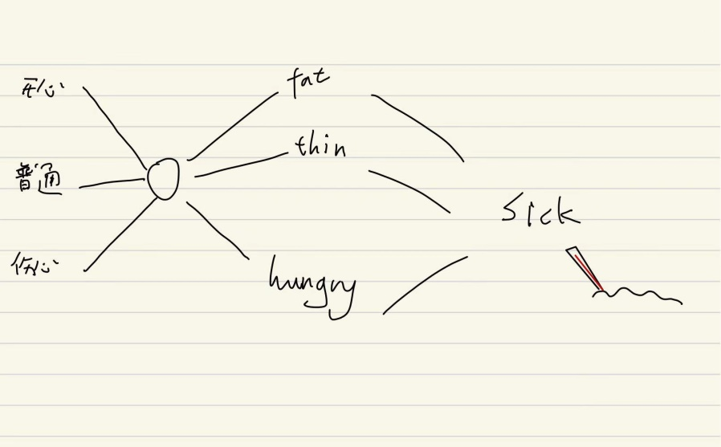
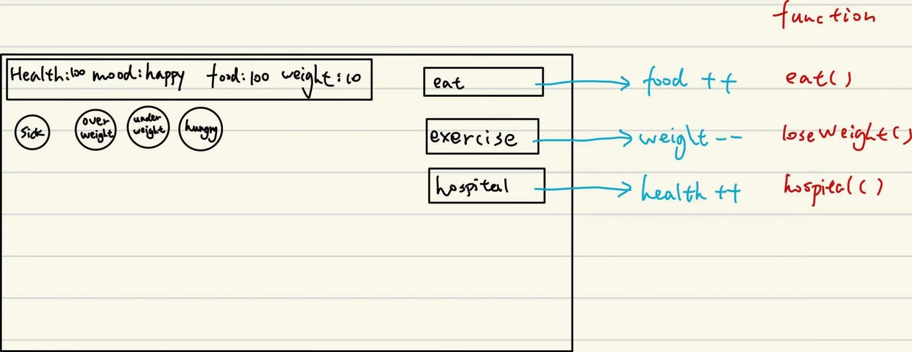
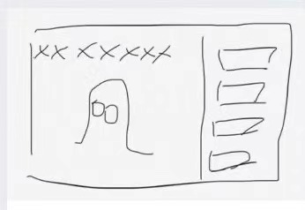
Notes when we designing the project
Part four
X

Slide 24
T
Y
X
TAMAGOTCHI
hank
ou
CSC335
TEAMPROJECT
X

