Slide 1
Minesweeper
Prabhkirat Bindra, James Colby, Joshua Kantarges, Denson Gothi

Slide 2
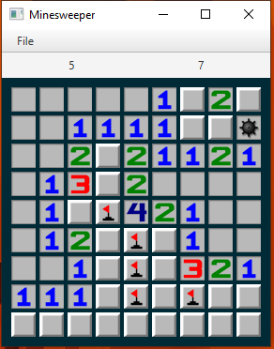
An N x M Grid Containing Mines

Slide 3
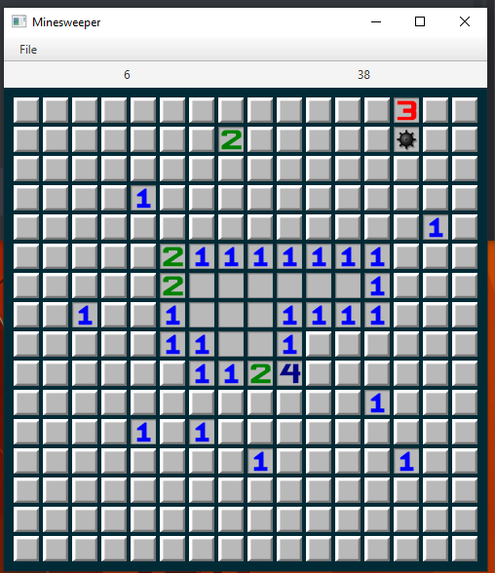
Clicks in Minesweeper
Each click either:
reveals a mine which causes the sound of an explosion to play and end the game or ...
reveals an integer that indicates the number of mines in the surrounding 8 squares.

Slide 4
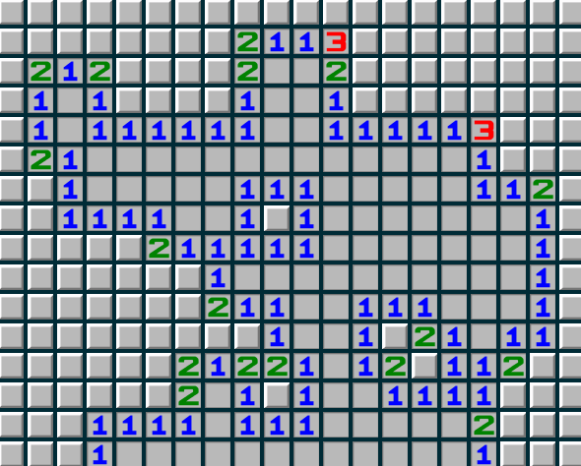
What if a square with no mines as neighbors is revealed?
All contiguous regions of “zero” squares gets automatically revealed!

Slide 5

A timer which indicates the elapsed time

Slide 6
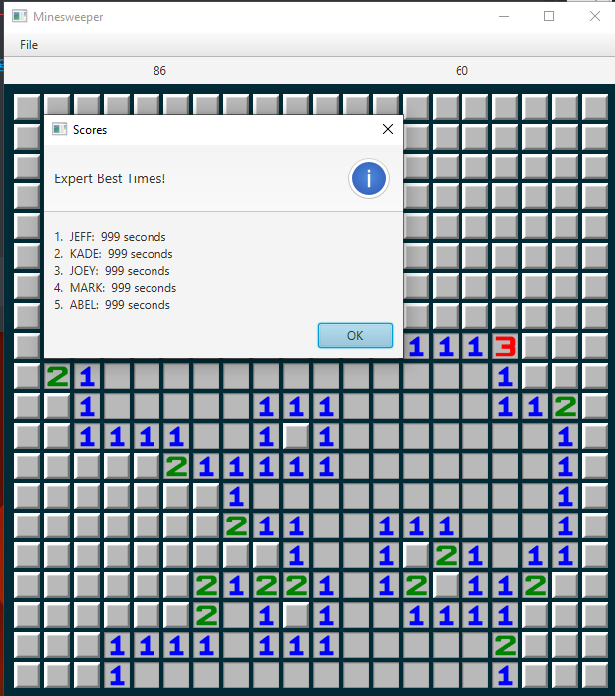
A high score board
There are three different high score boards for each difficulty present in Minesweeper.
Each one has their own board with the fastest
times from which players.

Slide 7
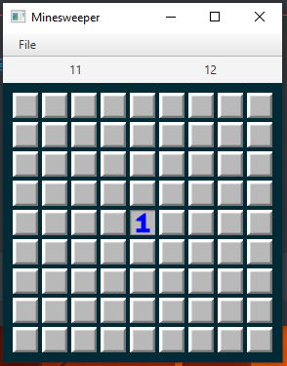
The first square clicked is never a mine!

Slide 8
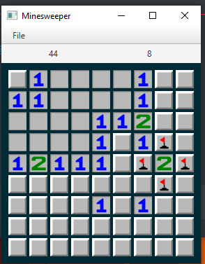
Marking of suspected mine squares prevents accidentally clicking on them.

Slide 9
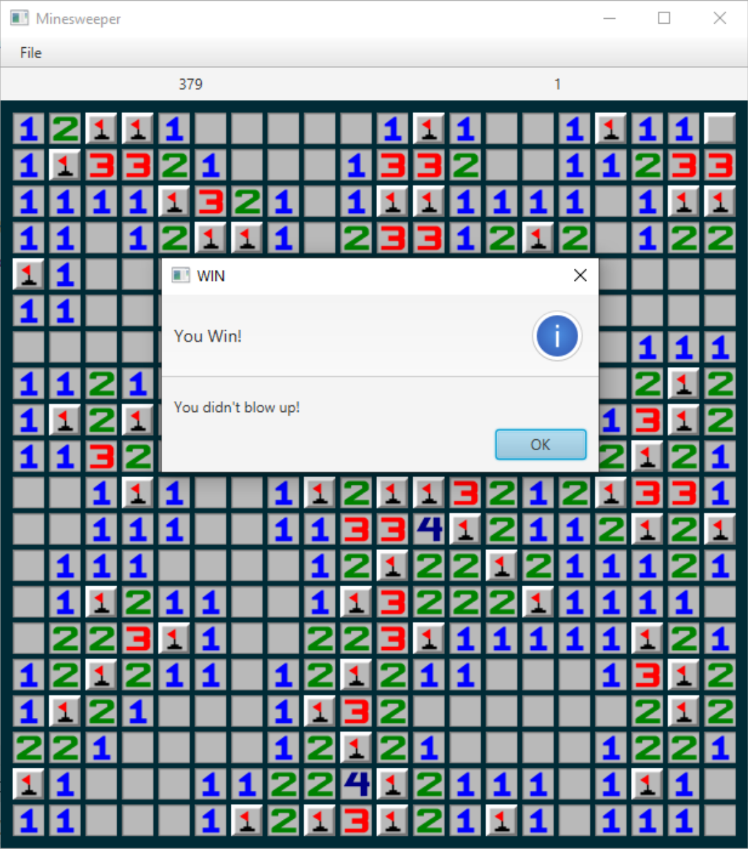
Win condition
Reveal all squares which do not have mines!

Slide 10
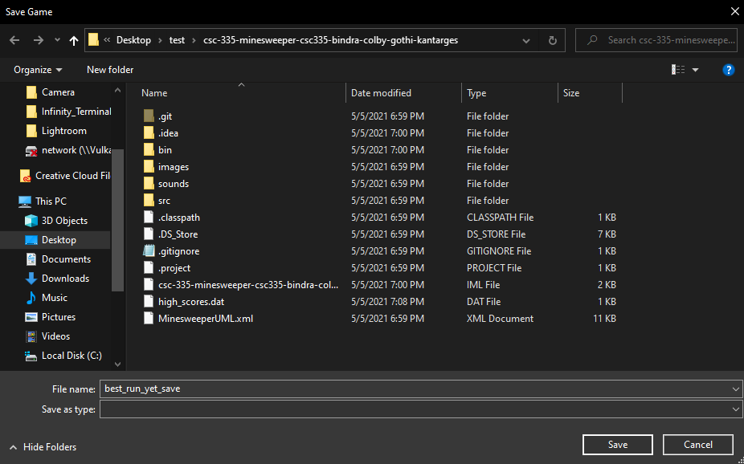
If you need...
You can save your progress and come back to a game at any time!

Slide 11
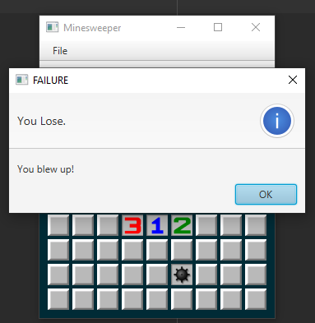
Our wow factor
We have a board comprised entirely of imagery based upon the original minesweeper. On top of that we also have sound effects integrated into our program.

