Slide 1
Society
A turn based strategy game
Adi Dillon Joseph Shane

Slide 2
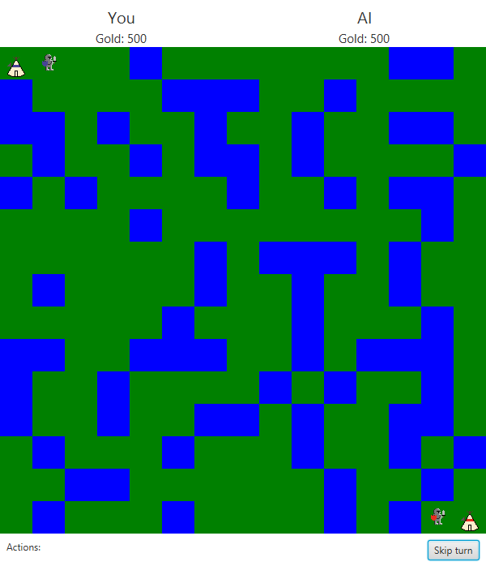
Gameplay
User controls blue nation, AI controls red nation
Both nations start with settler and foot soldier on opposite sides of the map
Users take turns, can either move a unit, or develop a unit each turn
Game has custom, hand crafted sprites for each unit

Slide 3
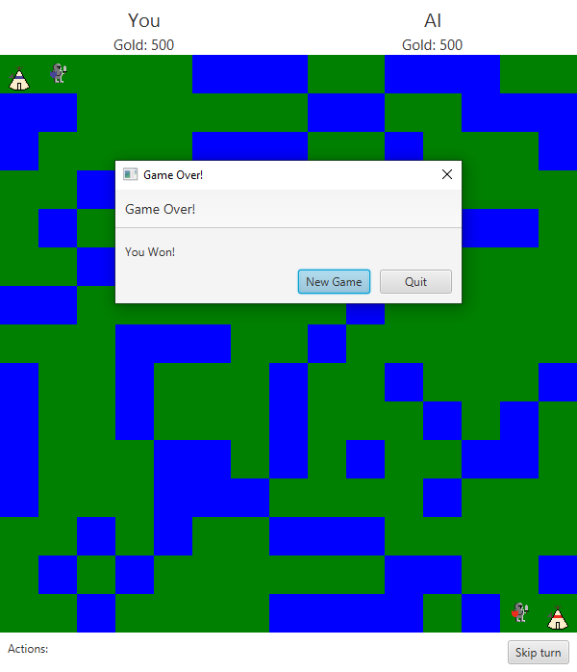
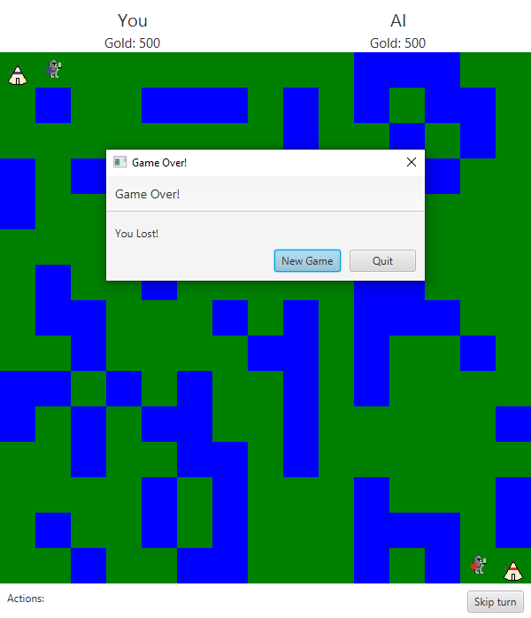
Goal
The game ends when a nation has no units after their turn. The player can then either restart the game, or close the application.

Slide 4
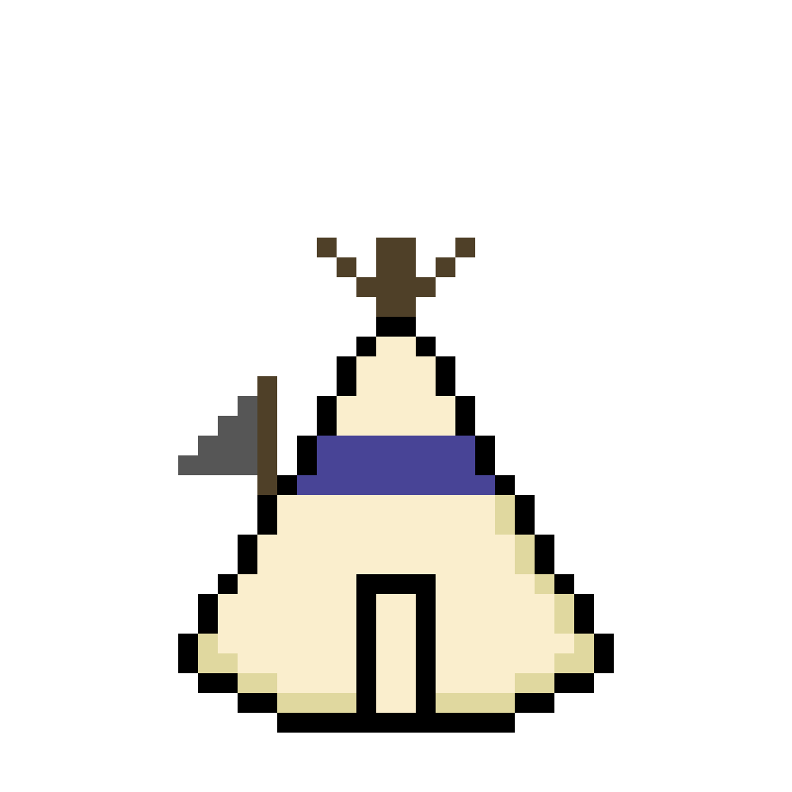
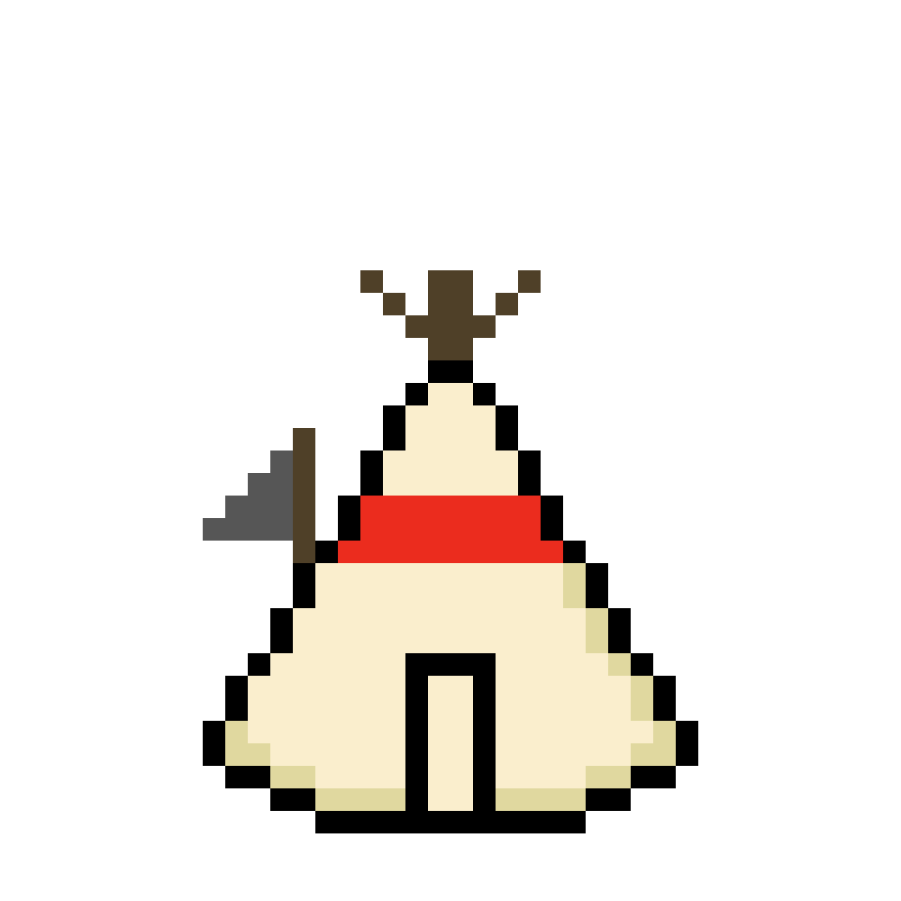
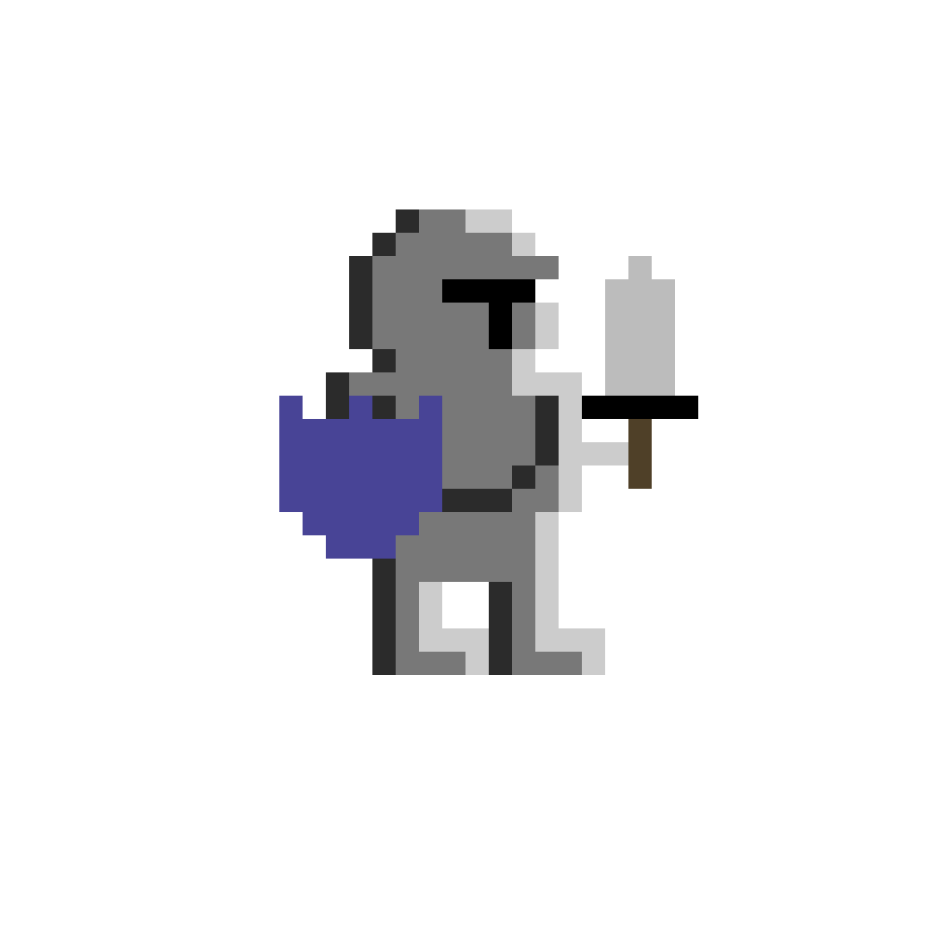
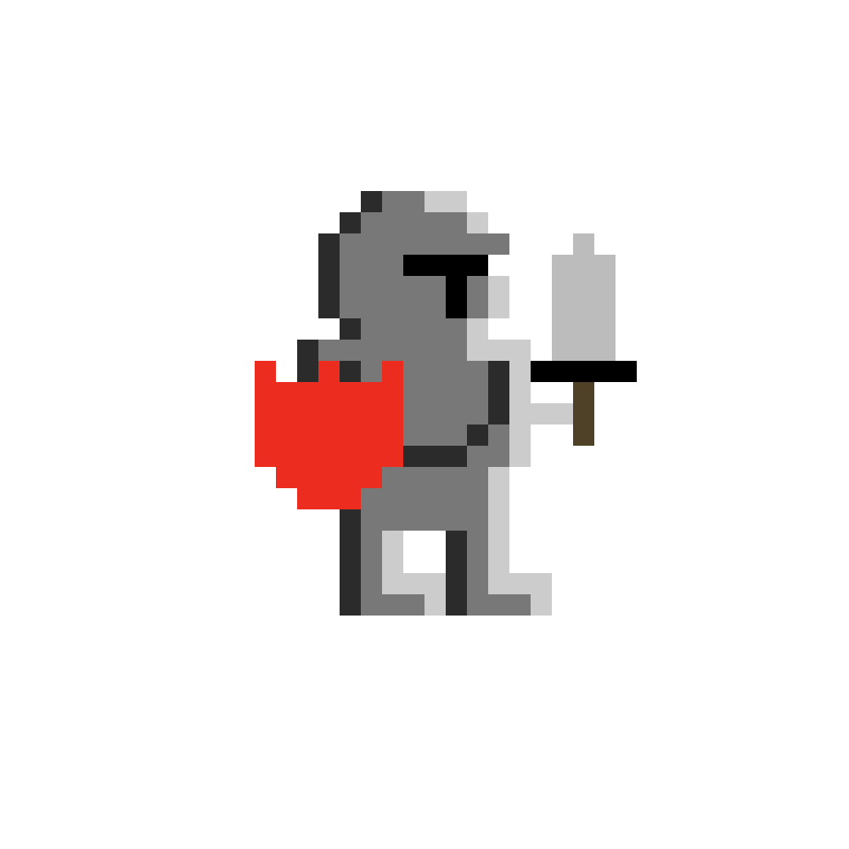
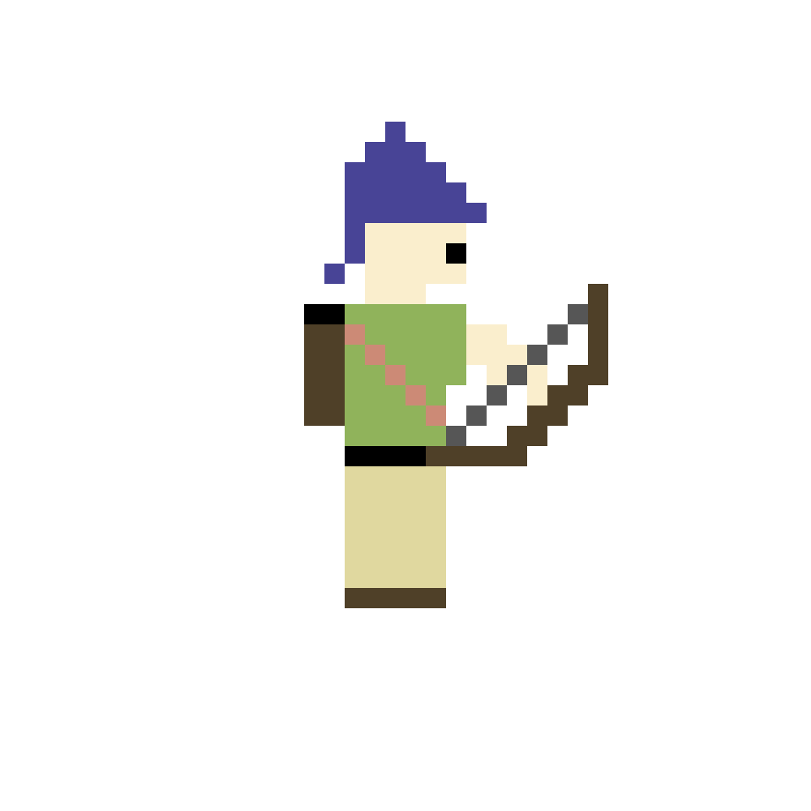
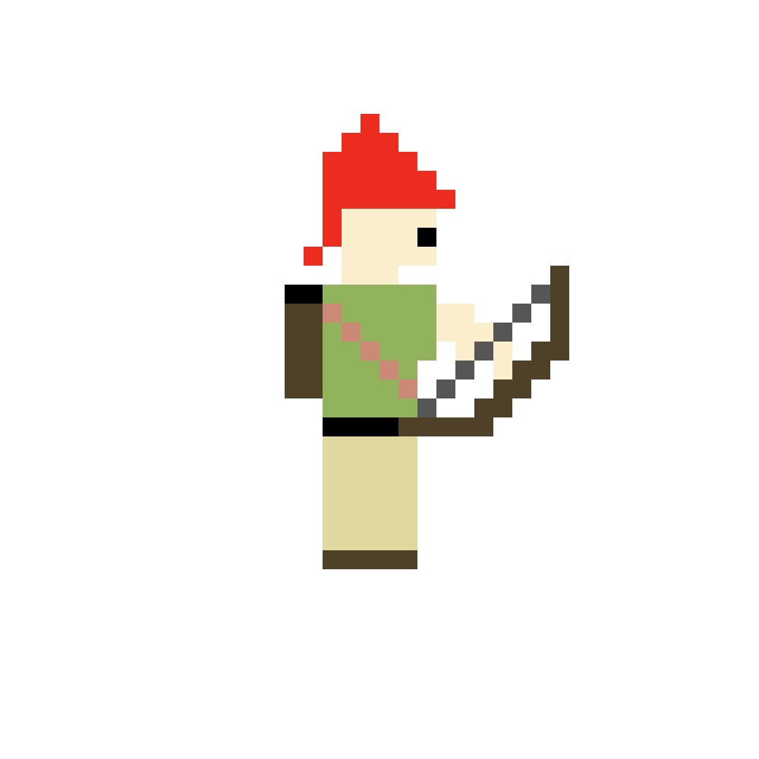
Units
There are 3 types of units in the game, each with different stats and abilities
Settler (50 gold)
Moves up to 2 spaces per turn
Creates cities on any dry piece of land
Foot Soldier (100 gold)
Moves up to 2 spaces per turn
Strongest piece in the game
Archer (75 gold)
Moves up to 4 spaces per turn
Attacks enemy units at range

Slide 5

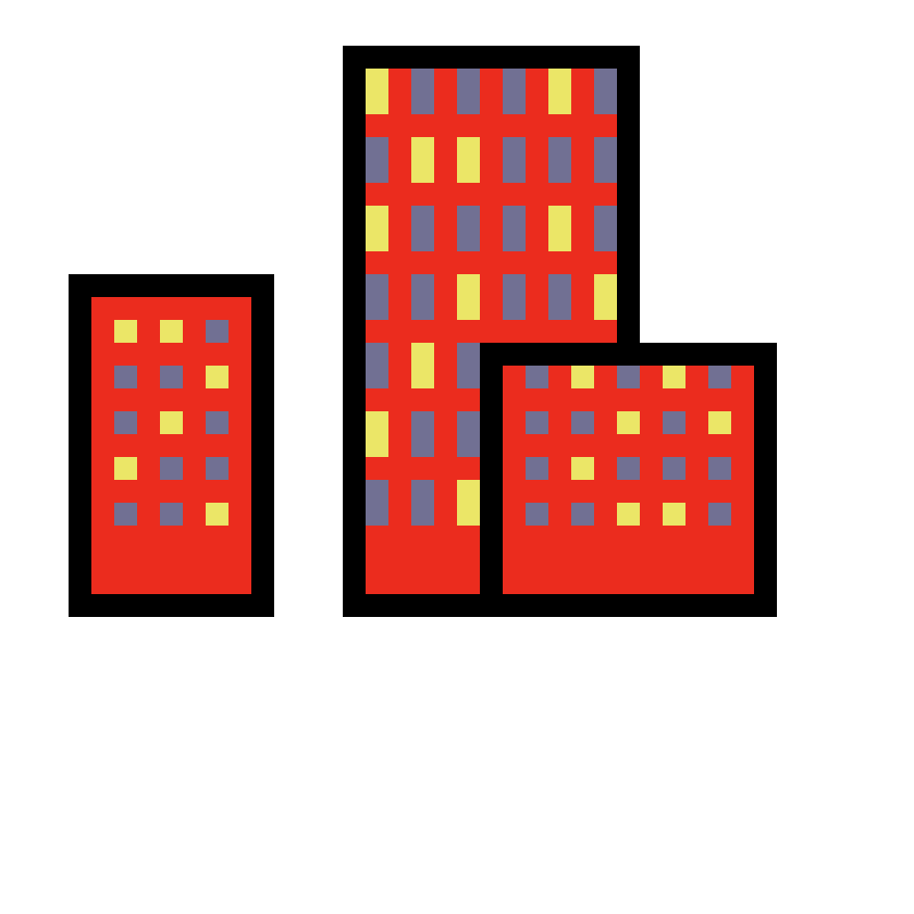
City
Cities are created by settler units. They can then recruit settlers, warriors, or archers for gold.
Each turn, cities produce 5 units of gold as tax for the nation.
The first city bought by a player costs 200 gold. Every time a city is bought, the price for a city doubles.

Slide 6

Movement and attacking
Clicking on a tile with a unit will highlight the tile
Clicking on another tile will either:
Move the unit to that tile
Attack an enemy unit on that tile
Health is decreased based on attack and defense stats
Unit is removed if its health is depleted
Nothing, if the movement is not valid
Units cannot move into water
Units cannot attack other friendly units
Move distance must be less than the units distance stat

Slide 7
Actions
Whenever a unit is highlighted, the action menu for that unit type is shown. For foot soldiers and archers, that looks like this:
For settlers, the action menu looks like this:
For cities, the action menu looks like this:

Slide 8
Actions- continued
Skip turn
Ends the turn for the player
Build City
Builds a city
Recruit Settler
Recruits a settler
Recruit Warrior
Recruits a warrior
Recruit Archer
Recruits an archer

