Slide 1

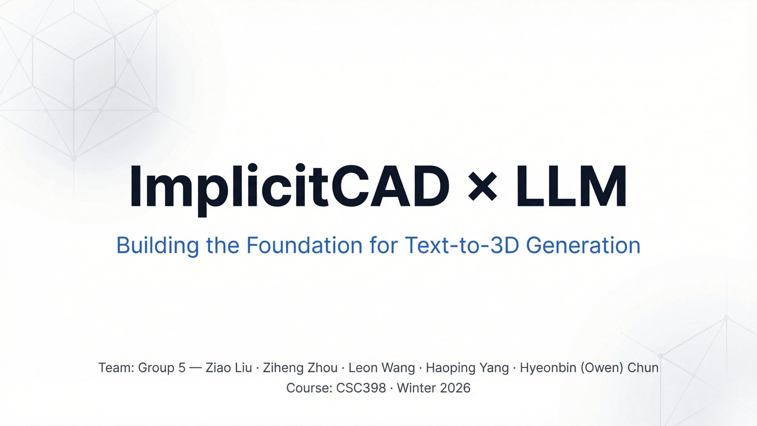
Notes:
Hello everyone, we're Group 5 and we're excited to share our work on making 3D design more accessible. We've built a foundational system that uses large language models to generate 3D models from text. Our project, ImplicitCAD times LLM, is all about building the groundwork for text-to-3D generation. We're tackling the challenge of making powerful 3D design tools easier for everyone to use. Let's dive into why this is such an important problem to solve.

Slide 2
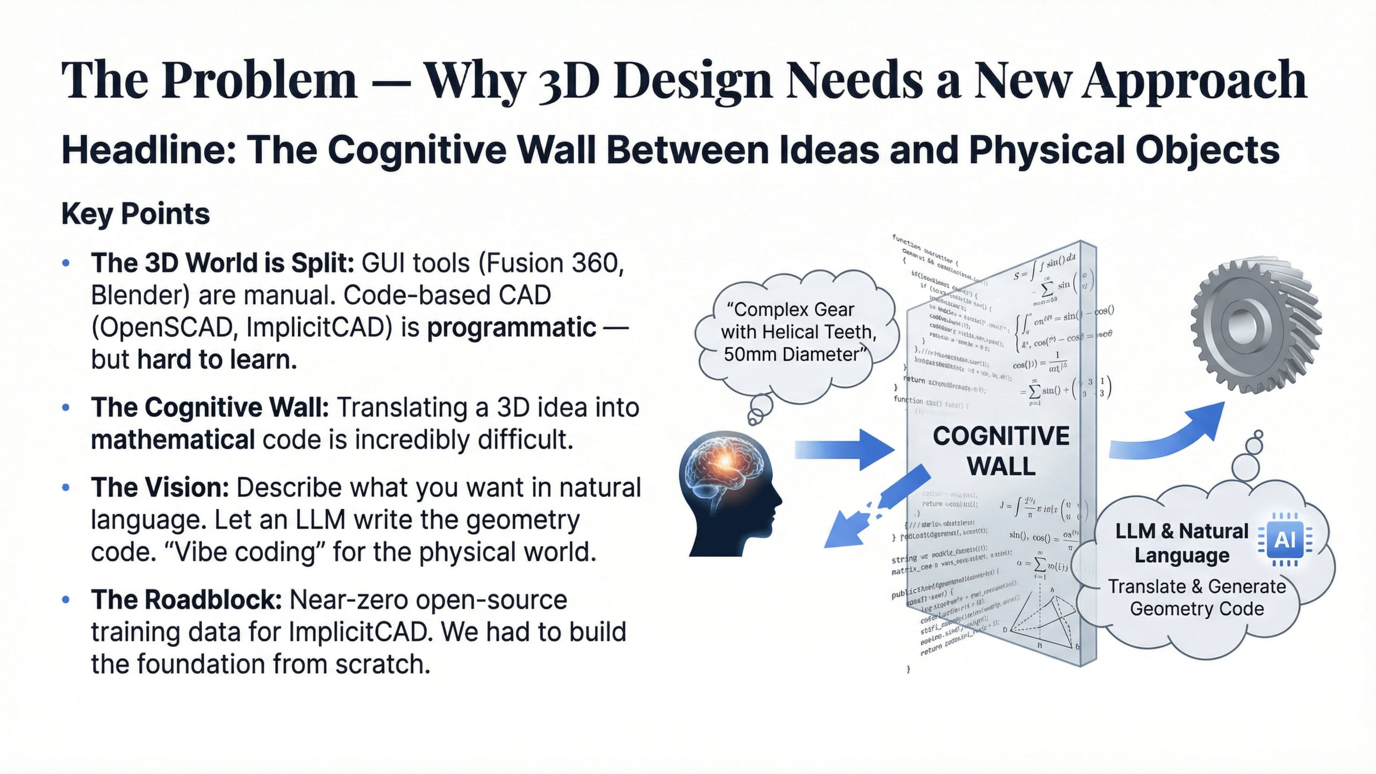
Notes:
So, why does 3D design need a new approach? The core issue is that traditional 3D modeling has a really high barrier to entry. Learning parametric CAD languages like ImplicitCAD is tough; it's like learning a new programming language with very little support. The ImplicitCAD community is tiny, which means almost no documentation, tutorials, or data for us to build on. This creates a vicious cycle: no users means no data, and no data means no models to attract new users. We actually had to build our entire dataset from scratch. This problem of inaccessibility is what we set out to solve, and we think we've found a powerful way forward. Let's look at what we built.

Slide 3
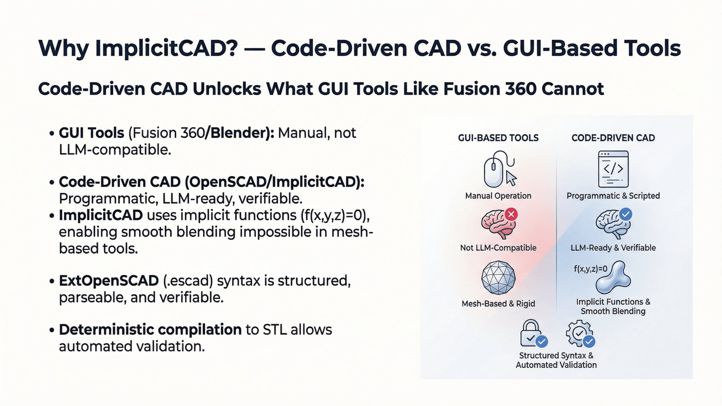
Notes:
We just outlined our solution, and a key part of that was choosing ImplicitCAD. So, why ImplicitCAD? It offers programmatic precision that traditional CAD tools simply can't match. Unlike mesh-based tools, ImplicitCAD defines geometry through mathematical expressions, making designs inherently precise and easily composable. Its SCAD-compatible syntax is human-readable, which makes it an ideal target language for an LLM. Plus, the compilation from SCAD to STL is deterministic, allowing for the systematic evaluation and validation that machine learning workflows require. This code-driven approach is a natural fit for language model output. Now, let's see how all these pieces fit together in our system pipeline.

Slide 4
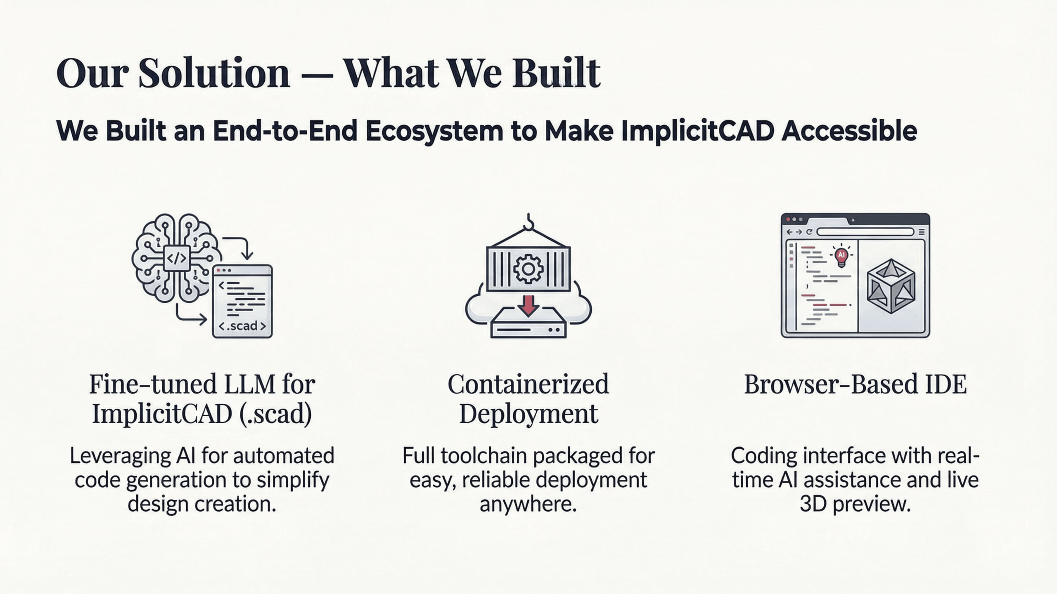
Notes:
We just talked about the problem of inaccessible 3D design, and our solution is an end-to-end ecosystem designed to make ImplicitCAD accessible to everyone. We built three interconnected contributions that form the backbone of this system. First, we fine-tuned a large language model to generate valid ImplicitCAD code directly from natural language prompts. Second, we containerized the entire ImplicitCAD toolchain into a Docker image, so anyone can get started with a single script. And third, we developed a VS Code-like web frontend with a live 3D preview and an integrated local AI assistant. This means users can write, test, and iterate on 3D designs all in one place. Now, you might be wondering, why did we choose ImplicitCAD specifically? Let's explore that.

Slide 5
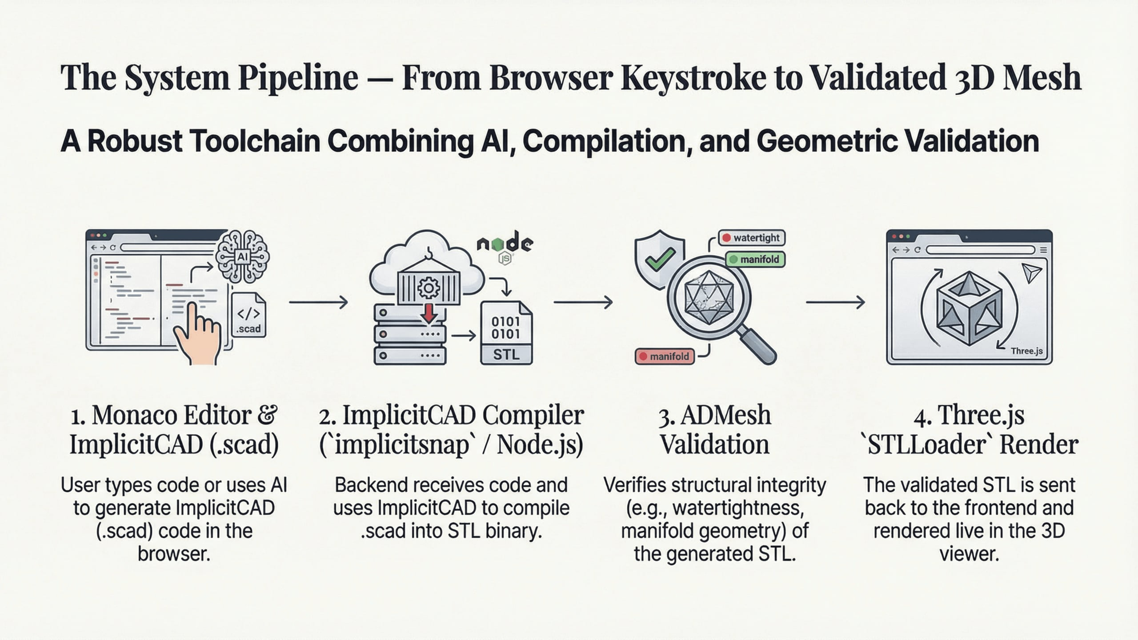
Notes:
We've discussed why ImplicitCAD is such a powerful choice, and now we'll look at how we turn natural language into a validated 3D object. Our system uses a five-stage pipeline to convert a user's prompt into validated 3D geometry. It starts with your natural language prompt, which then goes through input validation. The fine-tuned LLM generates candidate SCAD code, which ImplicitCAD compiles into an STL mesh. Then, a robust validation pipeline checks for mesh integrity, spatial constraints, and geometric relationships. If everything checks out, you get a validated 3D model; otherwise, you receive a detailed error report. This pipeline ensures correctness emerges from the system's interaction, not just the model's output. Next, we'll talk about how we made this entire system easy to set up.

Slide 6
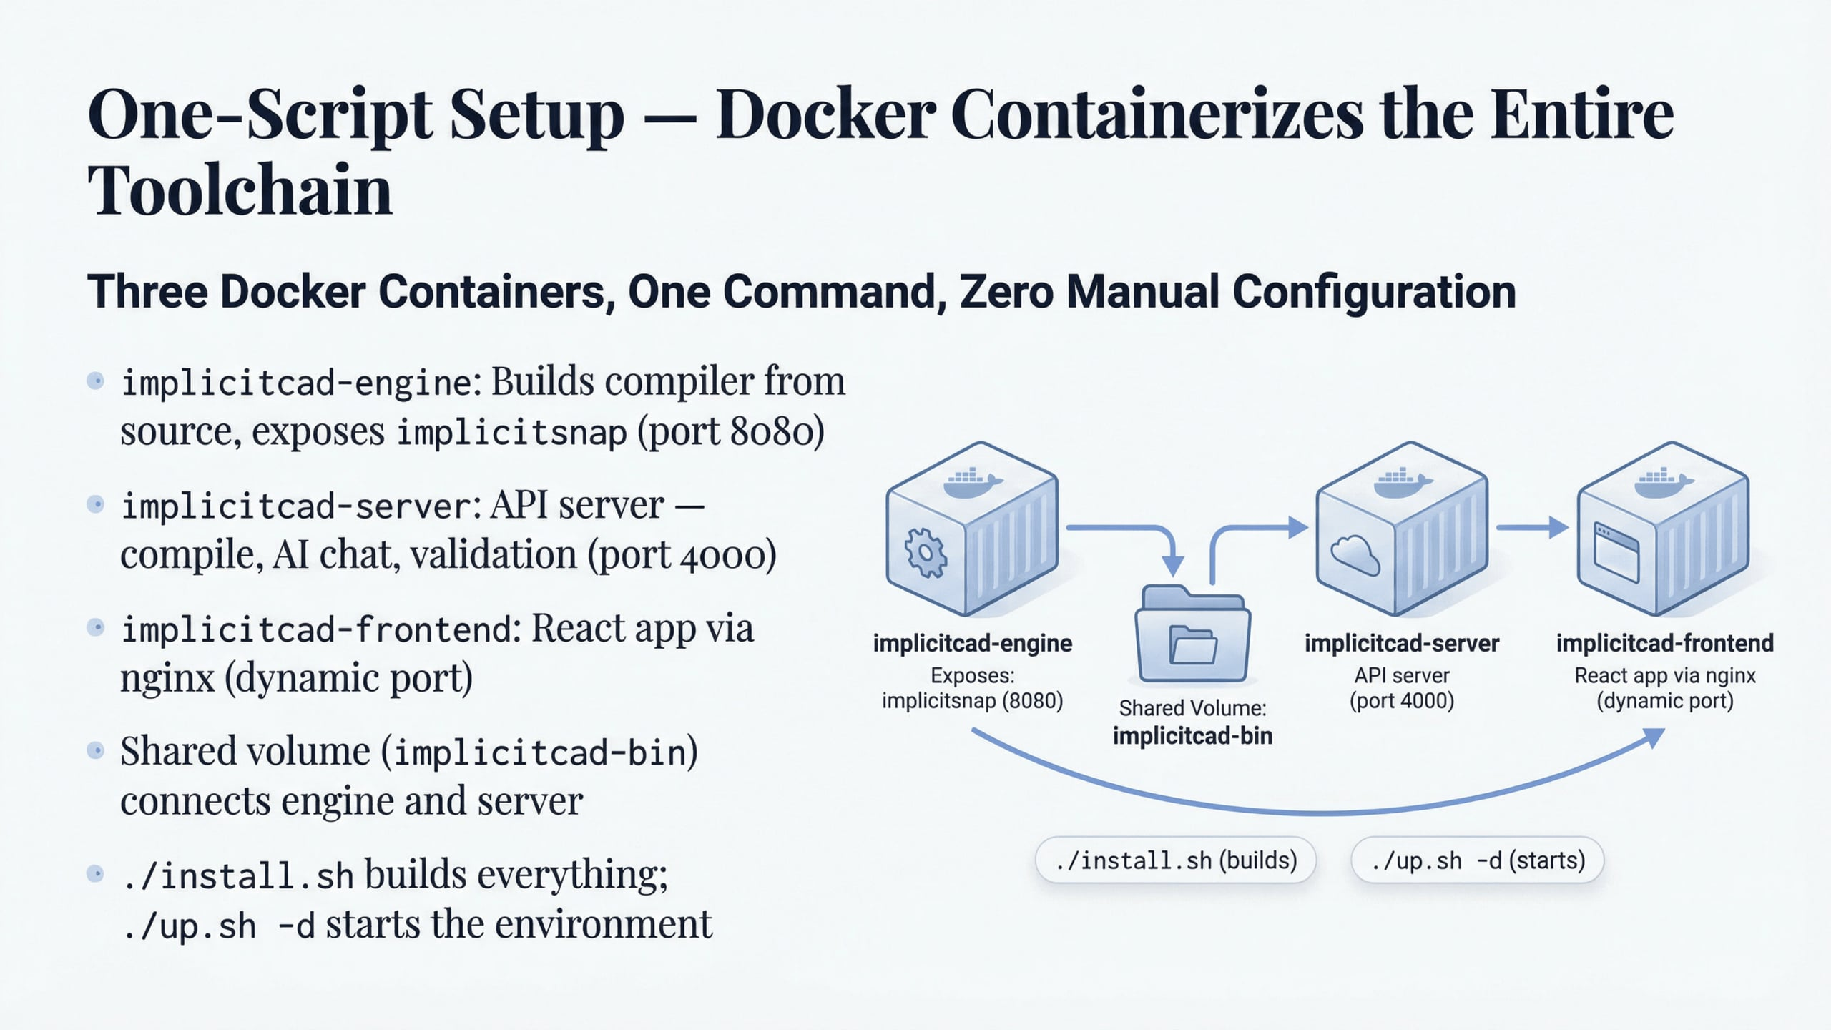
Notes:
After discussing the pipeline, let's talk about how we made it easy to use. We realized that setting up ImplicitCAD was a huge hurdle for new users. So, we tackled this by packaging everything into a single Docker container. This means you can get the entire ImplicitCAD environment up and running with just one script. We included the compiler, validation tools, and all dependencies, ensuring everyone starts with a consistent setup. This approach removes all the usual installation headaches, making it truly accessible. Now that we've made the backend accessible, let's look at the user-facing part: our custom IDE.

Slide 7
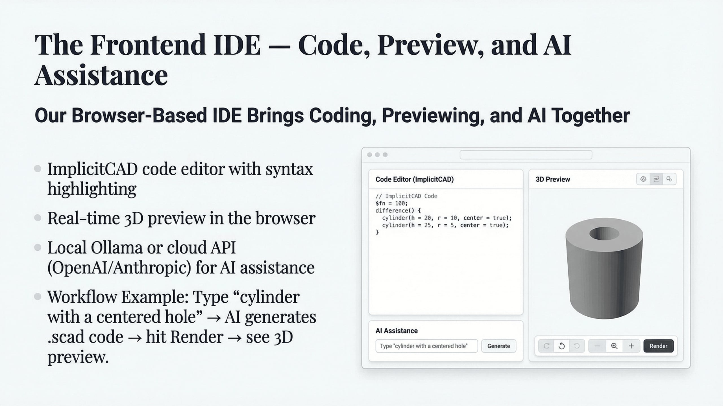
Notes:
Building on that accessible backend, we then focused on the user experience. We created a browser-based IDE that brings everything together in one place. This IDE gives you a syntax-aware editor for ImplicitCAD code and a live 3D preview of your design. We also integrated an AI assistant, powered by a local Ollama server, to help with coding and debugging. It's designed to make learning and iterating on 3D designs much more intuitive. But for our AI to be effective, it needed data. So, let's talk about how we built our dataset.

Slide 8
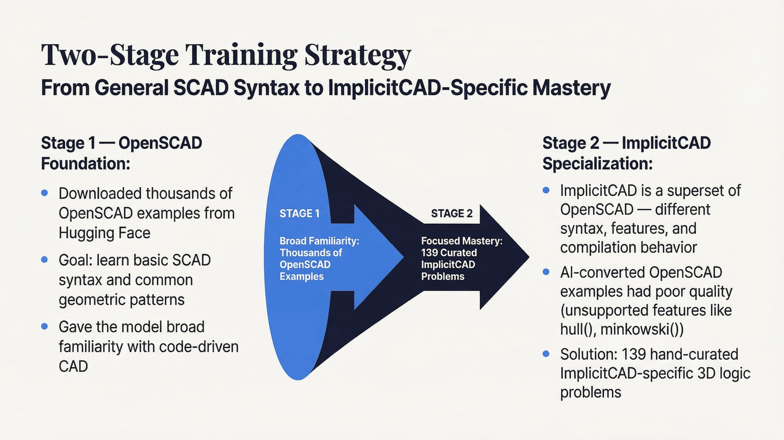

Slide 9
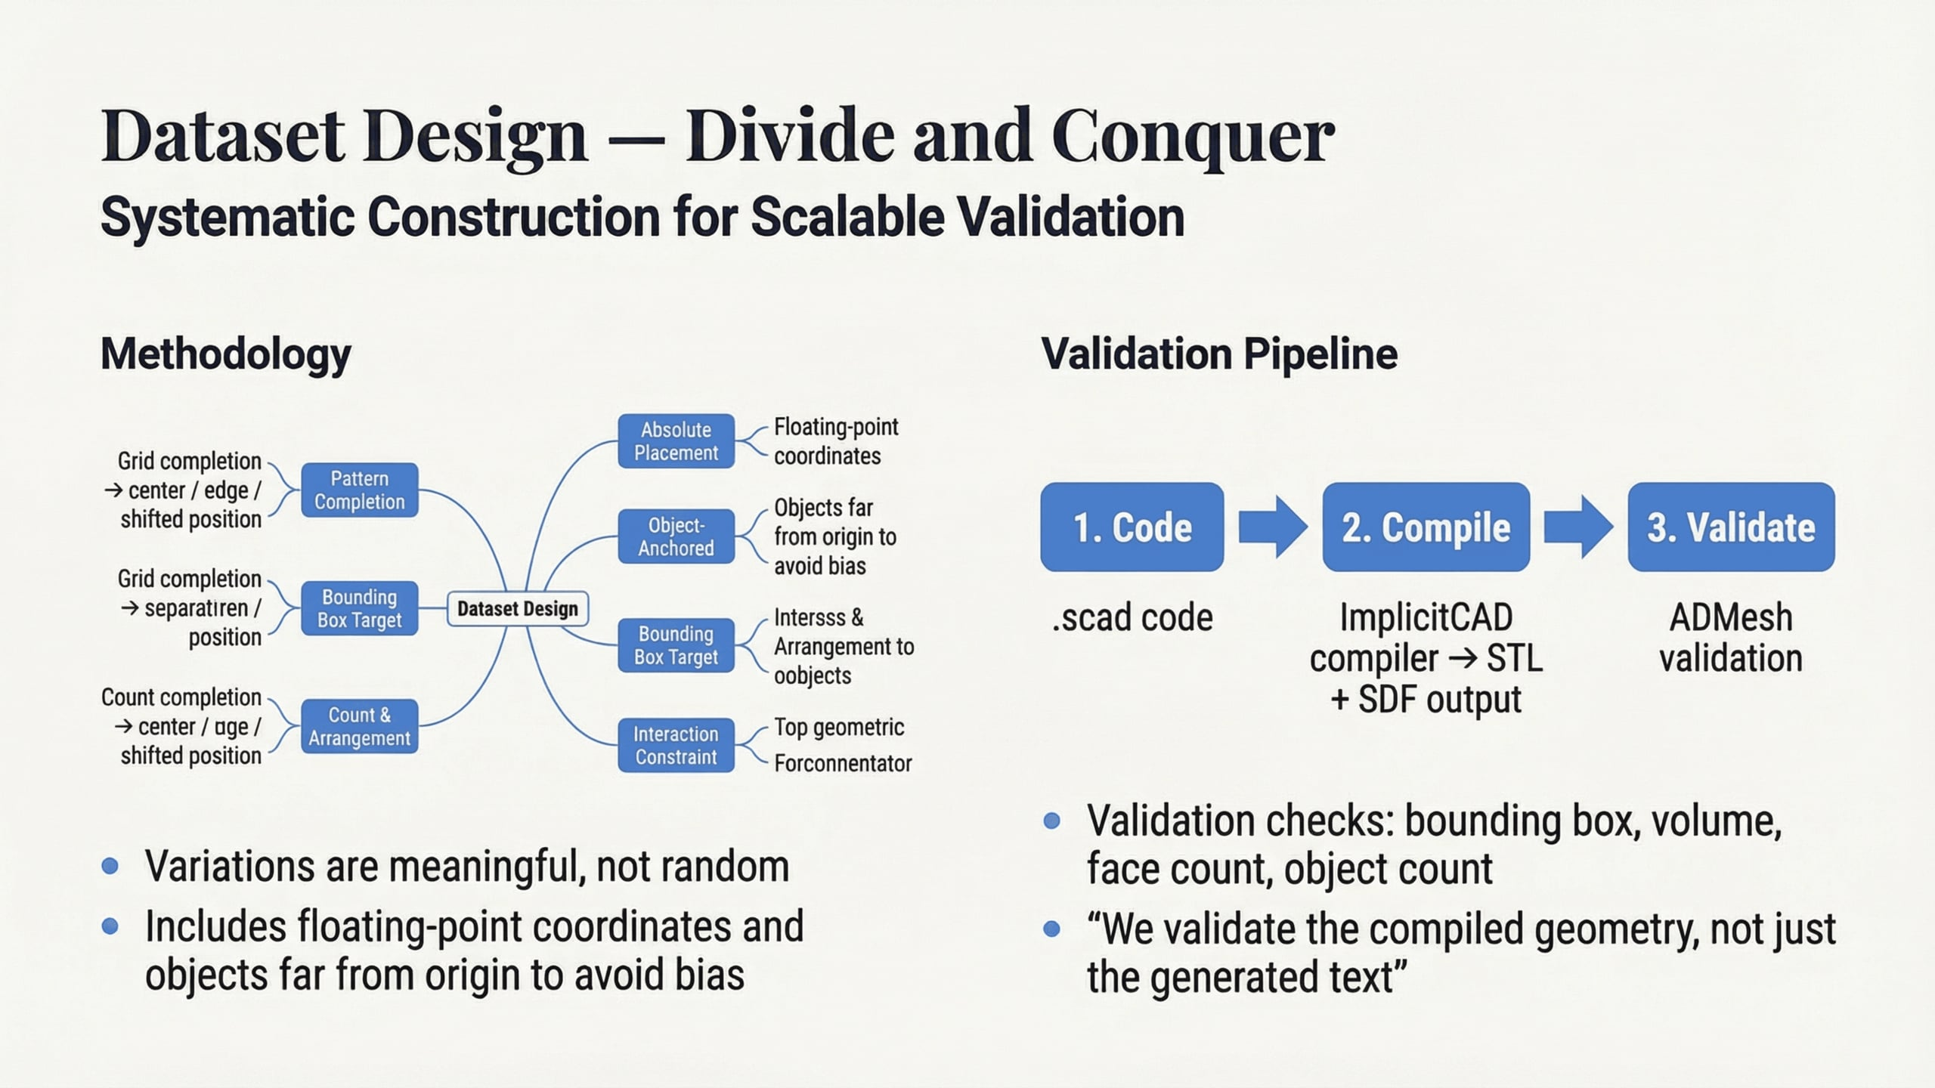

Slide 10
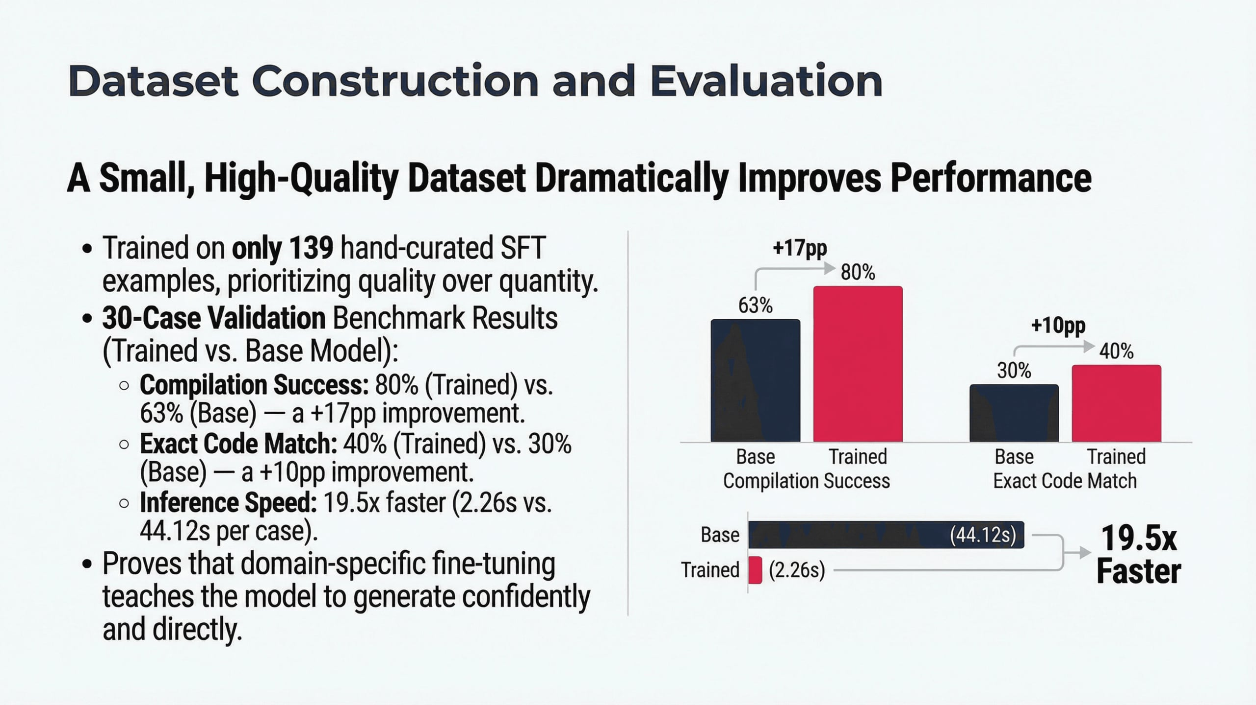
Notes:
We built our own paired dataset because none existed, which was a significant undertaking. Each example is a triplet: an ImplicitCAD program, a natural-language prompt for modification, and a human-verified target SCAD file. We evaluate model outputs across four key metrics. We measure compilation success rate, structural match using ADMesh statistics, geometric surface similarity, and human semantic scoring. This rigorous approach ensures we capture both technical correctness and user intent. Now, let's talk about the limitations of our system and what we learned.

Slide 11
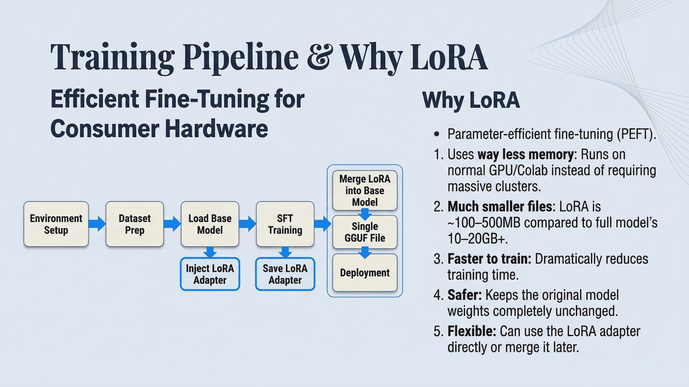

Slide 12
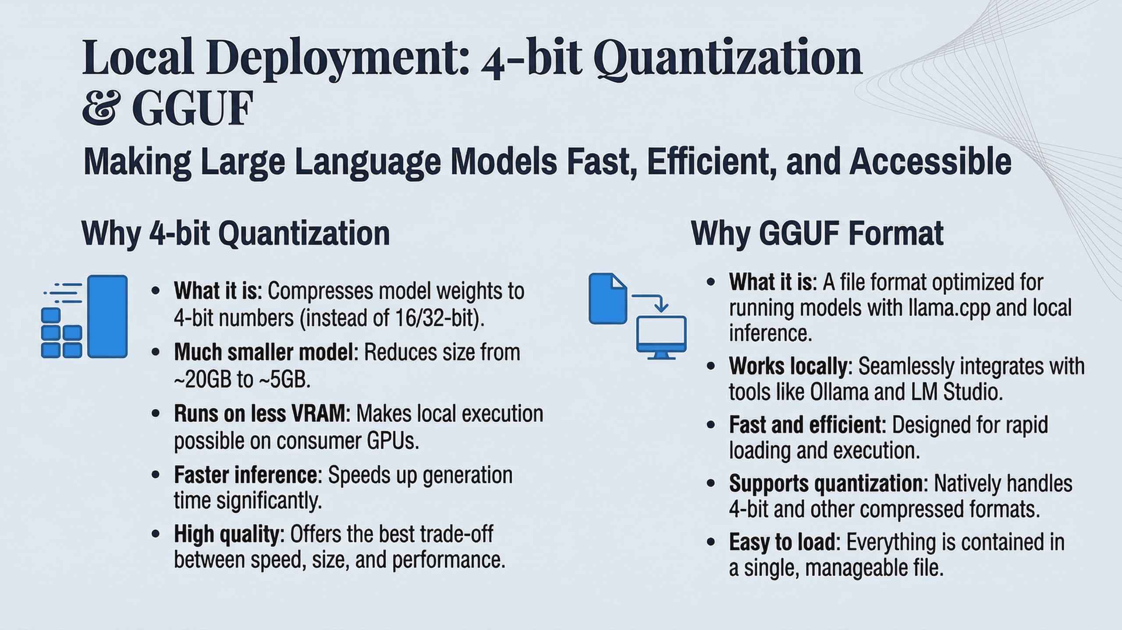

Slide 13
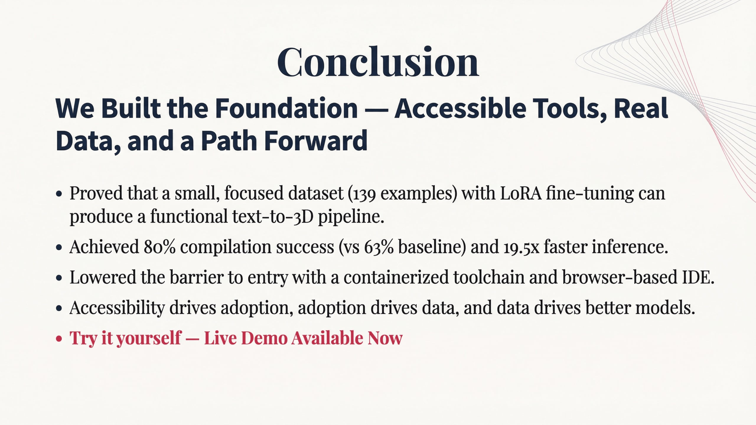
Notes:
Building on those limitations, our work this semester really lays the groundwork for future development. We've established a functional infrastructure and methodology for the next team. The Docker container, web IDE, Ollama integration, and evaluation pipeline are all ready to go. Future work includes expanding the dataset with more diverse geometric patterns and improving the model's handling of complex scenes. We also want to add interactive clarification, where the system asks follow-up questions. Ultimately, we aim to grow the ImplicitCAD community, generate more data, and improve the model in a virtuous cycle. This brings us to our conclusion.

Slide 14
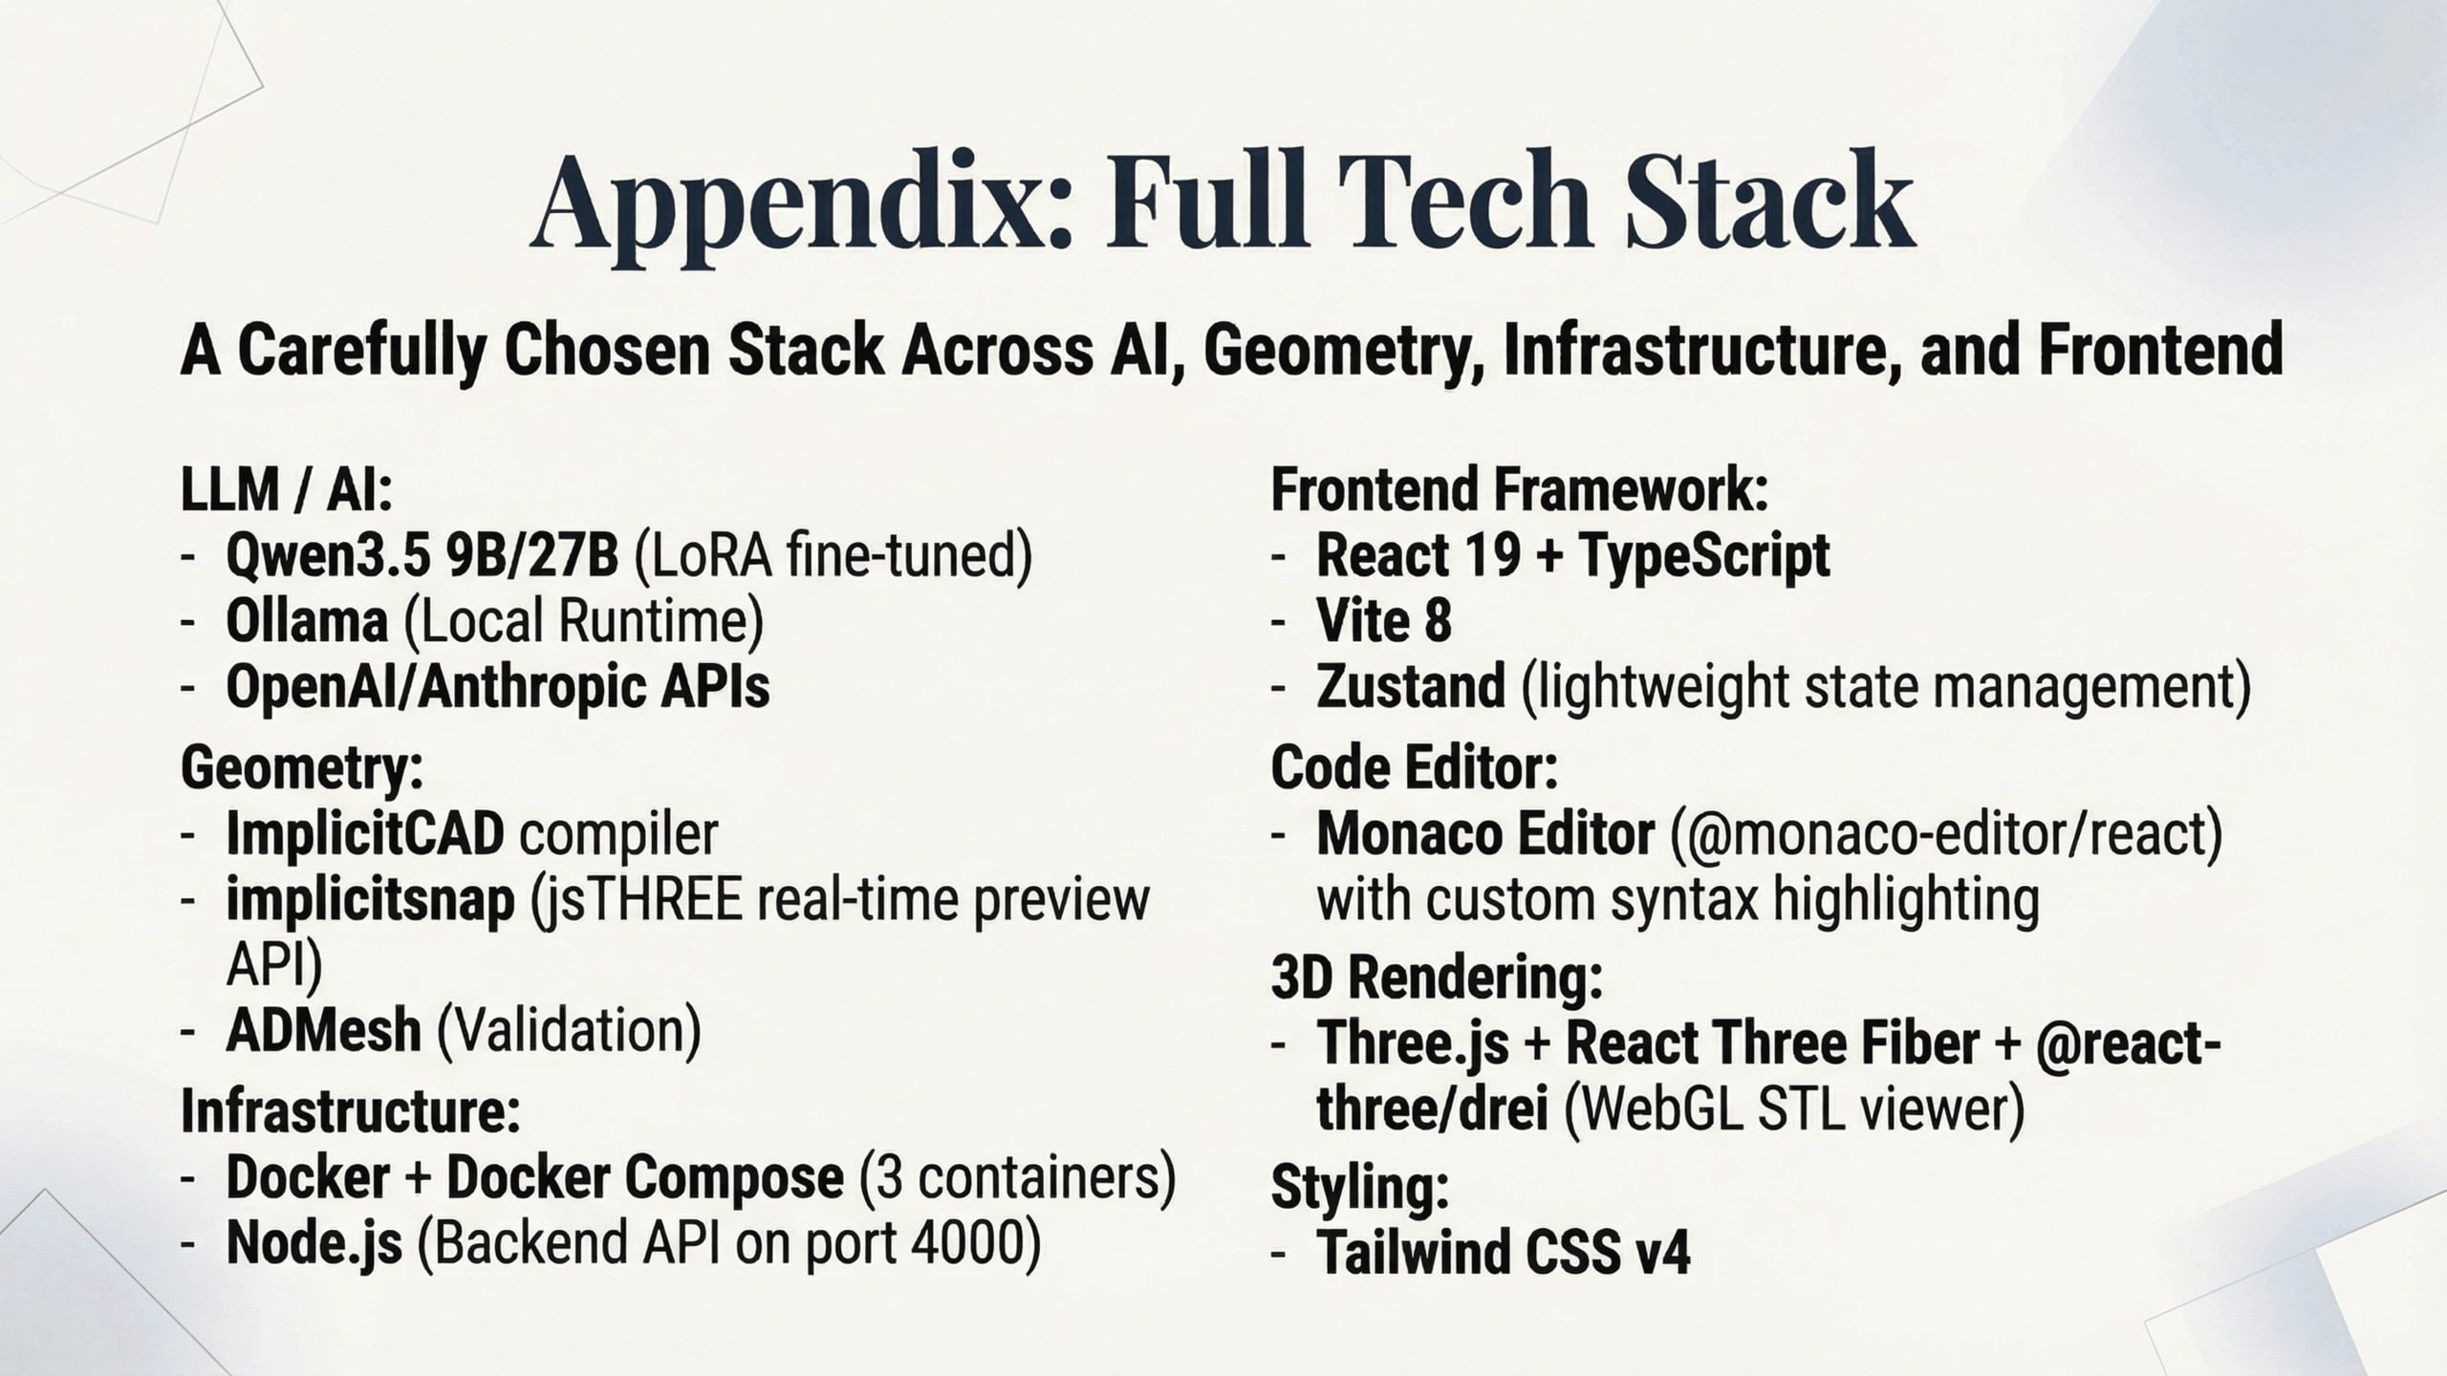
Notes:
This project integrates a diverse set of technologies, carefully chosen for their specific roles. Our tech stack combines modern AI with robust geometric tools. We use a fine-tuned LLM for SCAD code generation, with Ollama running locally for the AI assistant. ImplicitCAD handles the core geometry compilation, and ADMesh and Signed Distance Fields provide crucial validation. Docker ties it all together for easy deployment, and our custom web IDE provides the user interface. This combination ensures a powerful, yet accessible, platform for text-to-3D generation. Next, we'll discuss some of the limitations and ethical considerations we encountered.

