Slide 1
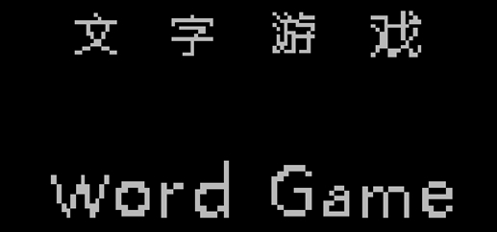
By: 王雨晨，张世翼，史顺天，刘泽华

Slide 2
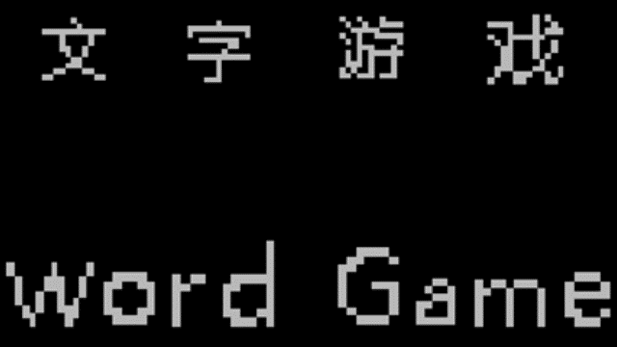
Demo

Slide 3
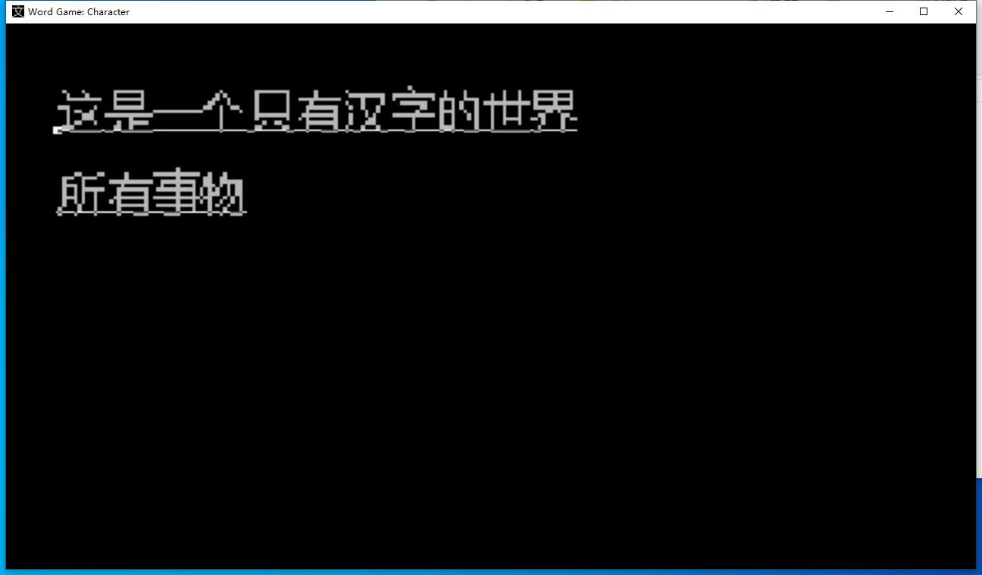
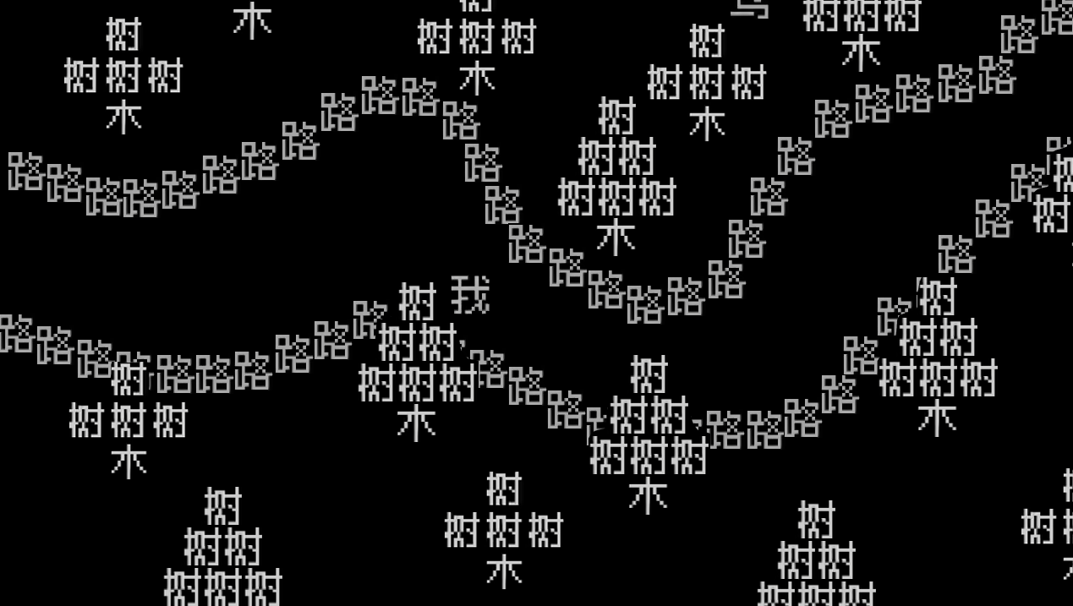
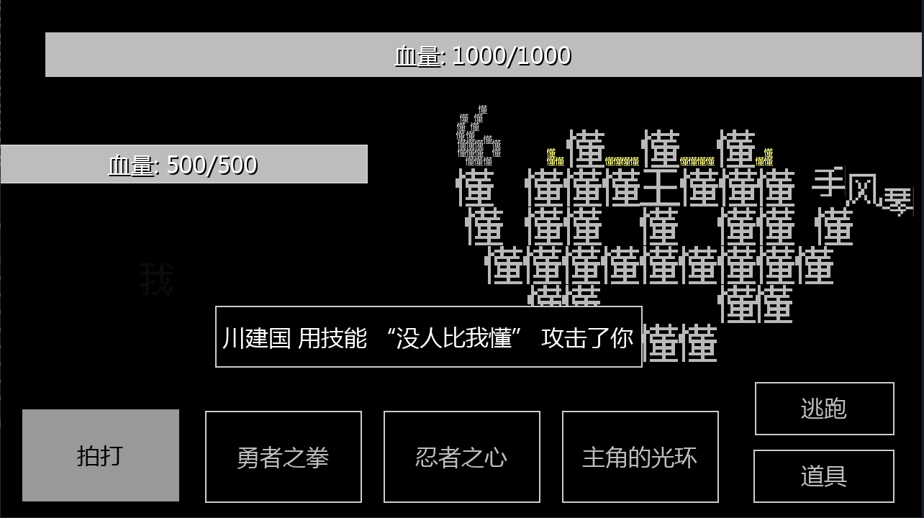
Demo

Slide 4
Introduction
1.1 Project overview
Our project is a web game, using a unique form of Chinese language, combined with an interesting storyline and a battle mode.
We hope that this game can bring players a novel game experience and make them feel the charm of Chinese characters, so that they are more willing to study Chinese character and culture.

Slide 5
Introduction
1.2 Objective
Our game will be developed with the help of Godot Engine. The system can be roughly divided into two parts, the frontend part with a friendly user interface which players can use and interact with the interface, and the backend part, where is the management of the database and many playing systems. Our goal is to provide a game with a clear player guide and kindly game experience.

Slide 6
Introduction 1.3 System Features
Our system mainly composed 5 parts
Combat
Login
System
Map
Skill
item

Slide 7
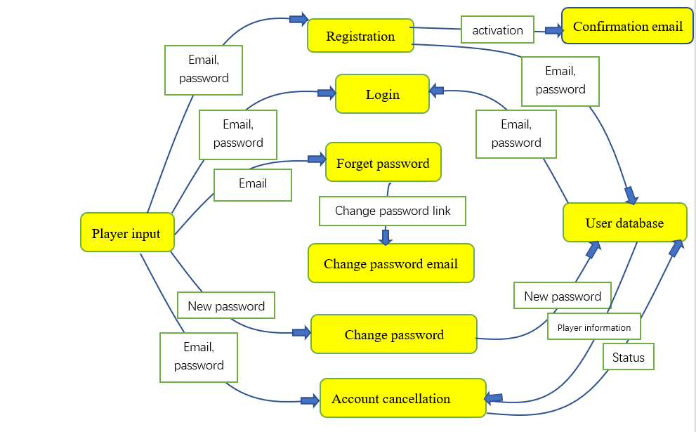
2. Specification
The most important system is Login system.
DFD:

Slide 8
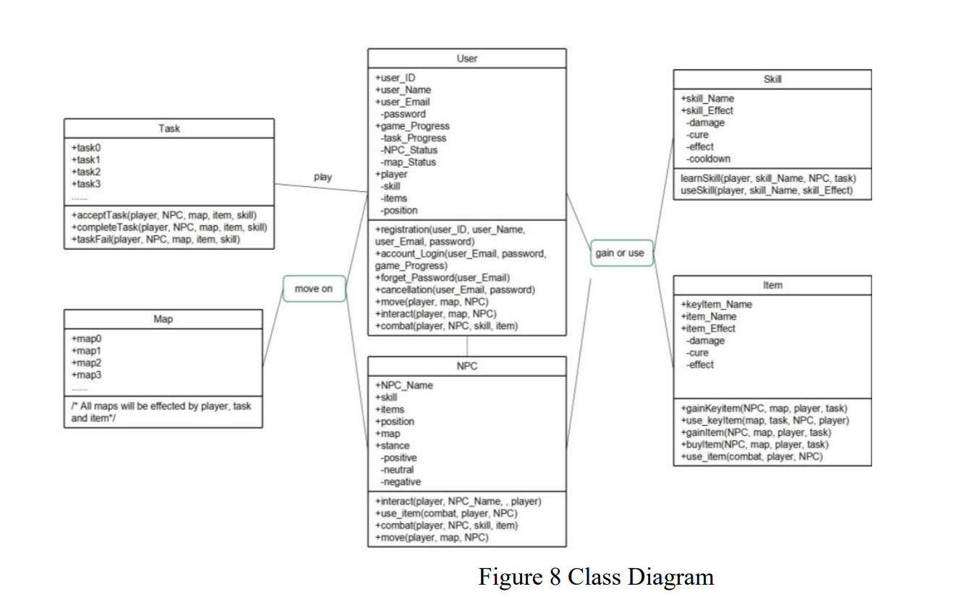
UML diagram Group28 Project Description Document.pdf

Slide 9
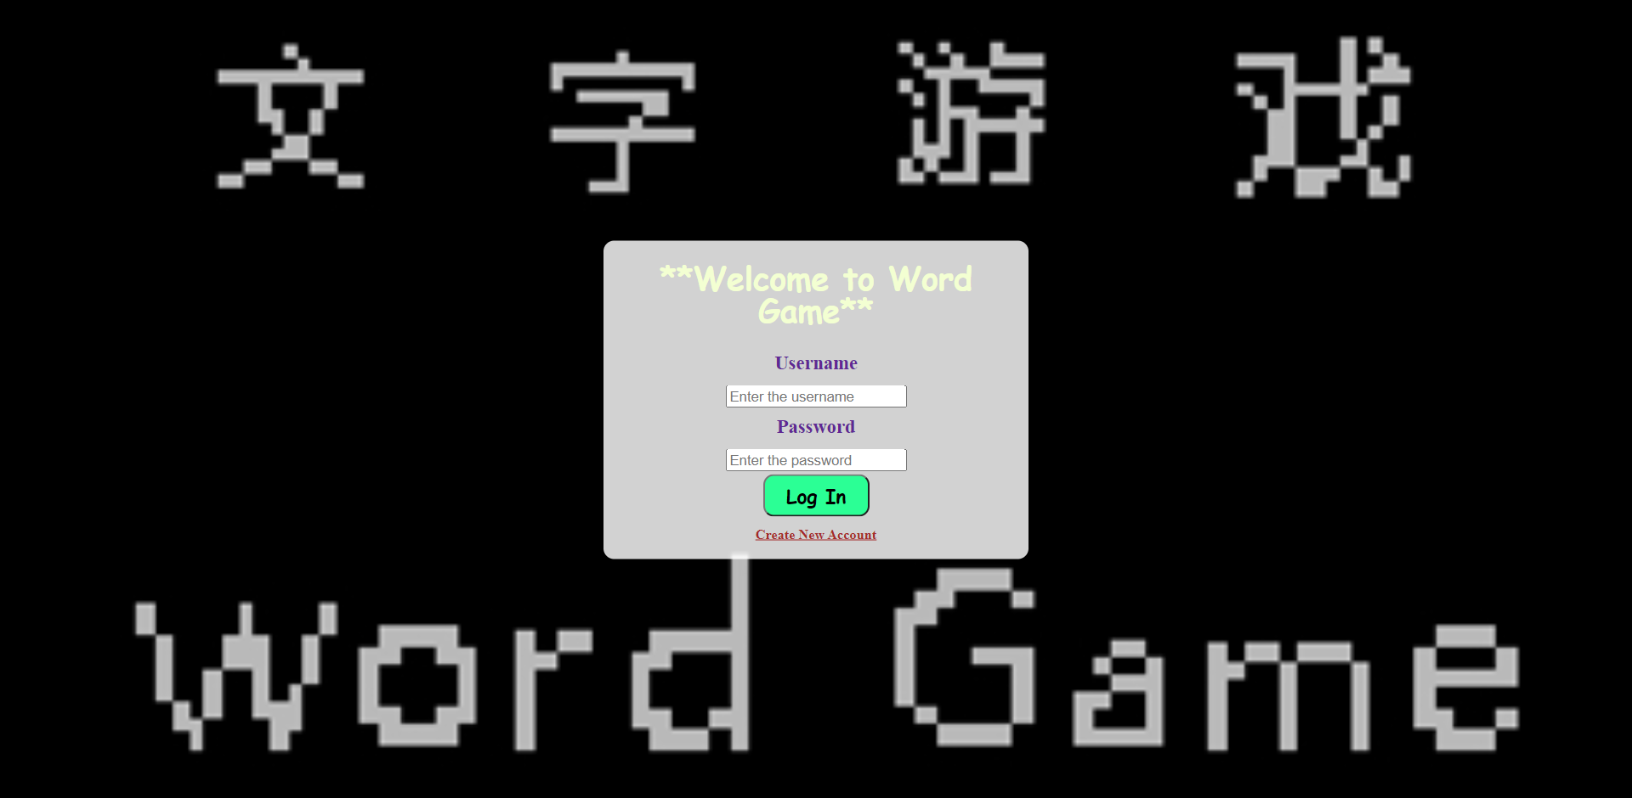
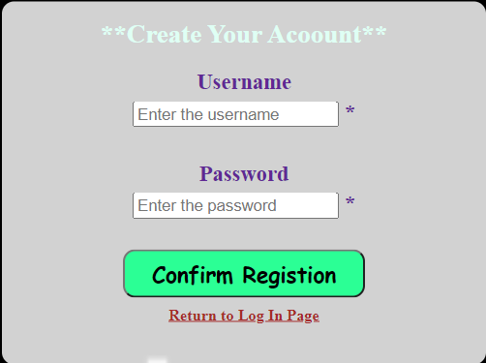
Login and register
This function requires a database to store the input information from the users. Players account can be freely registered.

Slide 10
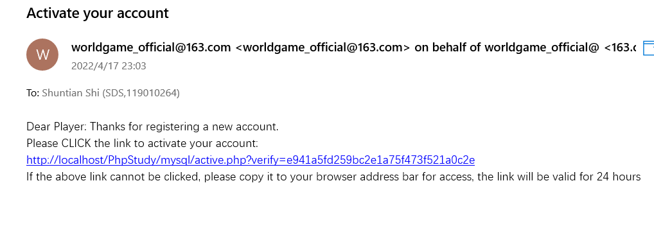
Login and register
During email verification, player need to input his email address then we will send back an email for verification. The email should be sent automatically to new players in order to do confirmation of the registration process.

Slide 11
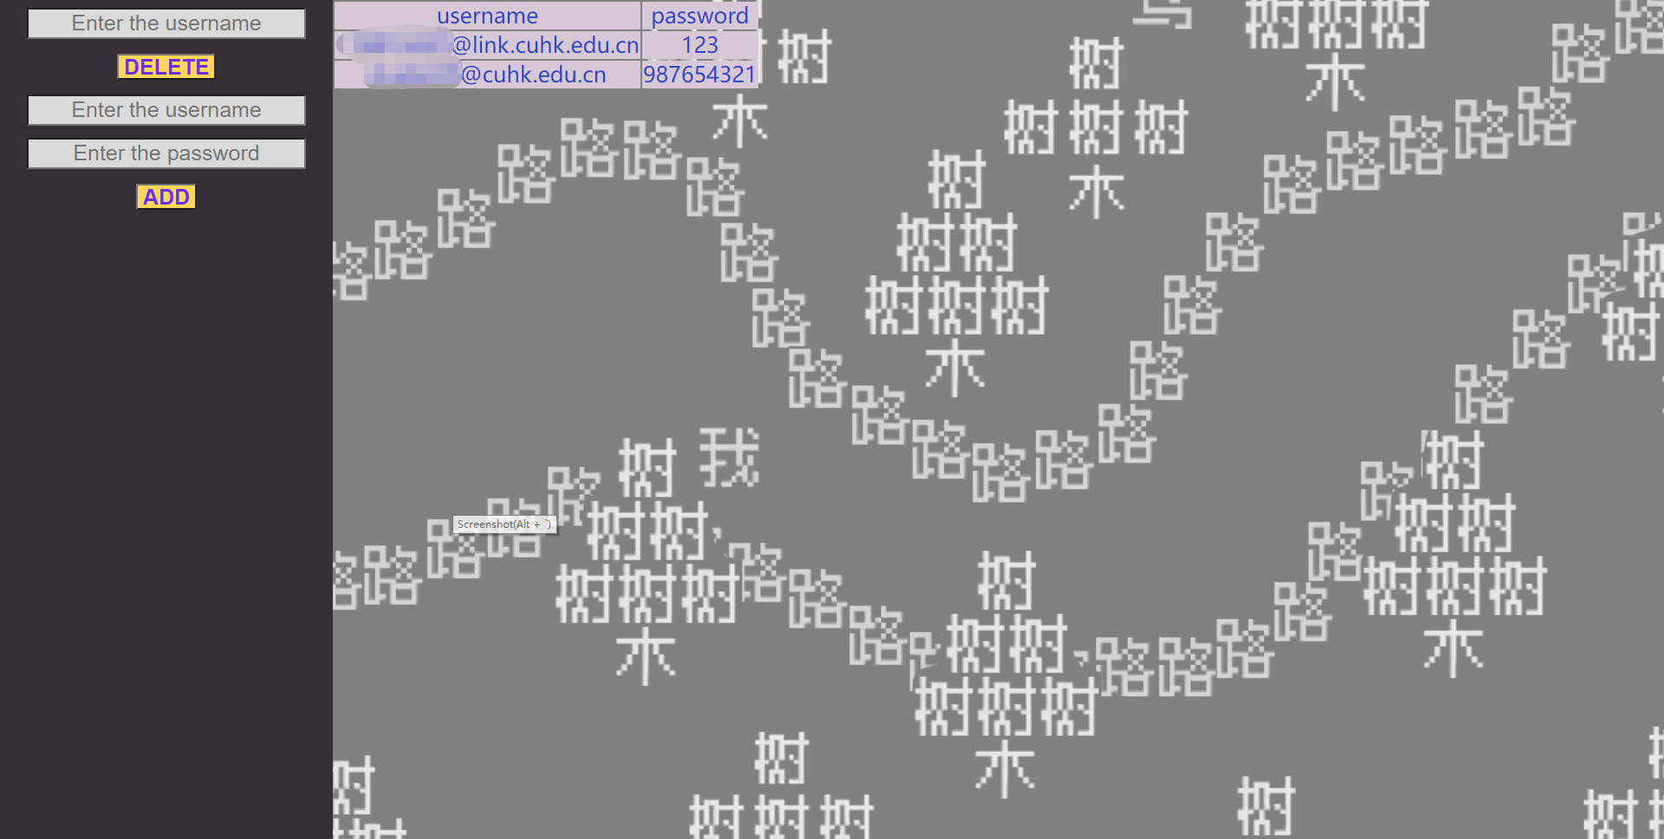
Login and register
Control database by admin

Slide 12
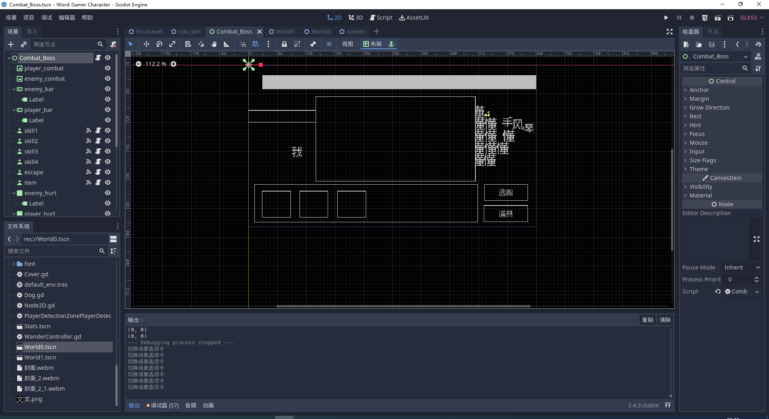
Combat system

Slide 13
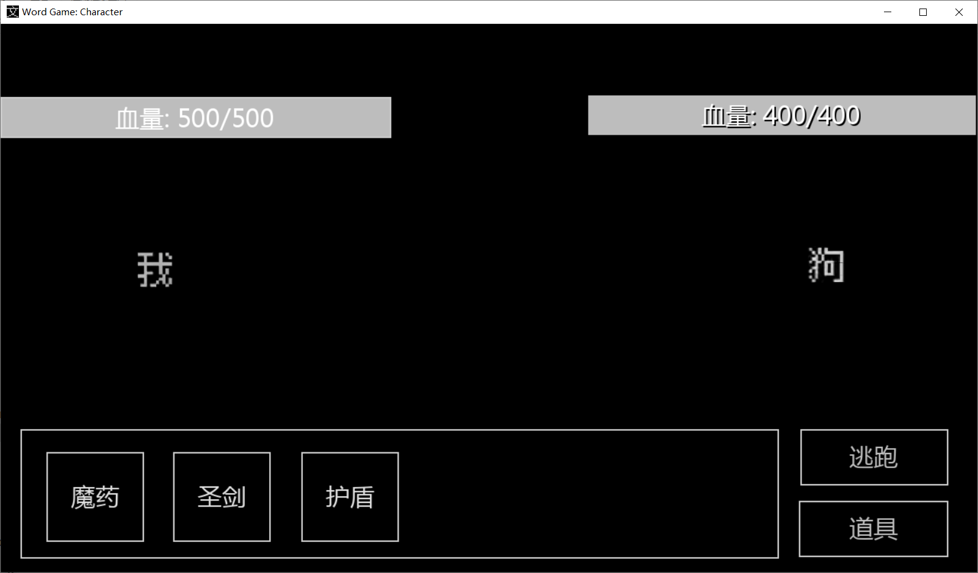
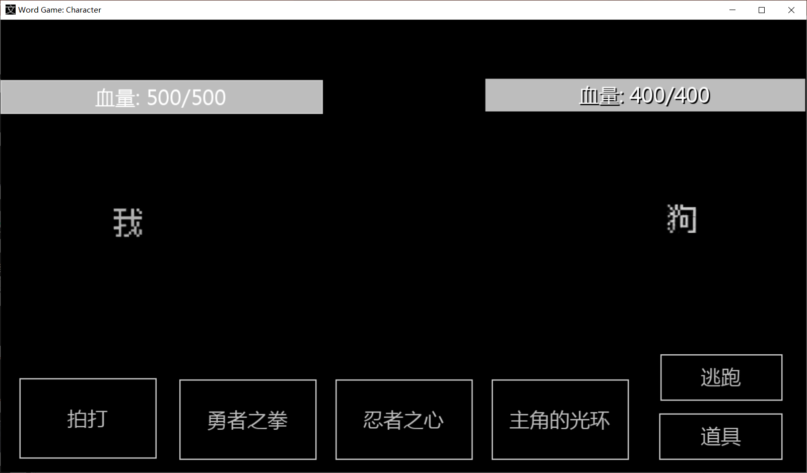
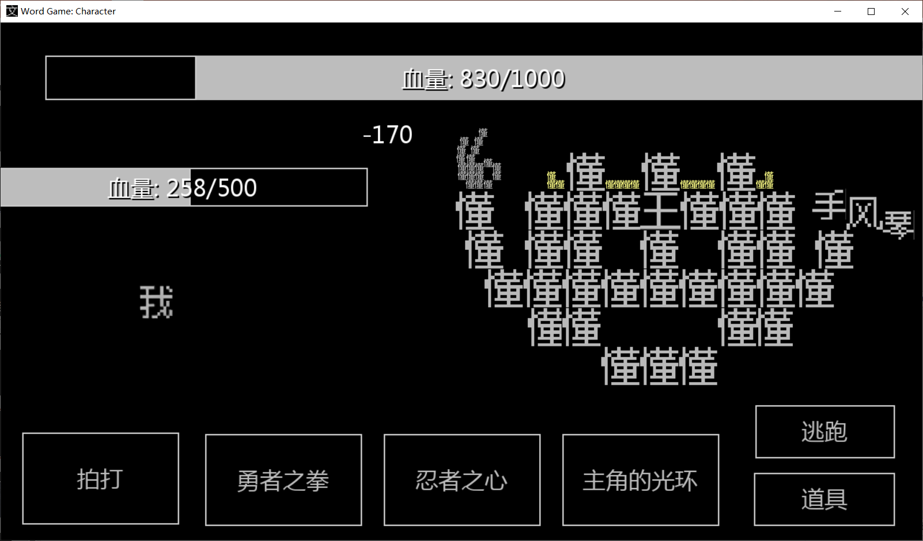
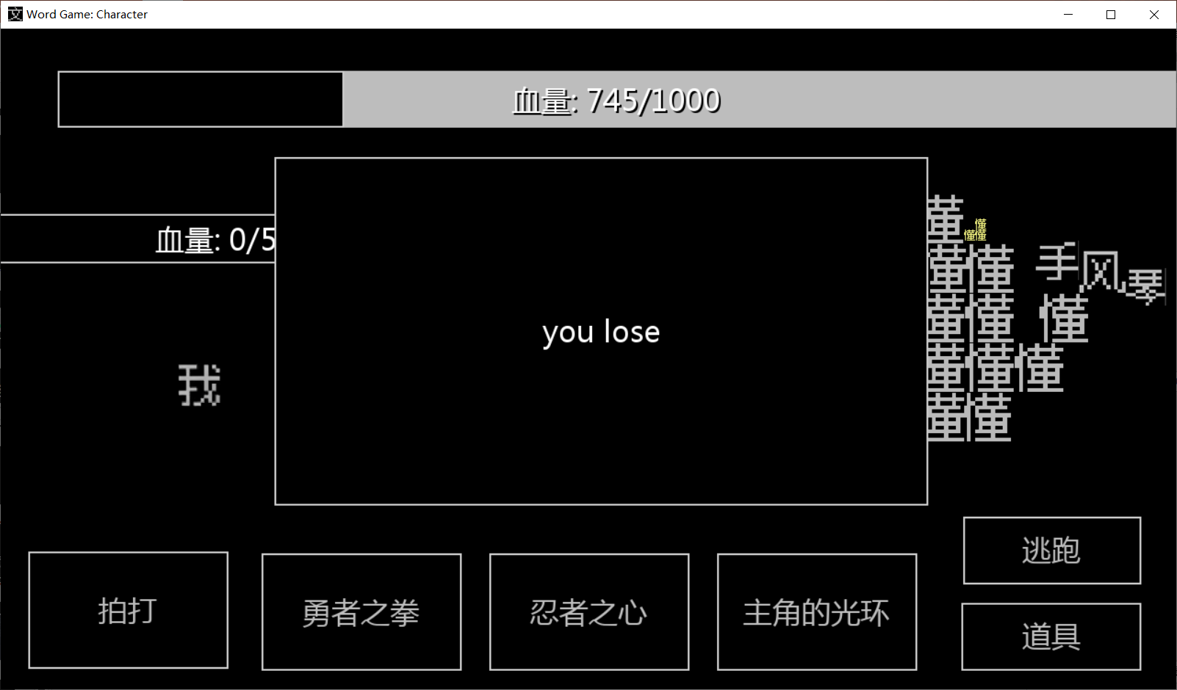
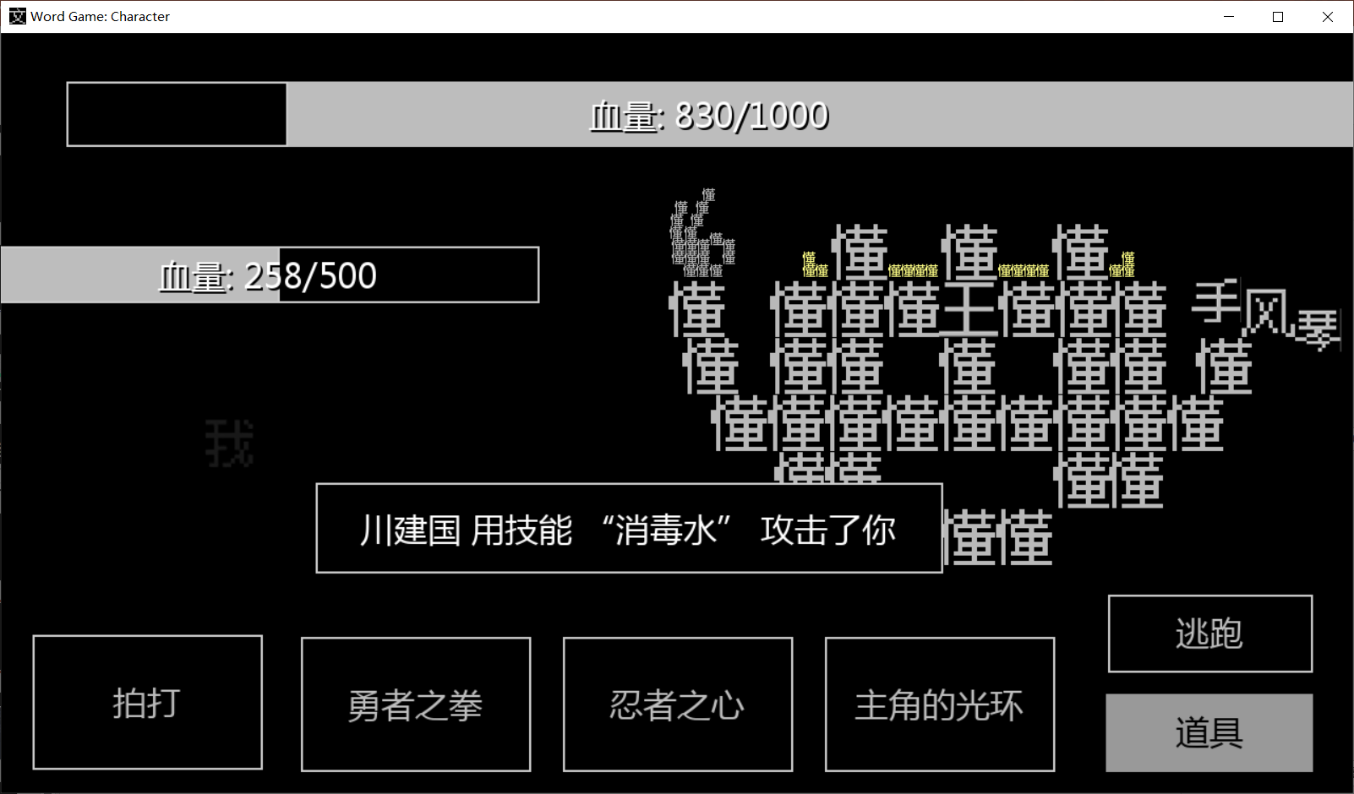
Combat system
item
skill
attack
suffer
dead

Slide 14
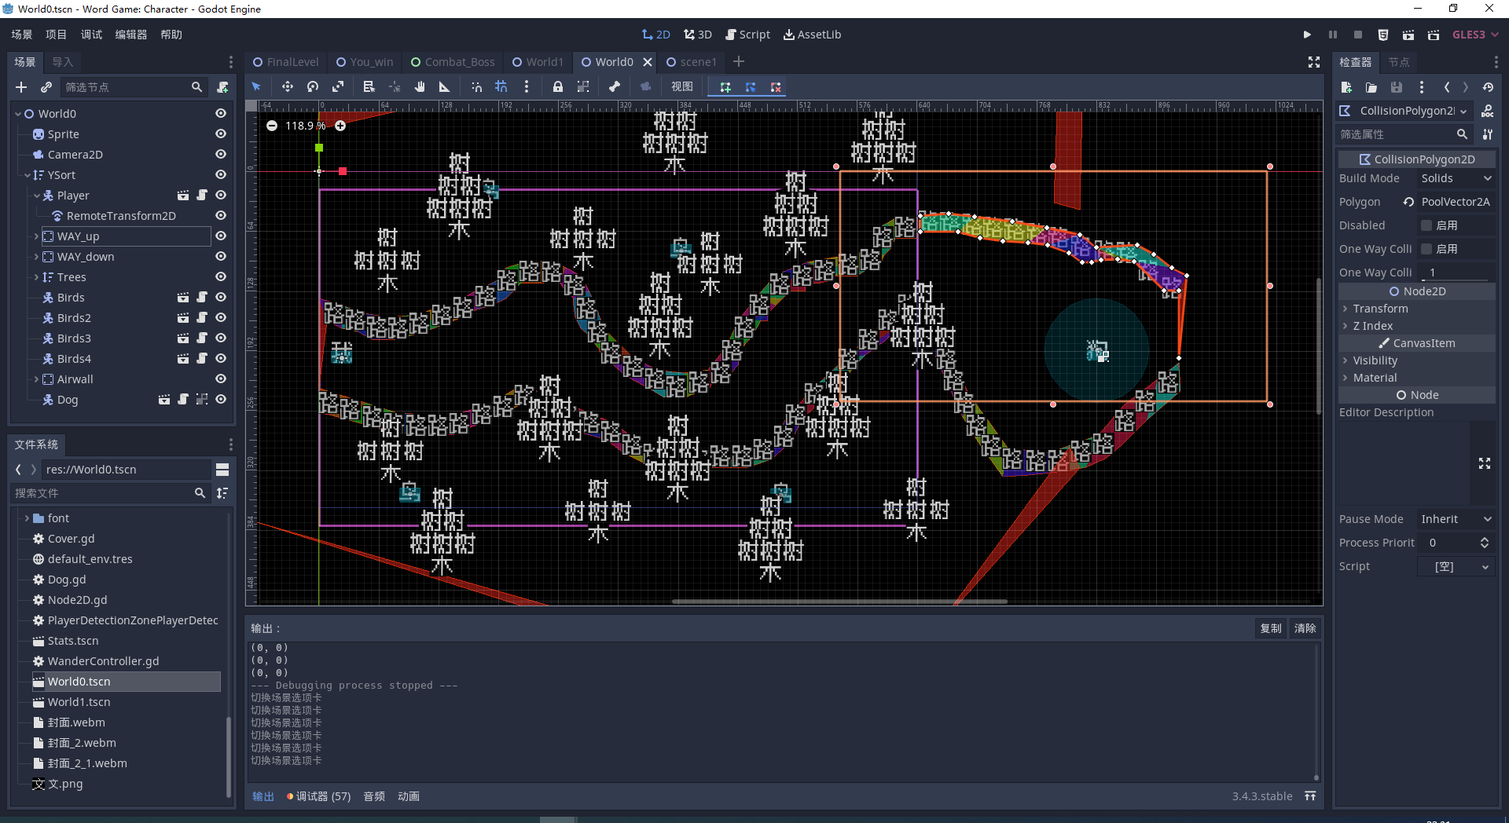
Map system

Slide 15
3. Test Cases
We design some Black-box Testing, especially in the combat and map system.

Slide 16
Thanks for listening

