Slide 1
Team 1 - Attend-In
Presentation 2
Alenka Tang, Justin Simard, Tinni Dhar, Vincent Kim

Slide 2
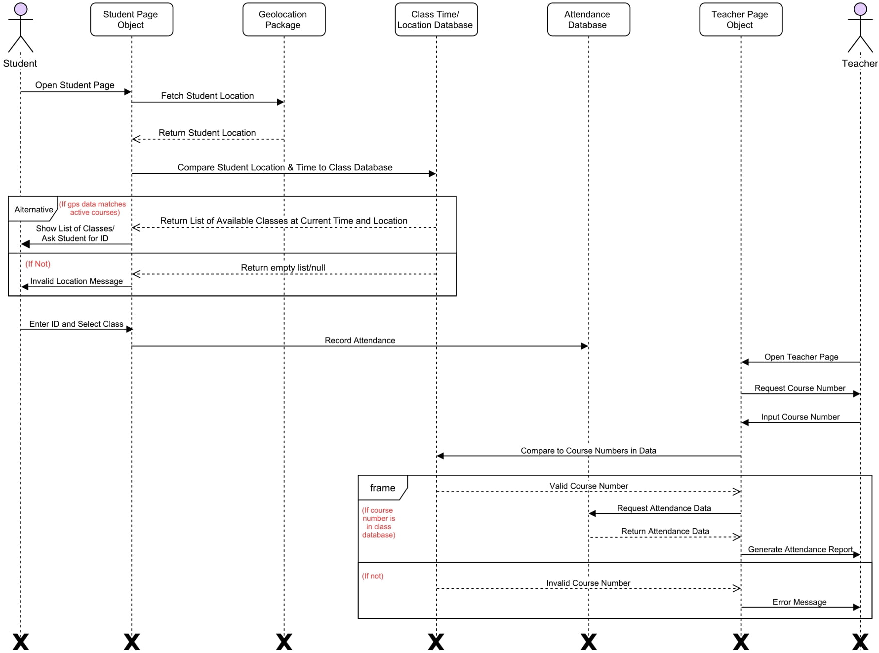
UML

Slide 3
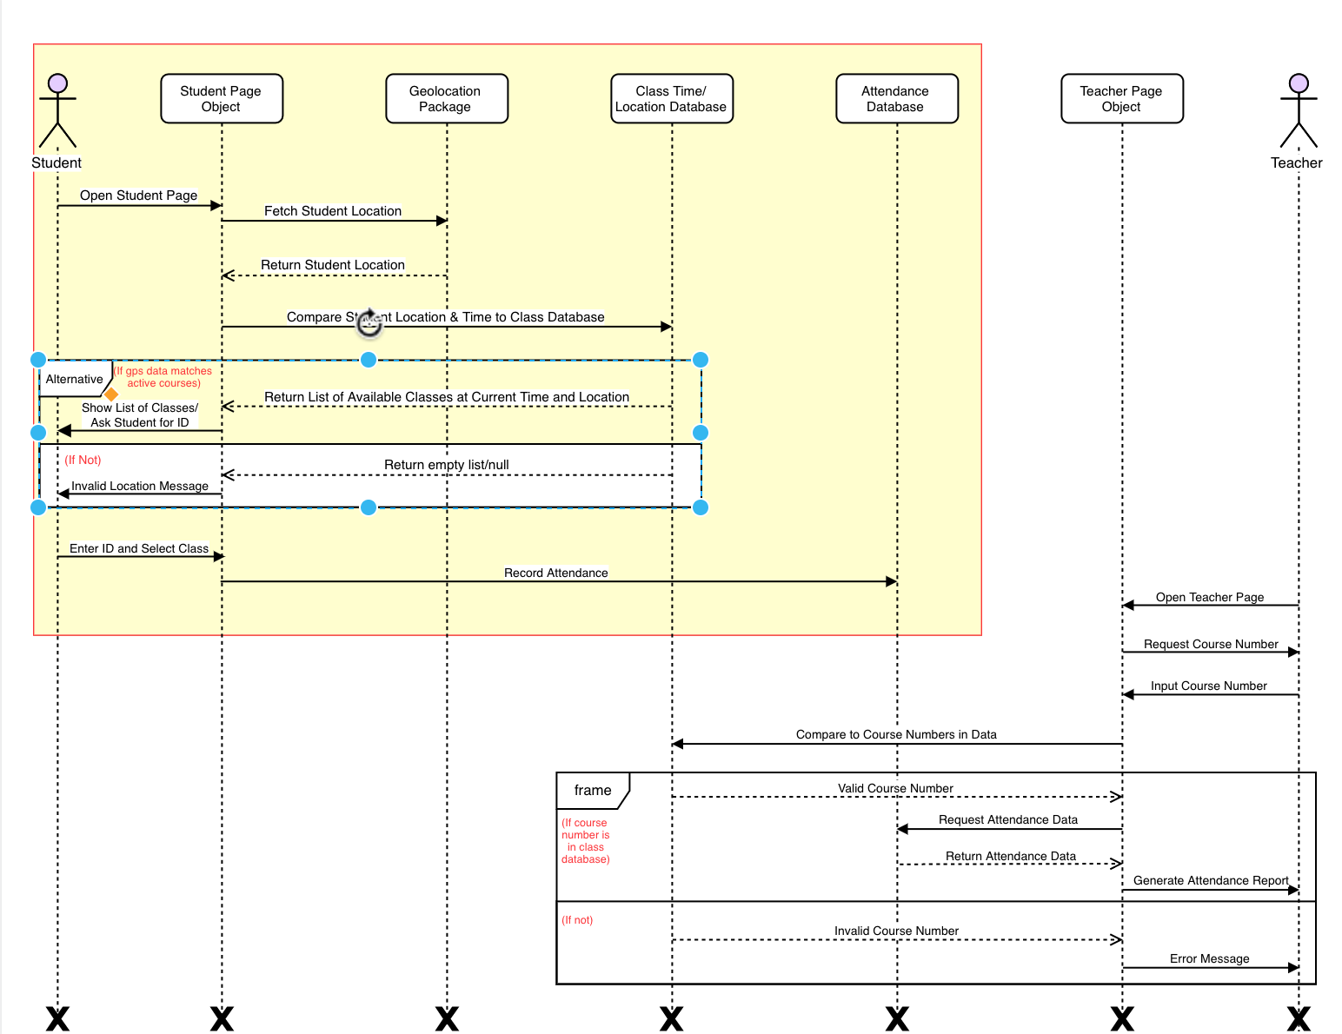
Student Side

Slide 4
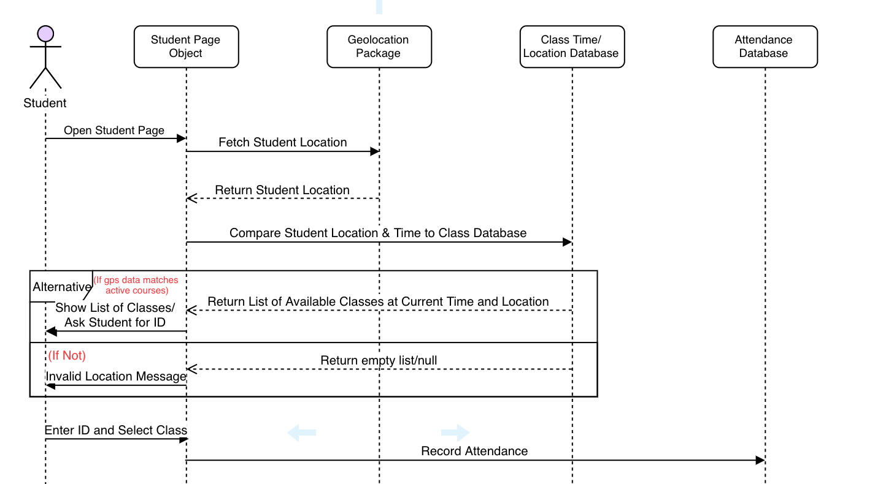

Slide 5
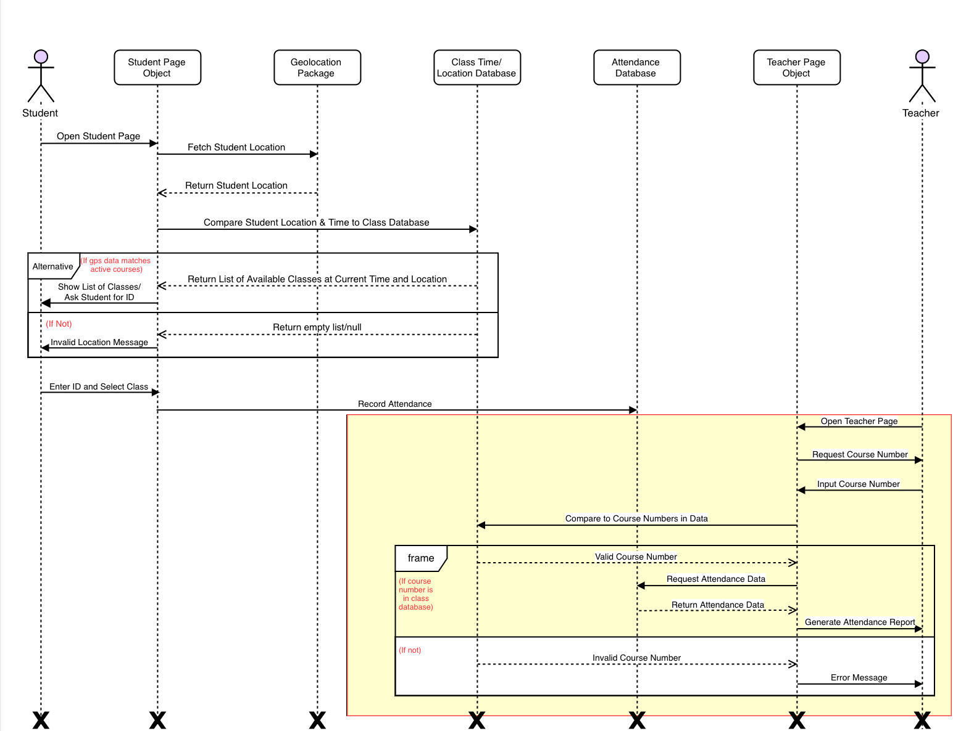
Teacher Side

Slide 6
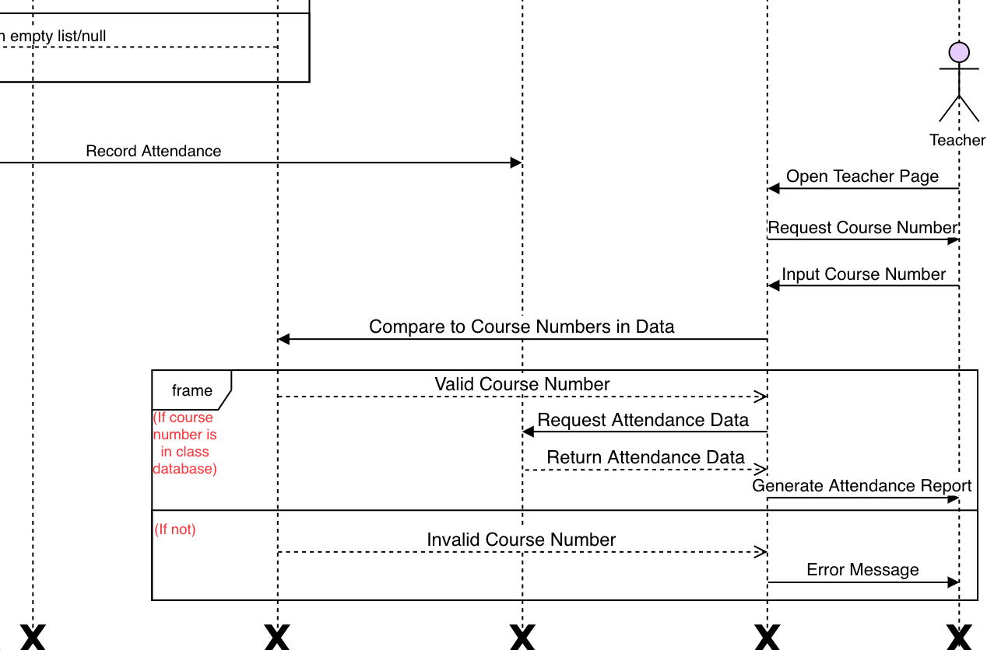

Slide 7
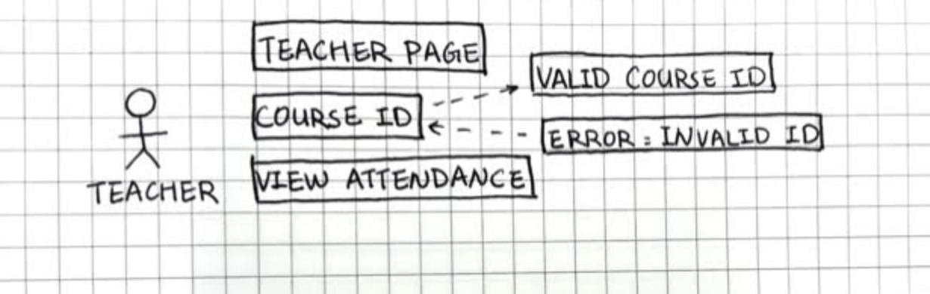
Teacher Use Case

Slide 8
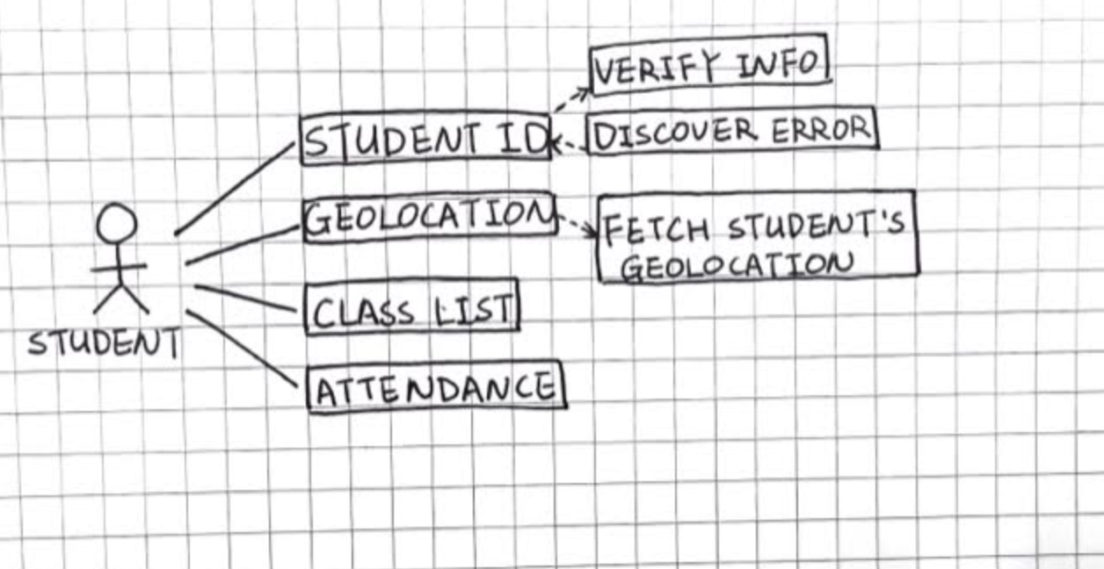
Student Use Case

Slide 9
Test Case 1
Match the student’s GPS location to the classroom location for the classes that are in session.
Shows a list of classes that are currently in session within a certain radius of the student’s GPS location.
Classes that does not match the GPS location or currently in session will not be shown.

Slide 10
Test Case 2
Professor checking for attendance base on the CRN number
The student’s attendance information are recorded to the database.
The professor enter the course CRN number for attendance query and the system returns a list of student IDs of the students that had checked-in for the class.

