Slide 1
Attend-In
Justin Simard, Vincent Kim, Tinni Dhar, Alenka Tang

Slide 2
Purpose of the Software
Record students’ attendance for a class only when the time and location match.
Allow professor to query attendance information by simply enter the CRN of the class.

Slide 3
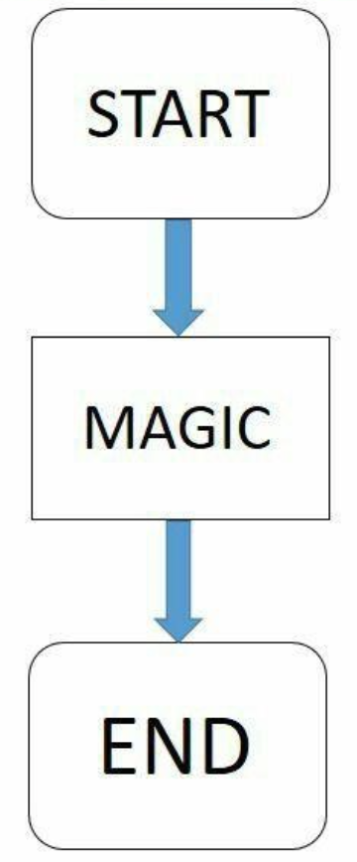
How does this work…

Slide 4
Functional Requirements
Matching student’s current GPS location to class location
Showing list of classes available for students to submit for attendance
Record students’ attendance information
Matching CRN number in the class database
Showing attendance record of the class

Slide 5
Non-Functional Requirements
Device that has wifi and GPS features
Database Access: accessing the list of classes for matching
Storing data: student’s attendance
Environment and Language: Android Studio, Kotlin, Java
Google Play Service: compatible Android device that runs Android 4.4 or higher and has Google Play Store app installed.

Slide 6
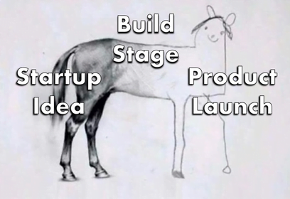
If we had more time…
Implementation of class database
Attendance record storage
UI refinement
iOS system

Slide 7
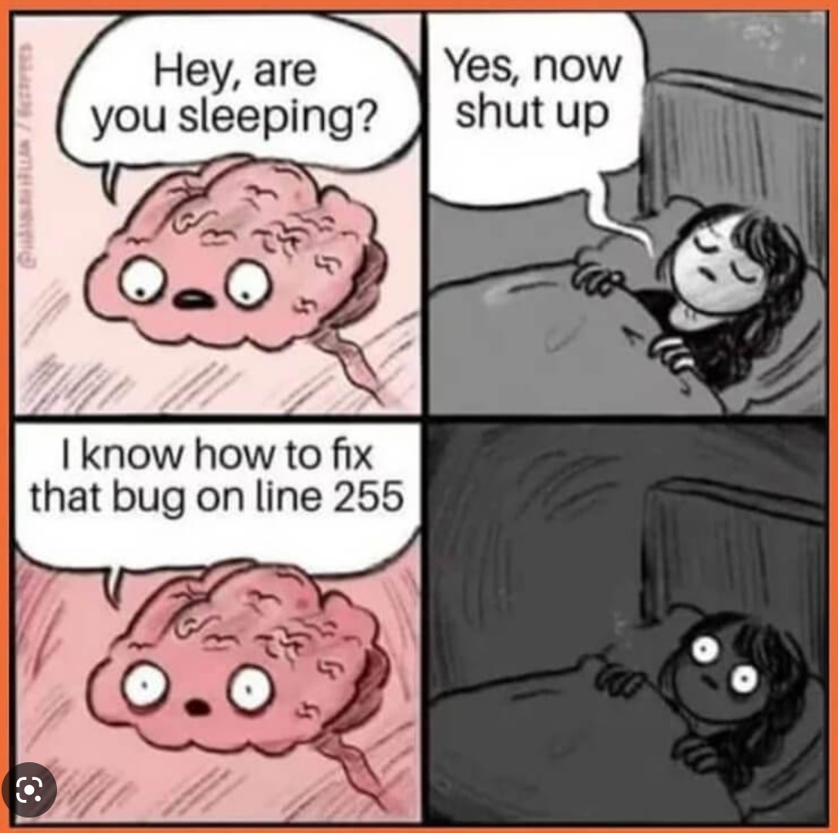
Conclusion
Great learning experience all around and developing better skills to design and develop software
Learning to implement new tools and working with unfamiliar technology stacks
Having a better understanding of time schedule and planning for software engineering

Slide 8

Thank you:)

