Slide 1
Team 11:
Course
Feedback
Christine Tye
Sriram Mohan
Quynh-anh Nguyen

Slide 2
Sequence Diagram

Slide 3
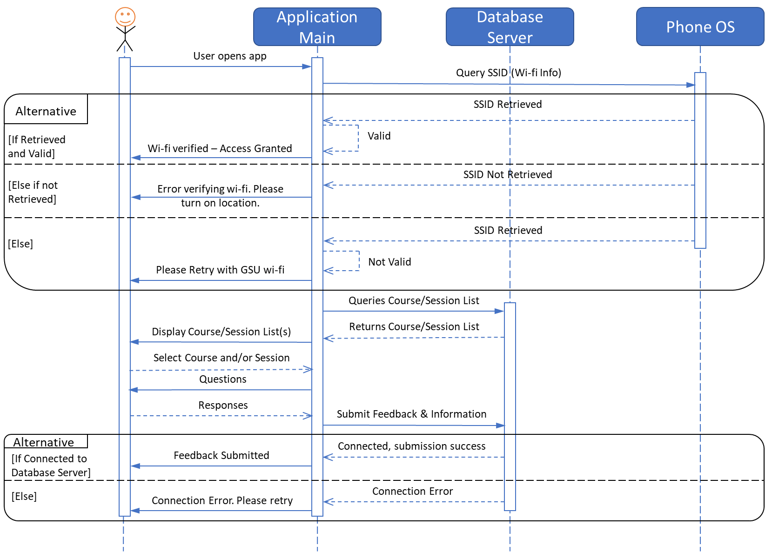

Slide 4
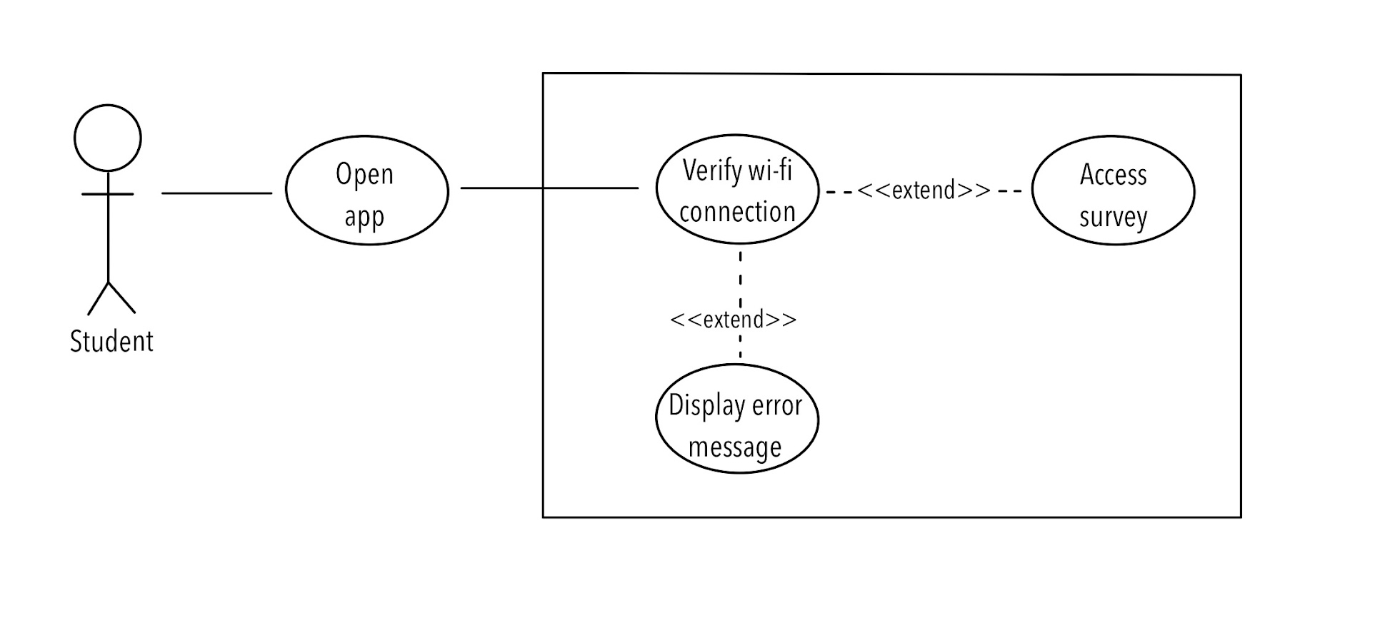
Use Case #1

Slide 5
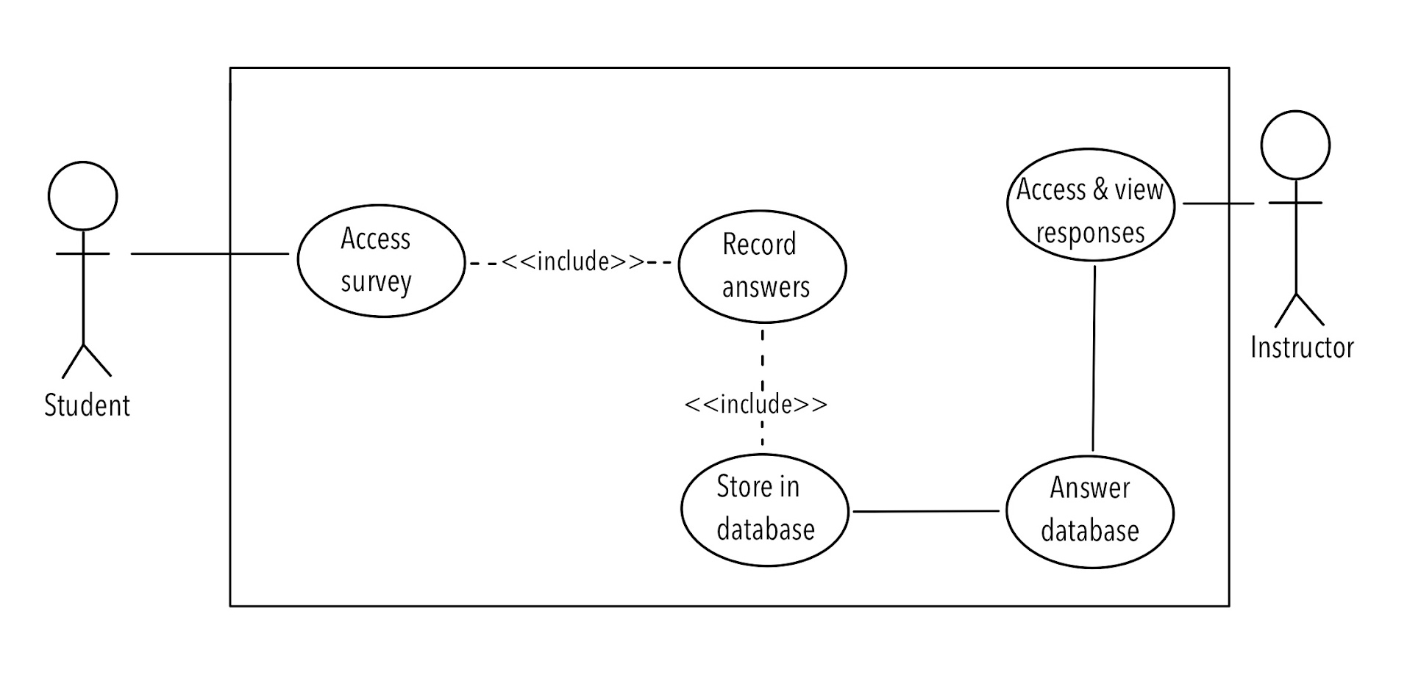
Use Case #2

Slide 6
Test Case #1 - VPN Checking
Input:
Signal for VPN
Test:
Test for VPN that matches GSU’s Wi-Fi
Test for VPN that does not match GSU’s Wi-Fi
Output:
Terms & Conditions Page or error message claiming the VPN does not match GSU’s Wi-Fi

Slide 7
Test Case #2 - Feedback
Input:
The name of the course
The instructor of the course
The session of the course
Answers to the 3 MCQ Prompts
Answer to Free Response
Signal for VPN
Test:
Test for when the user submits all the responses to question and is still connected.
Test for when the user submits all the responses but is disconnected halfway.
Output:
Successful submission or error message claiming user has disconnected (unsuccessful submission)
Saved responses into database or discarded response (TBD)

